Slide 1
How do students use technology to collaborate at UWTSD?
Anoshia Zaheer 2128010
Halima Bibi 2129612
Tasmia Begum 2129438
Digital Skills And Research Methods
LCHS4002
Rebecca Kavanagh

Slide 2
Introduction
Which digital tool is most used by students to collaborate at UWTSD together?
Research existing data and apply to our project.
AIM: to plan and execute a research project, analyse and present the results.
Anoshia

Slide 3
Rationale
Digital tools unlock students learning abilities
Success of students increase with their acquisition of digital skills
Digital tools "increase collaborative learning"
(Yousef et al., 2022)
Halima Bibi

Slide 4
Rationale
Teaching methods is reflected in students use of digital tools to collaborate
Tech and engineering students used digital tools more than social work course students(Margaryan et al., 2011).
Research was conducted over 10 years ago .
Has digital tool usage increased and progressed for the better?
Is there a need to increase students' knowledge and usage of digital tools for collaborative learning, especially post-pandemic?
Tasmia Begum

Slide 5
Rationale
The pandemic forced educational institutes to move learning online
In Palestine, Google classrooms was widely used to collaborate online learning
The study , as conducted by Tarteel et al.(2021) found that training students and educators in the use of Google classrooms application would greatly benefit learning
Anoshia Zaheer

Slide 6
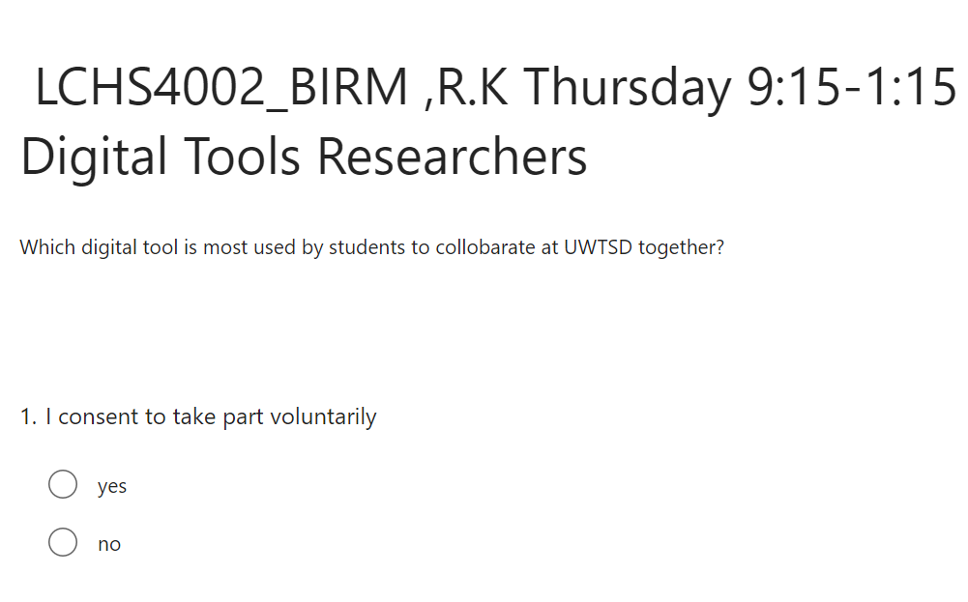
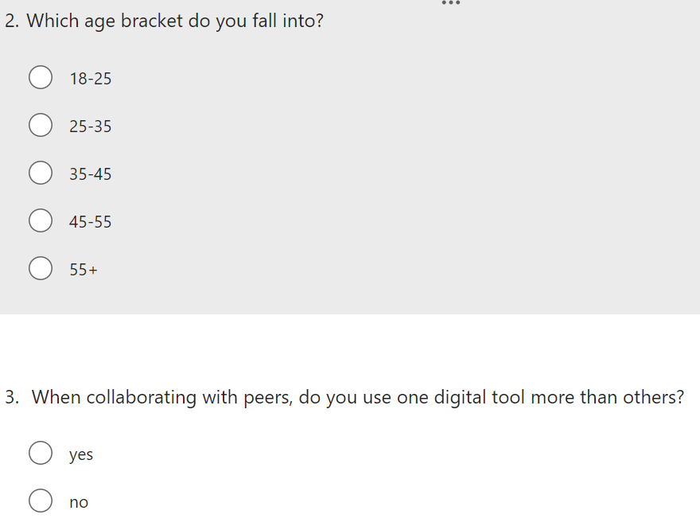
Proposed Method QUESTIONAIRRE ON MSFORMS
Ask 5 students within our campus
Collect and analyse all results

Slide 7
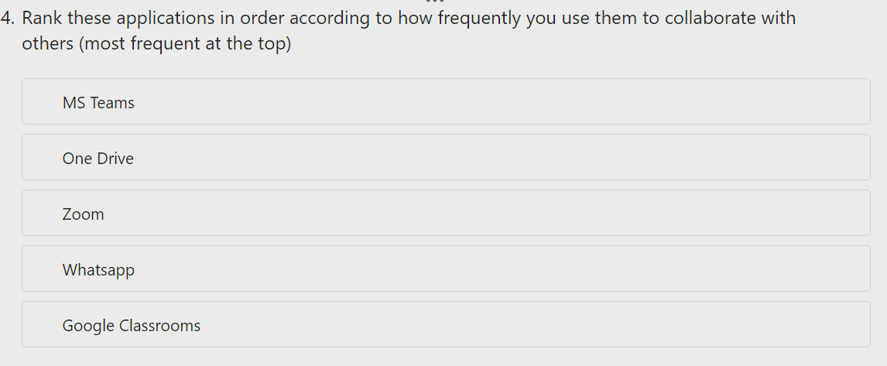
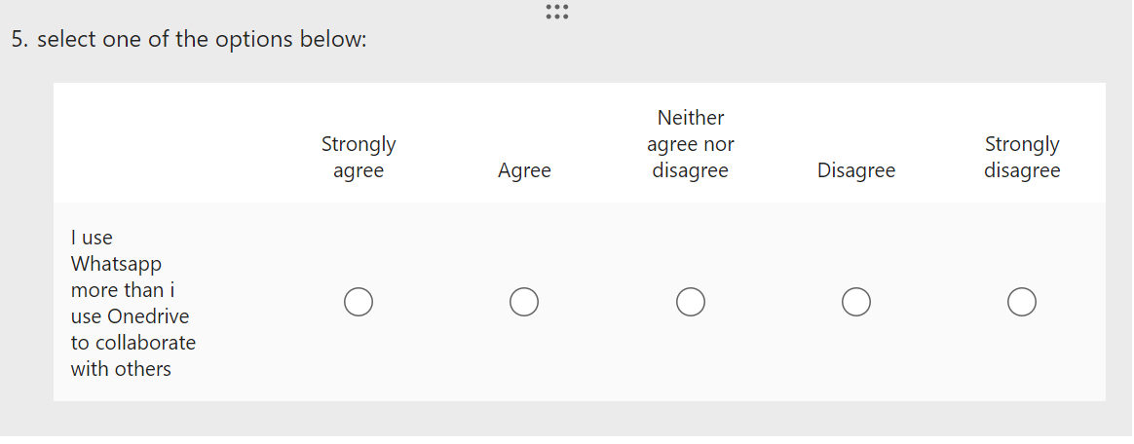
PROPOSED QUESTIONS

Slide 8
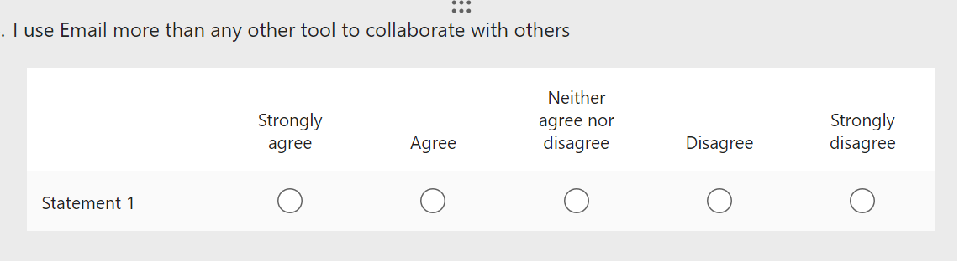
PROPOSED QUESTIONS

Slide 9
ETHICAL CONSIDERATIONS
We will ensure our research is conducted ethically by insuring:
We will involve different age groups, ethnicities and genders
We obtain informed consent from participants along with the right to withdraw at any point in the survey
We will not offer any incentive
We are respectful and considerate
Data obtained will remain anonymous and confidential
Accurately report results
Halima Bibi

Slide 10
Hypothesis
Our hypothesis is:
One Drive is most commonly used to collaborate.
Digital skills obtained in classrooms by students is reflected in their usage of these tools(Gabrielle & Margaryan, 2011).
One Drive is used most in our course by our lecturers.
Tasmia and Halima

Slide 11
Research Timeline
Week 7: Send out questionnaire on MS Forms to participants.
Week 8:Collect and analyse results using Word.
Week 9:Put results into charts/graphs/tables to present results clearly. Start research report introduction.
Week 10:Discuss results and what we have learnt from them-see if hypothesis is proven right or wrong. Write up conclusion-answer our chosen question.
Week 11:Reflect on research-any improvements? Submit report.
Tasmia

Slide 12
Reference List
Youssef,A.B,. Dahmani,M and Ragni.L, (2022) ‘ICT Use, Digital Skills and Students’ Academic Performance: Exploring the Digital Divide’, Information (Basel), 13(3), p. 129–. doi:10.3390/info13030129.
Tarteel,S., Badah,A and Khlaif,Z.N,(2021) Employing Google Classrooms to Teach Female Students during the COVID-19 Pandemic, Computers in the Schools,38:4,300-321, DOI:10.1080/07380569.2021.1988318
Margaryan,A , Litttlejohn,A, Vojt,G,(2011)`Are Digital natives a myth or reality? University students use of digital technologies, Computers and Education,vol.56.Issue 2,p.429-440.doi.org10.1016/j.compedu.2010.09.004.

