Slide 1
Postgresql and Express
Lecturer: Michael Dacey
E-mail: michael.dacey@uwtsd.ac.uk

Slide 2
Setup
Pre-requisites
  Node.js and Express.js installed and working
  Basic webservice in express.js has been built
  Postgresql drivers have been installed in node.js (pg and pg-format)
Create a new file called pgdbstudent.ts in the “nodewebservice” directory

Slide 3
Setup (Cont)
Open up a terminal window and change to the directory containing both the “nodewebservice” sub-directory and the “docker-compose” file
Edit the “docker-compose” file and temporarily comment out the web server while we test the web service and Postgresql database
version: "3.6“
services:
# webserver:
# build:
# context: .
# dockerfile: Dockerfile
# target: webserver
# image: node-a-webserver
# restart: always
# ports:
# - "81:80"
# networks:
# - dbnetwork
# volumes:
# - ./nodewebserver:/var/www/node
webservice:
build:
context: .

Slide 4
Virtual Machines
Virtual machines make it possible to run multiple applications on the same physical hardware while keeping conflicts among software components and competition for hardware resources to a minimum.
But virtual machines are bulky—typically gigabytes in size. They don’t really solve problems like portability, software updates, or continuous integration and continuous delivery

Slide 5
Why Docker?
Containers make it possible to isolate applications into small, lightweight execution environments that share the operating system kernel.
Typically measured in megabytes, containers use far fewer resources than virtual machines and start up almost immediately.
They can be packed far more densely on the same hardware and spun up and down en masse with far less effort and overhead.
https://www.infoworld.com/article/3204171/what-is-docker-docker-
containers-explained.html

Slide 6
Docker and Microservices
If a VM is running a microservice the overhead of the OS becomes more significant e.g. it can increase from 2-3% of the total CPU load for a full service to 6-10% for a microservice
Using Docker the microservice shares the OS with other microservices with much less overhead and cost
App
VM
App
OS
OS
2-3%
OS
OS
6-10%
Service
Microservice
App1
App2
App3
App4
App5
Apps in containers
VM
OS
OS
Microservices in Docker

Slide 7
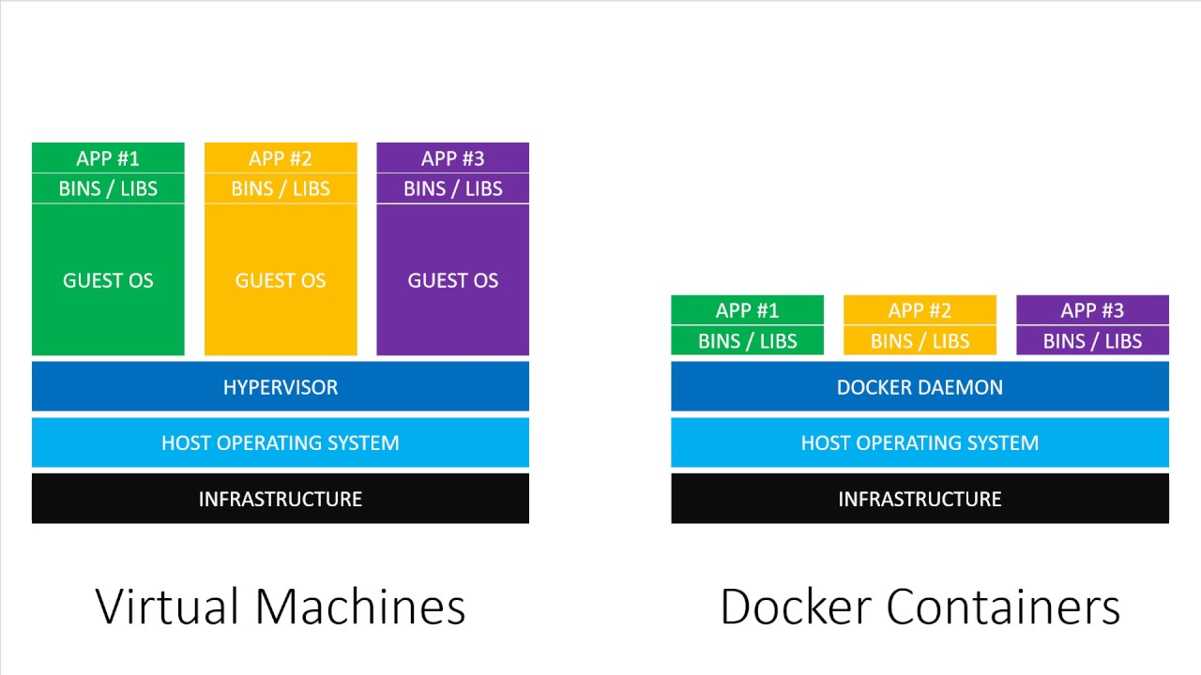
What is a “container” ?
Actually, a software container (or container for short)
  a container is ” a lightweight, stand-alone, executable package of a piece of software that includes everything needed to run it.”
The key difference is that every container shares the same kernel on the host machine, while each virtual machine has its own kernel.
Basically, a container uses virtualization techniques at the level of the operating system, not the hypervisor.
Containers use the Open Container Initiative (OCI) format

Slide 8
Running or Web Service and Database
To run our webservice and the Postgresql database
In the directory containing the “docker-compose” file we type
The last line tells us the service is running and you will find it on port 1339
You can actually access it as http://webservice:1339 from your code
$ docker-compose up
…..
…..
webservice_1 | > nodewebservice@1.0.0 run /var/www/node
webservice_1 | > node ./dist/service.js
webservice_1 |
webservice_1 | Example web service listening at http://localhost:1339
Errors?:
Did you use “\\”s in package.json? → change back “/”s
Problem with npx symlink? → try changing Dockerfile “npm install -g npx --force”

Slide 9
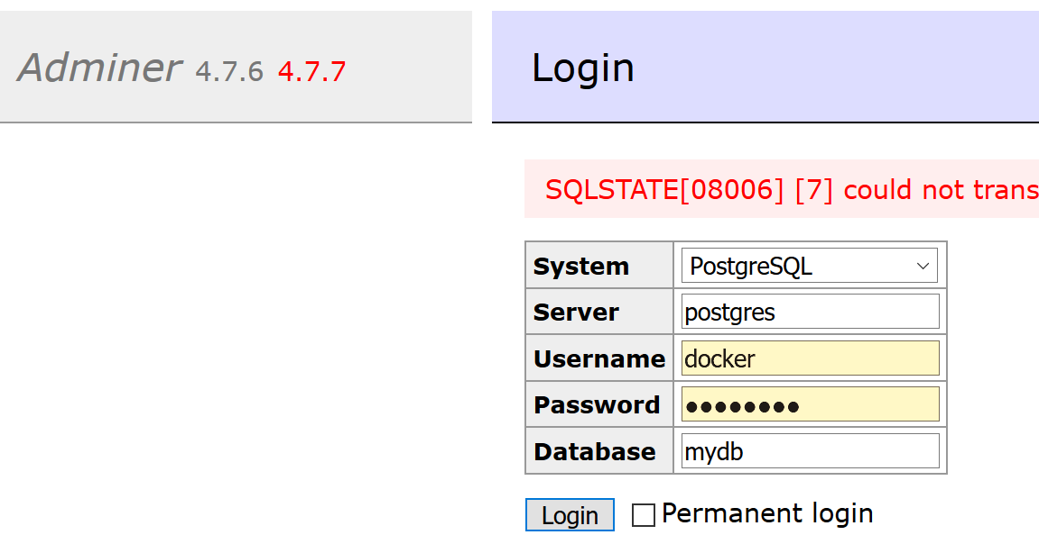
Postgresql Database Setup
From your browser type http://localhost:8080
You will see the login page
System: PostgreSQL
Server: postgres
Username: docker
Password: password
Database: mydb

Slide 10
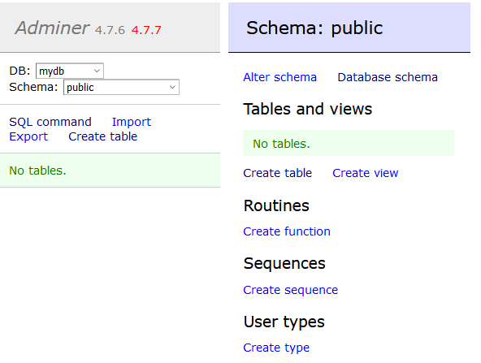
Schema

Slide 11
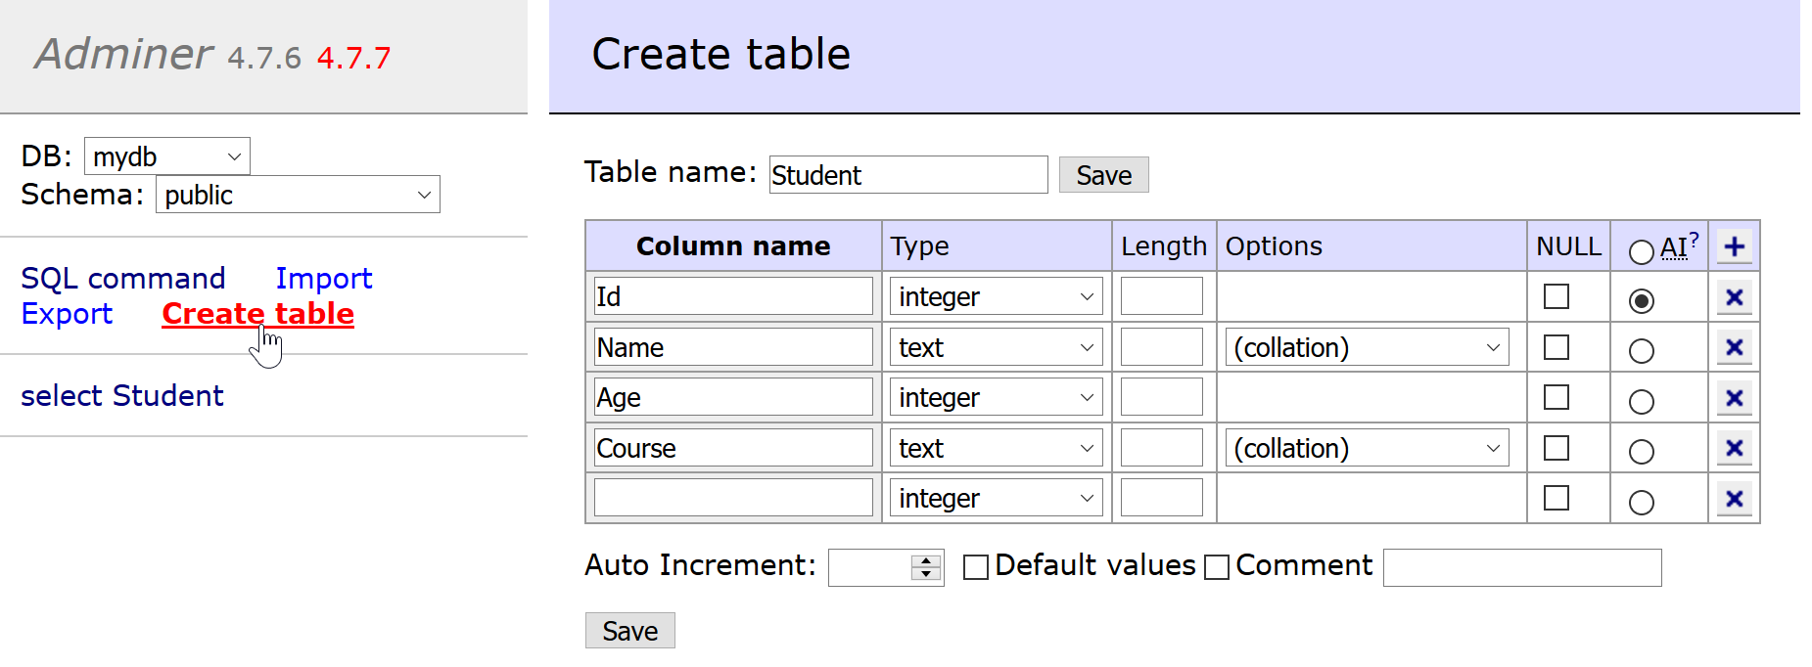
Create Table
Auto Increment
Provide your database table field details and save them

Slide 12
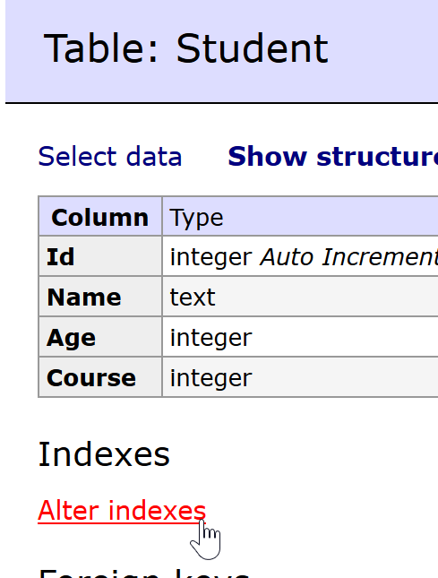
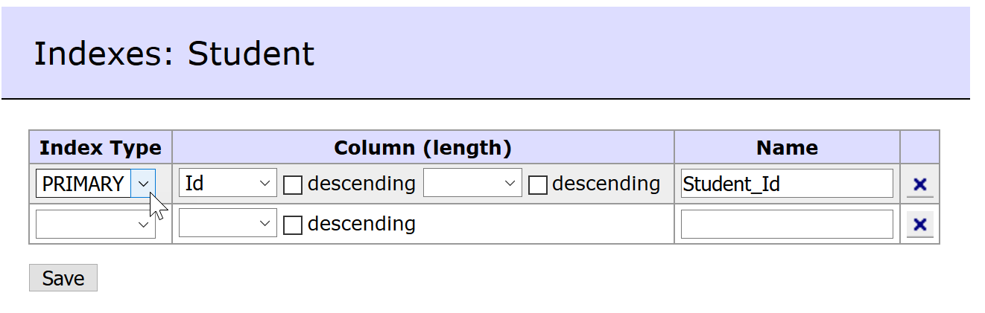
Primary Key
Make the “Id” field a primary key

Slide 13
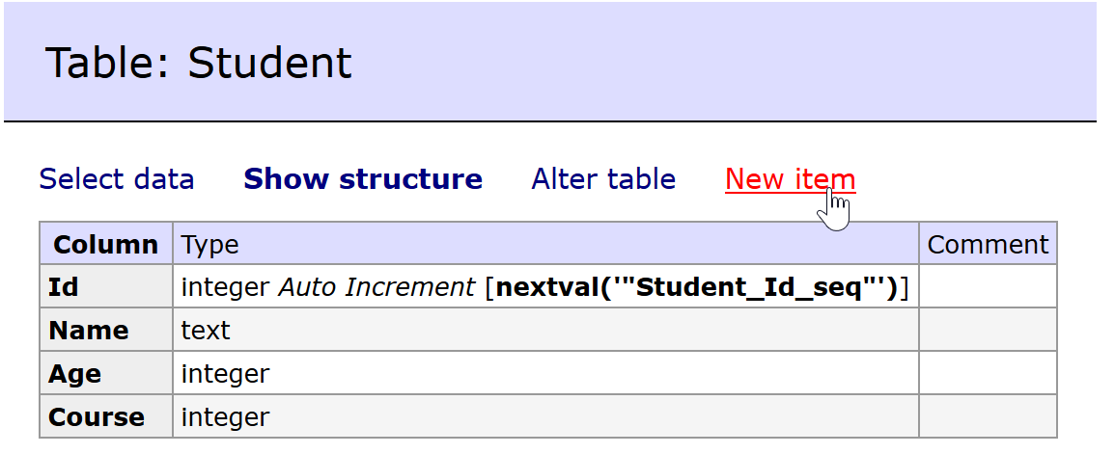
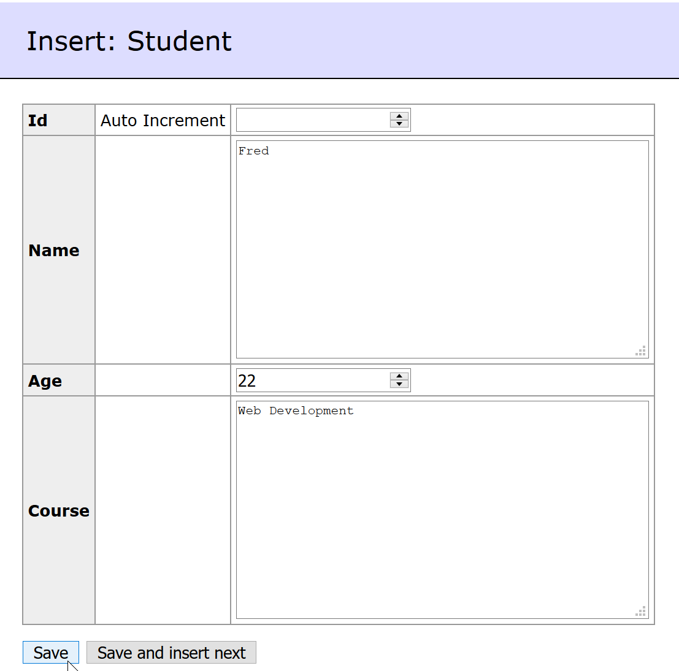
Add Row of Data

Slide 14
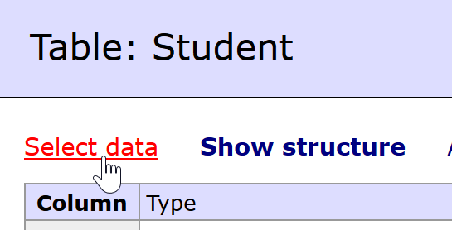
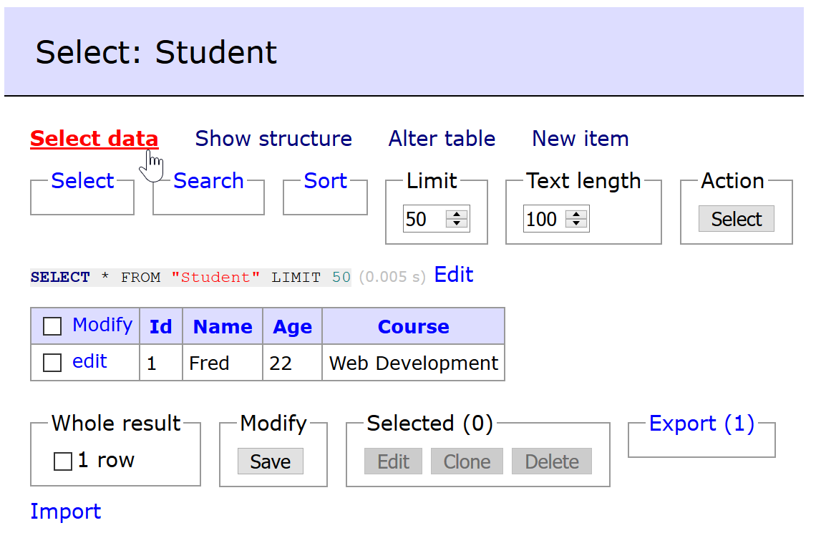
Show Rows

Slide 15
Postgresql Notes
SQL statements in Postgresql are a little different to other SQL implementation
A table of field name is interpreted as an all lower case name unless included in double quotes
  Say you have a table Student then
  SELECT * FROM Student reads from the table student
  whereas,
  SELECT * FROM “Student” reads from the table Student
String values must be included within single quotes, such as:
SELECT * FROM “Student” WHERE “Name”=‘Fred’
Note: Postgres-format automatically adds single quotes around string values

Slide 16
pg Package
To use the Postgresql database from our web service we need to use the “pg” package we have already installed
You can use a connection pool → the best approach
OR
Use the Client class which we will use to keep things simple
let client: Client;
client = new Client( {
host: "postgres", ← URL for the database
port: 5432, ← Postgresql port
    user: "docker", ← Admin username
password: "password", ← Admin password
database: "mydb“ ← Database name
} );

Slide 17
Queries
To connect to the database call connect() on the client
Once connected, you can execute a query() on the client
A query is actually any SQL statement not just SELECT
However, we will want to create the query string by inserting values into it using the format() function
let client: Client;
let query: string ;
let id: number = 4;
let results: any;
client = new Client( ….. );
await client.connect();
query = format( ‘SELECT * FROM "Student“ WHERE Name = %L’, id );
results = await client.query(query);
“id” value is copied into here

Slide 18
Exercise
Edit the pgdbstudent.ts file
We will use a TypeScript class
import express from 'express';
import { Response } from "express-serve-static-core";
import {Client, Connection} from 'pg';
import format from 'pg-format';
export class PGStudentTable
{
private GetClient(): Client
{
return new Client( {
host: "postgres", // Service name in docker-compose
port: 5432,
user: "docker",
password: "password",
database: "mydb"
} );
}
}

Slide 19
Exercise
export class PGStudentTable
{
private GetClient(): Client
{
…..
}
Select = async (res: Response): Promise<void> =>
{
let client: Client = this.GetClient();
console.log(`Reading all the students details`);
try
{
}
catch(error)
{
console.log(error);
res.status(403).send(error);
}
finally
{
await client.end();
}
};
Add methods to the class for each of the operations we want to perform on the database table

Slide 20
Exercise
Select = async (res: Response): Promise<void> =>
{
let client: Client = this.GetClient();
console.log(`Reading all the students details`);
try
{
await client.connect();
let query: string = 'SELECT * FROM "Student"';
let results = await client.query(query);
if( results.rows.length > 0 )
console.log(`Read ${results.rows.length} records`)
else
console.log(`Database is empty`);
res.send( results.rows );
}
catch(error)
{
Read all the students in the database

Slide 21
Add Other Operations
Example: Inserting a new student into the table might look like this:
Insert = async (student: Student, res: Response): Promise<void> =>
{
………
await client.connect();
let query: string = format('INSERT INTO "Student"("Name", "Age", "Course")
VALUES(%L, %L, %L) RETURNING *',
student.Name,
student.Age,
student.Course);
let results = await client.query(query);
…….
};

Slide 22
The full class for handling the Student database table will be provided for you!!
pgdbstudent.ts
Add it to the “nodewebservice” directory

Slide 23
Express
We can modify our web service to use the database

Slide 24
Insert
service.post('/students', async (req, res) => {
console.log("Add student");
console.log(req.body.name);
console.log(req.body.age);
console.log(req.body.course);
res.status(201).end();
});
BEFORE
service.post('/students', async (req, res) => {
let studentDB: PGStudentTable = new PGStudentTable();
await studentDB.Insert({
Name: req.body.name,
Age: req.body.age,
Course: req.body.course
}, res);
});
AFTER

Slide 25
Select All & By Name
service.get('/students', async (req, res) => {
let data = [];
if(typeof req.query.name === "string")
{
console.log("Read the students' details");
….
}
else
{
console.log("Read all student details");
…
}
res.send(data);
});
BEFORE
This…..
…..becomes this
service.get('/students', async (req, res) => {
let studentDB: PGStudentTable = new PGStudentTable();
if(typeof req.query.name === "string")
await studentDB.SelectByName(req.query.name, res);
else
await studentDB.Select(res);
});
AFTER

Slide 26
Select By Id
service.get('/students/:id', async (req, res) => {
console.log("Read a student's details");
console.log(req.params.id);
res.send({ Id: req.params.id, Name:"Fred", Age:23, Course: "SE" });
});
BEFORE
service.get('/students/:id', async (req, res) => {
let studentDB: PGStudentTable = new PGStudentTable();
await studentDB.SelectById(parseInt(req.params.id), res);
});
AFTER

Slide 27
Delete
service.delete('/students/:id', async (req, res) => {
console.log("Delete student");
console.log(req.params.id);
res.end();
});
BEFORE
service.delete('/students/:id', async (req, res) => {
let studentDB: PGStudentTable = new PGStudentTable();
await studentDB.Delete(parseInt(req.params.id), res);
});
AFTER

