Slide 1




Nature vs Nurture
Darcey Jones

Slide 2
Aims and Outcomes of This Session.
AIM- Examine the Nature vs Nurture debate.
OUTCOME- To have critically examined theories and studies on Nature vs. Nurture.
OUTCOME- Look at personal opinions on nature vs nurture and how and if they shape a child’s development

Slide 3
Activity
z
Everyone standing, I will ask 10 questions, depending on your answer, stand either by the door or the window (which side will be explained before each question) .

Slide 4
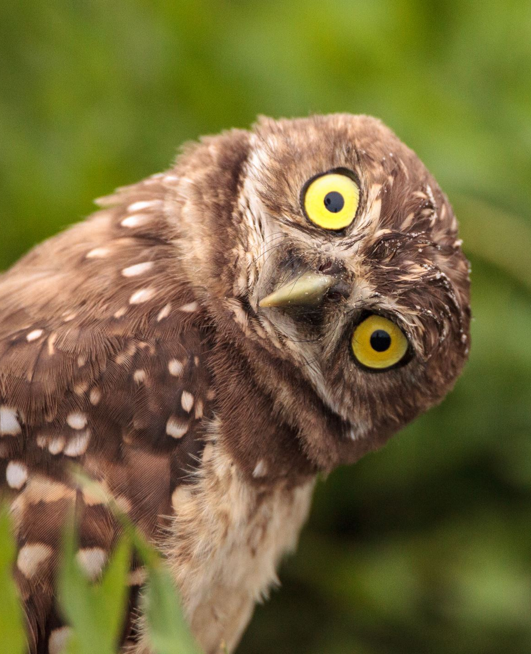
Are you talented at any specific sport?
Are you a night owl or morning bird?
Do you like butter on your bread?
Do you prefer to travel by airplane or boat?
Do you need or have ever needed to use prescription glasses?
Would you consider yourself to be intelligent?
Are you organised?
Would you rather be rich or famous?
Would you rather a relaxing holiday or an adventurous holiday?
Do you like coffee?
z

Slide 5

Do you think your upbringing is the main reason for these answers, or do you would have answered the same regardless of experience?
z
What do you think effected your answers for each of those questions?

Slide 6
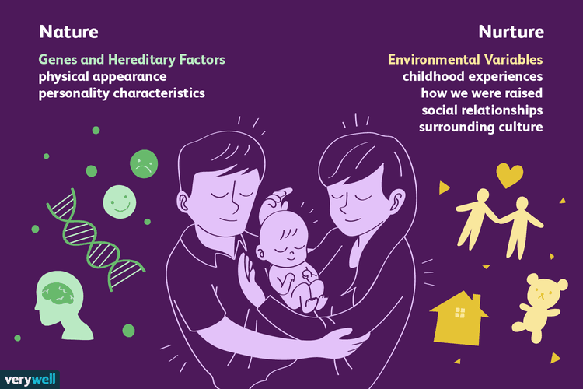
What is the Nature vs Nurture debate about?
Argument on whether genetic factors or environmental factors have the most impact on our development. (Cherry 2022).
What makes us who we are, how are decisions can be both free-willed, but also from instinct and culture. (Ridley, 2003).
(Seong, 2022).

Slide 7

Does our upbringing change our mindset, reactions and our own parenting style?

Slide 8
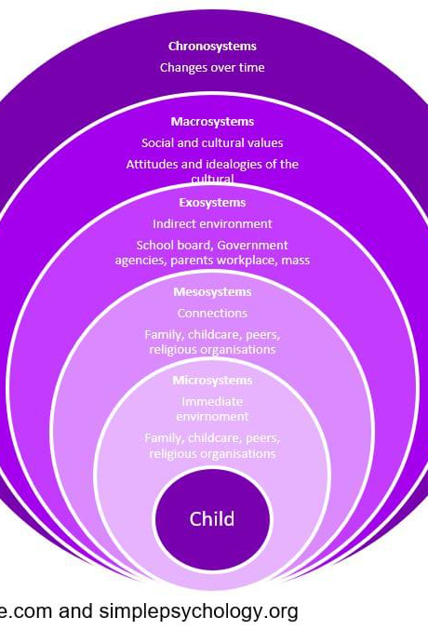
Bronfenbrenner’s Ecological System’s Theory
The environment (nurture) that you grow up in and the people you encounter effect the development of the child.
Microsystem – immediate environment, people who are in the child’s life daily (immediate family, teachers, friends, etc). Social media.
Mesosystem – also has direct effect. How the immediate people around them act towards each other. (e.g. parent, teacher communication).
Exosystem – non-direct environments that can shape the child’s upbringing, such as healthcare, extended family, school curriculum etc.
Macrosystem – Wider society and cultural elements that effect development. This could include the their social norms, traditions, beliefs, nationality.
Chronosystem – This talks about like experiences that can change a child’s outlook, or that have influenced development, such as, transitions or significant events. These experiences could potentially have a big impact of development of personality, mindset, expectations and so on.

Slide 9
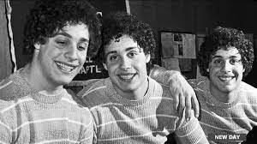
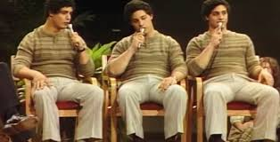
Study on Identical Triplets.
z

Slide 10
‘Three Identical Strangers’
https://www.youtube.com/watch?v=A-WByPZuWqQ 6:36.
Study began in the 1960’s by a man named Dr Peter Neabauer.
Study completed on twins and triplets.
Adoptive parents were not told about the siblings and thought the study was simply for ‘adopted children’.
Identical siblings were separated as babies and placed strategically with different class families.
Findings of the study has been sealed until 2066, however it has been researched by Lawrence Wright, who discusses this in the ‘Three Identical Strangers’ documentary.
Triplets seem to develop separation anxiety.
Found each other aged 19 by chance, news channels showed all their similarities, such as, mannerisms, similar hobbies, smoked the same cigarettes, same tastes for food.
David Kellman “I believe that I’m still here today because a foundation was given to me by my parents.”

Slide 11
Feedback

Slide 12
Reference List
Bronfenbrenner, U. (1979). The ecology of human development. Harvard University Press.
Cherry, K. (2022). The Nature vs. Nurture Debate. Genetic and Envrionmental Influences and How They Interact. Available at: https://www.verywellmind.com/what-is-nature-versus-nurture-2795392. (Accessed: 23 October 2023).
Perry, P. (2019). The Book You Wish Your Parents Had Read (and Your Children Will be Glad That You Did). Penguin Random House UK.
Ridley, M. (2003). Nature via nurture: Genes, experience, and what makes us human. HarperCollins Publishers.
Seong, J. (2022) Nature/Nurture picture. Available at: https://www.verywellmind.com/what-is-nature-versus-nurture-2795392.
Three Identical Strangers. Directed by Tim Wardle, performance by, David Kellman, Robert Shafran and Lawrence Wright. Raw, 2018. Netflix app.

