Slide 1
‘The battle of waterloo’ 18TH JUNE 1815
DOCTOR LESTER MASON – UNIVERSITY OF TRINITY ST DAVID, LAMPETER

Slide 2
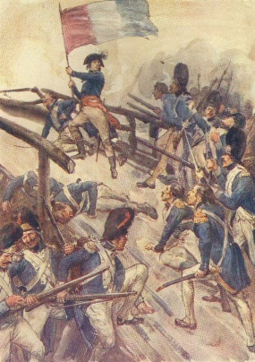
FRENCH REVOLUTIONARY WARS
Aim – to maintain popularity of the Revolution
Little heed paid to state of French army - many officers became Emigres
French interests look north to Austrian Netherlands and east to Prussian lands
Austria and Prussia pre-occupied with partition of Poland

Slide 3

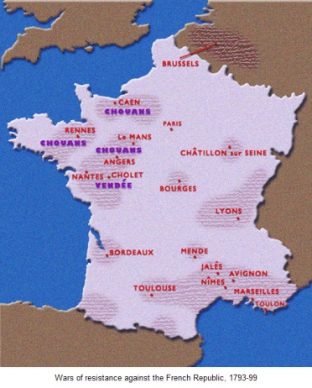
VENDEE 1793-5

Slide 4

GENOCIDE?

Slide 5
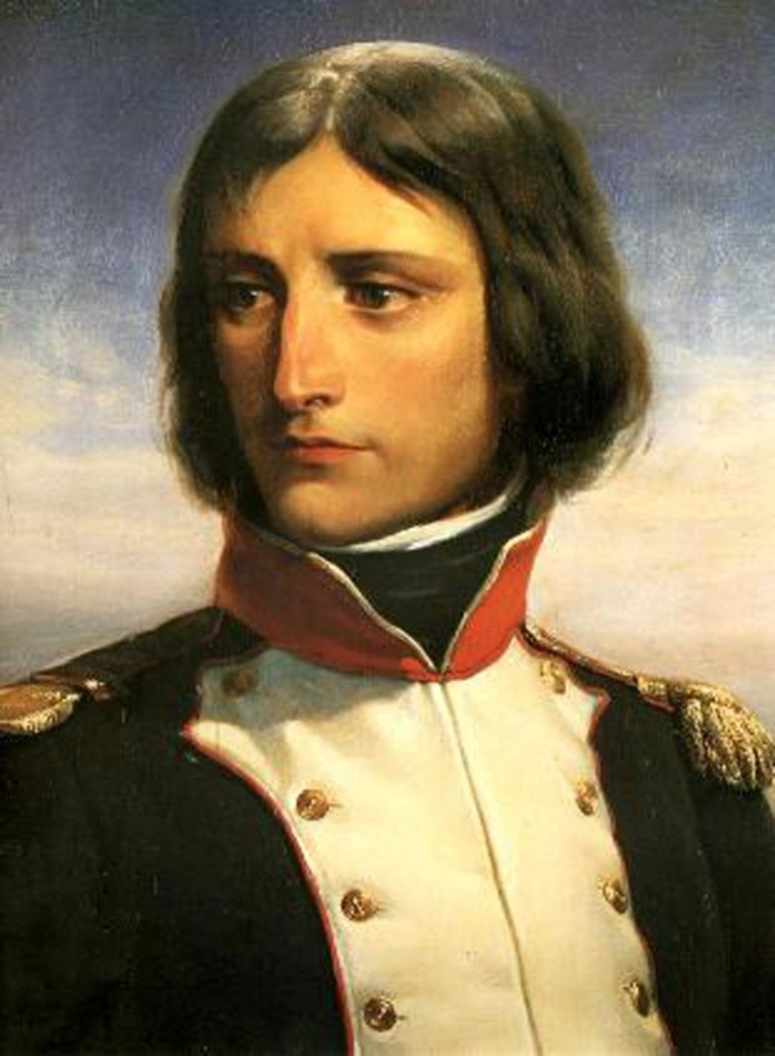
FRENCH REVOLUTIONARY WARS
Appeals made in France for a new Citizens Army; also element of conscription and general mobilisation (aspects of Total War?) – central here was Lazare Carnot (1753-1823)
Opportunities in new atmosphere for ambitious and talented officers e.g Napoleon, to make headway
1795 – France under control in Austrian Netherlands and occupy the Rhineland

Slide 6
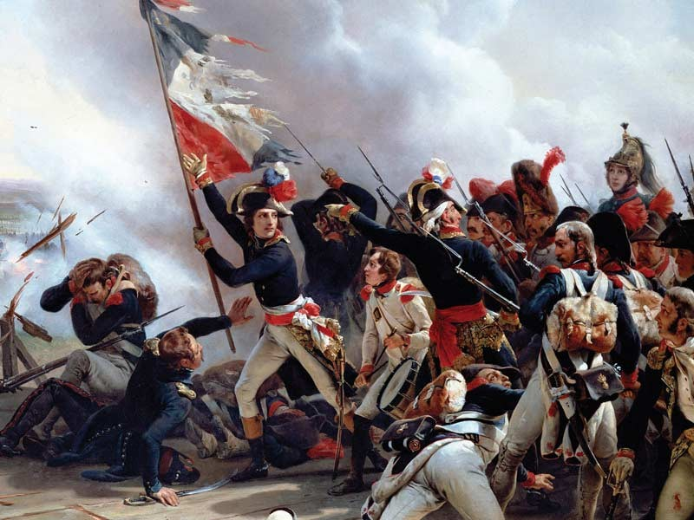
FRENCH REVOLUTIONARY WARS
Revolutionary principles coupled with ‘Glorious’ victories sustained the French campaign
Also ‘living off the land’ in conquered territories maintained ambitions of officers and fed and paid the expanding army
All = ‘self-sustaining’ system of warfare
‘Every citizen must be a soldier, every soldier a citizen’ (report to French Assembly 1789)
1796 onwards – able to look east towards Austrian Habsburg territory

Slide 7
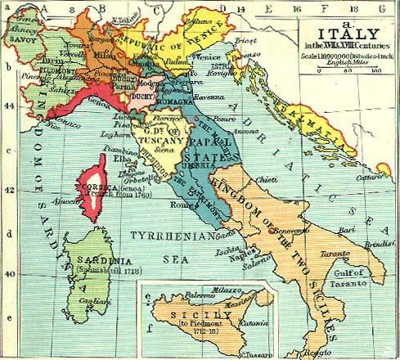
ITALY
Napoleon invades Piedmonte-Sardinia lands – plunder and ‘Glory’ on Italian soil
Covets Austrian Habsburg lands in Italy, including Lombardy and Milan
Napoleon’s skills as tactician emerge – concentration of forces

Slide 8
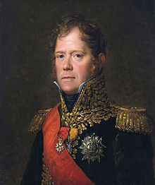
TACTICS
1800s – coalition emerging against Napoleon – Russians, Austrians, British threaten French gains in Italy and the Rhineland
Returns from campaigning in Egypt to defeat Austrians at Marengo (June 1800) and consolidate gains in Italy . Austria make peace
1801-05 Napoleon reorganises during lull
Strong and experienced army at his command
Marshal-led (e.g. Ney pictured)and Corps based, able to move independently and rapidly (without peers), with competent General Staff
Self sufficient without the need for a supply train

Slide 9
EASTWARDS!
August 1805 – new alliance emerges between Austria , Russia, and Sweden; Napoleon (now Emperor) invades Austro-Hungary and occupies Vienna
Problems – combined forces of Austria and Russia are a formidable foe; winter approaching, living off the land more precarious
Answer – quick and decisive campaign – Austerlitz (Moravia - December 1805). Austria defeated but Prussia declare war on France

Slide 10
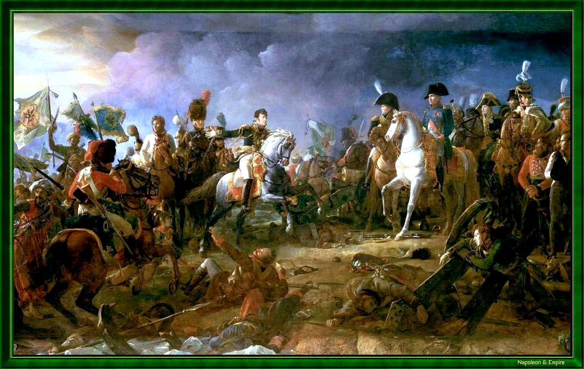
AUSTERLITZ – 18TH DECEMBER 1805

Slide 11
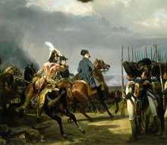
EASTWARDS!
Battle of Jena (October 1806) – Napoleon’s decisive victory sees Berlin occupied and subjects Prussia to French hegemony until 1812
Battle of Wagram (July 1809) France finally defeats Austria, but cost of war begins to impact on French finances

Slide 12
AIMS AND WEAKNESSES
Territorial aggrandisement and military glory
Creation of a ‘Continental System’ aimed at stifling British overseas power
Personal status
Revolutionary fervour and zeal?
Opposition in conquered lands e.g German states
Inherent weakness of ‘Client-states’ with relatives in charge e.g. brother Joseph, King of Naples and Sicily 1806-08
Diminishing effectiveness of French army

Slide 13
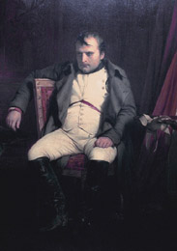
DOWNFALL
Grand Duchy of Warsaw (Napoleon’s Polish settlement) threatens Russian lands; war ensues
Summer 1812 – Napoleon with an army of 600k invades Russia

Slide 14
DOWNFALL
Napoleon’s army of 1812 = half French; the rest troops from ‘client’ states, his reluctant allies!:
German Confederation of the Rhine
Kingdom of Italy
Duchy of Warsaw
Russians draw Napoleon deeper into their territory; Battle of Borodino (September 1812 – 70k casulaties!) hollow victory for the French; Moscow occupied but culminates in ‘epic retreat’

Slide 15
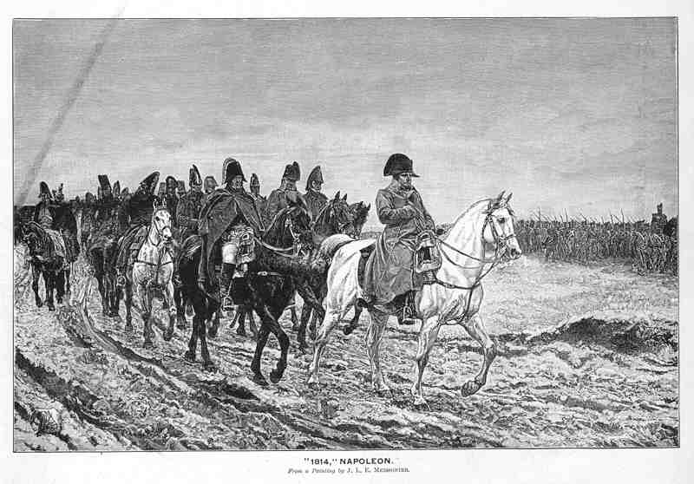
RETREAT

Slide 16
DOWNFALL
French now faced new alliance of Prussia, Austria, Sweden, Russia, Britain, Sweden
Battle of Leipzig (16th- 19th October 1813) – over 500k troops involved in decisive defeat for Napoleon ; casualties range from 80k-110k
Despite skilled rear guard action during retreat, Paris occupied and Napoleon abdicates to Elba (April 1814)
Bourbons re-instated in France under Louis XVIII

Slide 17
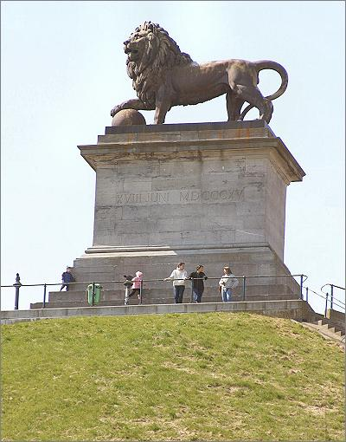
WATERLOO
18TH June 1815 near Brussels
Culmination of Napoleon’s ‘Hundred Days’ after his return from exile in Elba
Napoleon went on the offensive before the Allies could unite on the battlefield

Slide 18
WATERLOO
Belligerents:
1. France with army of 73k
2.Allies, totalling 118k (incl 50k Prussians):
Britain including King’s German League;
Netherlands, including Dutch/Belgians;
Hanover;
Nassau;
Brunswick
Prussia under von Blucher

Slide 19
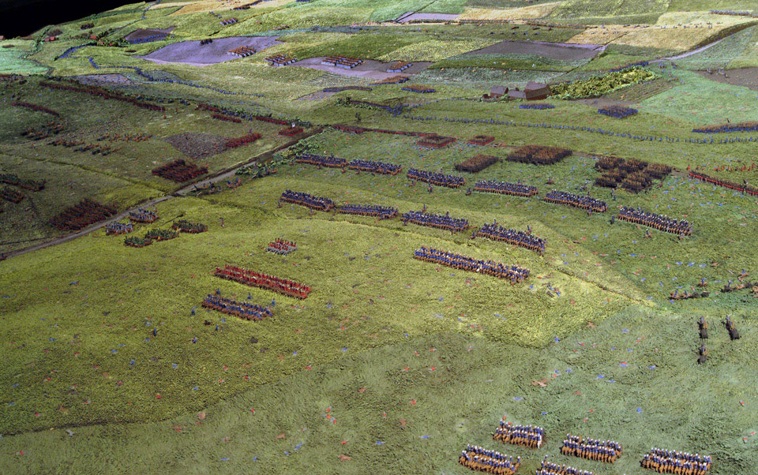
SIBORNE

Slide 20
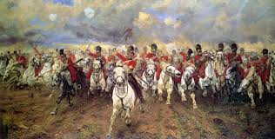
WATERLOO

Slide 21
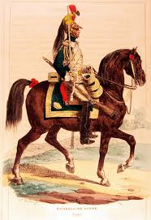
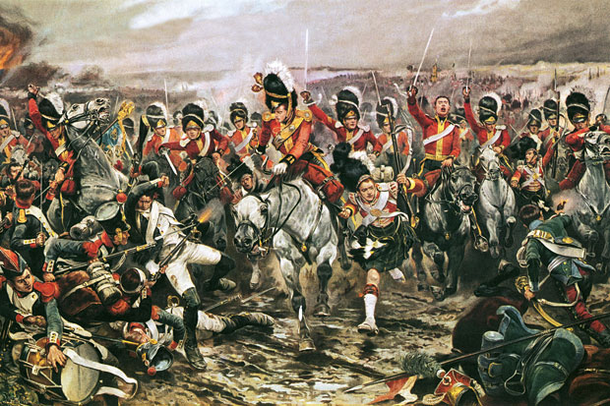
Waterloo

Slide 22
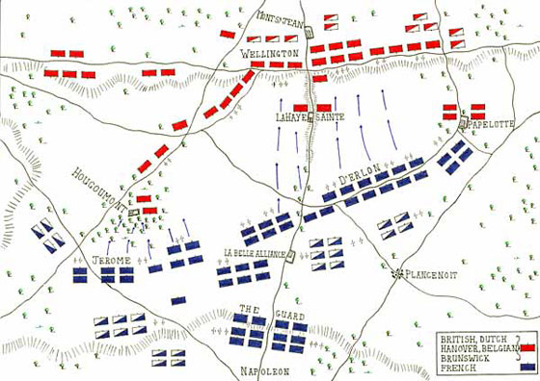
Waterloo

Slide 23
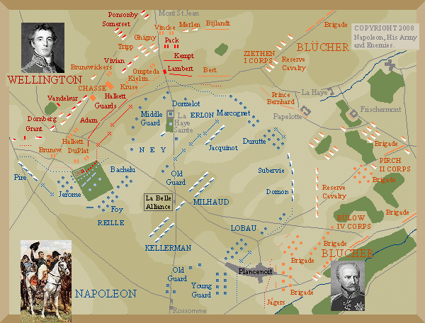
THE PHASES

Slide 24
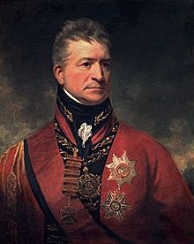
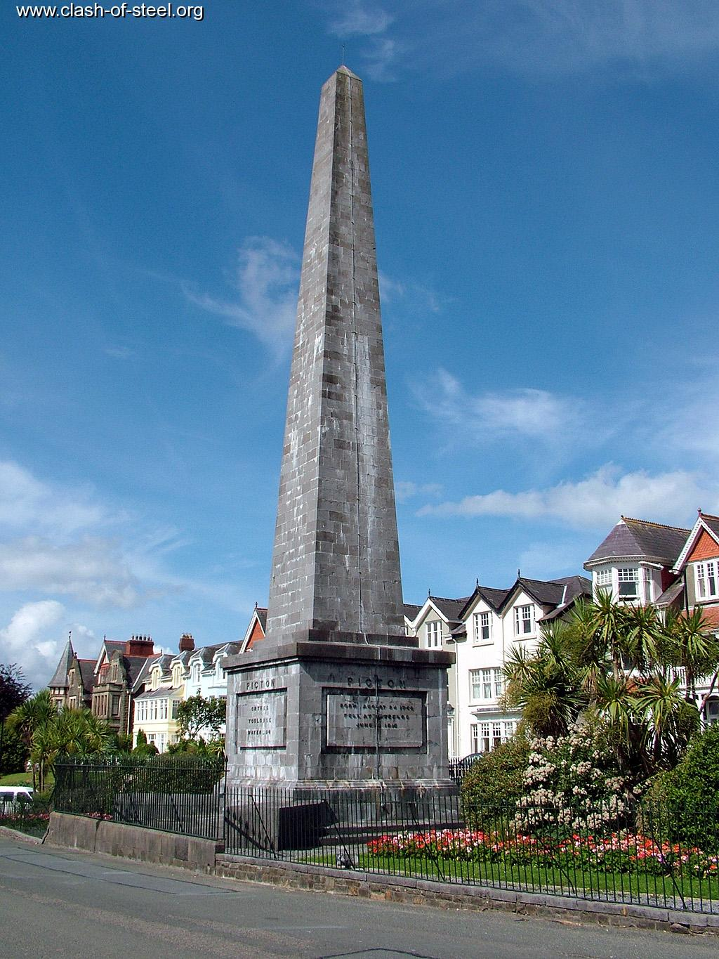
PICTON

Slide 25
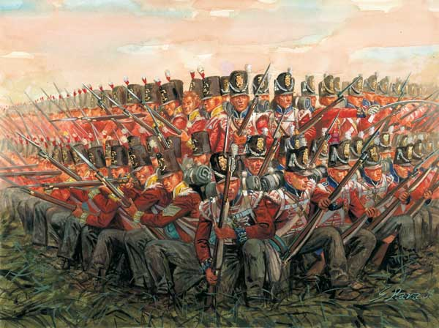
BRITISH INFANTRY

Slide 26

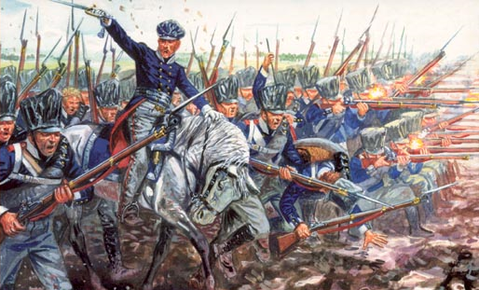
KING’S GERMAN LEAGUE AND THE PRUSSIANS

Slide 27
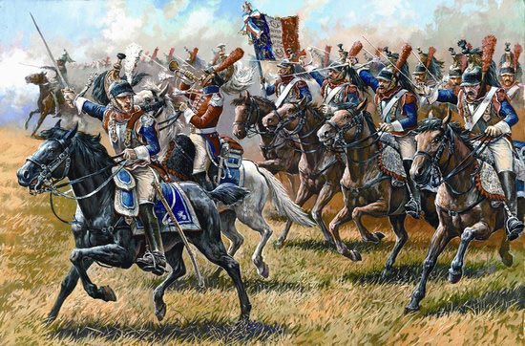
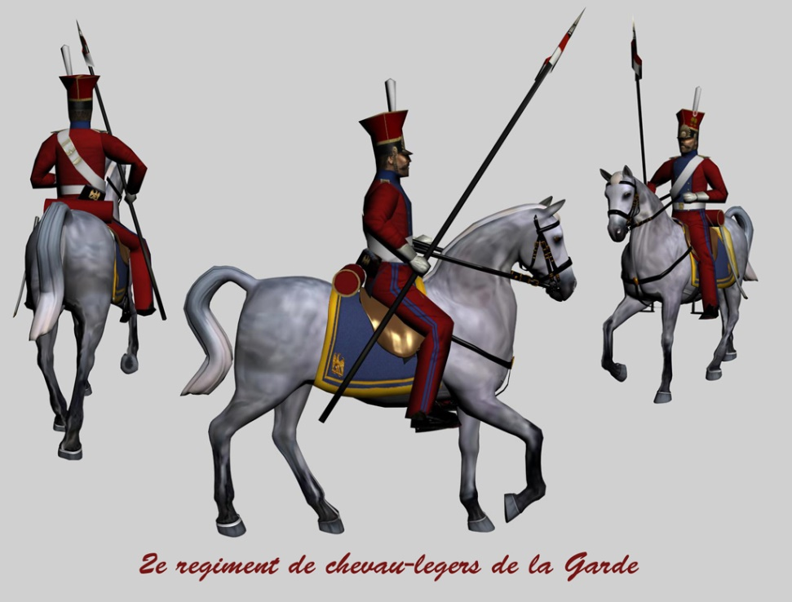
FRENCH CAVALRY

Slide 28
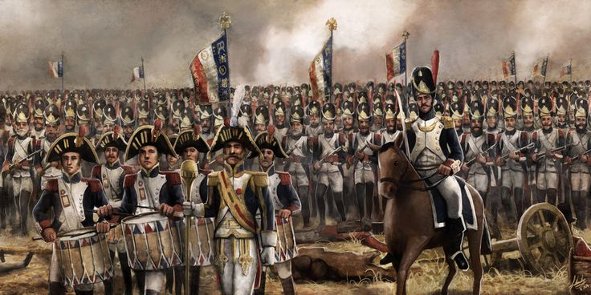
IMPERIAL GUARD

Slide 29
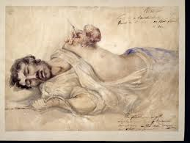
AFTERMATH
1. ALLIED LOSSES:
4,700 KILLED – 3,500 ALLIES; 1200 PRUSSIANS
16,600 WOUNDED
5,000 MISSING
This is one of a series of watercolours by the surgeon Charles Bell (1774-1842) of wounded soldiers from the battle of Waterloo.

Slide 30

AFTERMATH
2. FRENCH LOSSES:
24-26k killed or wounded
6-7k captured
15k missing

Slide 31
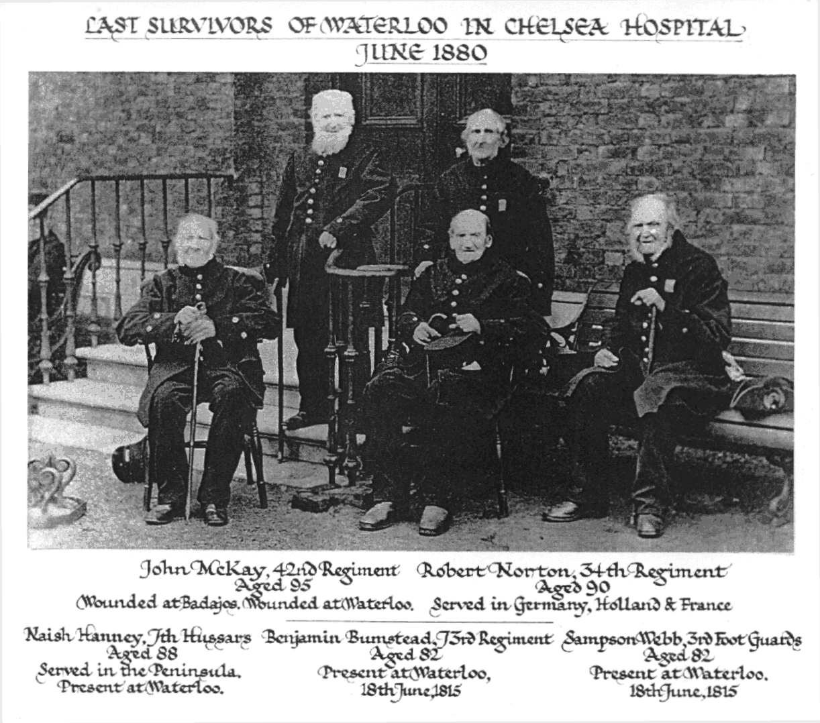
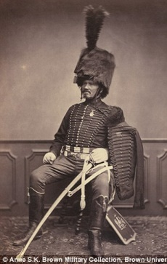
Veterans photos

Slide 32
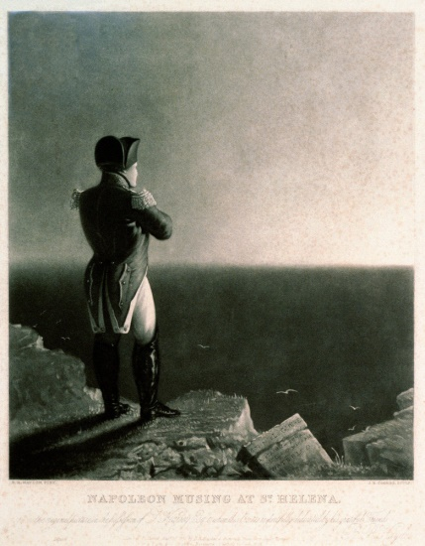
Napoleon on St Helena

Slide 33
POST-NAPOLEON
Congress of Vienna 1814-15
Return of old dynasties – e.g. Bourbon restoration in France
Spheres of influences created in Europe
Russia attains the Duchy of Warsaw
Prussia attains Saxony and parts of Duchy of Warsaw, and Rhineland Westphalia
German Confederation set up – loose association of 38 German states; a buffer between Prussia and Austria

Slide 34
POST-NAPOLEON
United Kingdom of the Netherlands created out of the Netherlands and southern Netherlands (Belgium)
Kingdom of Bavaria recognised
Austria gain the Tyrol, Lombardy and Venetia
Habsburg regain Tuscany and Modena
Papal States restored to Pope
Kingdom of Sardinia restored in Piedmonte, Nice, and Savoy
Kingdom of Naples restored to Bourbons

Slide 35
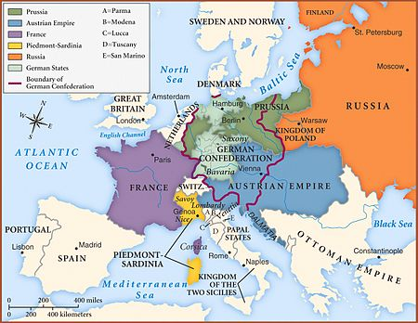
POST- NAPOLEON

Slide 36
RESPONSE
1793: Alien Act – recording and registration of all foreigners arriving in Britain
1795: Seditious Meetings Act, Treason Act – restricted public assembly
1799: Combination Acts outlawed trade unions and unlawful assembly; Pitt’s response to perceived Jacobin activity
1798: Ireland – United Irishmen rebellion – republican-based nationalist uprising led by Wolfe Tone, failed and followed by repressive martial law; followed by failure of uprising in 1803 led by Robert Emmet

Slide 37
RESPONSE
Period 1790-1820 witnessed fears of republican plots, indictments for treason, government secrecy and intrigue
Even moderate republican associations e.g. The London Corresponding Society, victim of government repression, including imprisonments and transportations
1820: Cato Street conspiracy – radical Spencean group attempted to assassinate Lord Liverpool et al, and set up a ‘Committee of Public Safety’; it failed and marked the end of radical republicanism in Britain

Slide 38
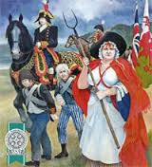
1797 AND ALL THAT!

Slide 39

1798!
The United Irishmen – Republicans influenced by the American and French Revolutions
Versus British rule in Ireland
Founded 1791 from within both Protestant and R.C Communities

Slide 40
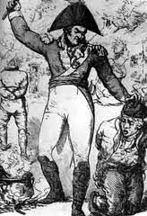
REBELLION
Aborted landed of rebels and French at Bantry Bay 1796
De facto martial law and reprisals including ‘pitch capping’
British encouraged ‘sectarianism ‘ e.g Ulster and the Orange order, formed 1795-6

Slide 41
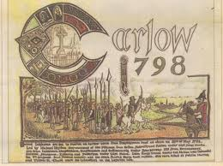
REBELLION
Start – May 1798
Aim: the control of Dublin
Informants ensured a strong army presence in the City
Rebellion emerged in country areas – Co Kildare, Meath, Carlow – spreads to Co Wicklow and Antrim

Slide 42
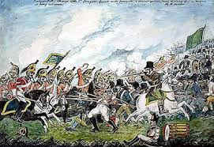
REBELLION
Generally a failure, but early success in Co Wexford
Eventually defeat at Vinegar Hill 21 June
Aftermath characterised by atrocities, recriminations, summary executions - echoes of Cromwell

Slide 43
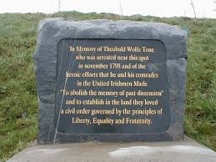
REBELLION
French involvement in Co Mayo (August)– 1000 troops, but unsuccessful
Wolfe Tone enters Co Donegal with force in December but is captured and condemned to death
Escapes executioner – dies of wounds following suicide attempt

Slide 44
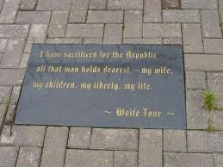
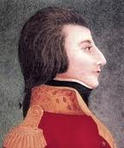
Legacy of 1798
The Act of Union – removal level of autonomy enjoyed by Protestant Ascendancy
Sectarian fault lines: Increasing schism between Presbyterians and R.C.s – inclusion of all Protestants in the Ascendancy ; fear of R.C. retaliation

Slide 45
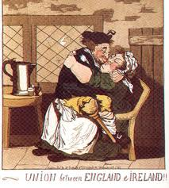
The Act of Union
Constituted 1 January 1801
Merged Irish and British Crown
Dublin legislature abolished – power shifted to Chief Secretary
Irish M.P.s elected to the Commons
Promise to secure Catholic Emancipation not met

Slide 46
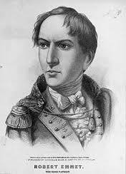
EMMET
Robert Emmet rebellion July 1803
Failed to secure Dublin Castle
Infamous for riotous behaviour than bid to take power
Legacy – 19th September, Emmet’s speech on eve of execution

