Slide 1

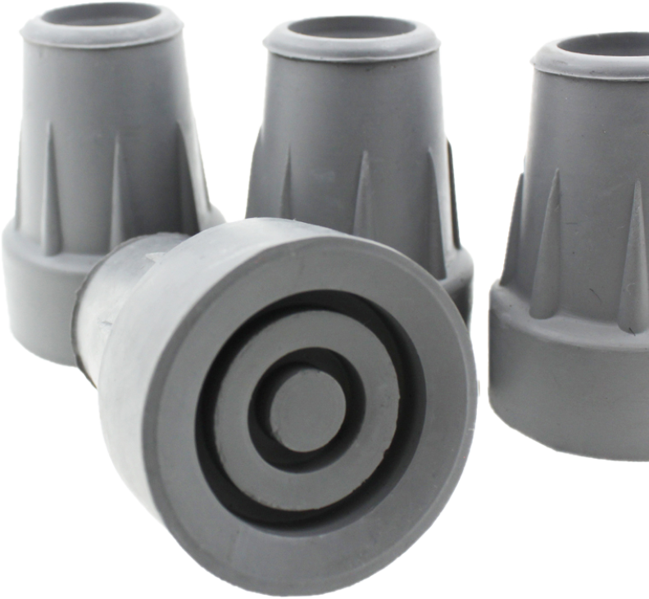
The maintenance of patients ferrules within the Community.
By dylan foxley

Slide 2

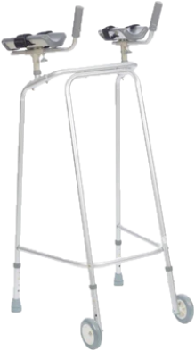

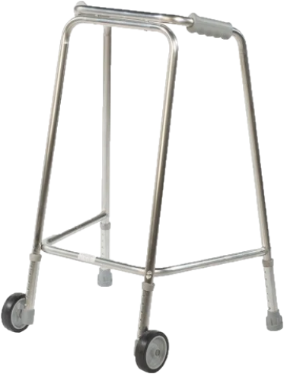
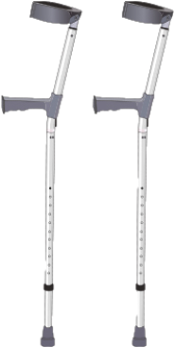
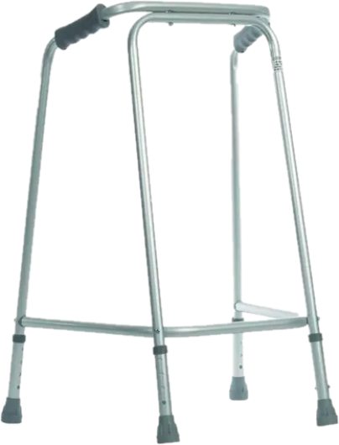
Ferrules & Walking aids
A ferrule “makes contact with the ground, saving your stick from hard impacts and cushioning the shock that travels into your arm” (walkingsticks.co.uk, 2021)
What is a ferrule?
What are the different types of ferrules?
The Rubber ferrule.
Walking aids.

Slide 3
Importance of Walking aids
Improved stability
Pain Reduction
Improved Posture
Facilitates Physical Activity
Improved Confidence
Promotes Independence
Security When Walking
“Routine maintenance is a critical aspect of safety. Regular checks for wear and tear, especially in the parts that bear weight, can prevent sudden breakages and resulting falls.”
(UK Care Guide, 2024)

Slide 4
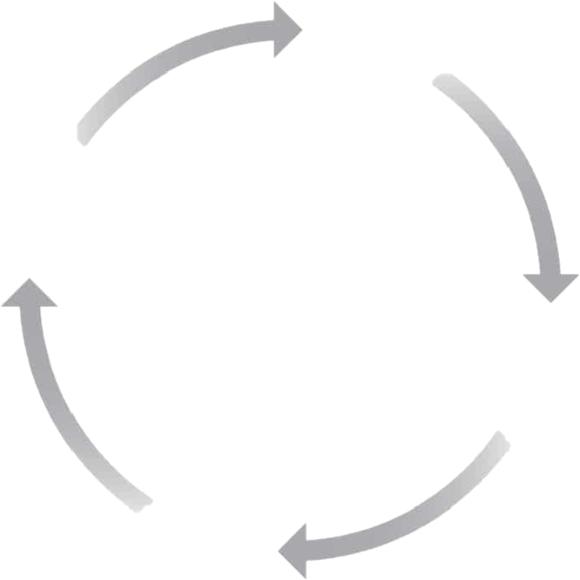

PDSA Cycle
P -
D -
S -
A -
What are we trying to achieve?
How are we going to do it?
What have we found out?
How are we going to improve?

Slide 5
plan
What are we trying to achieve?
- Can we as a team be more proactive with checking ferrules?
- Can we as a team be more effective in replacing ferrules?
- Who would be benefitting from having regular ferrule checks?
- Would the patients be safer by having regular ferrule checks?
Why are we doing this?
- Ferrules can wear down quickly and should be checked regularly
- They lose their grip over time
- Should be changed to ensure stability and safety
Proactively looking after our patients walking aids can surely only be of benefit to them as at the very least it will reduce the likelihood of a fall.
(Guy`s and St Thomas NHS Trust, 2024)
- To keep our patients safe and to reduce risk of falls
(SB Physiotherapy, 2024)

Slide 6
DO
How are we going to do it?
- On every visit, the team are to check the patients’ ferrules.
- Each therapist to ask the patient when their ferrules were last checked
- Each therapist to take a couple of ferrules out on each visit for ‘just in case’ situations
- The 12 therapists in the team will each complete a questionnaire after each visit over a two-week period to identify how many ferrules needed changing
Questionnaire
1. Does the patient have a walking aid?
2. What walking aid does the patient use?
3. Did you check the ferrules on the walking aid?
4. Did the ferrules need replacing?
5. Did you replace the ferrules or are you planning to?

Slide 7
study
What have we found out?
- Over a period of two weeks, the therapists of the North Community Therapy Team answered a questionnaire following each visit regarding the patient’s ferrules
- Over the two-week period 60 patients were reviewed for ferrules by the 12 therapists in the team.
- The following 5 slides will look into the answers from the questionnaire completed during this time

Slide 8
study
What have we found out?

Slide 9
study
What have we found out?

Slide 10
study
What have we found out?

Slide 11
study
What have we found out?

Slide 12
study
What have we found out?

Slide 13
act
How are we going to improve?
A conversation was had during a meeting with the Community Therapy Team in North Powys on how we can ensure the maintenance of ferrules. It was decided that…
- Each clinical therapist is to review the condition of the ferrules during each visit they complete
- To introduce a mandatory check on ferrules during the initial assessment process
- For therapists to advise patients on the best way to maintain their ferrules
- To advise each patient that regularly checking their ferrules is important and to contact the Community Therapy Team if they need new ferrules
- To be overall more proactive with walking aids and ensure they are safe for the patient to use from a wear and tear perspective

Slide 14
Reference list continued
SB Physiotherapy & Sports Injury Clinic (2024) Tips for the Safe Use Of Walking Aids.
Available at: https://sbphysiotherapy.co.uk/tips-for-the-safe-use-of-walking-aids/ [Accessed on: 28th January 2025].
Guys and St Thomas NHS Trust (2024). Keeping active and using a Walking aid.
Available at:
Falls - Keeping active and using a walking aid | Guy's and St Thomas' NHS Foundation Trust
[Accessed on: 28th January 2025].
UK Care Guide (2024). Benefits of Using Walking Aid.
Available at: https://ukcareguide.co.uk/benefits-of-using-walking-aids/
[Accessed on: 28th January 2025].
Walking Sticks (2024). What is a Ferrule?
Available at: https://www.walkingsticks.co.uk/blog/what-is-a-ferrule.html#:~:text=The%20Rubber%20Ferrule,hand%20and%20up%20your%20arm. [Accessed on: 28th January 2025].

