Slide 1

Introduction to social psychology
BMHP4003 Psychology in Health and Social Care
Week 6

Slide 2



During today’s session
We will introduce social psychology
We will explore the concept of self
We will examine the impact of social influence

Slide 3
Social Psychology
Hogg and Vaughan (2017, p4) describes that social psychology is the study of behaviours, thoughts and feelings of humans and how these are influenced by other people.
Social psychology is a science because it seeks to develop theories to:
how humans will be influence by others.
describe
explain
predict

Slide 4
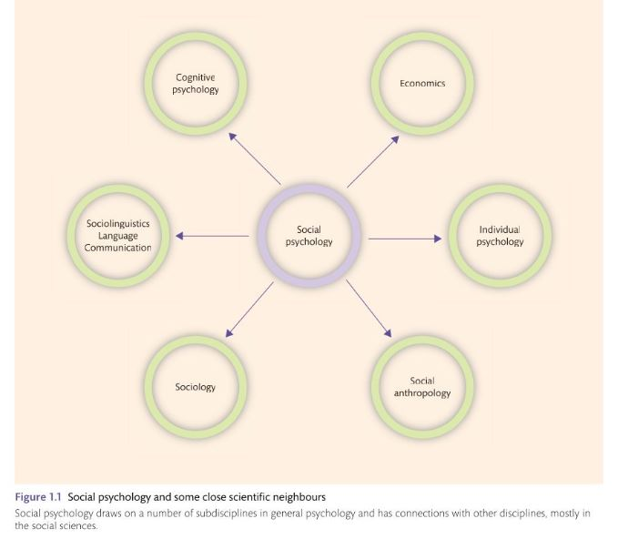
Where does social psychology fit?
Those who define themselves as social psychologist will have overlapping interests with a range of other disciplines.
However, their key focus is on the influence of the social context on humans and therefore involves a lot of face to face working whereas other psychologists may focus on the interaction between a person and other stimuli such as food, sound, colour, weather or animals.
Hogg & Vaughan (2017, p5)

Slide 5

Dr Brenda Major
Listen to Dr Brenda Major briefly explain the field of Social Psychology.

Slide 6
What will we be studying?
Self Concept
Social Identity theory and Social Influence
During today’s lecture we will focus on ;
During the rest of this module we will be examining and discussing:
Attitudes and Attribution Theory
Theory of Planned Behaviour
Theories of aggression
Prosocial behaviour and bystander effect
Humanism and conditions of worth.

Slide 7
Component 2 Assessment Brief.
Please ensure that you have accessed the Assignment Brief.
Let’s look at where to find the assignment brief and guidance now.

Slide 8
Access your Assignment Brief
Please now all ensure that you are able to access your assignment brief and guidance on the Moodle page for our module.

Slide 9
Break.
After the break we will discuss and explore
Self concept
Social Identity theory and Social Influence

Slide 10
References.
Hogg, M. and Vaughan, G., (2017), Social Psychology, 8th edn. Harlow: Pearson Education.
Society for Personality and Social Psychology, (2017), Introduction to Social Psychology, [video] Available at: https://www.youtube.com/watch?v=CEw23EFu4rc Accessed: (10 October 2022).

