Slide 2
Communication
Network and Cybersecurity
Essentials (ACCA4024)
Applied Computing - WISA

Slide 3
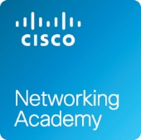
Previous Class
Network Types
Data Transmission
Bandwidth and Throughput
Clients and Servers
Network Components
Wireless Networks
Local Network Connections
Network Documentation
During our previous lectures, we discussed the concept of network, its entities (data, devices), metrics (bandwidth, throughput), roles (server, client/host) and components.
Finally, the importance of documenting the network was elaborated.
We also discussed the Coursework. The coursework is available on your Moodle course page.

Slide 4
Labs Checkpoint
Install Packet Tracer 8.0
Complete the Introduction to Packet Tracer Course via Cisco Networking Academy
Design and Connect a Simple Network and determine IP Address
So far Tutorial session: Sign up to Introduction to Packet Tracer Course, Download the latest packet tracer file, Install and complete a simple activity. Simultaneously, complete the 10 hours independent learning and get your certificate/ digital badge.
https://www.netacad.com/courses/packet-tracer/introduction-packet-tracer

Slide 5
In this lecture, you will understand the different types of network cables used in a home network. Network cables are very vital component which helps in establishing a successful network.
You will also understand the need of standard protocols in a network and discuss in detail about the communication principles used with in the network.
After having a better understanding on the connecting components and the rules in establishing the communication, you will deep dive and look into the Ethernet frame and the purpose of routing.
Tutorial session: Analyze MAC Address, Wired and Wireless Network Connection and Address resolution protocol (ARP).
Today’s Class
Cables
Communication Principles
Ethernet
Routing

Slide 6
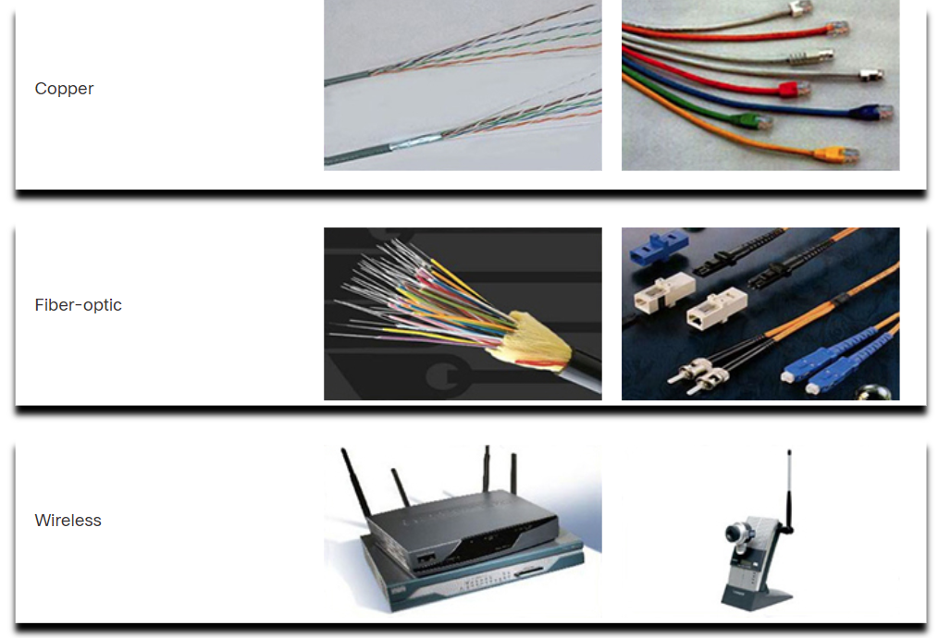
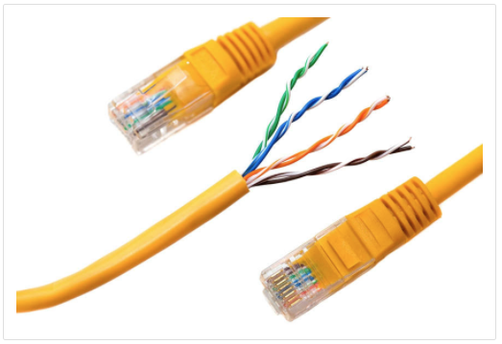
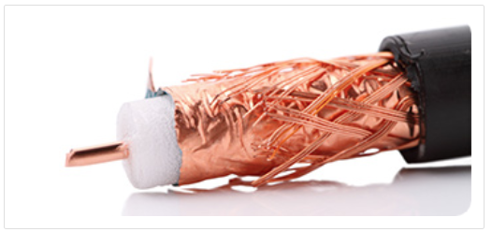
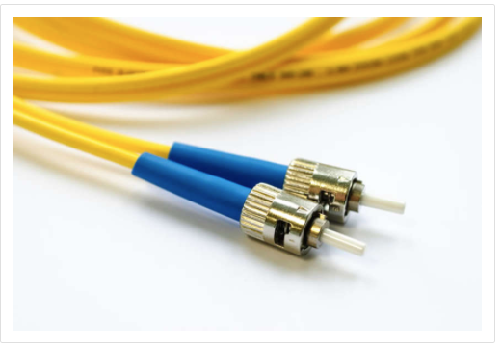
Network Cables
Communication transmits across a network on media. Modern networks primarily use three types of media to interconnect devices.
Metal wires within cables - Data is encoded into electrical impulses.
Glass or plastic fibers within cables (fiber-optic cable) - Data is encoded into pulses of light.
Wireless transmission - Data is encoded via modulation of specific frequencies of electromagnetic waves.
Twisted-Pair Cable
Ethernet technology generally uses twisted-pair cables to interconnect devices.
Coaxial Cable
It was one of the earliest network cabling types developed. It is used as a high-frequency transmission line to carry high-frequency or broadband signals.
Fiber-Optic Cable
It can be either glass or plastic and it can carry digital information at very high speeds over long distances.

Slide 7
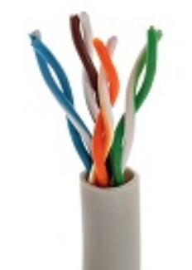
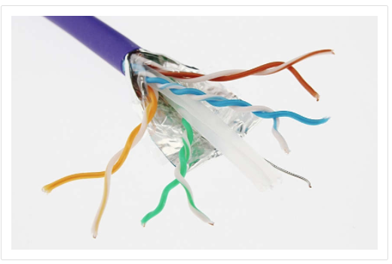
Network Cables
There are two commonly installed types of twisted-pair cable:
  Unshielded twisted-pair (UTP)
    This is the most common type of network cable in North America and many other areas.
    UTP cables are used to connect workstations, hosts and network devices.
    Ethernet UTP cables consists of 4 pairs of twisted cables.
    Each pair is identified by a specific color code.
  Shielded cables (STP)
    These are used almost exclusively in European countries.
    STP cables are immune to EMI and RFI interference.
    STP cables are expensive, not as flexible, and have additional requirements because of the shielding.
  Shielded cables (STP) Ethernet NICs and the ports on networking devices are designed to send data over UTP cables.
  Specific pins on the connector are associated with a transmit function and a receive function.
  The interfaces on each device are designed to transmit and receive data on designated wires within the cable.
Twisted-Pair Cable
Ethernet technology generally uses twisted-pair cables to interconnect devices.

Slide 8
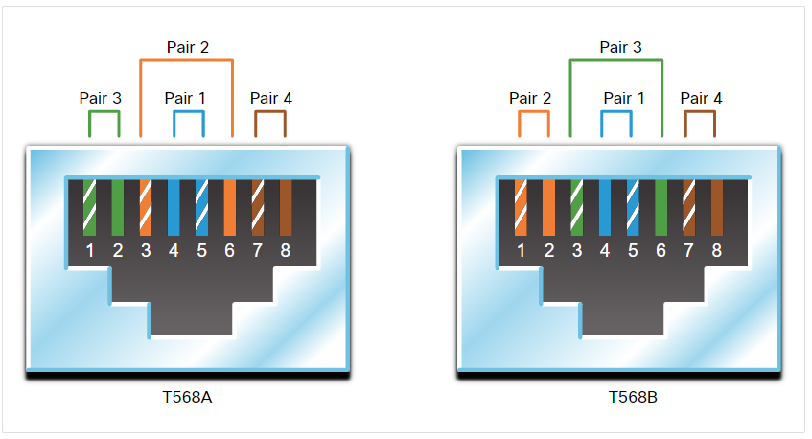
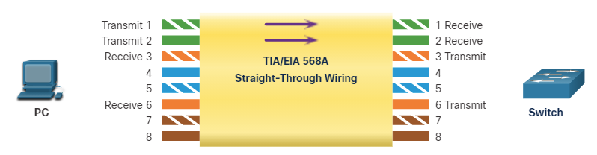
Network Cables
Category | Speed | Features
Cat 3 UTP | 10 Mbps at 16 MHz | Suitable for Ethernet LANs Most often used for phone lines
Cat 5 UTP | 100 Mbps at 100 MHz | Manufactured with higher standard than Cat 3 to allow for higher data transfer rates
Cat 5e UTP | 1000 Mbps at 100 MHz | Manufactured with higher standard than Cat 5 to allow for higher data transfer rates More twists per foot than Cat 5 to better prevent EMI and RFI from outside sources
Cat 6 UTP | 1000 Mbps at 250 MHz | Manufactured with higher standard than Cat 5e More twists per foot than Cat 5 to better prevent EMI and RFI from outside sources
Cat 6a UTP | 1000 Mbps at 500 MHz
Cat 7 ScTP | 10 Gbps at 600 MHz
When two unlike devices are directly connected using an UTP Ethernet cable, it is important that the transmit function and the receive function on each end of the cable are reversed.
This cable is called straight-through cable and it has the same color patterns on both ends of the cable.

Slide 9
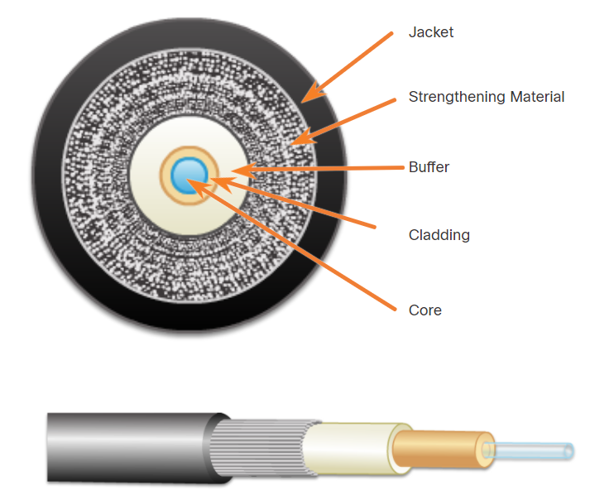
Network Cables
Fiber-optic cables transmit data using pulses of light.
Fiber-optic cable is constructed of either glass or plastic and it is immune to EMI and RFI.
Parts of a fiber-optical cable are:
  Jacket - typically a PVC jacket that protects the fiber against abrasion, moisture, and other contaminants.
  Strengthening Material - Surrounds the buffer, prevents the fiber cable from being stretched when it is being pulled
  Buffer - Used to help shield the core and cladding from damage.
  Cladding - Made from slightly different chemicals than those used to create the core. It tends to act like a mirror.
  Core - The light transmission element at the center of the optical fiber. Light pulses travel through the fiber core.
Fiber-Optic Cable
It can be either glass or plastic and it can carry digital information at very high speeds over long distances.

Slide 10

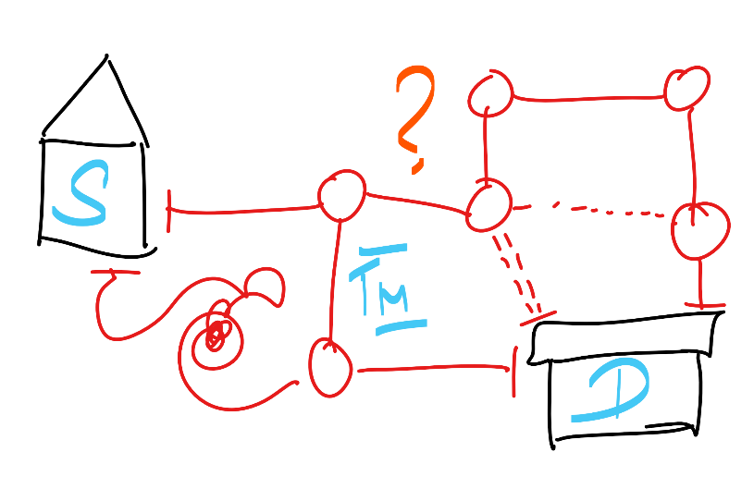
Communication
Source
Destination
Transmission Medium
Before beginning to communicate with each other, we establish rules or agreements to govern the conversation. Online Etiquette. Likewise, before beginning to communicate between devices, set of rules of communication is defined by International standard organizations. Networking/Communication protocols.
All communication methods have three elements in common:
  The first of these elements is the message source, or sender. Message sources are people, or electronic devices, that need to communicate a message to other individuals or devices.
  The second element of communication is the destination, or receiver, of the message. The destination receives the message and interprets it.
  The third element is called a transmission medium, or channel. It provides the pathway over which the message can travel from source to destination.

Slide 11
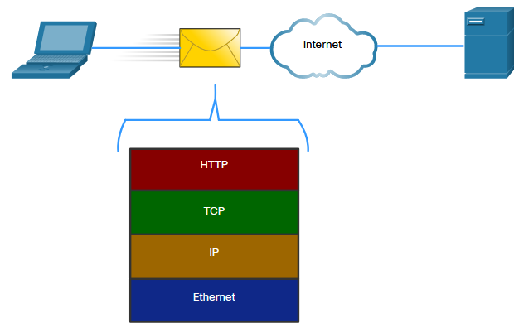
Communication
Hypertext Transfer Protocol (HTTP)
This protocol governs the way a web server and a web client interact.
HTTP defines the content and formatting of the requests and responses that are exchanged between the client and server.
Transmission Control Protocol (TCP)
This protocol manages the individual conversations.
TCP is responsible for guaranteeing the reliable delivery of the information and managing flow control between the end devices.
Internet Protocol (IP)
This protocol is responsible for delivering messages from the sender to the receiver.
IP is used by routers to forward the messages across multiple networks.
Ethernet
This protocol is responsible for the delivery of messages from one NIC to another NIC on the same Ethernet local area network (LAN).

Slide 12
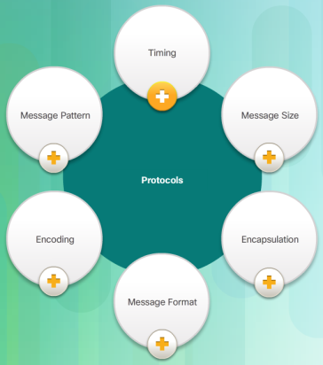

Communication: Protocols and Standards
The Internet and Standards
A standard is a set of rules that determines how something must be done.
Networking and internet standards ensure that all devices connecting to the network implement the same set of rules or protocols in the same manner.
Using standards, it is possible for different types of devices to send information to each other over the internet.
Network Standards Organizations
When a new standard is proposed, each stage of the development and approval process is recorded in a numbered Request for Comments (RFC) document.
RFCs for internet standards are published and managed by the Internet Engineering Task Force (IETF).
Other standards organizations that support the internet are shown in the figure.
Notes:
IBM and Digital Equipment Corporation
International Standards Organization
Layered Approach and its Importance

Slide 13
Communication: Protocols and Standards
We all know what a network is? and a protocol is a kind of rule…. So, why a protocol is important? What it deals with?
Protocol Characteristic | Description
Message format | When a message is sent, it must use a specific format or structure. Message formats depend on the type of message and the channel that is used to deliver the message.
Message size | The rules that govern the size of the pieces communicated across the network are very strict and can be different, depending on the channel used. It may be necessary to break a longer message into smaller pieces in order to ensure that the message can be delivered reliably.
Timing | Many network communication functions are dependent on timing. Timing determines the speed at which the bits are transmitted across the network. It also affects when an individual host can send data and the total amount of data that can be sent in any one transmission.
Encoding | Messages sent across the network are first converted into bits by the sending host. Each bit is encoded into a pattern of sounds, light waves, or electrical impulses. The destination host receives and decodes the signals in order to interpret the message.
Encapsulation | Each message transmitted on a network must include a header that contains addressing information that identifies the source and destination hosts. Encapsulation is the process of adding this information to the pieces of data that make up the message.
Message pattern | Some messages require an acknowledgment before the next message can be sent. This type of request/response pattern is a common aspect of many networking protocols.

Slide 14
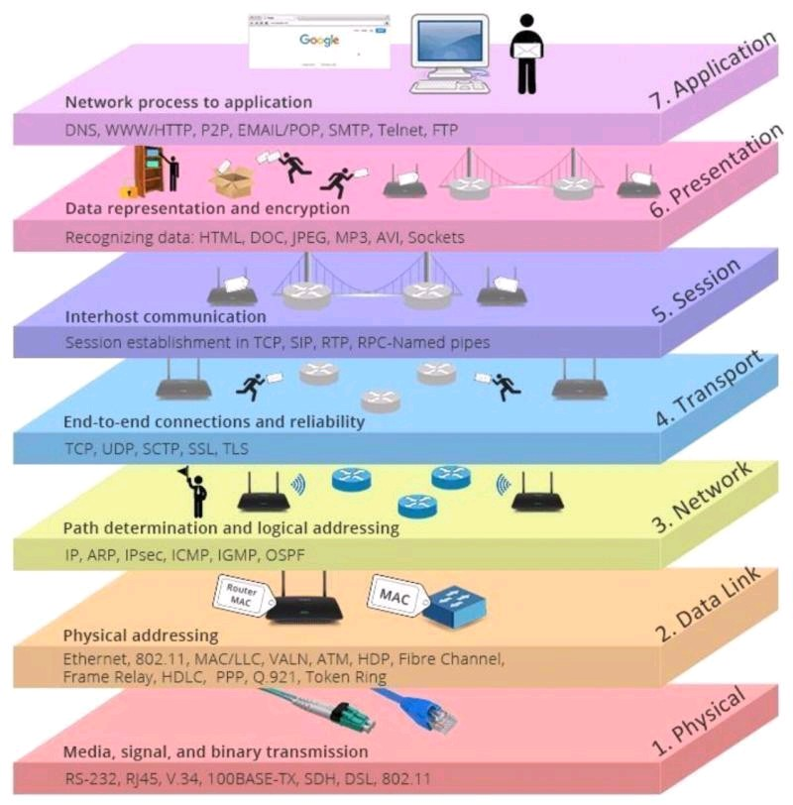
Communication: Protocol Models – Layered Approach
Protocol Model | Reference Model
TCP/IP Model | Open Systems Interconnection (OSI) Model
FTP, SMTP, HTTP, POP3…
4. APPLICATION
3. TRANSPORT
2. INTERNET
1. NETWORK INTERFACE
7. APPLICATION
6. PRESENTATION
5. SESSION
4. TRANSPORT
3. NETWORK
2. DATA LINK
1. PHYSICAL
TCP & UDP
IP
Ethernet

Slide 15
Communication: Protocol Models
FTP, SMTP, HTTP…
Network IP
Network Aware App
JPEG, PNG…
Packet (IP Addressing/ Best Path)
Encryption Services
MAC, FCS
Connection
Creates and maintains sessions
Frame (MAC Addressing/ Error)
TCP/ UDP
Signal
Segment (TCP/UDP- Port Numbers)
Bit (Actual Data Transfer)

Slide 16
Communication: Protocol Models
(AL) Web Browser
(NIL) Actual Transfer
(TL) Packets/ Transport
(IL) IP Address

Slide 17
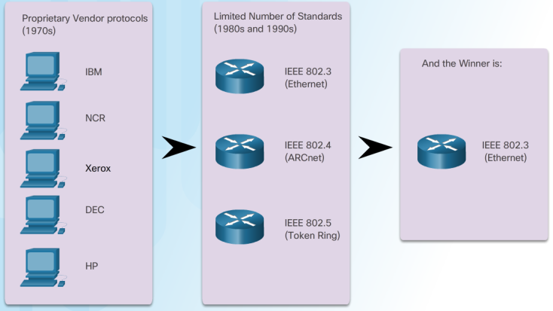
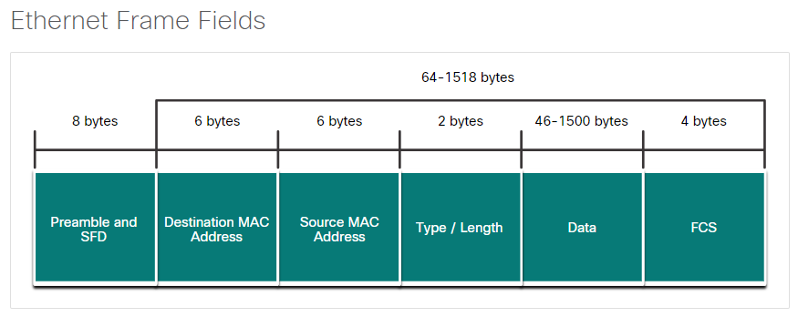
Ethernet
There is no official local area networking standard protocol, but over time, Ethernet has become the most common.
Ethernet protocols define how data is formatted and how it is transmitted over the wired network.
The Ethernet standards specify protocols that operate at Layer 1 and Layer 2 of the OSI model.
Ethernet has become a de facto standard, which means that it is the technology used by almost all wired local area networks, as shown in the figure.
The Institute of Electrical and Electronic Engineers (IEEE) maintains Ethernet and wireless standards.
Each host connected to an Ethernet network is assigned a unique physical address known as the Media Access Control (MAC) which identifies it on the network.
The physical address is address and is assigned to a NIC it when it is manufactured.
IEEE 802.3 Ethernet Frame
7 bytes | 1 | 6 | 6 | 2 | 46 to 1500 | 4
Preamble | Start of Frame Delimiter | Destination MAC Address | Source MAC Address | Type / Length | 802.2 Header and Data | Frame Check Sequence

Slide 18
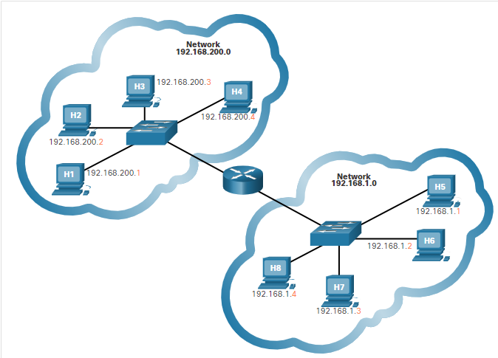
Addressing
Physical and Logical Addresses
  A MAC address is physically assigned to a NIC and never changes.
  An IP address (network address) is logically assigned to a host NIC.
Both the physical MAC and logical IP addresses are required for a computer to communicate on a hierarchical network.

Slide 19
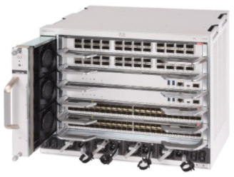
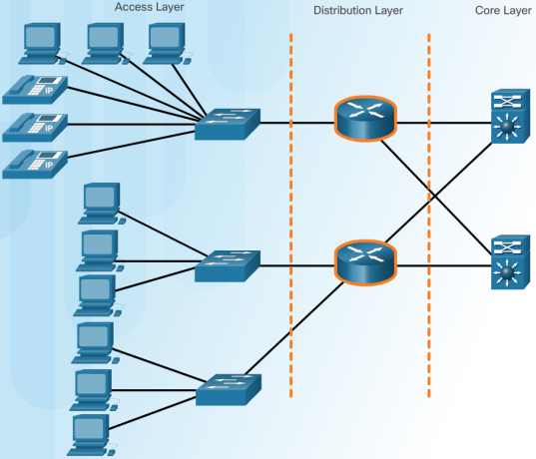
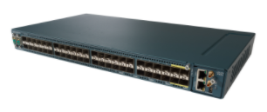
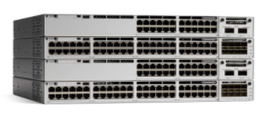
Hierarchical Approach
A hierarchical, layered design provides:
Increased efficiency
Optimization of function
Increased speed
A way in which to scale the network without impacting the performance of existing ones
Cisco Catalyst 9600
Provides a high-speed connection between distribution layer devices
Provides connections to hosts in a local Ethernet network.
Cisco ME 2600X Access Layer Switch
Interconnects the smaller local networks.
Cisco C9300 Series Distribution Layer Switches

Slide 20
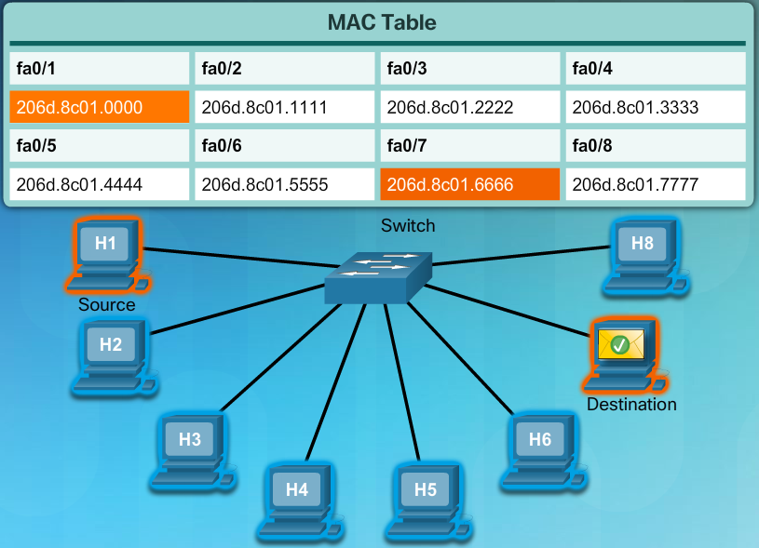
Hierarchical Approach
An Ethernet switch is an access layer device.
A switch builds a MAC address table.
A switch uses the MAC address table to send the message to a specific port.

Slide 21
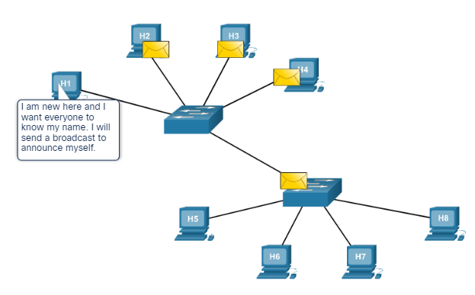
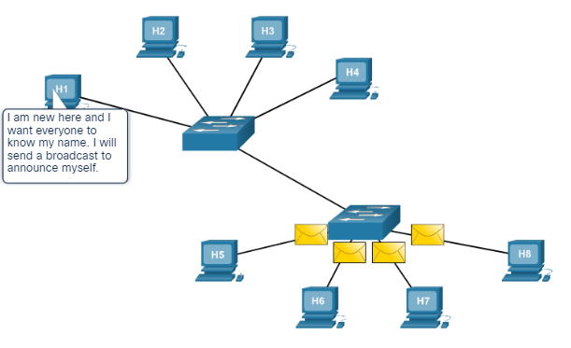
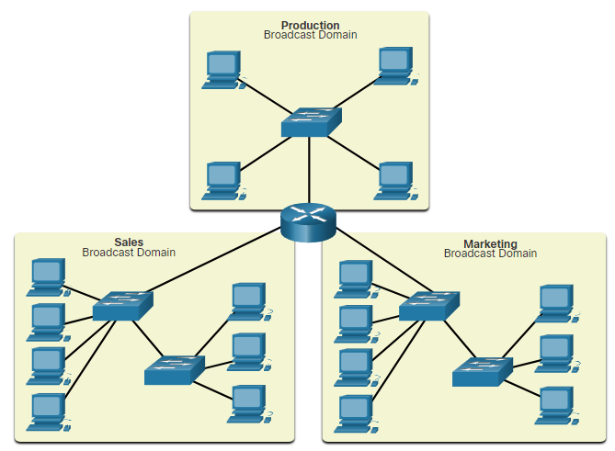
Broadcasts
A broadcast message is used to contact every other device on the local network.
An Ethernet broadcast is all 1s in the destination MAC address – FFFF.FFFF.FFFF.
A broadcast domain is the area through which a broadcast message can travel.
Each local Ethernet network is a broadcast domain.
Routers are used to divide the network into multiple broadcast domains.

Slide 22
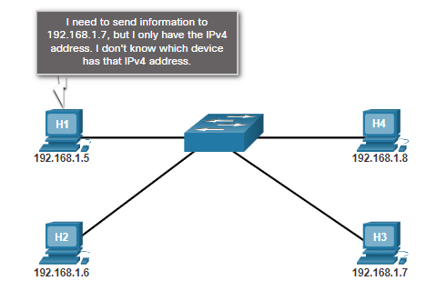
Broadcasts
In order to send information from a device that is on an Ethernet network, the device must supply its own source MAC address, a destination MAC address, its own source IP address, as well as a destination IP address.
The address resolution protocol (ARP) is used to discover the MAC address of a device on the same local network

Slide 23
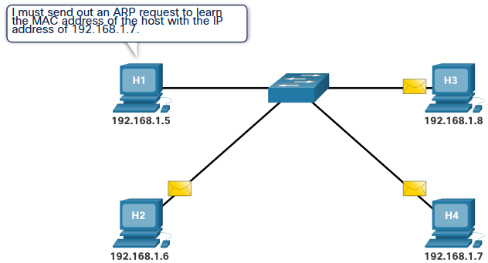
Broadcasts
ARP uses 3 steps to discover and store the MAC address of a host on the local network when only the IPv4 address of that host is known.
The sending host creates and sends a frame addressed to a broadcast MAC address. Contained in the frame is a message with the IPv4 address of the intended destination host.
Each host on the network receives the broadcast frame and compares the IPv4 address contained in the message with its own IPv4 address. The host with the matching IPv4 address sends its own MAC address back to the original sending host.
The sending host receives the message and stores the MAC address and the IPv4 address in an ARP table.

Slide 24

Broadcasts
The destination MAC address is used to forward the packet to either the router if the destination IP address is for a different network or a specific network device on the local network.
The ARP table shows a mapping of IP address to MAC address.
Send data to a device
The PC attempts to ping IP address 10.1.1.1.
PC> ping 10.1.1.1
Is the MAC address in my ARP cache?
Send an ARP Request to IP 10.1.1.1
No
  Dest MAC: FF-FF-FF-FF-FF-FF
The PC requires the destination IP address and MAC address.
Yes
Send ping packet
Receive ARP Reply from 10.1.1.1 with its MAC address

Slide 25
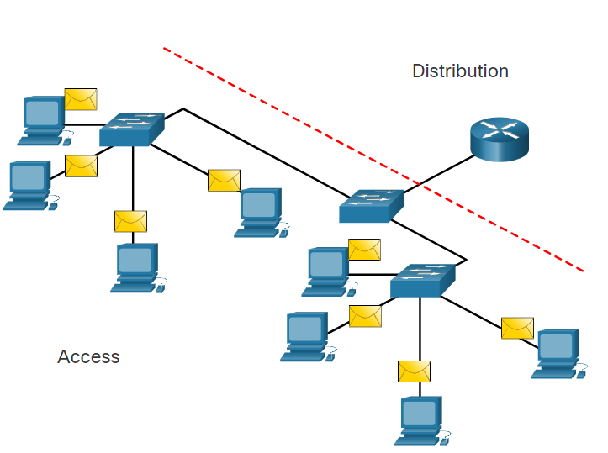
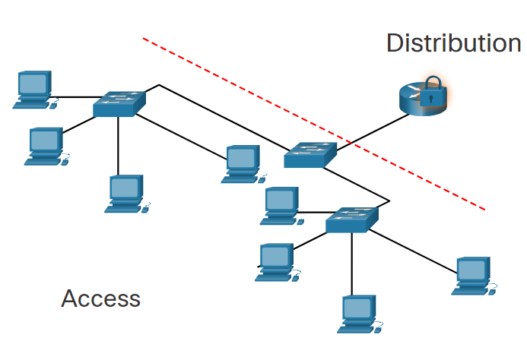
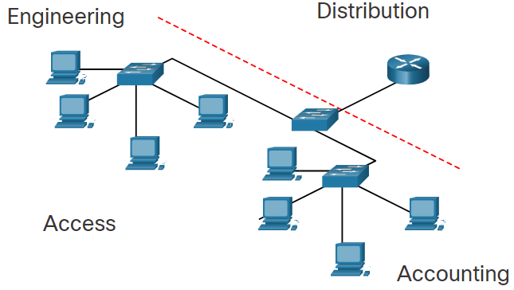
Routing
Broadcast Containment
Routers in the distribution layer can limit broadcasts to the local network where they need to be heard.
Although broadcasts are necessary, too many hosts connected on the same local network can generate excessive broadcast traffic and slow down the network.
Security
Routers in the distribution layer can separate and protect certain groups of computers where confidential information resides.
Routers can also hide the addresses of internal computers from the outside world to help prevent attacks, and control who can get into or out of the local network.
Locations
Routers in the distribution layer can be used to interconnect local networks at various locations of an organization that are geographically separated.
Logical Grouping
Routers in the distribution layer can be used to logically group users, such as departments within a company, who have common needs or for access to resources.

Slide 26
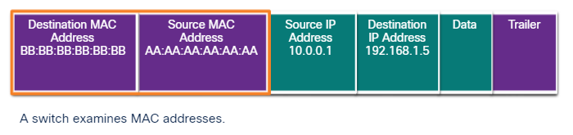
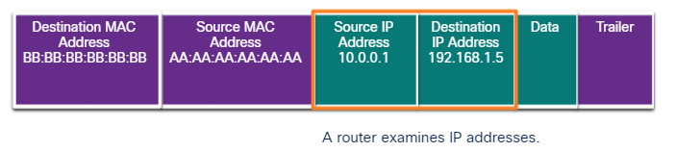
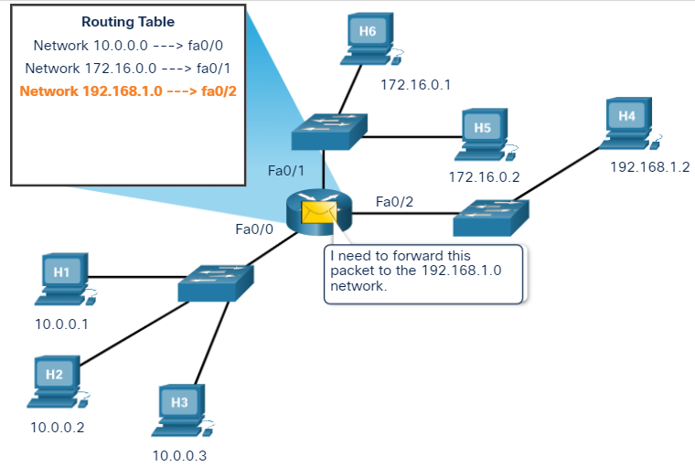
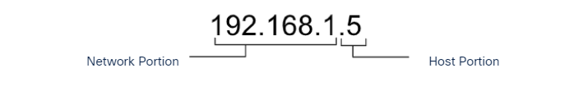
Routing
Path Selection
Each router interface connects to a different network.
A routing table contains information for how to reach local and remote networks.
The destination IP address is used and compared with the networks in the routing table to determine the interface to forward the packet out of.
Routers do not forward broadcast messages

Slide 27
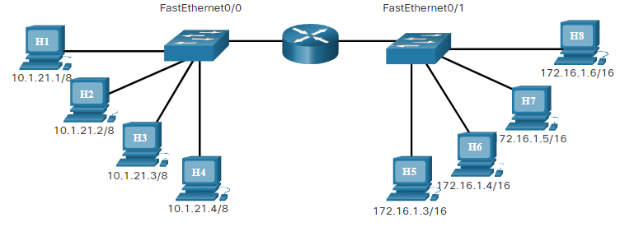
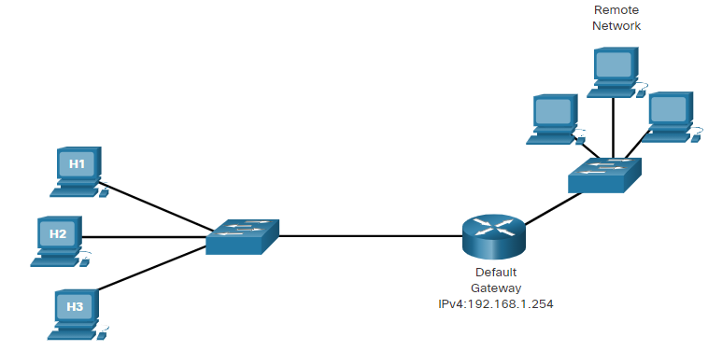
Routing
Routing Table Entries
A routing table contains network addresses and the best path to reach a network.
Two ways routes can be added to a routing table
  Dynamically learned from other routers
  Manually entered by a network administrator
A default route is the router interface used when forwarding packets to a destination that is not in the routing table.
If a packet is destined for a network that is not in the routing table and no default route exists, the packet will be dropped.
Type | Network | Port
C | 10.0.0.0/8 | FastEthernet0/0
C | 172.16.0.0/16 | FastEthernet0/0
PC | IPv4 Address | Subnet Mask | Default Gateway
H1 | 192.168.1.1 | 255.255.255.0 | 192.168.1.254
H2 | 192.168.1.2 | 255.255.255.0 | 192.168.1.254
H3 | 192.168.1.3 | 255.255.255.0 | 192.168.1.254

Slide 28
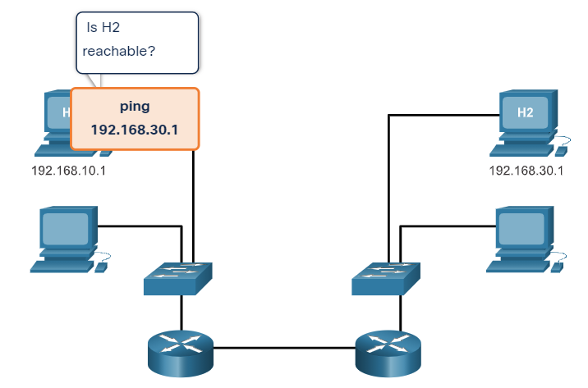
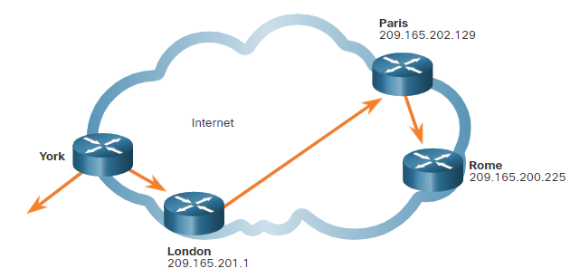
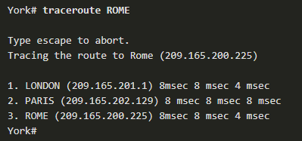
Verification
A host that sends messages across the internet must have an IP address to identify it to the other devices in the network.
The ping utility can be used to test end-to-end connectivity between the IP address of the sending host and the IP address of the destination host.
It measures the time that it takes test messages to make a round trip from the source to the destination, and whether the transmission is successful.
However, if the test message does not reach the destination, or if delays are encountered along the way, ping cannot determine where the problem is located.
The format of the ping command is ping x.x.x.x, where x.x.x.x is an IP address or domain name of the destination host:
For example, ping 192.168.30.1, ping www.cisco.com, etc.
The traceroute utility traces the route a message takes from its source to the destination.
Each individual network through which the message travels is referred to as a hop.
The traceroute command displays each hop along the way and the time it takes for the message to get to that network and back.
Ping and Trace Route

Slide 29
Verify Connectivity
The traceroute Command
The traceroute utility traces the route a message takes from its source to the destination.
Each individual network through which the message travels is referred to as a hop.
The traceroute command displays each hop along the way and the time it takes for the message to get to that network and back.
If a problem occurs, the output of the traceroute utility can help determine where a message was lost or delayed.
The traceroute utility is called tracert in the Windows environment.

Slide 30
Successful communication between hosts requires interaction between a number of protocols that are implemented in software and hardware on each host and networking device.
Networking and internet standards ensure that all devices connecting to the network implement the same set of rules or protocols in the same manner.
The most widely known internetwork reference model was created by the Open Systems Interconnection (OSI) project and is commonly referred to as the OSI model.
  The OSI model breaks network communications down into multiple processes. Each process is a small part of the larger task.
  The OSI model helps us troubleshoot by focusing on a specific layer to identify and resolve network problems.
  The protocols that make up the TCP/IP protocol suite can be described in terms of the OSI reference model.
Ethernet is the technology used by almost all wired local area networks and Ethernet standards specify protocols that operate at Layer 1 and Layer 2 of the OSI model.
  Each host connected to an Ethernet network is assigned a physical address, known as a MAC address, which serves to identify the host on the network.
Summary
All communication methods have three elements in common.
  The first of these elements is the message source, or sender.
  The second element of communication is the destination, or receiver, of the message.
  The third element is called a transmission medium, or channel.
Protocols are required for computers to properly communicate across the network.
  Networking protocols define many aspects of communication over the local network which include message format, message size, timing, encoding, encapsulation, and message patterns.
A layered model depicts the operation of the protocols occurring within each layer, as well as the interaction with the layers above and below it.

Slide 31
Routers are needed to connect multiple Layer 3 IP networks.
Switches make their forwarding decision based on the destination Layer 2 MAC address.
Routers make their forwarding decision based on the destination Layer 3 IP address.
Each router has a routing table.
A routing table contains all locally connected networks and the interfaces that connect to the networks.
A routing can contain remote networks learned dynamically from other routers or entered manually by a network administrator.
A default route in the routing table is the router interface used when forwarding packets to a destination that is not in the routing table.
If a packet is destined for a network that is not in the routing table and no default route exists, the packet will be dropped.
A local area network (LAN) is under the same administrative control and typically is wired Ethernet or wireless.
A simple network design keeps all hosts on a single local network.
If a network design has multiple local networks, a router is needed for communication between networks.
Summary
A part of the encapsulation process on an Ethernet network is to create a frame that includes the source and destination MAC address.
Networks have a hierarchical design of IP addressing that includes a network portion and a host portion.
Networks can be designed using a hierarchical design model with three layers: access, distribution and core.
An access layer device provides connections so hosts can get onto a network.
The distribution layer connects networks.
The core layer provides a high speed connection between distribution layer devices.
Hubs takes signals from one port and sends the same message out all other ports. All connected devices share the bandwidth.
Switches build a MAC address table by examining and saving the source MAC address from a received frame.

