Slide 1

NAME: RAVJEET KAUR
ID: 2421160
Programme: Certificate of Higher Education in Health and Social Care
Module: Psychology in Health and Social Care
Module code: LCHS4010
Assignment : Individual Presentation
Title: Supporting Amira’s Development in the Nursery Setting

Slide 2

What is Bowlby’s Attachment Theory
John Bowlby’s theory is about how babies and young children form close emotional bonds with their main caregivers.
If a child has a secure attachment, they feel safe, happy, and are more confident to explore and learn.
If the bond is disrupted or insecure, the child might feel anxious, clingy, or pull away from others.
Bowlby believed these early relationships shape how children grow and relate to others.
Amira shows signs of separation anxiety when her carer leaves, which could mean her attachment is insecure or under stress.
The Photo is licensed under CCYYSA.

Slide 3

Key Concepts of the Theory
Monotropy: Babies usually become most attached to one special person, often a parent or main carer.
Internal Working Model: The way a child is treated early on shapes how they expect relationships to be in the future.
Critical Period: The first 5 years of life are very important for forming strong, healthy bonds.
Separation Anxiety: If a child gets upset when their carer leaves, it shows their attachment is being tested — this is normal , but can also be a sign of stress.
Amira feels upset when her carer leaves. This shows her attachment system is under pressure, which is something Bowlby believed could affect how children feel and act later in life if they don’t form strong early bonds.
The Photo is licensed under CCYYSA.

Slide 4
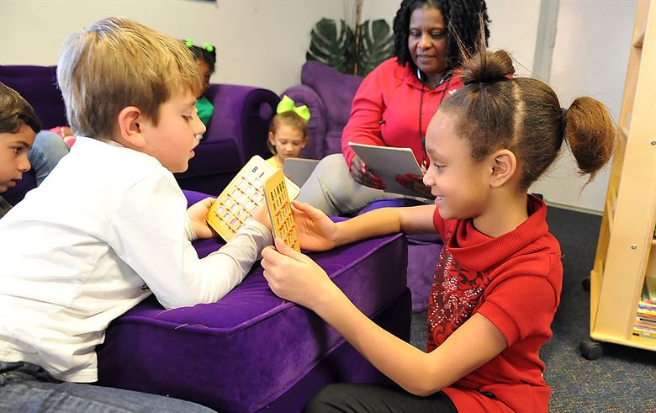
Why Bowlby’s Theory is Relevant in Early Childhood
Helps understand emotional responses
Explains social and language delays
Guides support strategies in nursery settings
This theory is especially useful in early years settings like nurseries. It helps explain behaviour such as clinginess, fear, or quietness. It also helps practitioners design support strategies that focus on relationships and emotional security — which is key for learning and development.
The Photo is licensed under CCYYSA.

Slide 5
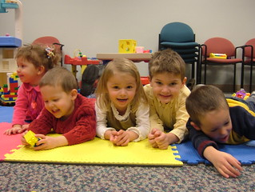
Applying Bowlby’s Theory to Amira
Amira might not have a strong, secure bond with anyone at the nursery yet.
Her anxiety when left could show she’s scared of being left alone or abandoned.
Her quietness or limited speech might mean she feels stressed or uncomfortable.
She finds it hard to play with others, which can be a sign she doesn’t feel emotionally safe yet.
These behaviours suggest Amira doesn’t fully feel safe or settled in the nursery environment.
The Photo is licensed under CCYYSA.

Slide 6

Practical Strategies to help Amira Based on Bowlby’s Theory
Give Amira a key person she sees every day to help her feel safe and build trust.
Use a slow settling-in process so she gets used to being at nursery without feeling scared.
Keep routines the same each day so she knows what to expect – this helps her feel secure.
Let her bring a comfort item from home, like a toy or blanket, to help her feel more relaxed.
Spend time with her in one-to-one activities like reading or drawing to build a strong, caring bond.
The Photo is licensed under CCYYSA.

Slide 7

Activities to Support Development
Emotion cards or puppets to express feelings
Parallel play leading to group play
Simple routines: songs, storytime, snack time
Encourage speech through one-to-one storytelling
Play-based strategies can help. Amira may benefit from emotion cards or puppets to explore and express feelings. Parallel play (playing alongside others without interaction) is a gentle step towards social play. Structured routines, like circle time or story time, promote speech and belonging. One-on-one storytelling can encourage verbal communication and build attachment.
The Photo is licensed under CCYYSA.

Slide 8

Nature and Nurture in Amira’s Development
Biological (Nature):
  Temperament (shy, sensitive)
  Possible speech or developmental delay)
Environmental (Nurture):
  Family background
  Previous experiences ( trauma or loss)
  Language or cultural differences
  Amira’s development may be influenced by both nature and nurture. She may naturally be a quiet or sensitive child. There may also be speech or developmental delays. Her environment also matters — changes at home, previous nursery experience, or cultural differences might affect how she settles and communicates.
The Photo is licensed under CCYYSA.

Slide 9
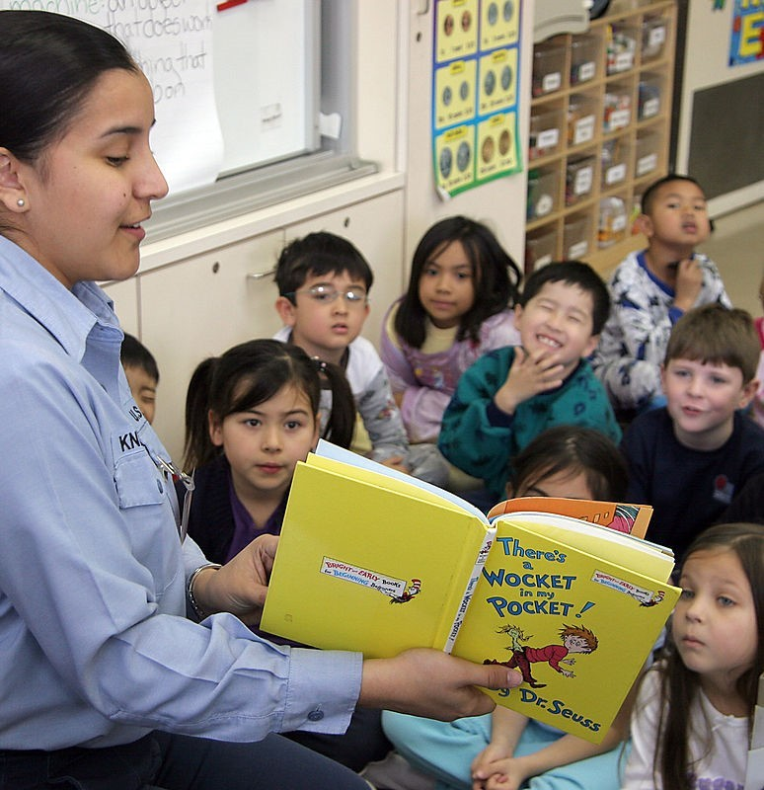
Evaluation of Bowlby’s Theory
Why it’s useful:
It reminds us how important emotional bonds are for children.
It gives helpful ideas for nurseries and early years settings.
It’s backed up by research, like Ainsworth’s “Strange Situation” study.
Limitations:
It focuses too much on the mother, but children can bond with other carers too.
It doesn’t fully consider things like family situation or social background.
It may not work the same way in all cultures.
Bowlby’s theory is helpful, especially for understanding young children’s emotions. But it doesn’t explain everything, and some children may have different experiences.
The Photo is licensed under CCYYSA.

Slide 10
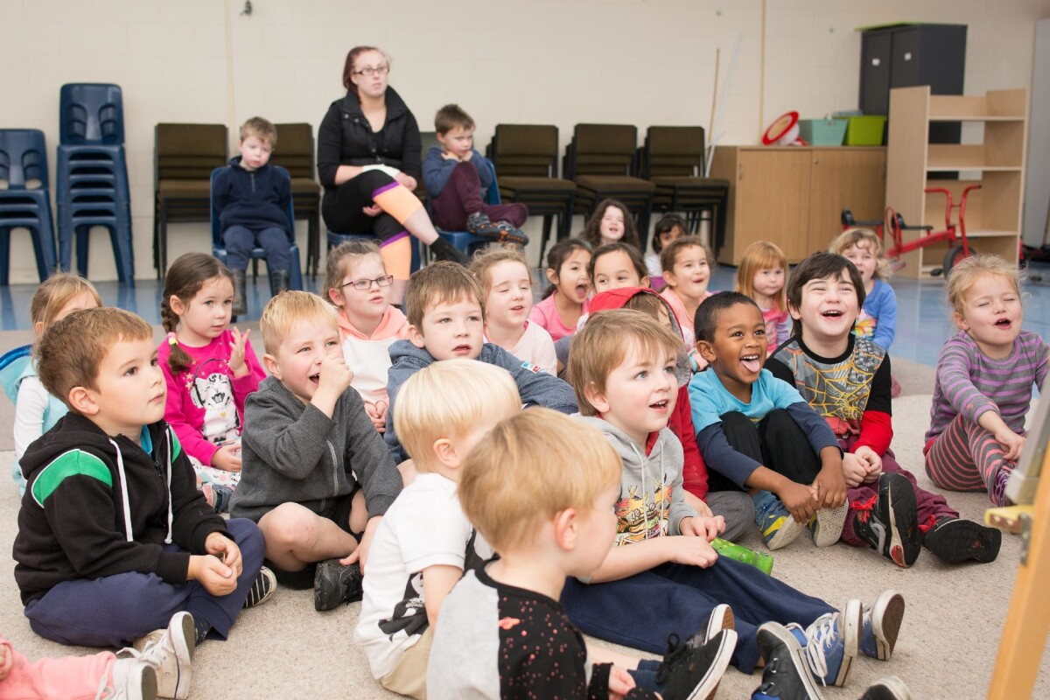
Conclusion
Amira’s behaviour is understandable through Bowlby’s lens
Secure attachment in nursery is key
Strategies must be emotional, consistent, and child-centred
In conclusion, Bowlby’s theory helps us understand Amira’s anxiety and social difficulties. Building a secure attachment in the nursery can help her feel safe, communicate more, and start to engage in group play. Consistent and emotionally responsive care is the best way forward.
The Photo is licensed under CCYYSA.

Slide 11
Reference List
Bowlby, J. (1969). Attachment and Loss: Volume I. Attachment. London: Hogarth Press.
Ainsworth, M. D. S. et al. (1978). Patterns of Attachment: A Psychological Study of the Strange Situation. Hillsdale, NJ: Erlbaum.
Bee, H. & Boyd, D. (2019). Lifespan Development (7th ed.). Harlow: Pearson.
Schaffer, H. R. (2007). Introducing Child Psychology. Oxford: Blackwell.
Department for Education. (2021). Development Matters.
Available at: www.gov.uk
McLeod, S. (2017). Bowlby’s Attachment Theory. Simply Psychology.
Available at: https://www.simplypsychology.org/bowlby.html
Gerhardt, S. (2004). Why Love Matters: How Affection Shapes a Baby’s Brain. London: Routledge.

