Slide 1


BMSK4002
Effective Team Working
Presentation
By
Alin Chirila

Slide 2

Presentation Plan

Slide 3

TITLE………………………………………………......................................1
Presentation plan……………………………………………………2-3
Aim………………………………………………………….………………….4
Bruce Tuckman theory………………………………………….....5-6
Meredith Belbin theory…………………………………..……….7-8
Groups vs Teams ………………………………………………….……9
Teamwork and the Importance of Trust………………..….10
13 behaviours to create trust ……………………….…..……11
Characteristics of Effective Team…………………………..12
Workplace examples……………………………………………….13
Questions……………………………………………..………………….14
References………………………………………………………….…..15
Presentation Plan

Slide 4

Aim of the presentation
Bruce Tuckman theory
Meredith Belbin theory
Groups vs Teams
Trust at your workplace
Be a team player, be part of teamwork.
How to improve performance in teams
13 behaviors described by Stephan M.R. Covey
Any question at the end of presentation.

Slide 5
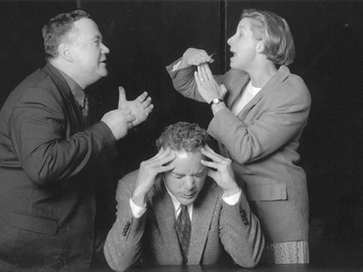
Bruce Tuckman theory

Slide 6
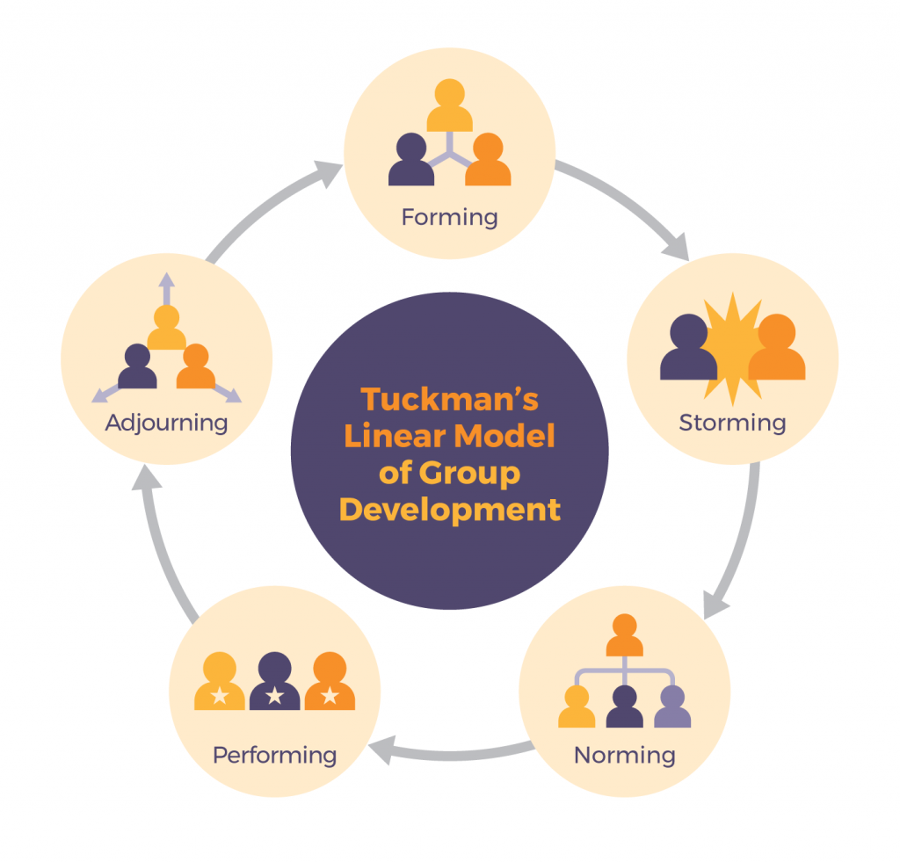

Slide 7
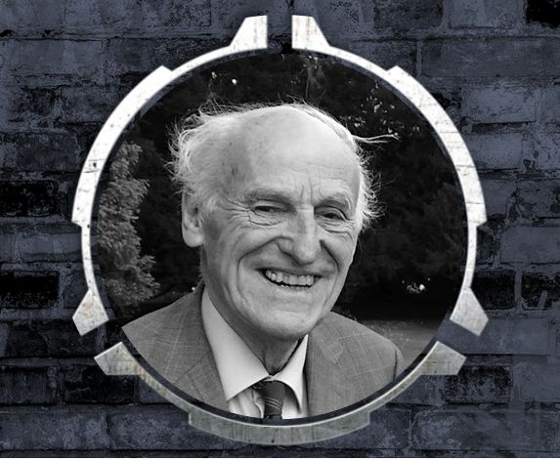
Meredith Belbin theory

Slide 8
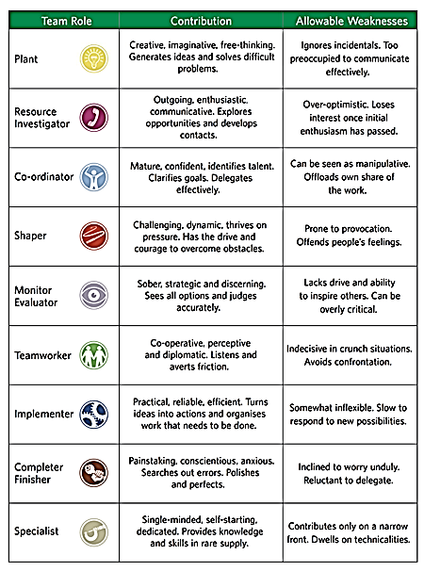

Slide 9
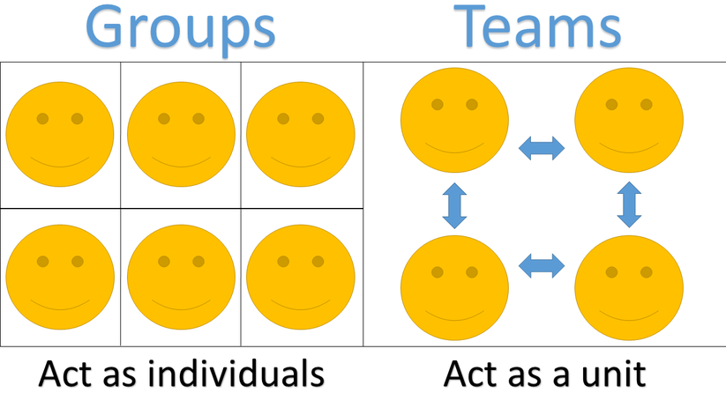
Groups vs Teams

Slide 10

Teamwork and the Importance of Trust

Slide 11
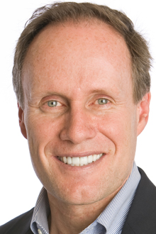
Stephen M.R. Covey describes 13 behaviours to create trust as part of his book ‘The Speed Of Trust’.
Talk straight
Demonstrate respect
Create transparency
Show loyalty
Right wrongs
Deliver results
Get Better
Confront Reality;
Clarify expectations
Practice Accountability
Listen first
Keep commitments
Extend trust

Slide 12
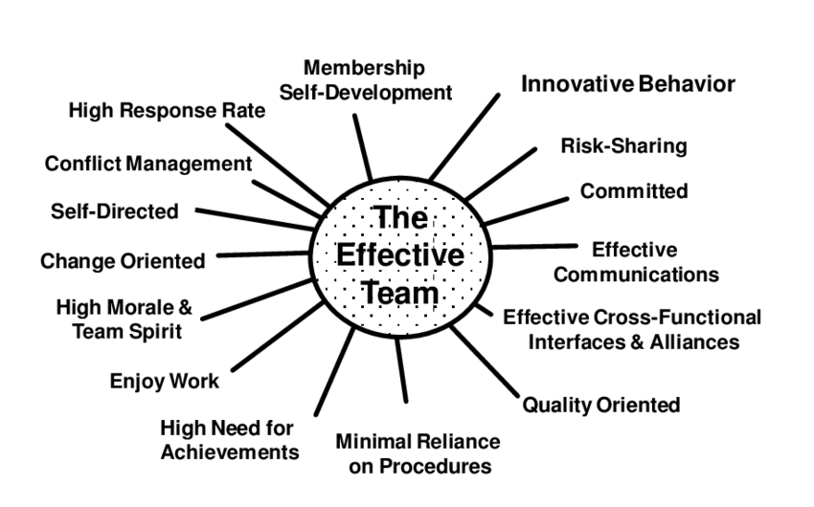
Characteristics of Effective Team in the Workplace

Slide 13

the good & the bad
Workplace examples
Don’t be negative, be positive
Be on time
Don't Gossip
Be a Problem Solver
Be Dependable
Help when someone is off work by taking the shift
Allow Extra Time for Everything
Be Prepared to Not Know Everything
Put Your Phone Away While at Work
Dress smart
Always have a smile
Ask for Help if you need and give if you are being asked
Always Do Your Best
Be Kind
Don’t say "It's Not My Job“
Look at Problems as Opportunities
Keep Personal Problems Out of the Workplace
Ask Questions
Learn the Policies
Don't Be Afraid to Say "I Don't Know"
Be Organized
Always have a smile

Slide 14

Any questions?

Slide 15
References
AMANDA S. MARCY, CPA; DOUGLAS M. BOYLE, DBA, CMA, CPA; JAMES F. BOYLE, DBA, CPA; AND DANIEL P. MAHONEY, PH.D., CPA, CFE (March ,2020) THE VALUE OF TRUST. [online] Available at: https://sfmagazine.com/post-entry/march-2020-the-value-of-trust/ (Accessed: 15 September 2021).
Ambrose,T.( August,2015) 4 Goals for Any Speech, Pitch or Presentation. [online] Available at: https://www.linkedin.com/pulse/4-goals-any-speech-pitch-presentation-trevor-ambrose (Accessed: 17 September 2021).
Ansary, A.S. (September ,2021) 25 Characteristics of Effective Team in the Workplace. [online] Available at: https://www.careercliff.com/characteristics-of-effective-team/ (Accessed: 25 September 2021).
Chapman, A. (February,2017) Bruce Tuckman's 1965 Team-Development Model. [online] Available at: https://www.businessballs.com/team-management/tuckman-forming-storming-norming-performing-model/ (Accessed: 17 September 2021).
Covey, S.M.R. 2006, “The speed of trust: the one thing that changes everything” Simon & Schuster, New York; London.
Dininni,J(September ,2010) Management Theory of Meredith Belbin. [online] Available at: https://www.business.com/articles/management-theory-of-meredith-belbin/ (Accessed: 15 September 2021).
Mindtools (2021) Tuckman's Model for Nurturing a Team to High Performance. [online] Available at: https://www.mindtools.com/pages/article/newLDR_86.htm (Accessed: 15 September 2021).
Pre Pearl training development (no year) Belbin Team Roles. [online] Available at: Belbin Team Roles - PrePearl Training Development(Accessed: 17 September 2021).
Tuckman, W. B. (1965) Development sequence in small groups. Psychological Bulletin, 63, pp. 384-99.[online]. https://web.mit.edu/curhan/www/docs/Articles/15341_Readings/Group_Dynamics/Tuckman_1965_Developmental_sequence_in_small_groups.pdf (Accessed: 25 September 2021).
UKEssays (November,2018) What is teamwork? [online] Available at: What is teamwork? (ukessays.com) (Accessed 17 September 2021)
Zambas, J. (June ,2018) 20 Bad Work Habits You Need to Eliminate from Your Life. [online] Available at: https://www.careeraddict.com/bad-work-habits (Accessed: 15 September 2021).

Slide 16
THE END

