Slide 1
Research & Development Methods
Research Philosophies, Strategies & Methodologies

Slide 2
What is research?
People undertake research in order to find things out in a systematic way, thereby increasing their knowledge (Jankowicz, 1995).
Hussey and Hussey (1997, p. 1) define research as ‘enquiry and investigation [that]…is systematic and methodical…[and] increases knowledge’.

Slide 3
What is a research methodology?
Research methodology refers to the step-by-step research process; the selection of the most efficient ways to collect, analyse and present data whilst maintaining academic rigour.
‘an operational framework within which the facts are placed so that their meaning may be seen more clearly’.
Leedy (1989, cited by Remenyi et al, 1998, p. 28)

Slide 4
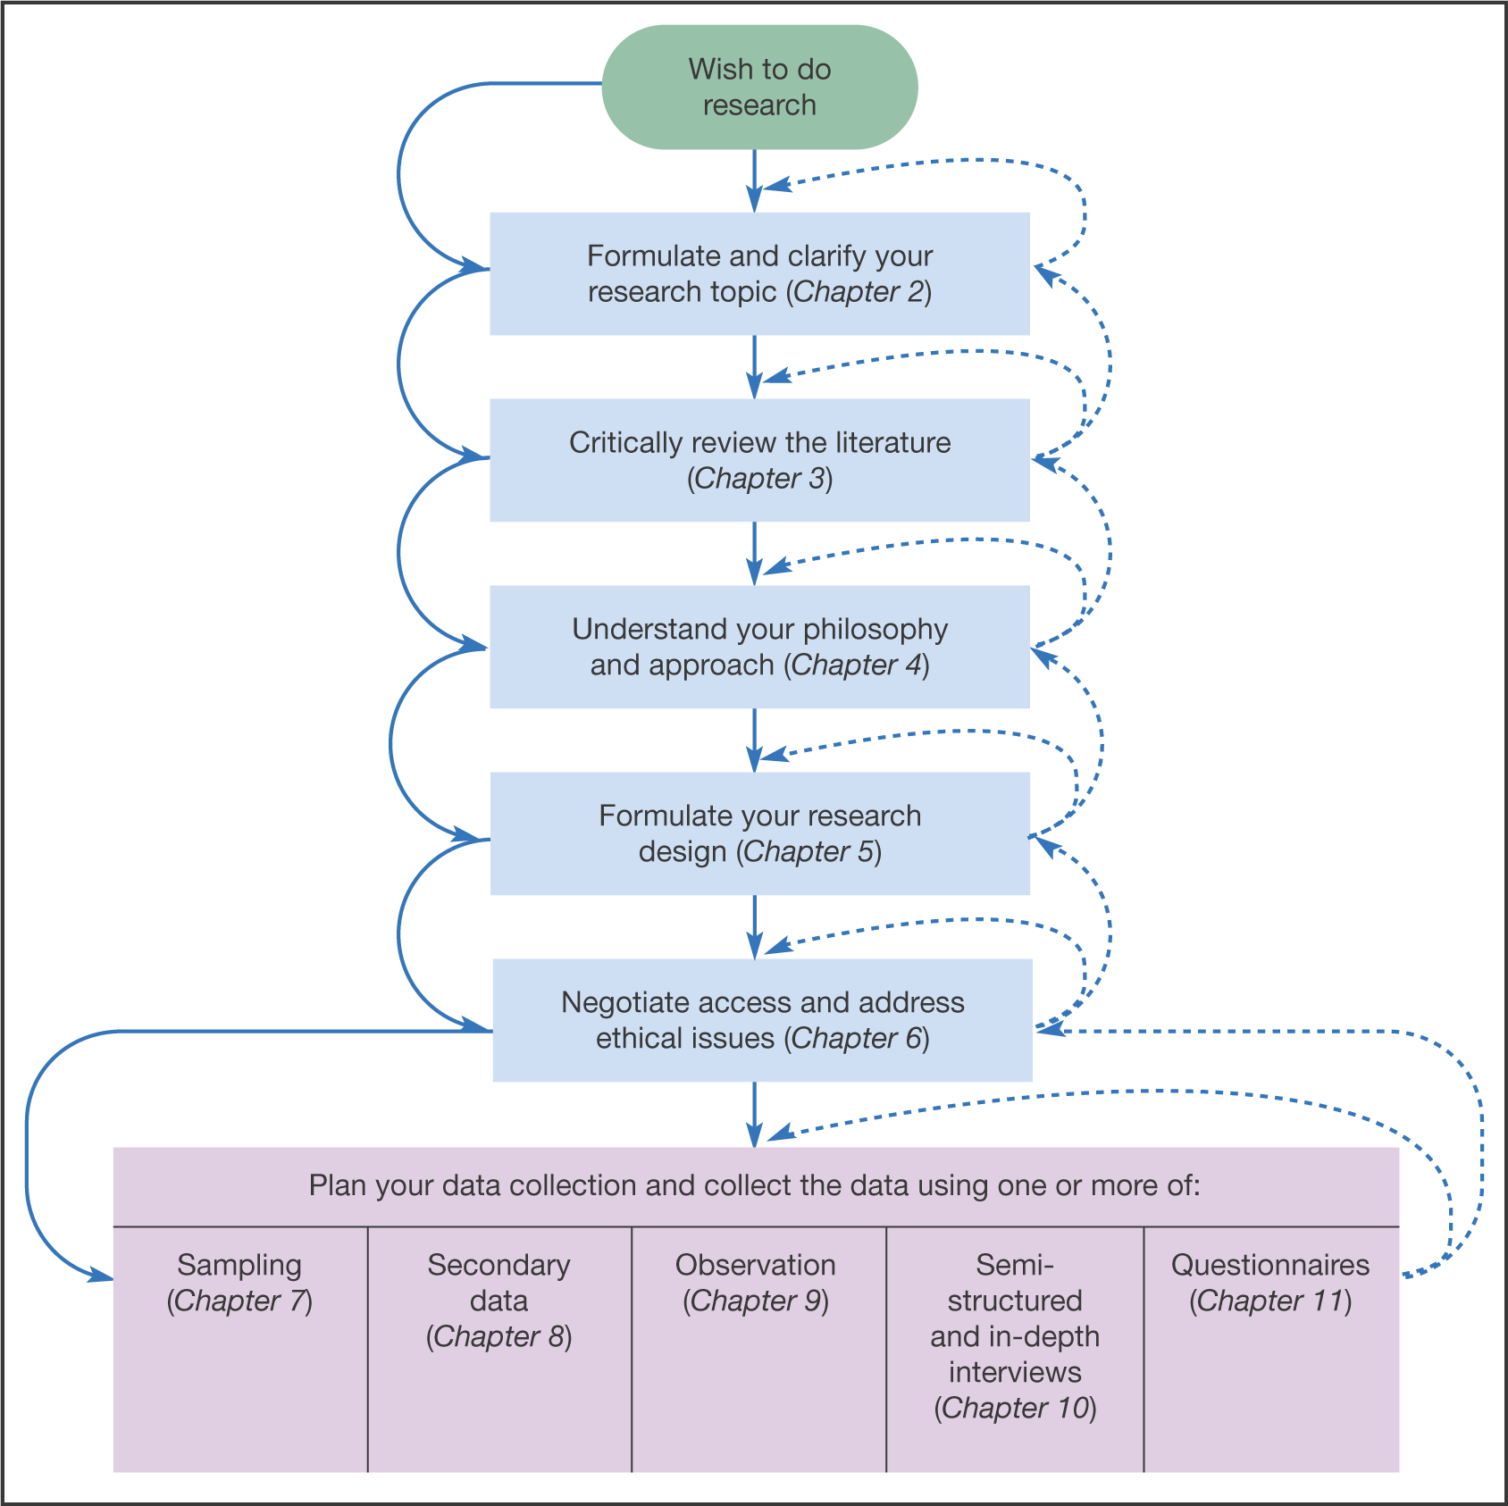
Figure 1 The research process
Source: © Saunders, Lewis and Thornhill, Research Methods in Business, 4th Edition © Pearson Education Limited 2007

Slide 5
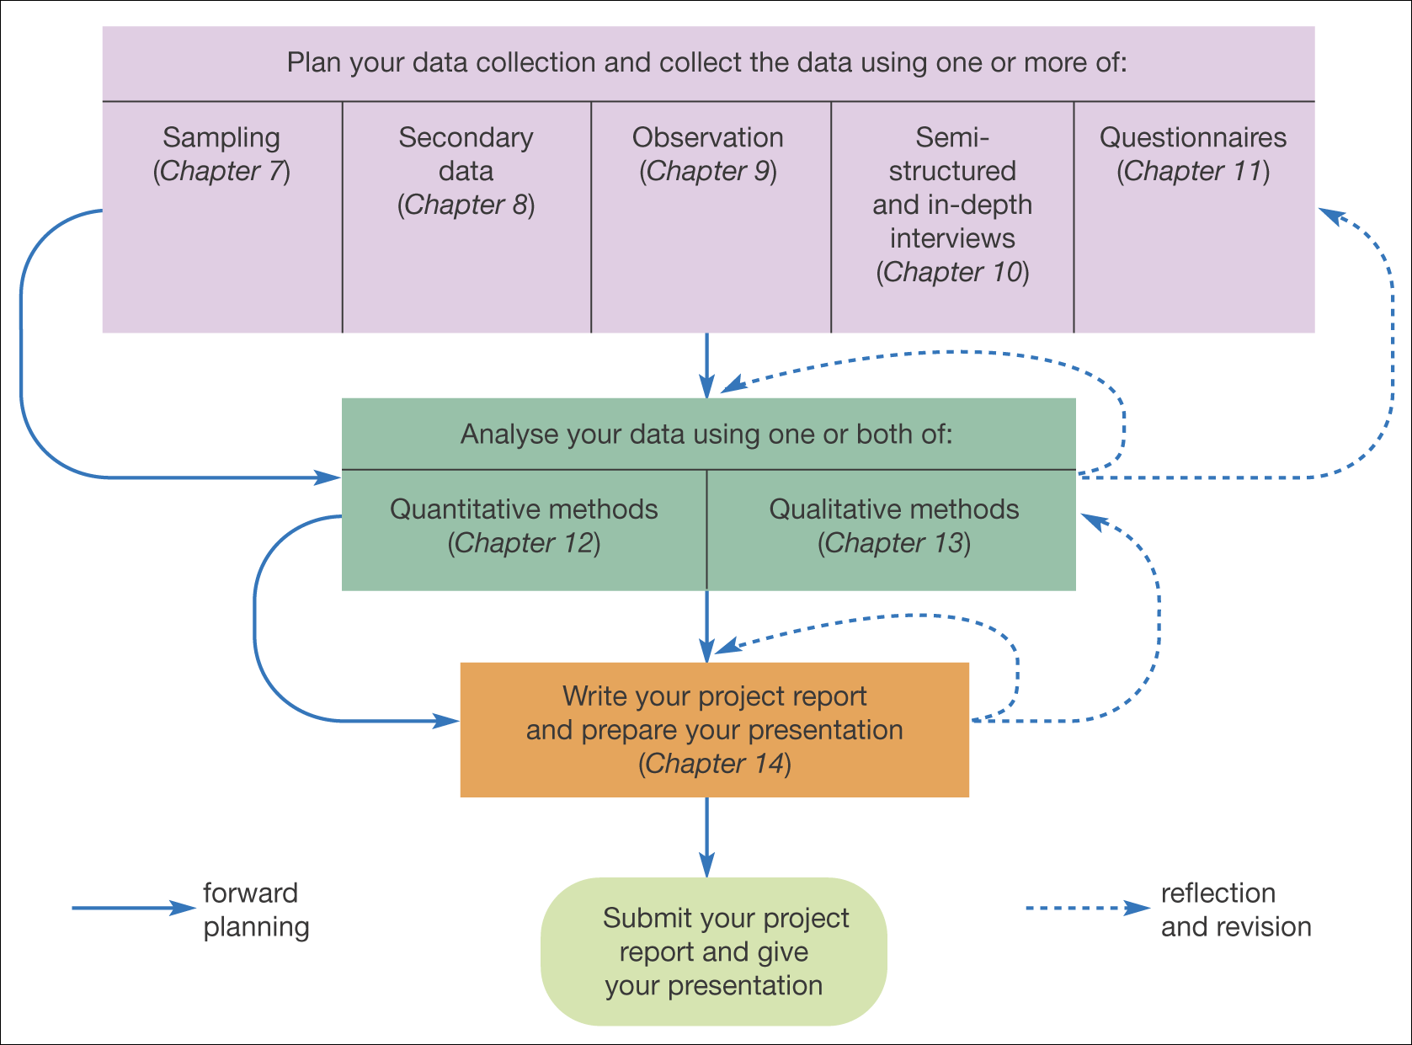
Figure 1 The research process (Continued)
Source: © Saunders, Lewis and Thornhill, Research Methods in Business, 4th Edition © Pearson Education Limited 2007

Slide 6
So research has a purpose…
There are three kinds of research purpose:
  Exploratory research is often undertaken in order to collect preliminary data to help clarify or identify a problem, rather than for generating problem solutions. The purpose is to make an initial assessment of the nature of a problem, so that more detailed research work can be planned appropriately.
  Descriptive research aims to provide the researcher with a better understanding of a particular issue or problem. For example, assessing the search behaviour of users of a particular website and the reasons behind the behaviour exhibited.
  Explanatory (causal or predictive) research seeks to establish cause and effect relationships. The emphasis here is on studying a situation or problem in order to explain the relationships between variables.

Slide 7
What is the difference between primary and secondary research?
Primary research (or field research) involves the collection of original (new) data by the researcher to address a specific problem.
Secondary research (or desk research) is based on data that has been collected by somebody else for some other purpose (and for this reason, it may not precisely meet the needs of the secondary user). However, it can help the researcher gain understanding of an issue, and formulate and generate ideas, which can later be refined by carrying out primary research.

Slide 8
What is the difference between quantitative and qualitative research?
Qualitative research involves the collection of (soft) data that are open to interpretation, for example, people’s opinions which cannot be generalised in numerical terms.
Quantitative research – research that produces statistics (hard data). This usually involves surveys of large numbers of respondents.

Slide 9
Credibility of research findings
Research findings must be credible. The three tests of credibility are
  Reliability
  Validity
  Generalisability

Slide 10
1. Reliability
Reliability is concerned with the findings of the research. If a research finding can be repeated (replicable), it is reliable.
Threats to reliability (Robson, 1993) include:
  Subject (respondent) error
  Subject (respondent) bias
  Observer (interviewer) error
  Observer (interviewer) bias

Slide 11
2. Validity
Validity is the extent to which the research findings accurately represent what is really happening in the situation. Research errors can undermine validity.
  Are you asking the right questions?
  Are you asking the right people?
  Are you measuring what you should be measuring?

Slide 12
3. Generalisability
Generalisability refers to the extent to which you can come to conclusions about one thing (often a population) based on information about another (often a sample).
Are your research results applicable in other settings/contexts? This is a particular worry if you are conducting case study research - is your organisation markedly different in some way?

Slide 13
Positivism
Philosophy
Deductive
Approach
Experiment
Strategy
Survey
Cross
sectional
Sampling
Questionnaires
Secondary data
Observations
Interviews
Document
Analysis
Case
Study
Longitudinal
Action Research
Inductive
Time horizon
Phenomenographical
Data collection method
The research ‘onion’
Based upon Mark Saunders, Philip Lewis and Adrian Thornhill 2007

Slide 14
Research philosophies
(or paradigms, epistemology)
Epistemology, your research philosophy, depends on the way that you think about the development of knowledge
Epistemology asks the question ‘how do we know what we know?’ Two main research philosophies:
  Positivism
  Phenomenology

Slide 15
Positivism
Positivists believe that knowledge we may gain is based on the observation or experience of real phenomena in an objective and real world (Cornford and Smithson, 2006)
Positivism contends there are single true answers to questions, which can be found by carefully applying scientific procedures, such as experiments.

Slide 16
Positivism
‘The positivist approach seeks the facts or causes of social phenomena with little regard to the subjective state. Thus logical reasoning is applied to the research so that precision, objectivity and rigour replace hunches, experience and intuition as a means of investigating the research problem.’ (Collis & Hussey, 2003, p. 52)
This view has come under considerable criticism in recent years from researchers who argue that research is heavily influenced by a person’s world-view or perception.

Slide 17
Phenomenology/Phenomenography
‘The phenomenological paradigm is concerned with understanding human behaviour. This approach stresses the subjective aspects of human activity by focusing on the meaning, rather than measurement of social phenomena.’ (Collis and Hussey, 2003, p. 53)
Reality is socially constructed, based on participants’ perceptions, and needs to be ‘understood’ rather than trying to generate ‘facts’ (Saunders et al, 2007)
We all see the world through our own ‘conceptual goggles’, so rather than attempting to find single true answers to our focus questions, we are attempting to build knowledge from event(s) and/or object(s), based upon the world as we see it.

Slide 18
Alternative terms for the main research paradigms
Positivistic | Phenomenological
Quantitative Objectivist Scientific Experimentalist Traditionalist | Qualitative Subjectivist Humanistic Interpretivist

Slide 19
Features of the main research paradigms
Positivistic | Phenomenological
Tends to produce quantitative data Uses large samples Concerned with testing theory (deductive approach) Data is highly specific & precise The location is artificial Reliability is high Validity is low Generalises from sample to population | Tends to produce qualitative data Uses small samples Concerned with generating theory (inductive approach) Data is rich and subjective The location is natural Reliability is low Validity is high Generalises from one setting to another

Slide 20
Some associated methods of the main paradigms
Positivistic | Phenomenological
Structured questionnaire surveys Structured interview surveys Experiments Cross-sectional studies Longitudinal studies | Action research Case studies Ethnography Content analysis Unstructured interviews Focus groups

Slide 21
Positivism
Philosophy
Deductive
Approach
Experiment
Strategy
Survey
Cross
sectional
Sampling
Questionnaires
Secondary data
Observations
Interviews
Document
Analysis
Case
Study
Longitudinal
Action Research
Inductive
Time horizon
Phenomenographical
Data collection method
The research ‘onion’
Based upon Mark Saunders, Philip Lewis and Adrian Thornhill 2007

Slide 22
Research approaches
Two major types:
  Deductive research (linked to positivism)
  Inductive research (linked to phenomenology)
Relates to the extent to which you are clear about the ‘theory’ at the beginning of your research

Slide 23
The deductive approach
The deductive approach aims to test theory
This involves developing a theory and hypothesis, and designing a research strategy to test that hypothesis
The outcome will be a confirmation or modification of the theory

Slide 24
Deduction emphasises…
Scientific principles
Moving from theory to data
The need to explain causal relationships between variables
The collection of quantitative data
A highly structured approach
Researcher independence of what is being researched
Large sample size to allow generalisations

Slide 25
The inductive approach
The inductive approach aims to build theory
This involves collecting data, analysing it, then developing theory
The outcome will be to add to the body of knowledge in that area

Slide 26
Induction emphasises…
Gaining an understanding of the meanings humans attach to events
A close understanding of the research context
The collection of qualitative data
A more flexible structure to permit changes of research emphasis as the research progresses
A realisation that the researcher is part of the research process
Less concern with the need to generalise

Slide 27
Which is best?
Deduction:
  Is suitable when your research topic has a wealth of literature from which you can define a theoretical framework and a hypothesis
  Is quicker, often based on ‘one take’
Induction:
  Is suitable when the topic is new, has much debate and/or there is little existing literature
  Takes longer to gather the data

Slide 28
Positivism
Philosophy
Deductive
Approach
Experiment
Strategy
Survey
Cross
sectional
Sampling
Questionnaires
Secondary data
Observations
Interviews
Document
Analysis
Case
Study
Longitudinal
Action Research
Inductive
Time horizon
Phenomenographical
Data collection method
The research ‘onion’
Based upon Mark Saunders, Philip Lewis and Adrian Thornhill 2007

Slide 29
Research strategy
Your research strategy is the general plan of how you will go about achieving your research objectives (you will specify the specific tactics of data collection later)
The research strategy is determined by four key issues:
  Research questions/objectives;
  Costs or budget available to the researcher;
  Time available and target date for completion;
  Skills of the researcher.
You must have valid reasons for all your research strategy decisions. The justification should be based primarily on your research objectives (what suits best).

Slide 30
Research strategy
There are a number of alternative strategies or approaches available to the researcher, including:
  Experiment
  Survey
  Case study
  Document review/content analysis
  Action research

Slide 31
1. Experiments
Experimentation sets out to examine the relationship between two factors (or variables) by manipulating one whilst measuring changes in the other.
  For instance, we may test out three different e-commerce website designs and measure the effect on usability.
Experiments are used to determine if a causal relationship exists - in other words, if the alteration of one variable ‘causes’ a change in another.

Slide 32
1. Experiments – the hypothesis
Some of the main terminology used in experimentation:
Hypothesis – this is the ‘big question’ that your study is aimed at answering. For instance, does the design of a website affect whether customers will use the site?
This must be expressed in a form that can be tested, e.g. ‘websites that do not incorporate frames have higher customer usage than websites using frames'.

Slide 33
1. Experimental variables
Variables – these are the factors under investigation. For instance, website usage and website design using frames.
  Independent variable – this is the name for the variable(s) we are manipulating or altering.
    In the example given, this would be website frames, (but we might also change fonts, background colour, font colour, hyperlinks, number of pages, etc. - these would also be independent variables) and then measure the effect on website use.
  Dependent variable – this is the name for the variable(s) we are measuring.
    In the example given, this would be website use (but we might also want to measure customer feelings towards the new design and other aspects of their purchase behaviour as a result of changing the website design – these would also be dependent variables).

Slide 34
1. Experiments: Causation
In order to demonstrate causation, it is necessary to show three things:
  That there is a relationship between two variables, i.e. that changing the independent variable causes a change in the dependent variable.
  That any changes in the DV happen after changes in the IV
  That any changes were not due to some external factor

Slide 35
1. Experiments: Causation (cont.)
Where there is a relationship between two variables:
  A positive correlation means that high values of one variable are associated with high values in the other.
  A negative correlation means that high values of one variable are associated with low values in the other.
  If there is no correlation between two variables they are said to be uncorrelated.
Correlation does not guarantee causation!

Slide 36
2. Surveys
…’the collection of a large amount of data from a sizable population in a highly economical way’
Saunders et al (2007)
Usually undertaken via questionnaires or interviews

Slide 37
2. Surveys
The survey method of obtaining information is based on the questioning of respondents.
Respondents are asked a variety of questions regarding their computer use, behaviour, intentions, attitudes, demographic and lifestyle characteristics, etc.
These questions may be asked verbally, in writing or via computer, and the responses may be obtained in any of these forms.
However, all involve designing an appropriate questionnaire/schedule of structured interview questions.

Slide 38
2. Surveys: Methods
Survey questionnaires may be administered in four major modes:
  Personal (face-to-face) interviewing (at work, in-street, in-home, etc).
  Postal interviewing (i.e. distributed without personal contact)
  Telephone interviewing (traditional and computer-assisted)
  Electronic interviewing (via CAPI, the internet and e-mail)

Slide 39
2. Surveys: Characteristics
Standardised questions
Mass audience (broad sweep rather than depth)
Usually cross-sectional (snapshot in time)
Large amounts of quantitative data
Economical and relatively quick
Tends to answer ‘what’ and ‘how’ questions
May generalise from sample to population
Statistical validity/significance requires a large sample
Linked to positivism

Slide 40
2. Surveys: Reliability & Validity
Surveys are very structured so are highly replicable - therefore they are usually highly reliable.
However, they may be low in validity so you must ensure that the questions are derived from the expert literature and have been piloted.

Slide 41
3. Case studies
A case study is an extensive examination of a single instance of a phenomenon of interest and is an example of a phenomenological methodology.
The importance of the context is essential and Eisenhardt (1989, p.534 cited by Collis & Hussey, 2003) refers to the case study as: ‘a research study which focuses on understanding the dynamics present within a single setting’.
Thus, a case study approach implies a single unit of analysis, such as a company or a group of workers, an event, a technology, a process or even an individual.

Slide 42
3. Case studies: Characteristics
The research aims to understand phenomena within a particular context
It uses multiple methods for collecting data which may be both qualitative and quantitative (e.g. interviews, questionnaires, documentary analysis), often over a long period of time, with a view to obtaining in-depth knowledge
Allows us to explore in detail why something has happened.
Low reliability (unlikely to be repeatable but might allow similar observations to be made).
High validity (captures the essence of the phenomenon, data is rich in its explanation and analysis)

Slide 43
3. Case studies: Weaknesses
Access to a suitable organisation is often difficult to negotiate
Can be very time consuming
It is difficult to decide where to place the boundaries of the study (delimitation)
Organisations have a history & a future which influences the understanding of the present. It may be difficult to understand the events in a particular period of time without knowledge of what went before and what may follow.

Slide 44
4. Document review / content analysis
Content analysis enables the researcher to evaluate large amounts of textual information and systematically identify its properties, e.g. the frequencies of most used keywords.
This textual information must be categorised according to a theoretical framework, which will inform the data analysis, providing at the end a meaningful reading of content under scrutiny.

Slide 45
4. Document review / content analysis
It is generally viewed as a positivist method.
  Quantitative content analysis starts with word frequencies, space measurements (column centimeters/inches in the case of newspapers), time counts (for radio and television time) and keyword frequencies.
  Qualitatively, content analysis can involve any kind of analysis where communication content (speech, written text, interviews, images ...) is categorized and classified.
While methods in quantitative content analysis in this way transform observations of found categories into quantitative statistical data, the qualitative content analysis focuses more on the intentionality and its implications.

Slide 46
5. Action research (cont.)
Action research can take place when the researcher actively promotes change (e.g. within an organisation). It commonly involves:
  taking a static picture of a situation;
  making some change (e.g. the introduction of a new computer system in an organisation);
  taking and evaluating a second picture of the situation (monitoring the results of the change).
The researcher is not just an observer, but is an active participant in the action for change. The co-operation of others (e.g. company personnel, users, etc.) will be crucial to the success of this strategy.
While the results of the action research should inform other contexts (have implications beyond the immediate project), it is unlikely that this strategy will be replicable.

Slide 47
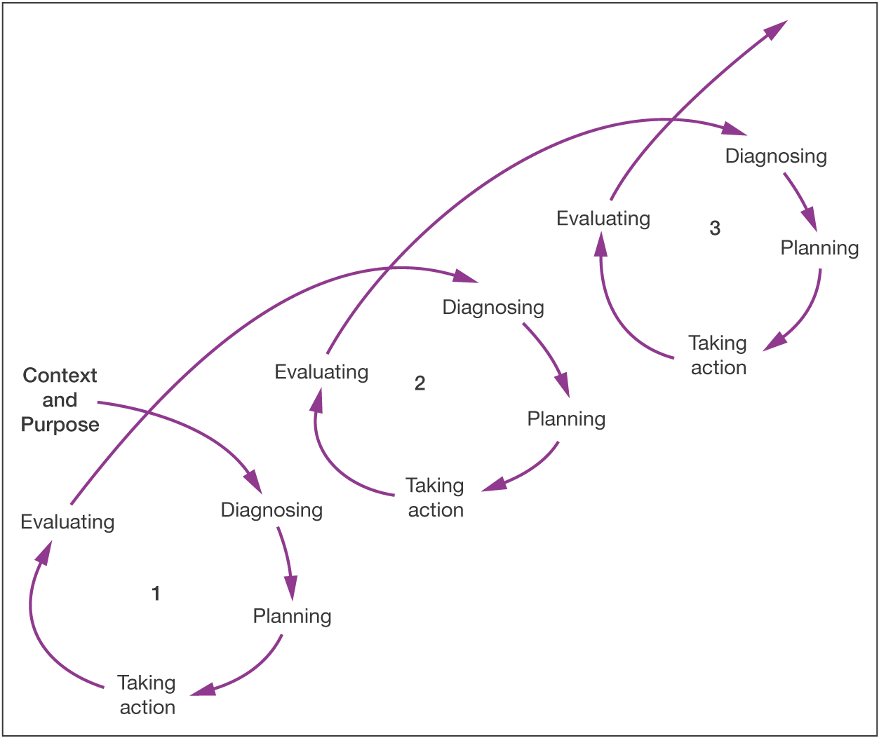
The action research spiral
Source: © Mark Saunders, Philip Lewis and Adrian Thornhill 2007

Slide 48
Using multiple data collection methods
It is acceptable to use more than one research method
Different methods for different purposes (e.g. interviews to get a feel for the issues, then questionnaires to address the important issues – or vice versa)
Enables triangulation to take place (the use of different data collection methods in a study to evaluate the extent to which findings are consistent, may be trusted and inferences made).

Slide 49
Positivism
Philosophy
Deductive
Approach
Experiment
Strategy
Survey
Cross
sectional
Sampling
Questionnaires
Secondary data
Observations
Interviews
Document
Analysis
Case
Study
Longitudinal
Action Research
Inductive
Time horizon
Phenomenographical
Data collection method
The research ‘onion’
Based upon Mark Saunders, Philip Lewis and Adrian Thornhill 2007

Slide 50
Time horizon: Longitudinal versus cross-sectional research
Longitudinal research extends over a substantial period of time and involves studying changes over time.
Cross-sectional research takes a 'snapshot' of a situation in time.

Slide 51
Writing this up
When writing the proposal document you do NOT need to write a long essay on the different philosophies, strategies and methodologies available to you
You should instead state for each layer of the research onion:
  Which philosophy/strategy/method you have chosen
  Why you have chosen it
  Any advantages it has, and how you plan to use these
  Any disadvantages it has, and how you plan to work around these

Slide 52
Coming Soon…
Next session: Aims, Objectives and the Literature Review
Homework:

