Slide 1
PRACTICE-BASED RESEARCH
Sampling Strategies & Techniques
Created by: Dr Aishat Bakre
Modified by: Dr Zeno Leung

Slide 2
Aims of the Session
To understand
Explain sampling strategies
Importance of sampling
Types of Sampling with examples

Slide 3
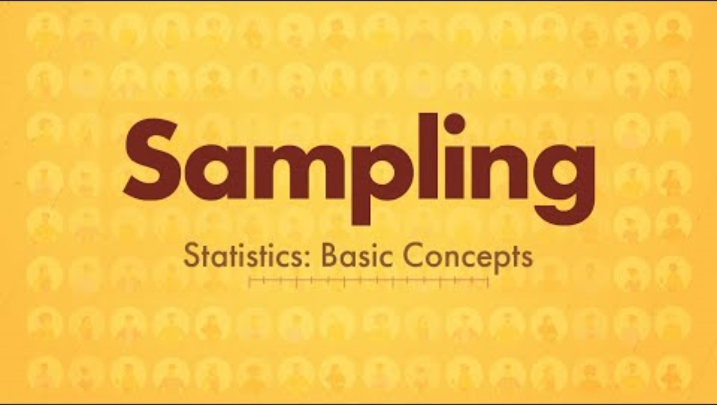
What is Sampling?
A statistical technique in which we represent the whole by just looking at a smaller part of it (i.e. sample)
In a research, sample is the group of individuals (subjects) who actually participate
Representativeness

Slide 4
Population vs sample
A population is the entire group that you want to draw conclusions about.
A sample is the specific group that you will collect data from.
The size of the sample is always less than the total size of the population.

Slide 5
Population
In research, a population doesn’t always refer to people.
always relates to your area of study and research focus; such as objects, events, organizations, countries, species, organisms, etc.
can be very broad or narrow, and defined in terms of geographical location, age, income, and many other characteristics

Slide 6
It is important to carefully define your target population according to the purpose and practicalities of your project.
If the population is very large, demographically mixed, and geographically dispersed, it might be difficult to gain access to a representative sample.

Slide 7

Why are Samples used in research?

Slide 8
Why using sample?
Samples are used to make inferences about populations.
Samples are easier to collect data from because they are practical, cost-effective, convenient and manageable, but
if the sample is not representative of the population, any findings or conclusions drawn from the data may be flawed or entirely misleading.

Slide 9
Key Considerations in Sampling
The key things to consider when deciding the population sample include
What is the target population?
What is the sampling frame?
What is the appropriate sampling method?
What size of sample is needed?

Slide 10
What is a Sampling frame?

Slide 11
Sampling frame
The sampling frame is the actual list of individuals that the sample will be drawn from.
Ideally, it should include the entire target population (and nobody who is not part of that population).

Slide 12
Examples
Research topic: Working conditions at Company X.
Population: all the 1000 employees of the company.
Sampling frame: using records in the company’s HR database
Research topic:UK people’s views on the NHS.
Population: UK residents aged 16 or above.
Sampling frame: using UK mobile numbers

Slide 13
Sample size
Sample size refers to the number of participants or observations included in a study.
This number is usually represented by n.
and N to represent the population.
Notes:
https://www.iwh.on.ca/what-researchers-mean-by/sample-size-and-power

Slide 14
Sample size
The number of individuals you should include in your sample depends on various factors, including the size and variability of the population and your research design.
There are different sample size calculators and formulas depending on what you want to achieve with statistical analysis.

Slide 15
Example of sample size calculator: https://www.calculator.net/sample-size-calculator.html
If we sample mean score of 100 with a confidence level of 95% and margin of error 5%, that means
We are 95% confidence that the true score of the population lie between 95 and 105 (i.e. 100 ± 5%)

Slide 16
Sampling strategy/technique

Slide 17
Sampling Strategy
You have to carefully decide how you will select a sample that is representative of the group as a whole,
so as to draw valid conclusions from your results.
You should clearly explain how your sample was selected in the methodology section

Slide 18

Participants and Sampling
Target Pop.
(N)
Sample (n)
Notes:
Earliest recorded example of random group allocation as recent as 1928 (Forsetlund et al. 2007)

Slide 19
Types of sampling strategy/methods
Probability sampling
Non-probability sampling

Slide 20
Probability sampling methods
Probability sampling means that every member of the population has a chance of being selected.
Often used in quantitative research.
Involves random selection, produces results that are representative of the whole population, allowing you to make strong statistical inferences, and thus the most valid choice.

Slide 21
Four types of probability sampling
Simple random sampling
Systematic sampling
Stratified sampling
Cluster sampling

Slide 22
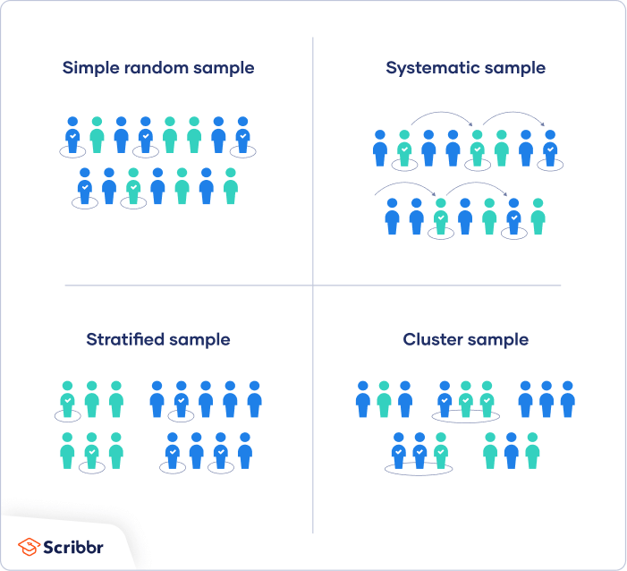
Four main types of probability sample

Slide 23
Simple random sampling
In a simple random sample, every member of the population has an equal chance of being selected.
Your sampling frame should include the whole population.
To conduct this type of sampling, you can use tools like random number generators or other techniques that are based entirely on chance.

Slide 24
Example
You want to select a simple random sample of 100 employees of Company X.
You assign a number to every employee in the company database from 1 to 1000, and use a random number generator to select 100 numbers.

Slide 25
Systematic sampling
Systematic sampling is similar to simple random sampling, but it is usually slightly easier to conduct.
Every member of the population is listed with a number, but instead of randomly generating numbers, individuals are chosen at regular intervals

Slide 26
Example
All employees of the company are listed in alphabetical order.
From the first 10 numbers, you randomly select a starting point: number 6. From number 6 onwards, every 10th person on the list is selected (6, 16, 26, 36, and so on), and you end up with a sample of 100 people.

Slide 27
Stratified sampling
Stratified sampling involves dividing the population into subpopulations that may differ in important ways.
It allows you draw more precise conclusions by ensuring that every subgroup is properly represented in the sample.

Slide 28
Stratified sampling
To use this sampling method, you divide the population into subgroups (called strata) based on the relevant characteristic (e.g. gender, age range, income bracket, job role).
Based on the overall proportions of the population, you calculate how many people should be sampled from each subgroup.
Then you use random or systematic sampling to select a sample from each subgroup.

Slide 29
Example
The company has 800 female employees and 200 male employees.
You want to ensure that the sample reflects the gender balance of the company, so you sort the population into two strata based on gender.
Then you use random sampling on each group, selecting 80 women and 20 men, which gives you a representative sample of 100 people.

Slide 30
Cluster sampling
Cluster sampling also involves dividing the population into subgroups, but each subgroup should have similar characteristics to the whole sample.
Instead of sampling individuals from each subgroup, you randomly select entire subgroups.

Slide 31
Multistage sampling
If it is practically possible, you might include every individual from each sampled cluster.
If the clusters themselves are large, you can also sample individuals from within each cluster using one of the techniques above.

Slide 32
Multistage sampling
This method is good for dealing with large and dispersed populations, but there is more risk of error in the sample, as there could be substantial differences between clusters.
It is difficult to guarantee that the sampled clusters are really representative of the whole population.

Slide 33
Example
The company has offices in 10 cities across the country (all with roughly the same number of employees in similar roles).
You don’t have the capacity to travel to every office to collect your data, so you use random sampling to select 3 offices – these are your clusters.

Slide 34
Non-probability sampling methods
In a non-probability sample, individuals are selected based on non-random criteria, and not every individual has a chance of being included.
This type of sample is easier and cheaper to access, but it has a higher risk of sampling bias. That means the inferences you can make about the population are weaker than with probability samples, and your conclusions may be more limited.
If you use a non-probability sample, you should still aim to make it as representative of the population as possible.

Slide 35
Non-probability sampling methods
Alternative / compromise when probability sampling is not achievable
Also often used in exploratory and qualitative research
In these latter types of research, the aim is not to test a hypothesis about a broad population, but to develop an initial and/or in-depth understanding of a small or under-researched population

Slide 36
Four types of non-probability sampling
Convenience sampling
Voluntary response sampling
Purposive sampling
Snowball sampling

Slide 37
Convenience sampling
A convenience sample simply includes the individuals who happen to be most accessible to the researcher.
This is an easy and inexpensive way to gather initial data, but there is no way to tell if the sample is representative of the population, so it can’t produce generalizable results

Slide 38
Example
You are researching opinions about student support services in your university, so after each of your classes, you ask your fellow students to complete a survey on the topic.
This is a convenient way to gather data, but as you only surveyed students taking the same classes as you at the same level, the sample is not representative of all the students at your university.

Slide 39
Voluntary response sampling
Similar to a convenience sample, a voluntary response sample is mainly based on ease of access. Instead of the researcher choosing participants and directly contacting them, people volunteer themselves (e.g. by responding to a public online survey).
Voluntary response samples are always at least somewhat biased, as some people will inherently be more likely to volunteer than others.

Slide 40
Example
You send out the survey to all students at your university and a lot of students decide to complete it.
This can certainly give you some insight into the topic, but the people who responded are more likely to be those who have strong opinions about the student support services, so you can’t be sure that their opinions are representative of all students.

Slide 41
Purposive sampling
This type of sampling, also known as judgement sampling, involves the researcher using their expertise to select a sample that is most useful to the purposes of the research.
It is often used in qualitative research, where the researcher wants to gain detailed knowledge about a specific phenomenon rather than make statistical inferences, or where the population is very small and specific.
An effective purposive sample must have clear criteria and rationale for inclusion.

Slide 42
Example
You want to know more about the opinions and experiences of disabled students at your university,
so you purposefully select a number of students with different support needs in order to gather a varied range of data on their experiences with student services.

Slide 43
Snowball sampling
If the population is hard to access, snowball sampling can be used to recruit participants via other participants.
The number of people you have access to “snowballs” as you get in contact with more people.

Slide 44
Example
You are researching experiences of homelessness in your city.
Since there is no list of all homeless people in the city, probability sampling isn’t possible.
You meet one person who agrees to participate in the research, and she puts you in contact with other homeless people that she knows in the area.

Slide 45

Watch this at home
Notes:
Research Design: Defining your Population and Sampling Strategy | Scribbr 🎓 - YouTube

Slide 46
Summary
Sampling Techniques
Nonprobability
Sampling Techniques
Probability
Sampling Techniques
Convenience
Sampling
Judgement
Sampling
Quota
Sampling
Snowball
Sampling
Simple Random
Sampling
Systematic
Sampling
(interval)
Stratified
Sampling
(subgroups)
Cluster
Sampling

