Slide 1
Through examining both positive and negative aspects of labelling theory critically explore why society deems it necessary to use the following labels.
disability

Slide 2
Content page
What does disability mean?
What does Safeguarding mean?
SEN?
Social medical model
Labelling theory
Social exclusion
Medical model
Discrimination
Do you still like me photo?
Equality act 2010
Stereotyping within disability ?
Conclusion

Slide 3
what does disability mean?
The law basically states a person with a disability as having one of these:
Physical impairment - Moving, coordinate properly and physical performance
Mental impairment - Affects someone's intellectual capacity and brain
Having a long term effect upon their ability to complete things on a daily basis.
(CCBC, 2018)

Slide 4
What does Safeguarding mean?
Safeguarding means:
Protecting all children from any abuse or being mistreated
Preventing any harm that may happen to children’s health or their development
Having a safe provision for children to grow up in
Making sure all children have the best outcomes in life
(NSPCC,2018)

Slide 5

what does SEN?
SEN stands for special educational needs
Children or young people who have SEN have a learning difficulty or a disability
A child or young person who have SEN will have extra support in school to help them
(Gov, 2017 & Liphook Infant School 2015 )

Slide 6
Social medical model
Removes barriers in society for disabled people so they feel equal
Social medical model was then introduced due to the medical model not developing in inclusive living ways
Changing peoples attitudes towards disabled people
Making disabled people feel included in society
An example of a social medical model is a person who has some sort of learning difficulty and wants to become independent and live on their own without their parents but worries that they will not be able to afford bills and rent. Being under the social medical model the young person would then be supported in living in their home and will get money to help pay for rent and bills.
(Disability Nottinghamshire 2018)

Slide 7
Labelling theory
Labelling theory is describing someone in one word an example would be in someone commits a crime and breaks the law they would then be called a criminal. This is classed as labelling them because they are stating them as one word. Others will then copy them and become biased against because they have a label.
(Crossman,2017).

Slide 8
Social exclusion
People may feel socially excluded from society
People may take some form of Discrimination
Children may feel like they are not included in activities in school due to their disability and this can they make them really upset and play up
People may feel like they cannot do anything due to having a condition and may feel like they have to stay inside doors and not interact with others.
.
(Levitas 2015 & GSDRC 2015)

Slide 9
Medical model
Looks at people who are disabled because of their impairments
To see what is an offer for people who have impairments whether they are non-medical or medical
Looks at what the persons needs
It helps with people who are not independent get there independence back and helps them with making choices
It creates a barrier for people to help with feeling socially excluded.
(University of Leicester 2018).

Slide 10
Discrimination
There are two main types of discrimination:
Direct discrimination – when someone discriminates you in a nasty way by comments due to your race. An example would be
2. In-direct discrimination - when an organisation have a policy in work that stops individuals in getting a job.
An example would be if a beautician does not allow you to wear anything that covers your faces when working, this could affect a women muslins as that would be a disadvantage in applying for a job as they where them as part of their religion.
(Equality and human rights commission 2016)

Slide 11
Disability Discrimination
This happens when a disabled person is treated unfavourably which then puts them at some sort of disadvantage due to being disabled
Disability discrimination is slightly different from direct discrimination as the reason for treatment does not matter but whether the disabled person has been treated wrongly due to their disability.
(Equality and human rights commission 2016)

Slide 12
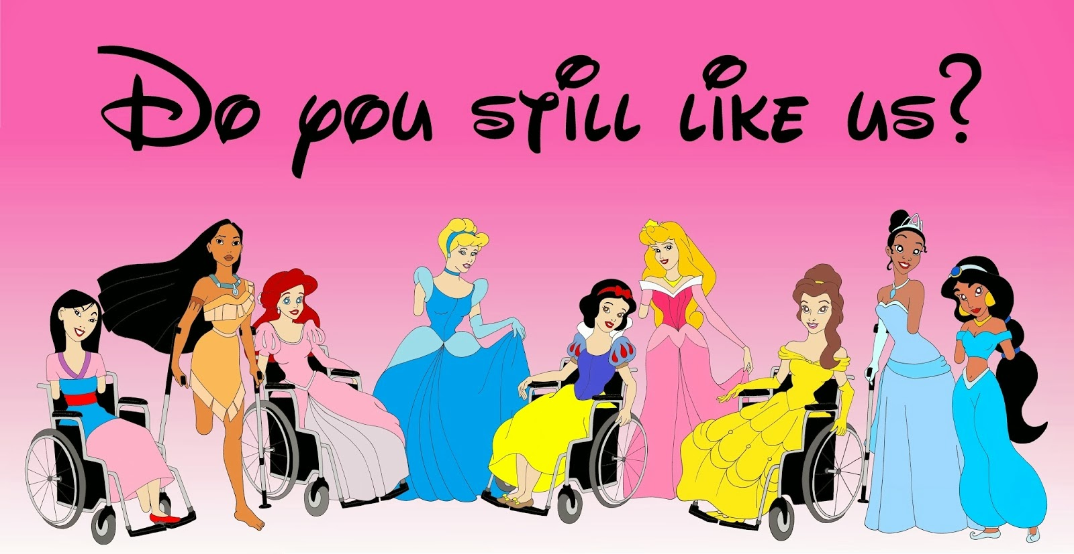
This is a good example on how people get should not be discriminated. As you can see in this picture they are ALL princess, just because some are in wheel chairs does not mean they do not have the potential to do the same tasks as the other princesses.
Baishya (2014)

Slide 13
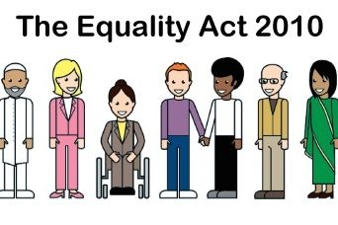
Equality act 2010
Protects people from discrimination in society and the work place
Everyone must follow the law and not treat someone in a horrible way, everyone must be treated equally
(Gov 2015 & church insights 2017).

Slide 14
Stereotyping within disability ?
Stereotyping is due to name calling, abuse and violence towards people
Attitudes towards groups and individuals
disabled are stereotyped in how they are limited to what they can do in life
Stating that something is true when it is not an example would be people who have a disability can not work and wont work then get all the benefits. This is not true. Most people who have disability can work with help or without help.
(Momene 2015)

Slide 15
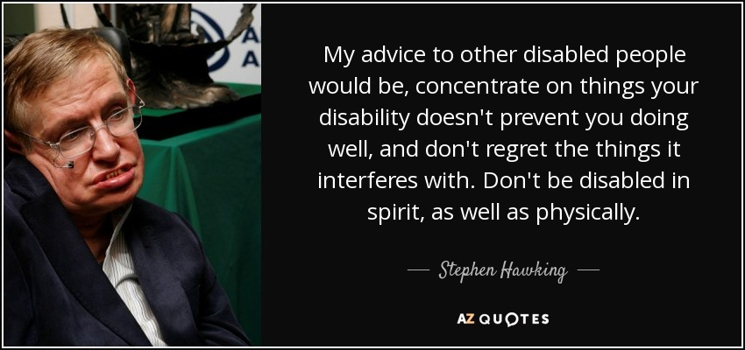
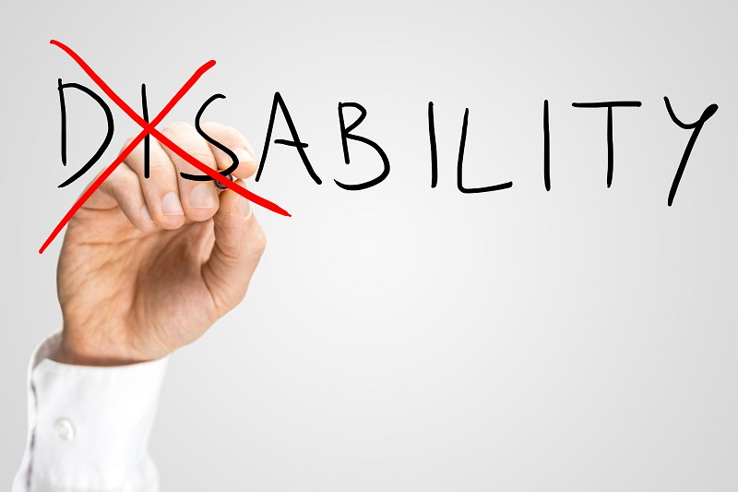
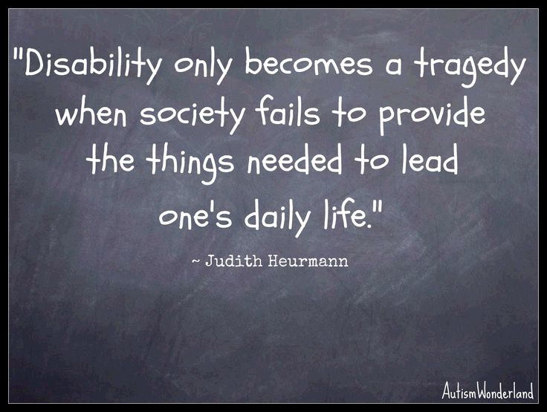
(Hawking, 2016 & Gooogle images n.d & Heurmann n.d )

Slide 16
References
  CCBC (2018) What does being disabled mean? Available at: http://news.bbc.co.uk/cbbcnews/hi/find_out/guides/uk/disability/newsid_3672000/3672642.stm accessed on 10.1.18
  NSPCC (2018) What is safeguarding? Available at: https://www.nspcc.org.uk/preventing-abuse/safeguarding/ accessed on 10.1.18
  Disability Nottinghamshire (2018) The Social Model vs The Medical Model of Disability, Available at: http://www.disabilitynottinghamshire.org.uk/about/social-model-vs-medical-model-of-disability/ [Accessed on 10.1.18]
  GSDRC (2015), Causes and forms of social exclusion available at: http://www.gsdrc.org/topic-guides/social-exclusion/causes/causes-and-forms-of-social-exclusion/ [accessed on 10.1.18]
  Lavitas R (2017), Defining and measuring social exclusion available at http://www.radstats.org.uk/no071/article2.htm [accessed on 10.1. 18]
  University of Leicester (2018) The social and medical model of disability, available at: https://www2.le.ac.uk/offices/accessability/staff/accessabilitytutors/information-for-accessability-tutors/the-social-and-medical-model-of-disability [Accessed on 10.1.18]

Slide 17
7. Equality and human rights commission (2016) What is discrimination? Available at: https://www.equalityhumanrights.com/en/advice-and-guidance/what-discrimination accessed on 10.1.18
8. GOV (2015) Equality Act 2010: guidance at https://www.gov.uk/guidance/equality-act-2010-guidance accessed on 10.1.2018
9. Momene R (2015) NEGATIVE STEREOTYPES AND ATTITUDES LINKED TO DISABILITY available at: http://www.atlascorps.org/blog/negative-stereotypes-and-attitudes-linked-to-disability/ accessed on 10.1.18
10. Liphook Infant School (2015) sen photo available at: http://www.liphookinfantschool.co.uk/key_information/sen__special_educational_needs_/sen__special_educational_needs_.html accessed on 15.1.18
11. church insights (2017) equality photo available at: https://www.transformworkuk.org/Articles/248326/Transform_Work_UK/Old_Folders_and/Resources_Individuals/Workplace_Hot_Topics/Diversity_and_Equality/Equality_Act_2010.aspx accessed on 15.1.18
12. Baishya A (2014) Princess photo available at http://ctcs517.blogspot.co.uk/2014/02/against-grain-and-all-over-again.html accessed on 15.1.18
13. Hawkins S (2016) https://www.bing.com/images/search?view=detailV2&ccid=JiCYG7gM&id=9B271E2FB6E009FE9F1A3B3C3C30528918463668&thid=OIP.JiCYG7gMclL_pl5fVii7WwHaDf&q=quote+on+disabled+people&simid=607994984088014103&selectedIndex=13&ajaxhist=0 accessed on 16.1.18
14. Heurmann n.d google photo https://i.pinimg.com/736x/3a/e2/95/3ae2951b8dc7e485bab97b30b9b299ef--disability-quotes-disability-awareness.jpg accessed on 16.1.18

