Slide 1

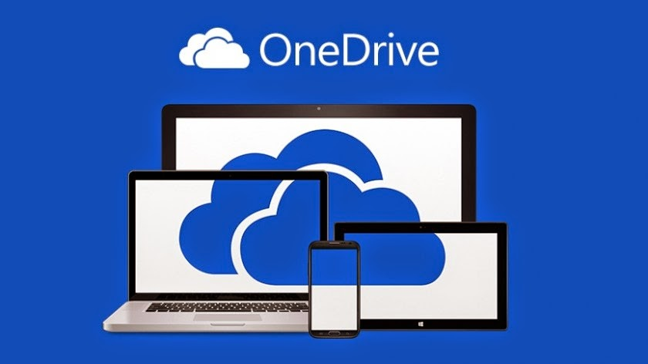
How to share a file through one drive.
By 2504532 Ashley Gelder.
ThePhoto by PhotoAuthor is licensed under CCYYSA.
In the sharing window, you’ll see options to set permissions. Click the Settings icon (represented by a gear symbol) to adjust access levels. You can choose whether the recipients can edit the file or view only.
If you're using the OneDrive mobile app on iOS or Android via your smartphone device, open the app and navigate to the file. Tap the three dots next to the file name, then select Share. You’ll be able to send the link directly via messaging apps, email, or other sharing options available on your device.
To share a file using OneDrive, begin by signing in. Visit www.onedrive.com or via your work or university app and log in using your Microsoft account credentials.
If OneDrive is synced to your PC, you can also share files directly from File Explorer. Right-click the synced file, choose Share, and follow the same steps to set permissions and send the link.
Once signed in, browse through your OneDrive folders to locate the specific file you want to share. When you find it, right-click on the file and select Share from the menu.
Additionally, you can also control who receives access either anyone with the link, specific people, or people within your organisation (For example, peers/lecturers).
Users may store and retrieve files and folders in the cloud with Microsoft OneDrive from any location. If you grant permission, you can also make the file available to others using the OneDrive app. People can share files or folders more easily as a result. (Prabhu S, 2022).
Reference list: Prabhu S, (2022) How to share OneDrive files or folders with others. Available at: https://thegeekpage.com/share_onedrive-files/ (Accessed on: 21st October 2025).

