Slide 1

Darrel Williams

Slide 2
Methodolegau Ymchwil Ansoddol a chynllun ymchwil
Qualitative Research Methodologies and research design
Cyflwyniad i rai o'r cysyniadau allweddol.
An introduction to some of the key concepts.

Slide 3
Beth yw ymchwil?/ What is research?
Ymholiad neu arholiad craff,
yn enwedig ymchwiliad beirniadol neu arbrawf
cael darganfod ffeithiau newydd i'w nod
a'u dehongliad cywir,
adolygu casgliadau a dderbyniwyd,
damcaniaethau neu ddeddfau yng ngoleuni ffeithiau newydd a ddarganfuwyd
neu gymhwyso casgliadau, damcaniaethau neu gyfreithiau o’r fath yn ymarferol’
‘A studious inquiry or examination,
especially a critical investigation or experimentation
having for its aim the discovery of new facts
and their correct interpretation,
the revision of accepted conclusions,
theories or laws in the light of new discovered facts
or the practical application of such conclusions, theories or laws’

Slide 4

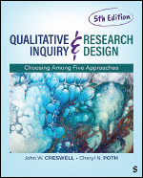
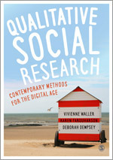

Slide 5
Strategaethau Dylunio Ansoddol Ymchwil Gymdeithasol/ Social Research Qualitative Design Strategies
Astudiaeth Achos
Ethnograffeg
Ffenomenoleg
Damcaniaeth Sylfaenol
Hanes Bywyd
Dulliau Hanesyddol
Ymchwil Clinigol
Ymchwil gweithredu ac ymchwil gymhwysol
Ymchwil cyfranogol
Case Study
Ethnography
Phenomenology
Grounded Theory
Life History
Historical Methods
Clinical Research
Action and applied research
Participatory research

Slide 6
Pam Ymchwil Gymdeithasol?/ Why Social Research?
Hysbysu Polisi?
Ogwydd gwleidyddol
Dod o hyd i Atebion i Broblemau Cymdeithasol
Archwiliwch y byd cymdeithasol
Dewch o hyd i rywbeth NEWYDD am gyd-destun sy'n bodoli
Gwella Arfer
Inform Policy?
Political slant
Find Solutions to Social Problems
Explore the social world
Find something NEW about an existing context
Improve Practice

Slide 7
Er mwyn Hysbysu Ymarfer….
To Inform Practice….
eich un chi…
Gwaith Cymdeithasol,
Addysg,
Nyrsio,
Datblygu Cymunedol,
Ymarfer sy'n seiliedig ar dystiolaeth
ac ati………
your own…
Social Work,
Education,
Nursing,
Community Development,
Evidence based practice
etc………

Slide 8
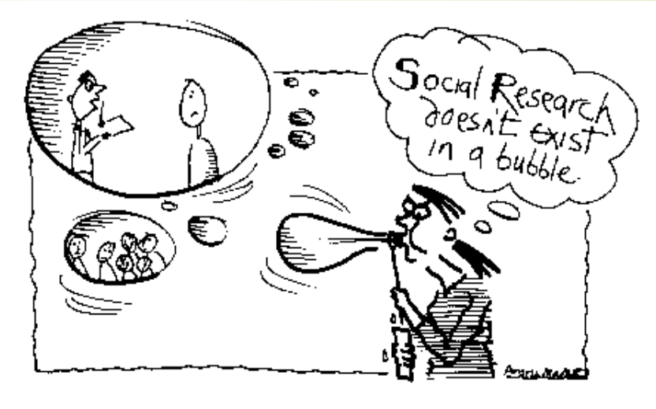

Slide 9
Methodoleg a Dulliau/ Methodology and Methods
Methodoleg
Y fframwaith damcaniaethol sy'n amlinellu'r rheolau i'w dilyn mewn astudiaeth.
Dulliau
Yr offer/camau gwirioneddol a gymerir i wneud ymchwil i bwnc neu bwnc.
Methodology
The theoretical framework that outlines the rules to follow in a study.
Methods
The actual tools/steps taken by which you conduct research into a subject or a topic.

Slide 10
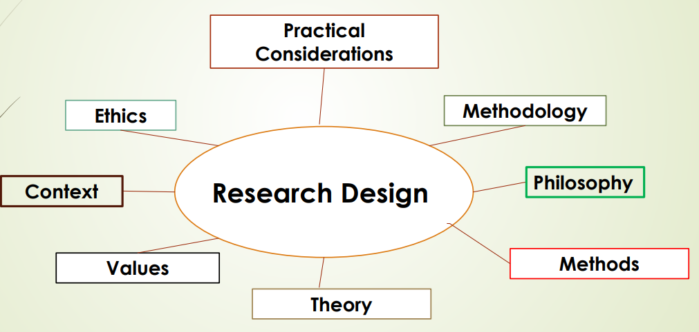

Slide 11
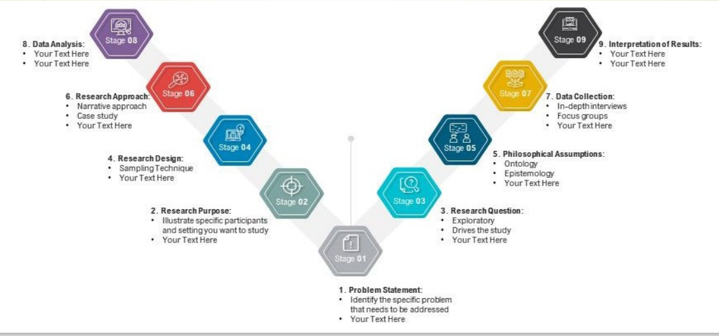
Qualitative Research Process

Slide 12
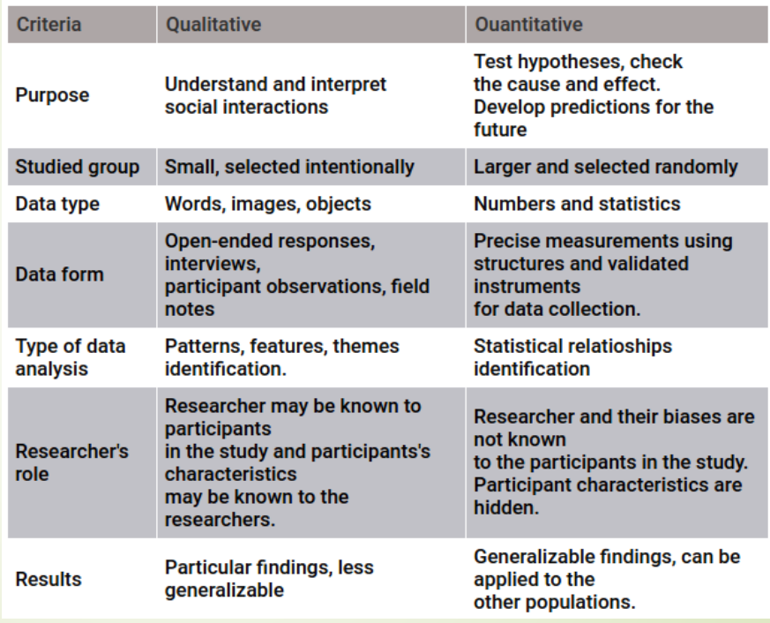

Slide 13
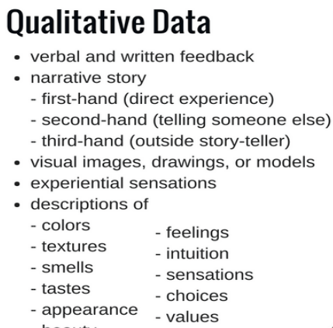

Slide 14
Ymchwil Gymdeithasol fel estyniad o ymarfer/ Social Research as an extension of practice
Meddyliwch am faes o’ch arfer presennol yr hoffech ymchwilio iddo neu ei werthuso:
datrys problem,
gwella ymarfer,
gwerthuso menter newydd i weld a yw’n gweithio……
Think about an area of your current practice that you would like to research or evaluate:
solving a problem,
improving practice,
evaluating a new initiative to see if it works……

Slide 15
Methodolegau Ymchwil Ansoddol a chynllun ymchwil/
Qualitative Research Methodologies and research design.
Gall bron unrhyw ffenomen, mater neu broblem gymdeithasol, wleidyddol, ddiwylliannol, economaidd neu esthetig fod yn destun ymchwil. Y peth allweddol yw nid yr hyn y mae'n ei olygu, ond y ffordd yr ydych yn mynd i'r afael â'r mater.
Almost any social, political, cultural, economic or aesthetic phenomenon, issue or problem can be the subject of research. The key thing is not what it’s about, but the way you approach the issue.

Slide 16
Chwilfrydedd/ Curiosity
Os ydych chi'n chwilio am bwnc ar gyfer eich ymchwil y pethau gorau i'w gwneud yw datblygu ymdeimlad gwirioneddol o chwilfrydedd ynghylch sut mae'r byd o'ch cwmpas yn gweithio neu gadewch i chi'ch hun fod yn agored i syniadau, gwrthrychau, profiadau neu ddigwyddiadau.
Boden, Kenway ac Epstein, 2005
If you are looking for a subject for your research the best things to do is to develop a real sense of curiosity about how the world around you works or let yourself be open to ideas, objects, experiences or events.
Boden, Kenway and Epstein, 2005

Slide 17
Cam 1. Penderfynu ar Gwestiynau Ymchwil/
Step 1. Determine Research Questions
Mae cwestiynau â ffocws wrth wraidd ymchwil ansoddol y gellir ei gweithredu. Mewn gwirionedd, maent wrth wraidd ymchwil meintiol da hefyd.
Focused questions are at the heart of actionable qualitative research. In fact, they are at the heart of good quantitative research as well.

Slide 18
Cam 2. Cynlluniwch yr astudiaeth/ Step 2. Design the study
Diffinio cwestiynau ymchwil, a yw "Beth" yr astudiaeth wedi'i sefydlu? Nawr meddyliwch Pwy, Pryd, Ble a Sut. Mae manteision a heriau logistaidd i gasglu'r data sydd ei angen arnoch. Mae'n fater o fasnachu nhw i ffwrdd.
Define research questions, has the "What" of the study been established? Now think Who, When, Where and How. There are logistical advantages and challenges to collecting the data you need. It's a matter of trading them off.

Slide 19
Cam 3. Moeseg/ Step 3. Ethics
Ystyriwch foeseg eich astudiaeth a gwnewch gais am gymeradwyaeth foesegol.
Consider the ethics of your study and apply for ethical approval.

Slide 20
Egwyddorion moeseg ymchwil.. Principles of research ethics..
‘Mae moeseg ymchwil yn ymwneud â bod yn glir ynghylch natur y cytundeb yr ydych wedi ymrwymo iddo gyda’ch pynciau ymchwil neu gysylltiadau. Dyma pam y gall contractau fod yn ddyfais ddefnyddiol. Mae ymchwil foesegol yn golygu cael gwybodaeth am gynnwys y rhai rydych chi'n mynd i'w cyfweld, eu holi, arsylwi neu gymryd deunyddiau ganddyn nhw. Mae'n ymwneud â dod i gytundeb ynghylch y defnydd o'r data hwn, a sut yr adroddir ar ei ddadansoddiad a'i ddosbarthu. Ac mae’n ymwneud â chadw cytundebau o’r fath pan fyddant wedi’u cyrraedd.’ Blaxter et al (1996, t. 146.).
‘Research ethics is about being clear about the nature of the agreement you have entered into with your research subjects or contacts. This is why contracts can be a useful device. Ethical research involves getting the informed consent of those you are going to interview, question, observe or take materials from. It involves reaching agreements about the uses of this data, and how its analysis will be reported and disseminated. And it is about keeping such agreements when they have been reached’ Blaxter et al (1996, p. 146.).

Slide 21
Mae’r cysyniad o foeseg yn un cymhleth, yn ymwneud â’r hyn sy’n dda i gymdeithas a’r unigolion ynddi. Dylid cynnal eich astudiaethau er mwyn dod o hyd i wybodaeth werth chweil yn y pen draw, y mae ei hymchwil wedi’i nodi fel ‘prif gyfrifoldeb moesegol yr ymchwilydd’ (Hammersley a Traianou, 2012, t. 6).
The concept of ethics is a complex one, concerned with what is good for society and the individuals within it. Your studies should be carried out to ultimately uncover worthwhile knowledge, the pursuit of which has been identified as ‘the prime ethical responsibility of the researcher’ (Hammersley and Traianou, 2012, p. 6).

Slide 22
Trefniadau Diogelu Moesegol/ Ethical Safeguards
Sicrhau bod pobl yn cymryd rhan yn wirfoddol
Gwneud sylwadau ac ymddygiad pobl yn gyfrinachol
Diogelu pobl rhag niwed
Sicrhau ymddiriedaeth rhwng ymchwil a'r bobl sy'n cael eu hastudio
Silverman (2014, t. 146)
  Ensuring that people participate voluntarily
  Making people’s comments and behaviour confidential
  Protecting people from harm
  Ensuring mutual trust between research and the people being studied
  Silverman (2014, p. 146)

Slide 23
Cam 4./ Step 4.
Casglu Data: Ni ddylai'r ymchwilydd ansoddol gael llawer o effaith ar y lleoliadau sy'n cael eu harsylwi - boed yn arsylwi cyfranogwyr neu'n cyfweld neu'n dosbarthu holiaduron. Mae ymchwil ansoddol yn aml yn gyfystyr â samplau bach.
Collect Data: The qualitative researcher should have little impact on the settings being observed - whether it be observing participants or interviewing or distributing questionnaires. Qualitative research is often synonymous with small samples.

Slide 24
Cam 5./ Step 5
Dadansoddi Data: Mae'r rhan fwyaf o astudiaethau ymchwil ansoddol yn cynhyrchu llawer o ddata. Mae creu system ar gyfer codio gweithredoedd a dyfyniadau nodedig yn helpu i gyflymu'r broses ddadansoddi
Analyse Data: Most qualitative research studies generate a lot of data. Creating a system for coding actions and notable quotes helps speed through the process of analysis.

Slide 25
Cam. 6/ Step 6
Cynhyrchu Canfyddiadau: Beth a ddysgwyd o ymgysylltu â defnyddwyr? Mae'r cam hwn yn cynnwys dadansoddi'r swm helaeth o nodiadau. Gan y bydd llawer o'r ymatebion gan gyfranogwyr yn benagored, bydd angen nodi patrymau
Generate Findings: What was learned from engaging users? This step involves analysing the copious amount of notes. As many of the responses from participants will be open-ended, there will be a need to identify patterns

Slide 26
Cam 7./ Step 7
Validate findings: One of the best ways to validate findings is to triangulate. One weakness of qualitative research is that it is hard to establish external validity, that is, to provide corroborating evidence that the findings aren't just the opinion of the researcher. Every researcher, of course, does bring with her biases on the problems with a product or what deserves emphasis in the interview.
One approach to minimize this researcher bias is to include a section on the interviewer or principal investigator's background and how it might influence their conclusions. Having recordings of sessions and detailed notes helps other interested parties come to their own conclusions and can help validate findings.
Dilysu canfyddiadau: Un o'r ffyrdd gorau o ddilysu canfyddiadau yw triongli. Un gwendid ymchwil ansoddol yw ei bod yn anodd sefydlu dilysrwydd allanol, hynny yw, darparu tystiolaeth ategol nad barn yr ymchwilydd yn unig yw'r canfyddiadau. Mae pob ymchwilydd, wrth gwrs, yn dod â thueddiadau ar y problemau gyda chynnyrch neu'r hyn sy'n haeddu pwyslais yn y cyfweliad.
Un dull o leihau'r duedd hon gan ymchwilydd yw cynnwys adran ar gefndir y cyfwelydd neu'r prif ymchwilydd a sut y gallai ddylanwadu ar eu casgliadau. Mae cael recordiadau o sesiynau a nodiadau manwl yn helpu partïon eraill sydd â diddordeb i ddod i’w casgliadau eu hunain a gall helpu i ddilysu canfyddiadau.

Slide 27
Cam 8./ Step 8.
Adroddiad: cynhyrchu adroddiad sy’n cynnwys crynodeb o’r holl gamau uchod ac unrhyw argymhellion ar gyfer gweithredu neu ymchwil yn y dyfodol.
Report: produce a report which contains a summary of all the steps above and any recommendations for future action or research.

Slide 28
Nid oedolion bach/ Not little adults
Nid oedolion bach yw plant ond maent yn bodau sy’n datblygu ac yn tyfu sydd â’u nodweddion penodol eu hunain’
Mae cydnabod eu bod yn wahanol yn fan cychwyn.
(Greig et al, 2013 t. 285)
‘Children are not little adults but are developing and growing beings who have their own specific characteristics’
Acknowledging they are different is a starting point.
(Greig et al, 2013 p. 285)

Slide 29
Cywirdeb/ Accuracy
Mae angen i’r ymchwilydd ddeall pwysigrwydd cywirdeb yn union broses yr ymchwil, ‘gan ddisgrifio pethau’n ofalus wrth iddynt ymddangos i ymwybyddiaeth’ (Moran, 2004, t. 5).
It is necessary for the researcher to understand the importance of accuracy in the very process of the research, ‘carefully describing things as they appear to consciousness’ (Moran, 2004, p. 5).

Slide 30
Crynodeb/ Summary
Trosolwg o'r hyn a olygwn wrth ddyluniadau ymchwil ansoddol
Nid yw ymchwil yn bodoli mewn swigen
Camau at ymchwil ansoddol
Nodweddion ymchwil ansoddol
Overview of what we mean by qualitative research designs
Research doesn’t exist in a bubble
Steps to qualitative research
Characteristics of qualitative research

Slide 31
References
Blaxter, L., Dodd, K., and Tight, M. (1996) How to Research. Buckingham: OU Press.
Bugental, J.F.T. (1964) The third force in psychology, Journal of Humanistic Psychology, 4 (1): 19-26
Greig, A. Taylor, J. and Mackay, T. (2013) Doing Research with Children A practical guide (3rd ed.). London: Sage.
Hammersley, M. and Traianou, A. (2012) Ethics and Educational Research, British Educational Research Association on-line resource. Online [bera.ac.uk].
Moran, D. (2004) Introduction to Phenomenology. London: Routledge.
Shaw, S. and Barrett, G. (2006) Research governance: regulating risk and reducing harm? In Journal of Research of the Royal Society of Medicine. January 2006: 99 (1), 14-19.
Silverman, D. (2014) Interpreting Qualitative Data, (5th ed.). London: Sage.
Webster, S. Lewis, J and Brown, A. ETHICAL CONSIDERATIONS IN QUALITATIVE RESEARCH, in Ritchie, J. Lewis, J, McNaughton Nicholls, C. and Ormston, R. (Eds.) (2014) QUALITATIVE RESEARCH PRACTICE A GUIDE FOR SOCIAL SCIENCE STUDENTS AND RESEARCHERS. Los Angeles, SAGE.
World Medical Association (2012) Declaration of Helsinki – Ethical Principles for Medical Research Involving Human Subjects. Available at: www.wma.net/en/30publications/10policies/b3/
Zubulake, D.M. (2017) ‘Building Blocks of Professionalism: Values, Principles, and Ethics in Youth Work’, Journal of Youth Development. Vol 12(1) 9-17.

