Slide 1
Visions for the Future – Theoretical Perspectives on Management LCDB7006
Lecture 1
Critical Thinking

Slide 2
Critical - academic
Your own evidence informed judgement
Rationally argued
Logically presented
Draws on research literature
Draws on theory/ideas from literature
  All practice has implicit theory
Hallmark of higher level university work

Slide 3
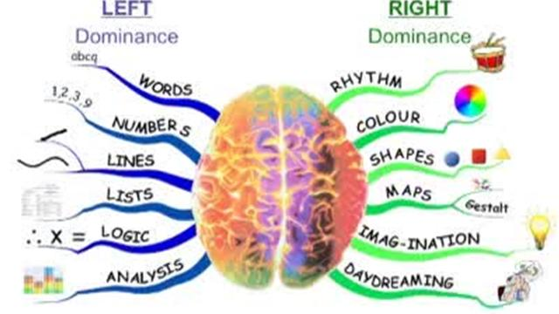
Critical & Creative Thinking

Slide 4










Today’s consumers are demanding more than ever…
a taxi in 5 minutes
a pizza in 10 minutes
groceries in 60 minutes
search results in 0.3 seconds
content on demand
not to stand in line at a supermarket
not to pay cash
immediate answers to ALL questions

Slide 5

Outline
Development
  Stages model
  Takes: time, practice, maturity, inclination
Valuing
  QAA, Practice, Assessment
Understanding
  Definitions
  Bloom’s model
Activities
  Review, evaluate, apply

Slide 6
CT as stages of development
Students (all of us) develop through stages
  We may be at different stages in different contexts
  e.g. in ‘real life’ and in new academic situations
1 Absolute knowing 2 Transitional stage
3 Independent knowing 4 Contextual knowing
Aim is fully contextual thinking
Unreasonable to expect it always and early at university

Slide 7
Levels of Cognitive Development:
“Ways of Knowing”
Absolute knowing Received Knowing
“Just give me the facts, Ma’am. Just the facts”
Transitional stage Subjective Knowing
“Everybody has an opinion and all opinions are equal”
Independent knowing Procedural Knowing
“Every field has its own games with their own rules”
Contextual knowing Constructed Knowing
“I understand why I believe this and why others don’t”

Slide 8
Valuing CT & its importance in H. E.
CT and its place in higher qualifications
Activities in courses and things you can do

Slide 9
First response system
Don’t try to work it out
Notice your first response:
A bat and a ball cost £1.10
The bat costs £1 more than the ball
How much does the ball cost?
Kahneman 2011
Notes:
Number comes to mind
10p
Easy puzzle provokes and answer that is intuitive, appealing and wrong
Do the maths for the correct answer of 5p
Takes conscious effort to check the answer
50% students at top US universities give wrong answer
80% failure rate in other universities
It takes effort to

Slide 10
People are overconfident &
It takes effort to check
The number that comes to mind is 10p
Easy puzzle provokes an answer that is intuitive, appealing and wrong
Do the maths
Takes conscious effort to check the answer
50% students at top US universities give wrong answer
80% failure rate in other universities
Notes:
- correct answer of 5p

Slide 11
Doctorates are awarded to students who have demonstrated:
Originality in the application of knowledge & in tackling and solving problems
Understanding of role of research
Ability to deal with complex issues both systematically and creatively
Qualities of sound judgement, personal responsibility and initiative, in complex and unpredictable professional environments
QAA

Slide 12
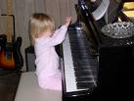
Deliberate Practice of CT skills
Research on achieving excellence reveals commonalities
van Gelder 2005 p7
Focussed practice to create improvement
Repetition
Use feedback
Keep at it – it takes time
Do activities to improve skills (of CT)
Have fun with puzzles

Slide 13
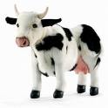
Use two squares to put all the cows in separate pens
Notes:
Add two squares to pen all the cows in separate pens
Nb – they go inside each other – first one on the diagonal points touching middle of outer square, second smaller inside and touching mid points on the diagonal square
Illustrates an assumption that squares are (always) placed on the horizontal

Slide 14
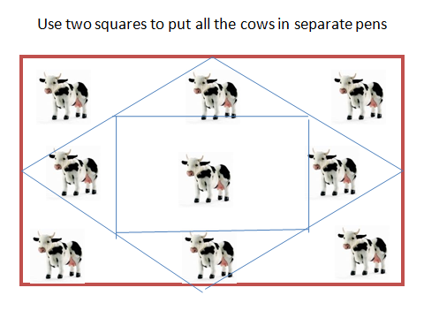

Slide 15
Fostering CT – in general
Recognise CT as a developmental process
  Takes time
  & attention
Use thinking opportunities
  Reflection, PDP
Get involved in class interactions e.g.:
Brainstorms
Discussions
Use ‘maps’
Check the evidence
Learn language of assessment/academia
What do you do?
What could you do?
  Following slides

Slide 16
Some things you can do
Summarise
  Prepare a summary - no more than seven most important points
Question
  Prepare at least three substantive questions about the material
Propose
  List at least three points you agree with and state why
Critique
  List at least two points you disagreed with or found unhelpful and state why
Find Examples
  Give at least three examples of key concepts presented

Slide 17
Argument Maps
4 more things you could do:
Against #2
Provide a visual representation of an argument
Produce well organised arguments in writing
Allow for evaluation of reasoning
For #1
For #2
Key Point
Against
#A
Against
#B
See: www.austhink.org
Notes:
Does a higher degree automatically = good thinking skills?
Are they automatically applied to all facets of life? If so, academics would have the best run lives????
I.e. we can all continually be improving our CT skills

Slide 18

Concept maps
“are graphical tools for organizing and representing knowledge. They include concepts, usually enclosed in circles or boxes of some type, and relationships between concepts indicated by a connecting line linking two concepts. Words on the line, referred to as linking words or linking phrases, specify the relationship between the two concepts”
Novak & Canas (2008)
Helps develop understanding

Slide 19
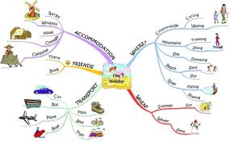
Mind maps
Show hierarchical relationships around a central idea or key word
Often hand drawn
Useful for planning, generating ideas, seeing connections
An alternative to using lists for planning assignments
  Some people love ‘em; others........
Helps develop understanding & new ideas
See Tony Buzan

Slide 20
Brainstorming
Divergent and convergent thinking
  Keep idea generation and judgement separate
Divergent thinking:
Focus on quantity: the more ideas generated, the more chance of getting useful new ideas
Withhold criticism: Suspend judgment to create the space for innovative and unusual ideas
Encourage unusual ideas: Look from new perspectives and suspend assumptions
Combine and improve ideas: Build on, combine and enhance ideas
Convergent thinking:
As a separate and later step: sort out ideas using set criteria, group ideas,
identify next steps

Slide 21
The language of assessment
Check with your tutor if in doubt
For example:
  Justify: make a case for a particular view; explain why something is like it is; give reasons; show adequate grounds
  Be critical: identify what is good and bad about the information and why, probe, question, identify shortcomings in the information
Fuller list in next slides for reference

Slide 22
Instruction | What is meant
clarify | identify the components of an issue/topic/problem; identify the main points; make the meaning plain; remove ambiguities or misunderstandings, restate something in your own words
analyse | break information into constituent parts; examine the relationship between the parts; question the information
be critical | identify what is good and bad about the information and why, probe, question, identify inaccuracies or shortcomings in the information, estimate the value of the material
evaluate, weigh up | as above but also – come to a conclusion (see below) about the information
compare | consider the similarities or dissimilarities; implies evaluation (e.g. which aspects of two or more topics/subjects are most valuable)
identify trends | identify patterns/changes/movements in certain directions (e.g. over time or across topics/subjects)

Slide 23
Instruction | What is meant
argue | put the case for/against a view or idea giving evidence for your claims/reasons; attempt to influence the reader to accept your view
conclude / draw conclusions | the end point of your critical thinking; what the results of an investigation indicate; arrive at a judgement by reasoning
develop a view | decide what you think (based on an argument or on evidence)
justify | make a case for a particular view; explain why something is like it is; give reasons; show adequate grounds for something
give evidence | evidence from your own work or that of others which could be checked by a third party to prove/justify what you say
summarise | briefly indentify the main points or aspects of the information, remove unnecessary detail
review | similar to summarise (see above) but usually includes evaluation, an overview, a reconsideration of something

Slide 24
Activities summary
Summarise, Question, Propose, Critique, Find examples
Get involved in class discussions
Mind maps; Argument maps; Concept maps; Brainstorming
Learn assignment & academic language
Plenty on the web
  E.g. Learn Higher, CT.org

Slide 25
Understanding CT
Definitions
Models
  Bloom’s Taxonomy
Universal Standards

Slide 26
Critical thinking
Is not: automatic response or intuition etc
whatever their value or lack of value!
Critical thinking is reasonable reflective thinking that is focused on deciding what to believe or do
The significant problems we face cannot be solved at the same level of thinking we were at when we created them. Einstein
Notes:
Automatic responses – skilled action, rapid reactions eg in a car or prejudices
Intuition etc slow thinking, non analytic knowing
Plenty of definitions usually include reason & rationale, use of evidence & criteria, & improving
Critical thinking is the disciplined art of ensuring that you use the best thinking you are capable of in any set of circumstances Paul & Elder (2002)
Not everything is amenable to analysis & CT
Masters/PhD thesis's are!!

Slide 27
Critical & Critical thinking
Critical position: personally derived evidenced based judgement Jude Carroll
Critical thinking: thinking that helps you figure out whether you should believe some claim, and how strongly you should believe it
  i.e. is it true or the art of being right! Tim van Gelder
Critical thinking: capacity to work with complex ideas…. Provide effective evidence to justify a reasonable judgement…. Attending to context
Jenny Moon

Slide 28
Critical & Critical thinking
Critical position: personally derived evidenced based judgement Jude Carroll
Critical thinking: thinking that helps you figure out whether you should believe some claim, and how strongly you should believe it
  i.e. is it true or the art of being right! Tim van Gelder
Critical thinking: capacity to work with complex ideas…. Provide effective evidence to justify a reasonable judgement…. Attending to context
Jenny Moon

Slide 29
The HAT Puzzle

Slide 30
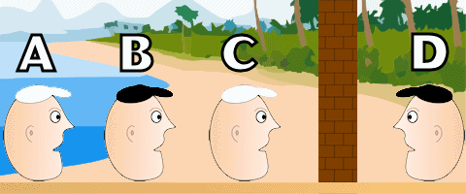
Four inmates are cleaning up a littered beach as part of a prisoner work program. The warden, who happens to be overseeing the work, decides to play a little game with the prisoners. He tells them that if they win the game he will let them go free! He then proceeds to bury each prisoner up to his neck in sand as shown below.

Slide 31
There is a wall between prisoners C and D (which cannot be seen through or around). Prisoner A can see prisoners B and C (by moving his head to the side). Prisoner B can see prisoner C. Prisoners C and D see only the wall.
The prisoners are immobilized in the ground and can't twist their body to see the person behind them. The warden shows them two black hats and two white hats and then puts the hats in a bag to conceal them. He then stands behind each prisoner, chooses a hat from the bag, and puts it on their head. The colour of each prisoner's hat is shown in the image above.
The rules are simple. If any prisoner can figure out the colour of the hat on his head, all four prisoners will be set free. But they must be sure, if one of them simply guesses and is wrong, they will all be shot dead! The prisoners are not allowed to talk to each other and they have 10 seconds.
The warden counts down "ten, nine, eight, seven". All four prisoners are silent. The warden smiles, knowing that he put the hats on in such a way that no prisoner could possibly know the colour of the hat they had on. He continues "six, five, four, three.."
"I know the colour of my hat!" one of the prisoners finally blurts out.
Which prisoner called out and why is he 100% certain of the colour of his hat?
PS: This is not a trick question.

Slide 32
ANSWER: Prisoner B.
EXPLANATION: If prisoners B and C had the same colour hat on, prisoner A would have know immediately that his hat was the other colour (there are only two hats of each colour). Since prisoner A was silent, prisoners B and C must have different colored hats. Prisoner B realized this and knew that his hat was not the same colour as prisoner C, therefore his hat must be black!

Slide 33
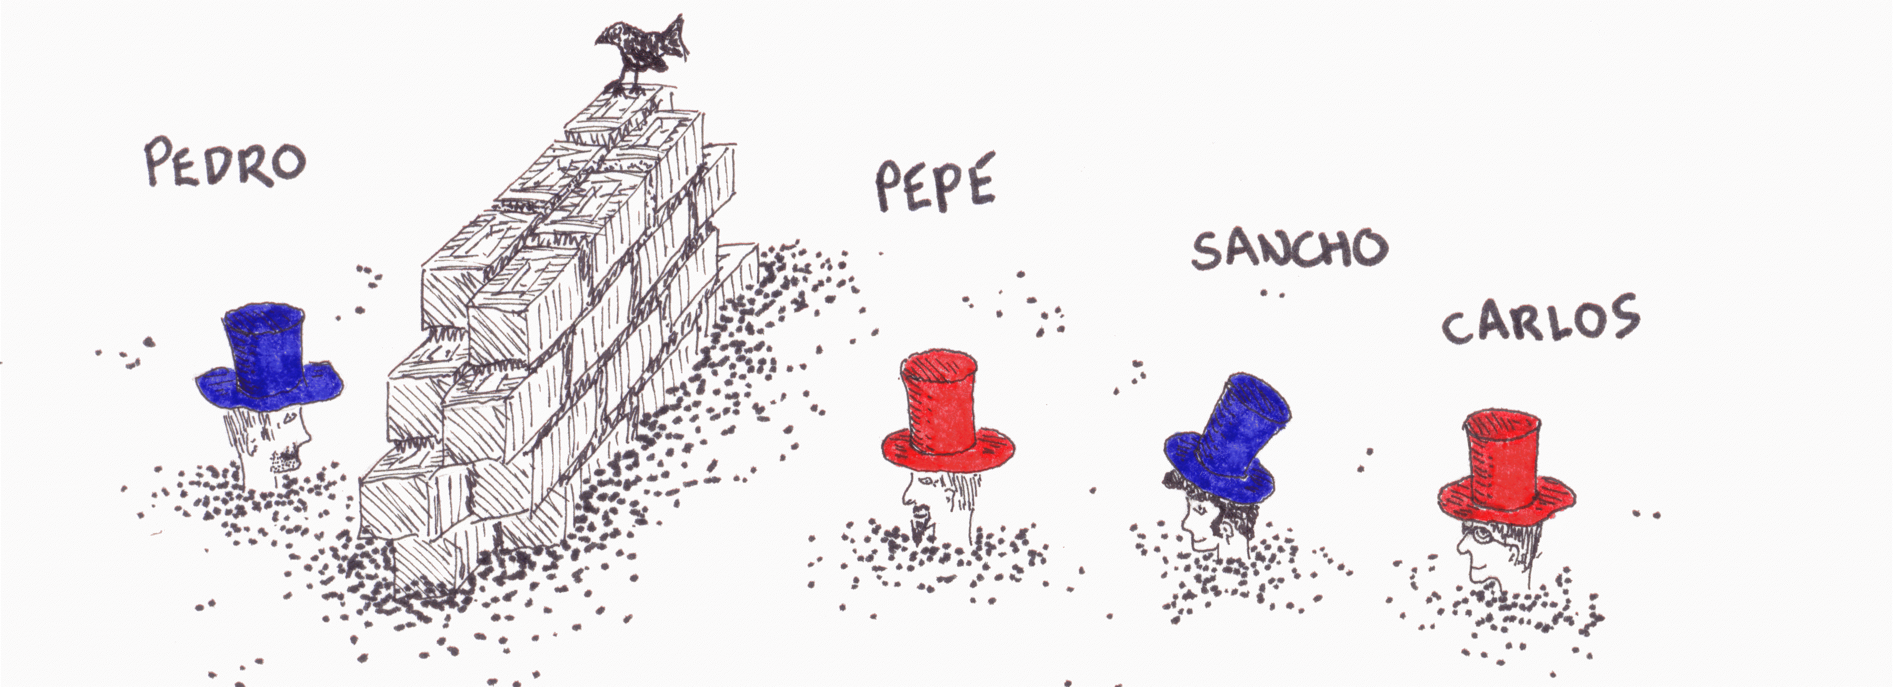
Each prisoner knows that there are 2 red hats and 2 blue hats, but no one knows the colour of his own hat
Notes:
Cover these points:
If one person can correctly call out the colour of their hat AND provide a rationale they can go free, it is not a guess!
Buried up to necks in sand
Can only see hats in front of them
Can’t speak
Cruel guards, if colour correctly identified can go free and live happily ever after, if incorrect even crueller punishment death and worse!!!
If asked: nothing to do with the wall or the bird, can’t knock off their hats, turn around or other trickery
Usually can’t do it at first need to add level of hints as seems appropriate
If someone either knows it or get it quickly ensure they stay quiet to give others a chance
Generally an excellent introduction to thinking, lead to the mix of analysis and insight to solve just like research (or whatever audience is being addressed)

Slide 34
BLOOMS OLD AND NEW TAXONOMIES

Slide 35
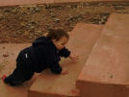

Six Levels of Thinking
Remembering
Understanding
Applying
Analysing
Synthesising – creating
Evaluating
Students need the language of their discipline
Thinkers need the language of thinking!
Bloom et al
- a classic model
Notes:
Language helps you to know what specific terms mean, able to help others and make specific use of tools at each level
Stress not all neat and tidy, need basics to develop more complex skills
Overlap and complexity can change ‘level’
Blooms taxonomy, relate to course levels – not rigid
1-6 = critical thinking – the works, includes lateral and creative

Slide 36

Remembering Information
list, name, identify, define, label, describe
Mnemonic – system for improving memory
Acronyms, Acrostics
Music accesses memory
Notes:
Writing often criticised for being overly descriptive not analytical or reflective
Depending on group or workshop aims:
Handout set 1-6
In groups make up a mnemonic from course work

Slide 37

2. Understanding Information
Mind maps (webs)
Key words
Single word
summarise, discuss, distinguish, predict, generalise, categorise
Thinking is the hardest work there is –
That’s why so few people do it – Henry Ford
Notes:
E.g. Summarise strategies #3
3 - interest
2 - like to know more about
1 - tell others about

Slide 38
3. Applying Information
Problem solving
Testing learning in the ‘real world’ or in class activities
apply, demonstrate, examine, solve
What we have to learn to do, we learn by doing
- Aristotle (this includes CT!!)
Notes:
Not focus for this session
Talk it through – examine it
Underline important points
Generate ideas
Decide - consider consequences
Implement – try it
Evaluate solution – did it work
Review – better way?

Slide 39
4 Analysing Information
Breaking it down
Fact v. opinion
Reasoned judgement
Logical thinking
Activity - PMI
analyse, explain, compare, classify
See Alec Fisher
Lots of activities to build arguments and reasoning

Slide 40
First response system
Is this argument logically valid?
Does the conclusion follow from the premises?
All roses are flowers
Some flowers fade quickly
Therefore some roses fade quickly
Kahneman 2011
Notes:
Most students get this wrong
It is hard to override the first intuitive response “it’s true, it’s true”
Takes effort to check

Slide 41
Question
What is the main point or claim being made?
What subsidiary points/claims are being made?
Do the subsidiary points/claims connect logically with the main one? Are all the points/claims linked together? Are they in an order which aids understanding?
Is there appropriate evidence for each point/claim?
Have any steps/information/evidence been missed out of the argument?
Has information/points/claims not relevant to the main point/claim been included?
Do the conclusions follow from the points/evidence/claims? Have the judgements been made about the topic or information?

Slide 42
SKILFUL ANALYSIS AND EVALUATION OF ARGUMENTS
‘Thinking Map’: Analysis
What are the main Conclusions: may be recommendations/explanations, Conclusion indicator words and ‘therefore’ test may help
What are the Reasons : data, evidence
What is Assumed ; i.e. implicit or taken for granted, perhaps in the Context
Clarify the Meaning (claims or arguments) as needed

Slide 43
Thinking Map: Evaluation
Are the reasons Acceptable – this may involve evaluating factual claims, definitions and value judgements and judging the Credibility of a source
(a) Does the reasoning Support its conclusions: is the support strong, e.g. ‘beyond reasonable doubt’, or weak
(b) Are there Other Relevant Considerations/ Arguments which strengthen or weaken the case
7. What is your Overall Evaluation from1-6
(Fisher, 2001)

Slide 44
5 Evaluating or criticising information
Objective
Open-minded, flexible
Check assumptions
Check bias
  NB first response system
assess, recommend, compare/contrast, conclude, justify
Questions are the active acts of intelligence
- Frank Kingdom
Notes:
Alec Fisher
Judge, justify, compare and contrast, good/bad, work/doesn’t work, problems/solutions
Who benefits, who misses out
Link to critical theory, power analysis, social justice

Slide 45
6 Synthesising or creating information
New ideas-Creativity
New applications of ‘old’ ideas
Lateral thinking
design, invent, rewrite, rearrange
See de Bono
Countless ideas: lateral thinking
Nothing can happen unless you first dream
Carl Sandburgh
Notes:
De Bono
Creativity in higher level HE work

Slide 46
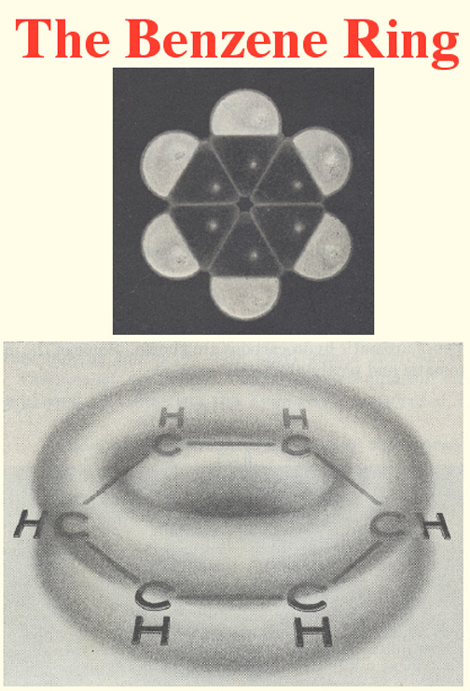
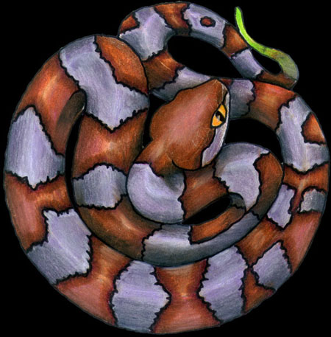
“Creative scientists are ones with access to their dreams”
– Albert Einstein
Snake swallowing its own tail
Let us learn to dream, gentlemen,
and then perhaps we shall learn the truth. August Kekulé
Notes:
"I was sitting writing at my text book, but the work did not progress; my thoughts were elsewhere. I turned my chair to the fire, and dozed. Again the atoms were gambolling before my eyes. This time the smaller groups kept modestly in the background. My mental eye, rendered more acute by repeated visions of this kind, could now distinguish larger structures of manifold conformations; long rows, sometimes more closely fitted together; all twisting and turning in snake-like motion. But look! What was that? One of the snakes had seized hold of its own tail, and the form whirled mockingly before my eyes. As if by a flash of lightning I woke;... I spent the rest of the night working out the consequences of the hypothesis. Let us learn to dream, gentlemen, and then perhaps we shall learn the truth." _ Kekule
Sewing machine – spears with holes in tops
Einstein – riding a beam of light
Mention T Kuhn – resistance in science to paradigm shifts
Combination of well structured problem (thought about – engaged with) and serendipity, other activities, rest – time out – letting subconscious creativity work – the Tortoise mind

Slide 47
Notes:
Join the 9 dots with four or fewer straight lines
Keep pen on paper
Only solvable by going outside the square
Lots of solutions depending on change of concept/assumption about the paper, pen, length of line

Slide 48
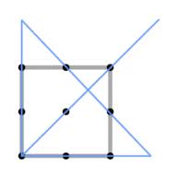
2
3
4
1

Slide 49
Universal Intellectual Standards
Clarity
Accuracy
Precision
Relevance
Depth
Breadth
Logic
(ethical)
Check thinking and writing against these universal standards
Critical thinking: involves improving the quality of thinking… by imposing intellectual standards - R. Paul
http://set.lanl.gov/programs/cif/Resource/Handouts/intlStan.htm

Slide 50
Summarising!
CT is developmental
  Variety in class and over time
Levels of thinking – a key model
  Allows analysis of your learning focus
  Allows analysis of assignments
Lots of activities
  Plenty on the web (Learn Higher, CT.org)

Slide 51
Sources
Carr, K. (2001) How can we teach critical thinking?
Claxton, G. (1997) Hare brain, tortoise mind
Fisher, A. (2001) Critical thinking: An introduction.
Kahneman, D. (2011) Thinking fast and slow
Langreher, J. (1992) Teach thinking strategies: Ideas for teachers
Novak & Canas (2008) The theory underlying concept maps and how to construct and use them
Paul, R. & Elder, L (2002) Critical thinking
QAA (2008) The framework for higher education qualifications in England, Wales and Northern Ireland
Notes:
Do it
Action plan sheet
Evaluation
Thanks

Slide 52
Useful Sites
Articles by Tim Van Gelder
  http://www.arts.unimelb.edu.au/~tgelder
van Gelder, T. J. (2005). Teaching critical thinking: some lessons from cognitive science. College Teaching, 45, 1-6.
Argument mapping
  www.austhink.org
Universal Intellectual Standards
  http://set.lanl.gov/programs/cif/Resource/Handouts/Handouts.htm
  http://criticalthinking.org/Posters.html
Bloom’s Taxonomy – Skills and questions
  http://www.coun.uvic.ca/learn/program/hndouts/bloom.html
Thinking Writing
  http://www.thinkingwriting.qmul.ac.uk/srb.htm
Jenny Moon (2005) We seek it here...a new perspective on the elusive activity of critical thinking. HEA Escalate
  http://escalate.ac.uk/2041

Slide 53
Useful Sites
We think of the mind as a storehouse to be filled, when we should be thinking of it as an instrument to be used - Reed & Graeme
Dan Kurland
  http://www.criticalreading.com/
Pierce handbook of CT
  http://academic.pgcc.edu/~wpeirce/MCCCTR/handbook.pdf
Critical Thinking Community
  http://www.criticalthinking.org/ABOUT/index.cfm
SNAS (HEA)
  http://www.heacademy.ac.uk/ourwork/professional/snas/snasdatabase
Learn Higher
  http://www.learnhigher.ac.uk/pages/critical_thinking_and_reflection.html

