Slide 1

MODULE LCHS7006
ASSESSMENT Component 1 — Individual Presentation
A Quality Assurance Failure at the Countess of Chester Hospital
Analysing systemic clinical governance failures through the Swiss Cheese and Donabedian models.
Student Name: Azmir Hossain
Student ID: 2510683
Lecturer's Name: Dilhara Mampitiya
Fig: Countess of Chester Hospital and Lucy Letby (Lawrence and Conn, 2024)

Slide 2
LCHS7006 | Countess of Chester Hospital
Contents · 2 / 16
Table of Contents
01
Introduction to the Case Study
3
08
Policy — National Centralisation
10
02
Scope of the Presentation
4
09
Policy — Governance and Whistleblowing
11
03
The Swiss Cheese Model
5
10
Impact on Quality and Efficiency
12
04
Latent and Active Failures
6
11
Impact on Equity
13
05
Donabedian Model — Structure
7
12
Roadmap for Component 2
14
06
Donabedian Model — Process
8
13
Conclusion
15
07
Donabedian Model — Outcome
9
14
References
16

Slide 3
LCHS7006 | Countess of Chester Hospital
01 · Introduction · 3 / 16
Introduction to the Case Study
Countess of Chester case: a serious failure of quality assurance and service delivery (The Lancet, 2023).
Neonatal unit overrun, short of doctors and using poor facilities (Lawrence and Conn, 2024).
Criminal narrative dominates the news; wider systemic failures need equal focus.
Health systems must analyse such incidents beyond individual responsibility (The Lancet, 2023).
13+
5
1971
Fig: Media portrayal of the Chester case (Lawrence and Conn, 2024)
neonatal deaths
June 2015 – July 2016
clinical areas covered
overnight by one junior
age of the unit
at the time of crisis
Notes:
The Countess of Chester Hospital case was a significant failure in the quality assurance and service delivery. Lawrence and Conn (2024) describe that the neonatal unit was overrun with babies and suffering from a lack of doctors and poor facilities. Though the criminal side of this case is the one that has been all over the news, an assessment of this crisis must be done beyond the responsibility of individuals. Health systems need to analyse these incidents and grasp the larger systemic failures in full, The Lancet (2023) states.

Slide 4
LCHS7006 | Countess of Chester Hospital
02 · Scope · 4 / 16
Scope of the Presentation
Views events as a clinical governance failure, not just a criminal case.
Aims to identify root causes within a systematic safety framework.
Highlights how patient safety was undermined at national and local levels.
A criminal focus alone would be a missed opportunity for reform (Whiteing, 2023).
A criminal focus alone is a missed opportunity.
Systemic analysis shows how policy, staffing, culture and infrastructure combined to allow harm to reach patients unchecked.
1
Governance Lens
2
Root Cause Analysis
Beyond criminality to systemic accountability.
Latent conditions and active failures.
3
Policy Critique
4
Recommendations
National centralisation vs local capacity.
Actionable service improvements.
(Whiteing, 2023)
Notes:
This presentation will view the events at the hospital as a serious failure of clinical governance, and not only as a criminal investigation. The goal is to determine the root causes of the tragedy in a systematic safety framework. Whiteing (2023) argues that only looking at the criminal investigation misses the opportunity to address broader issues. This analysis will highlight how patient safety was undermined at all levels by the policy and management choices made at national and local levels.

Slide 5
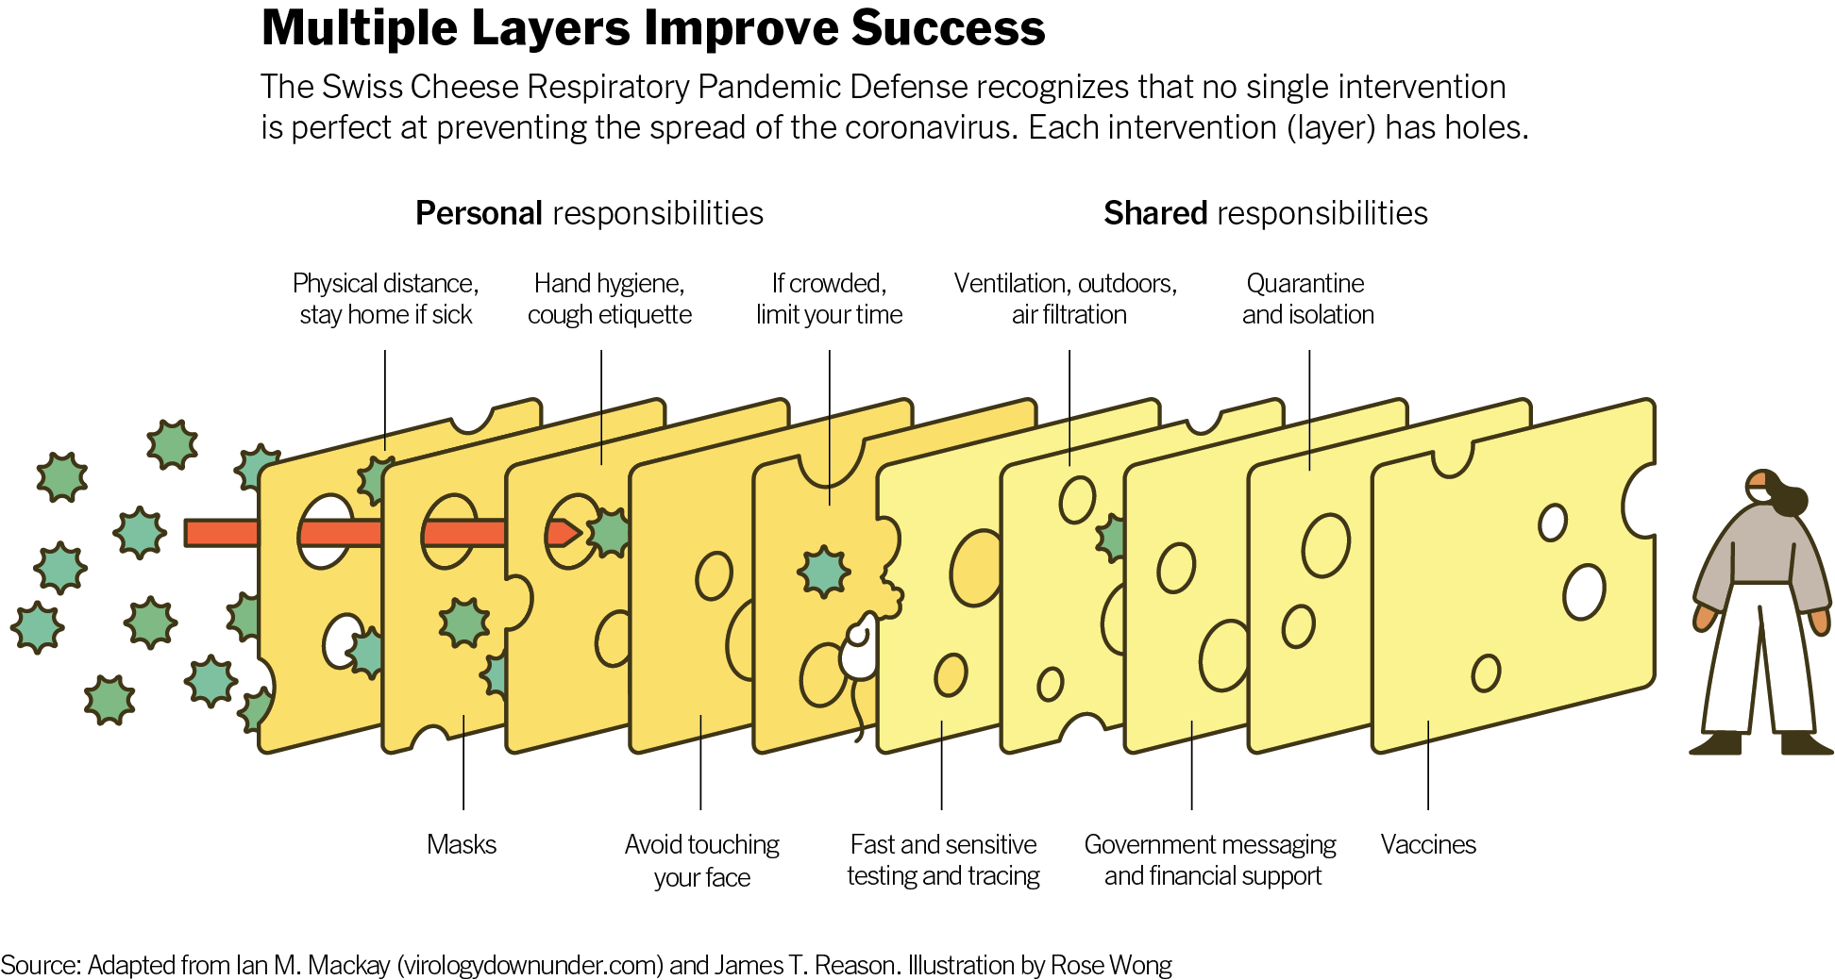
LCHS7006 | Countess of Chester Hospital
03 · Framework · 5 / 16
The Swiss Cheese Model
Accidents occur when weaknesses in defences align (Jesudason, 2023).
Chester's defences were completely undermined.
Unit downgraded without upgrading resources for complex cases.
Serial harm relies on latent vulnerabilities going undetected (Yorker and Barker, 2026).
Fig: Reason's Swiss Cheese Model applied to layered defences (Jesudason, 2023)
Weakened staffing
Absent seniority OOH
"True risk reduction is in finding the overlaps of these holes."
Ignored mortality signals
Suppressed whistleblowing
— (Jesudason, 2023)
Notes:
In order to determine the causes of some of the biggest disasters in health care, James Reason's Swiss Cheese Model is very powerful. This model proposes that accidents occur when there are several weaknesses (holes) in the defensive layers of the organisation. This is what Jesudason (2023) calls for: “True risk reduction is in finding the overlaps of these holes in the system.” The Countess of Chester Hospital defenses were completely undermined. The management downgraded the neonatal unit without taking measures to upgrade the resources to face highly complex cases, which led to the remaining staff working alone. As Yorker and Barker (2026) describe, although it is a singular danger, healthcare serial murder is very much dependent on these same latent vulnerabilities going undetected. Once you understand the Swiss Cheese Model it is clear that the disaster could not have just been the result of one person's actions, but a complete alignment of organisational weaknesses that allowed harm to come to fruition unchecked.

Slide 6
LCHS7006 | Countess of Chester Hospital
04 · Failures · 6 / 16
Latent and Active Failures
Latent failures: chronic issues embedded in the hospital's framework.
Active failures: errors that occur at the point of care.
Weak safety nets left the hospital with little protection (Lawrence and Conn, 2024).
Ignoring warning signals is no different from failing to learn (Leary, 2023).
LATENT FAILURES | ACTIVE FAILURES
Sewage backup and Pseudomonas superbug in taps | Delayed response to the surge in neonatal deaths
Chronic under-staffing and skill dilution | Leadership resistance to formal investigation
Dilapidated 1970s building, poor lighting | Pressuring consultants to apologise to a suspect
Unresolved shortage of neonatal transport | Failure to escalate anomalies in mortality data
Source: Lawrence and Conn (2024); Leary (2023)
Notes:
A breakdown of weaknesses of the hospital into latent and active failures indicates just how the quality assurance systems failed. Latent failures are the unobvious, chronic issues within the framework of the hospital. These ranged from extreme environmental problems at the Countess of Chester, such as sewage backup and a fatal superbug, to low staffing levels. Active failures are the actual errors that occur when the care is given. In this instance the active failures were the delay in response to the unexpected surge in neonatal deaths and the senior leadership's resistance to properly investigate these anomalies. Management that takes no heed of such clear warning signals, as Leary (2023) says, is no different than those that have failed to learn from them, resulting in continuing deterioration of patient safety. Poor working conditions, non-responsiveness to obvious mortality data, and poor safety net meant that the hospital offered little protection. These hidden and manifest weaknesses must be corrected in order to prevent similar tragedies from occurring again.

Slide 7
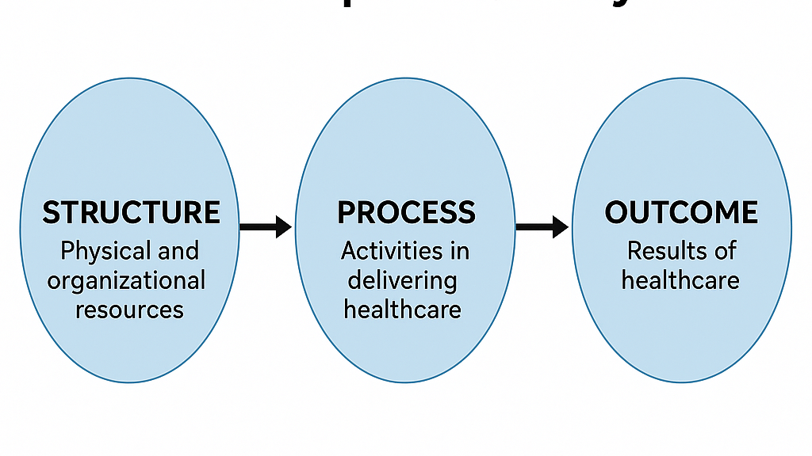
LCHS7006 | Countess of Chester Hospital
05 · Donabedian · 7 / 16
Donabedian Model — Structure
FOCUS: STRUCTURE
Physical & human resources
Fig: Donabedian's Structure–Process–Outcome framework (Bowie, 2025)
Structure covers physical and human resources.
Emergency care facilities were woefully inadequate.
Dilapidated, overcrowded 1970s building.
Neonatal nurses phased out for less qualified staff to cut costs.
(Bowie, 2025).
Physical Estate
Human Resources
Equipment & Cots
1971 building; sewage backups; contaminated taps.
ANNP roles removed; ratio one-fifth below standard.
Level-2 unit stretched to deliver level-3 care.
Notes:
According to Avedis Donabedian's model of care quality, healthcare evaluation falls into structure, process and outcome. The structural element takes a look at the physical and human resources available. The structural deficits were worrying in this hospital. Bowie (2025) describes the emergency care facilities as being woefully inadequate, blaming a dilapidated and overcrowded building from the 1970s. Moreover, the highly trained neonatal nurses were being phased out by less qualified personnel to cut down on costs. This meant that the basic capability to provide safe intensive care for premature babies did not exist in this hospital due to the lack of proper physical environment and experienced staff.

Slide 8
LCHS7006 | Countess of Chester Hospital
05 · Donabedian · 8 / 16
Donabedian Model — Process
FOCUS: PROCESS
How care is delivered
Fig: The process stage of Donabedian's model (Harrison, 2025)
Process covers how care is delivered day to day.
Care processes unravelled given the fragile structure.
Senior consultants often absent out of hours; juniors covered many wards.
Managers ignored escalating concerns rather than investigating
(Harrison, 2025).
Concern raised
Report filtered
Concern dismissed
Doctors pressured
Harm continues
Fig: Escalation chain failure at Countess of Chester (Kirkup and Titcombe, 2023)
Notes:
Second part of the Donabedian model is the process (how care is delivered). Its processes of care soon unravelled due to the precariousness of the hospital's structure. Important lack of senior consultants out of hours; junior doctors working on a number of wards without assistance. The failure of healthcare regulation is evident in the way that the hospital reported incidents, as pointed out by Harrison (2025). Attempts to raise concerns regarding the escalating mortality rate were completely mishandled when the management process was implemented, opting to ignore the concerns instead of investigating them.

Slide 9
LCHS7006 | Countess of Chester Hospital
05 · Donabedian · 9 / 16
Donabedian Model — Outcome
FOCUS: OUTCOME
Impact on the patient
Fig: The outcome stage in Donabedian's framework (Dobson, 2023)
Outcome is the direct impact of care on the patient.
Deaths and collapses stemmed from failing structure and process.
Several premature infant harms were preventable .
Meaningful change often comes from affected families.
(Dobson, 2023)
Broken systems produce broken outcomes.
Without safe structure and disciplined process, outcome measures inevitably deteriorate.
Fig: Illustrative mortality clustering (Lawrence and Conn, 2024)
Notes:
The last piece of the Donabedian model is the outcome – the impact of the care on the patient. The appalling results at the Countess of Chester were a direct and mathematical consequence of the failing structures and corrupted processes. The deaths and significant falls of several premature infants were preventable due to the condition of the unit. Dobson (2023) argues that meaningful organisational change is due to families who are impacted by such devastating outcomes. Ultimately, the result of failure of broken systems is patient harm, and without a good system and process, there can be no safe outcomes in real life.

Slide 10

LCHS7006 | Countess of Chester Hospital
06 · Policy · 10 / 16
Policy Issues — National Centralisation
NHS policy: transfer very premature babies to tertiary centres.
Locally, transport capacity and tertiary beds were lacking (Lawrence and Conn, 2024).
Vulnerable babies stranded without specialist personnel.
National ambition and local reality can be incompatible (The Lancet, 2023).
Fig: NHS centralisation policy context (The Lancet, 2023)
NATIONAL POLICY EXPECTATION | LOCAL REALITY AT CHESTER
Transfer premature babies to tertiary centres | Alder Hey cots frequently unavailable
Specialist regional transport teams on standby | Transport recorded as a red-alert risk
Local units limited to appropriate acuity | Level-2 unit providing level-3 care
Source: Lawrence and Conn (2024); The Lancet (2023)
Notes:
Due to the high centralisation of the NHS system, very premature babies were expected to be transferred to larger specialised tertiary centres. But locally this national policy was not successful due to the lack of regional transport systems and the large hospitals not having beds available. This left extremely vulnerable babies stranded in a local hospital, where they were not provided the means and specialised personnel to safely care for them. This discrepancy between national expectations and local resources had a direct impact on the poor quality of care given to families. National healthcare policies and local realities are sometimes incompatible, posing risks in service delivery.

Slide 11
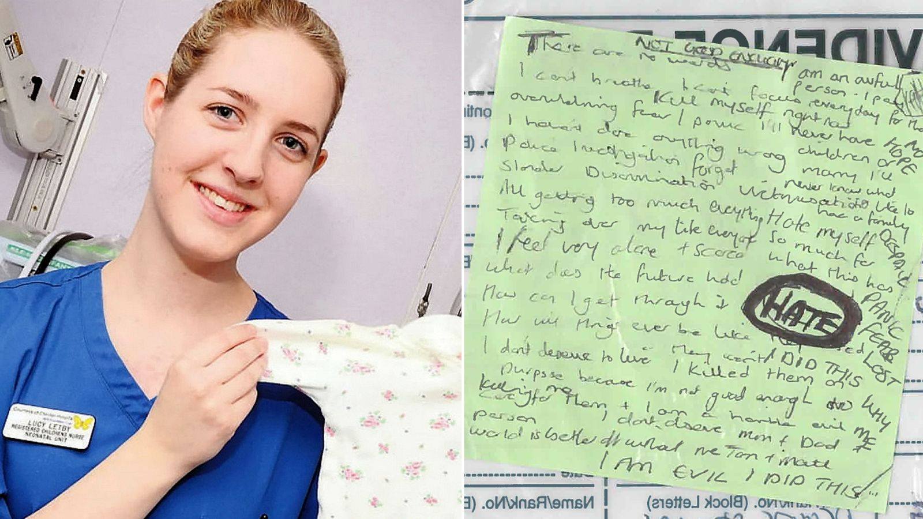
LCHS7006 | Countess of Chester Hospital
06 · Policy · 11 / 16
Clinical Governance and Whistleblowing
Senior doctors tried to raise the alarm as deaths grew.
Managers required doctors to apologise instead of investigating (Kirkup and Titcombe, 2023).
Reputation was valued above patient safety (Kirkup and Titcombe, 2023).
Policies only work if leaders follow them in practice (Dyer, 2023).
Fig: Contested case at the centre of governance failures (Dyer, 2023)
"Managers valued the hospital's reputation over the safety of its patients."
Suppression
Reputation
Regulation Gap
Concerns dismissed; whistleblowers pressured.
Trust image prioritised above patient safety.
No enforcement of duty of candour on managers.
— (Kirkup and Titcombe, 2023))
Notes:
Another major failure at the failing hospital was its local clinical governance and whistleblowing. As the number of infant deaths began to grow, and because it was not normal, senior doctors attempted to raise the alarm. Kirkup and Titcombe (2023) emphasise that rather than heeding the whistleblowers, management required the doctors to apologise and valued the hospital's reputation over the safety of its patients. This culture was toxic, defensive and actively stifled clinical governance. This is an aggressive rejection of risk escalation policies, a deep fault in how NHS trusts are regulated as policies are only effective if people follow them in practice, Dyer (2023) explains.

Slide 12
LCHS7006 | Countess of Chester Hospital
07 · Impact · 12 / 16
Impact on Quality and Efficiency
Quality weakened by infection risk and missed clinical signs (Lawrence and Conn, 2024).
Unit acuity had to be downgraded to restore safety.
One junior covering five wards overnight is not an efficient service.
Directly contributed to delays in emergency interventions.
1
junior doctor covering
five wards overnight
20%
shortfall against national
neonatal nurse standards
Fig: Illustrative benchmark of quality and efficiency gaps (Harrison, 2025)
Notes:
The poor quality and inefficiency of the service was due to the structural disintegration and policy failure. It was so poor due to infection risk and failing to receive the necessary clinical signs and symptoms that eventually the care level had to be reduced to a much lower level. Efficiency was also lost. For one junior doctor to work in five paediatric and maternity areas overnight is the opposite to efficient medical service and therefore directly contributes to delays in emergency interventions.

Slide 13
LCHS7006 | Countess of Chester Hospital
07 · Impact · 13 / 16
Impact on Equity
Equity was undermined by these systemic failures.
Chester premature babies faced significantly higher mortality (Lawrence and Conn, 2024).
Patients faced a postcode lottery driven by absent transport and resources.
Structural neglect leaves the most vulnerable with the worst outcomes.
Near specialist centre
Lower mortality risk
Away from specialist centre
Significantly higher mortality
Same national policy — very different local outcomes.
1
Postcode Lottery
2
Transport Deficit
3
Structural Neglect
Geography set access to safe neonatal care.
Absent specialist teams stranded high-risk babies.
Vulnerable patients bore the cost of under-investment.
Notes:
A lack of equity in health care was another significant problem resulting from these systemic failures. The proportion of premature babies born at this hospital had significantly increased mortality rates than any babies born near specialist centres. Patients faced a postcode lottery as there were no safe transport and local resources. This injustice reflects the structural neglect that can result in health outcomes being significantly poorer for the most vulnerable in society than they deserve to be.

Slide 14
LCHS7006 | Countess of Chester Hospital
08 · Roadmap · 14 / 16
Roadmap for Component 2
Introduction to the case with full context.
Methodology grounded in Donabedian and Swiss Cheese models.
Root cause investigation of latent and active failures.
Policy assessment on centralisation and governance, plus strategic recommendations.
01
02
03
04
05
Case Introduction
Methodology
Root Cause
Policy Assessment
Recommendations
Context and framing.
Donabedian + Swiss Cheese.
Latent and active failures.
Centralisation and governance.
Strategic improvements.
The written report will translate this analysis into a defensible, action-oriented strategy.
Notes:
These themes will be further developed in the next written report. It will start with an introduction to the case, followed by an in-depth methodology based on Donabedian and Swiss Cheese models. It will then conduct a comprehensive root cause investigation of the latent and active failures of the whole hospital.

Slide 15
LCHS7006
Conclusion · 15 / 16
Conclusion
Quality assurance must be proactive and led by leadership.
Align national policy with local capacity to end postcode lotteries.
Respect clinical judgement and protect those who raise concerns (Dyer, 2023).
Systemic reform is the only route to preventing repeat harm (Dobson, 2023).
Fig: NHS trust accountability at the centre of reform (Dyer, 2023)
01
02
03
Systemic view
Cultural change
Aligned policy
Beyond individual acts to organisational conditions.
Protect and act on whistleblowing.
National ambition matched to local capacity.
Notes:
The report will then assess the specific policy failures in relation to centralisation and clinical governance. Lastly, it will provide strategic suggestions for enhancing the services. Overall, the Countess of Chester case illustrates that quality assurance needs to be proactive and must be truly supported by leadership to avoid such medical tragedies being repeated in the future.

Slide 16
LCHS7006 | Countess of Chester Hospital
References · 16 / 16
References
Bowie, K. (2025) 'Lucy Letby hospital is slammed over emergency care failings', BMJ, 390, p. r1703. https://doi.org/10.1136/bmj.r1703
Dobson, J. (2023) 'We owe the families affected by Letby meaningful organisational change', BMJ, 382, p. p1986. https://doi.org/10.1136/bmj.p1986
Dyer, C. (2023) 'Letby's killing spree raises questions over NHS governance', BMJ, 382, p. p1931. https://doi.org/10.1136/bmj.p1931
Harrison, J. (2025) 'The challenges of healthcare regulation using the Letby case as an example', British Journal of Nursing, 34(12), pp. 645–649. https://doi.org/10.12968/bjon.2024.0283
Jesudason, E. (2023) 'Reducing the Risk of NHS Disasters', Journal of Medical Ethics, 50(7). https://doi.org/10.1136/jme-2023-109534
Kirkup, B. and Titcombe, J. (2023) 'Patient safety: Listen to whistleblowers', BMJ, 382, p. p1972. https://doi.org/10.1136/bmj.p1972
Lawrence, F. and Conn, D. (2024) A superbug, doctor shortages and a neonatal unit 'out of its depth': Failures at Lucy Letby hospital revealed, The Guardian.
Leary, A. (2023) 'Lessons not learned', BMJ, 382, pp. p1943-p1943. https://doi.org/10.1136/bmj.p1943
The Lancet (2023) 'The Lucy Letby case: Lessons for health systems', The Lancet, 402(10404), pp. 747–747. https://doi.org/10.1016/s0140-6736(23)01839-1
Whiteing, P. (2023) 'Lucy Letby Inquiry Could Be a Missed Opportunity If It Does Not Look at the Wider Issue', Journal of Patient Safety and Risk Management, 29(1). https://doi.org/10.1177/25160435231212956
Yorker, B. and Barker, P. (2026) 'Serial Murder in Healthcare: A Distinct Subtype', The Psychology of Serial Murder, pp. 115–152. https://doi.org/10.1007/978-3-032-22228-2_7
Notes:
Bowie, K. (2025) “Lucy Letby hospital is slammed over emergency care failings,” BMJ, 390, p. r1703. Available at: https://doi.org/10.1136/bmj.r1703.
Dobson, J. (2023) “We owe the families affected by Letby meaningful organisational change,” BMJ, 382, p. p1986. Available at: https://doi.org/10.1136/bmj.p1986.
Dyer, C. (2023) “Letby’s killing spree raises questions over NHS governance,” BMJ, 382, p. p1931. Available at: https://doi.org/10.1136/bmj.p1931.
Harrison, J. (2025) “The challenges of healthcare regulation using the Letby case as an example,” British Journal of Nursing, 34(12), pp. 645–649. Available at: https://doi.org/10.12968/bjon.2024.0283.
Jesudason, E. (2023) “Reducing the Risk of NHS Disasters,” Journal of Medical Ethics, 50(7). Available at: https://doi.org/10.1136/jme-2023-109534.
Kirkup, B. and Titcombe, J. (2023) “Patient safety: Listen to whistleblowers,” BMJ, 382, p. p1972. Available at: https://doi.org/10.1136/bmj.p1972.
Lawrence, F. and Conn, D. (2024) A superbug, doctor shortages and a neonatal unit ‘out of its depth’: Failures at Lucy Letby hospital revealed, The Guardian. The Guardian. Available at: https://www.theguardian.com/uk-news/article/2024/sep/08/a-superbug-doctor-shortages-and-a-neonatal-unit-out-of-its-depth-failures-at-lucy-letby-hospital-revealed (Accessed: July 8, 2026).
Leary, A. (2023) “Lessons not learned,” BMJ, 382, pp. p1943-p1943. Available at: https://doi.org/10.1136/bmj.p1943.
The Lancet (2023) “The Lucy Letby case: Lessons for health systems,” The Lancet, 402(10404), pp. 747–747. Available at: https://doi.org/10.1016/s0140-6736(23)01839-1.
Whiteing, P. (2023) “Lucy Letby Inquiry Could Be a Missed Opportunity If It Does Not Look at the Wider Issue,” Journal of patient safety and risk management, 29(1). Available at: https://doi.org/10.1177/25160435231212956.

