Slide 1
Series hybrid assignment notes

Slide 2
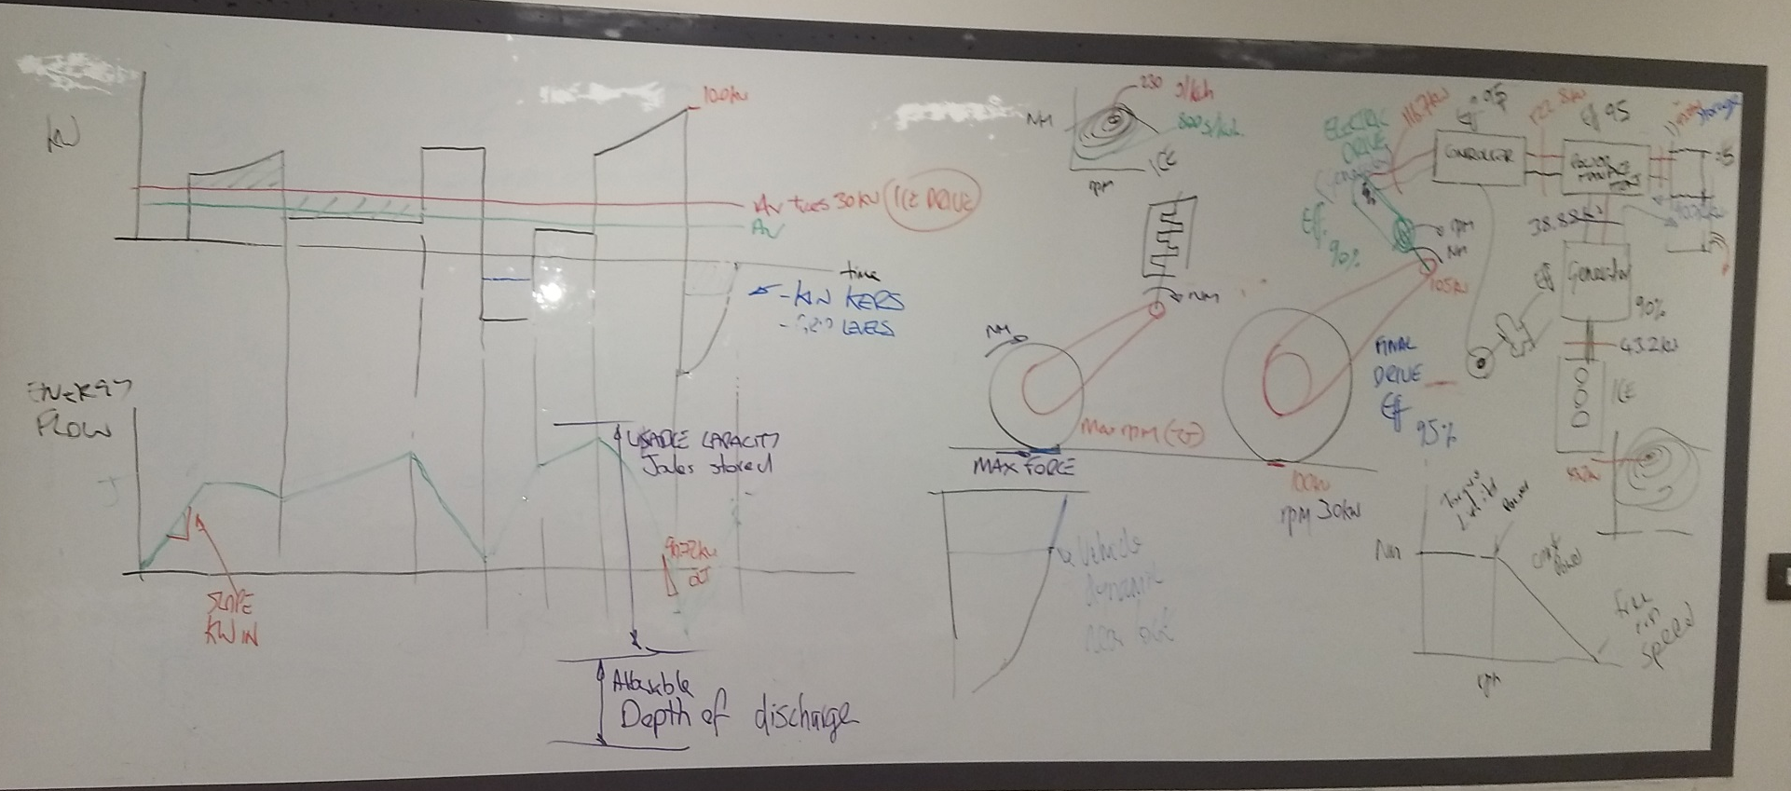

Slide 3


