Slide 1
Tools, skills, and approaches needed to build meaningful relationships ECYW4004
By Caitlin Joyce - 2204263

Slide 2
Introduction
This assignment will explain the skills, tools, and approaches needed to help build meaningful relationships with young people, in groups or on a one-to-one basis. Explanations in this presentation will be supported by wider reading and will be related to the national occupational standards.

Slide 3
Activity!
Decorate gingerbread cookies!

Slide 4
Activity explained
Cooking -
Helps towards the five ways to wellbeing.
Helps young people connect with others and make friends.
Helps improve communication skills.
Gives young people the opportunity to open up and relax.
Form of self-care.
How does this help build meaningful relationships?
Notes:
This activity helps to build meaningful relationships as it gives the young person a chance to open up to both the group and a youth worker. This is because cooking helps communication skills and allows talking to people to feel less forced

Slide 5
Skills!

Slide 6
Understanding Group dynamics
"A necessary condition of group work is an appreciation and utilization of group dynamics" (Ord, 2016, p.83).
As a youth worker it is important to have the skill of understanding group dynamics.
Understanding group dynamics means understanding the different roles within a group, the stages they go through and how all groups are different (Lewis, 2023a).
How does understanding group dynamics help to build meaningful relationships?
Notes:
As youth worker a youth worker understanding group dyanimcs helps to understand everyones role in the group. This helps build meaninful realtionships as the youth worker can help people in their roles to communicate effectively.

Slide 7
Understanding Tuckmans theory
"Group work is geared towards development" (Ord, 2016, p.81). This means that while a group is going through its different stages it is developing.
Tuckman a theorist, believes that groups go through four stages as the group develops. However, it is possible to go through these stages more than once and it is seen as a continuum.
The four stages include:
Forming
Storming
Norming
Preforming
(Chapman, n.d.)
Link this to mind how thr group looked at the start verus now. What stages were they in
How does understanding Tuckman's theory help to build meaningful relationships?
Notes:
Once a youth worker understands tuckmans theory, it helps to build meaningful relaitonships as young people in the groups go through the stages and the end goal is working together effectively. It also helps the youth worker as they are able to understand what stage they are in and help them through it improving their relationship.

Slide 8
Interpersonal and Counselling skills
As youth workers we use counselling skills, however it is important to remember that we are not councilors
Counselling skills can be used in many places, such as;
One to ones
Group work
Activities
Centre based
But ultimately, they are used wherever the young people are (Lewis, 2023b).
Some counselling skills include;
Problem solving
Listening skills
Communication skills
Empathy
(Indeed Editorial Team, 2021)
How do these skills help to build meaningful relationships ?
Notes:
Couselling skills help to build meaningful relationships as they allow the youth worker using them to communicate effectively to help build a relationship

Slide 9
Communication skills
Communication skills play an important role in youth work practice.
There are many ways in which a youth worker can communicate with young people. For example, "written communication, verbal communication, active listening, feedback, and inclusivity skills" (Kaplan, 2022).
It is important that non-verbal communication skills are taken into consideration. For example, SOLER
Squarely, Open posture, Lean, Eye contact, Relaxed
How does communication skills help to build a meaningful relationships?
Notes:
Using skills such as a soler help to communicate and build relationships with young people both in one to ones and groups. This is because it makes you approachable and makes conversation easier and more comfortable for those involved.

Slide 10
Leadership skills
In youth work practice, it is sometimes possible to have to use leadership skills.
It is beneficial to have good leadership skills as a youth worker because youth workers should be there to inspire and motivate young people towards their goal.
Good leadership skills also makes it easier to keep projects or events on track and direct the activities of the groups (YouthLink Scotland, n.d.).
How does good leadership skills help build meaningful relationships?
Notes:
As good leaderships results in young people being motivated. It allows for a meaningful relationship to form as young people will trust the youth worker and look up to them

Slide 11
Managing stress
Youth workers are always about working towards goals and helping young people develop. This can be difficult if a youth worker is experiencing a lot of stress. This is supported by Ingram and Harris when they say, "Stressed workers are not effective" (Ingram and Harris, 2001, p.57).
Ingram and Harris suggest that one way of managing stress is defining boundaries (Ingram and Harris, 2001, p.58).
How does managing stress help to build meaningful relationships?
Linking theory to practice
-My own placement.
Notes:
So inittially in my own placement I was quite stressed with uni placment and uni work. I impleent boundaries and a structure, and it reduced my stress and improved my youth work practice as I was able to be in the moment and enjoy my plaecement while with the young people.
And then as this allowed me to be in the moment, it resulted in me building meaninful reationships with the young people.

Slide 12
Collaboration skills
Youth workers need good collaboration skills, as youth work practice requires youth workers working with multi-agencies and young people's parents (Young, 1999, p.94).
Collaboration skills are based upon having good communication skills and utilizing the different forms of communication.
Youth workers may need to collaborate with others to help the young people reach a goal that has been set.
How can collaboration skills help to build meaningful relationships?
Notes:
After point 2; you can also refere back to slide 11 for such examples.
Having a good collaboration skill cn help build meaningful relationships as it sets a good example for the young people involved and may make parents more comfortable. It also benefits the young person if multiagencys are used.

Slide 13
Being respectful
One key skill of being a youth worker is being respectful to young people and other people they may be involved with
This includes respecting peoples' boundaries, feelings, religions and opinion.
How does being respectful help to build meaningful relationships?
Notes:
One basic skill.
Being respectful helps to build relationships as a lot of young people wont speak to soeone if they feel they are being disrespective. Being respectful also gives young people to open up either in one to ones or groups if they feel like they can trust who they are with

Slide 14
Tools!

Slide 15
The five ways to wellbeing
Connect
Be physically active
Learn new skills
Give to others
Mindfulness
(NHS, 2019)
Youth workers should use the 5 ways to well-being as a tool in planning activities and events with yong people. This is because young people's wellbeing should always be considered.
Connect – Connecting with someone can improve someone's wellbeing.
Be active – Physical activity has been shown to help reduce depression and anxiety. It also helps improve overall well-being.
Learn – learning can help to improve someone's self-esteem and can often aid peoples' social lives.
Give – Giving to others has been reported to make all involved, overall happier. Even one act of kindness a week can help someone to feel happier.
Mindfulness – Taking in the moment is often over-looked but can be beneficial in a lot of ways. It can help someone to understand themselves better and improve their own values and motivations (MIND, 2019).
How can the 5 ways to wellbeing help to build meaningful relationships?
Notes:
To help make a connection you should try speaking to soeone new. Phone someone instead of texting them and make more of an effort to make general conversations with people
Being activie does not havw to be intense it can be as simple as going for a walk or taking the stairs instead of the elevator.
Learning can be fun. It can be doing suduko or researching soething you’ve always been interested in, for example learning about youth work.
Giving does noot have to be expensive. It can simply mean helping someone find their way around an area you know.
So for example listening to music alone in your room
The 5 ways to well being can help build meanngful relationships as the young people can see the youth worker trying to help them as the 5 ways to well being have been proven to help bring happiness to those who take part.

Slide 16
Risk assessments
Risk assessments are important in youth work as it allows for youth workers to plan and execute activities and events successfully while keeping all involved safe.
Risk assessments "protect people from potential harm and ill-health" (Chas, n.d.).
In the summary functional map for youth work, key area E states "maintain health and saftey in the workplace". (CLD Standards, 2019, P.6) don’t forget to add this to y reference list
How do risk assessments help build meaningful relationships?
Notes:
After third poinnt ; Risk asssessments help youth workers meet this standard, as they find the risk, say how likely it is and allows youth workers to have an action plajn to eliminate that risk.
Risk assessments allow all of those involved to feel safe and this helps to buil realtonships as they feel they can trust the youth worker

Slide 17
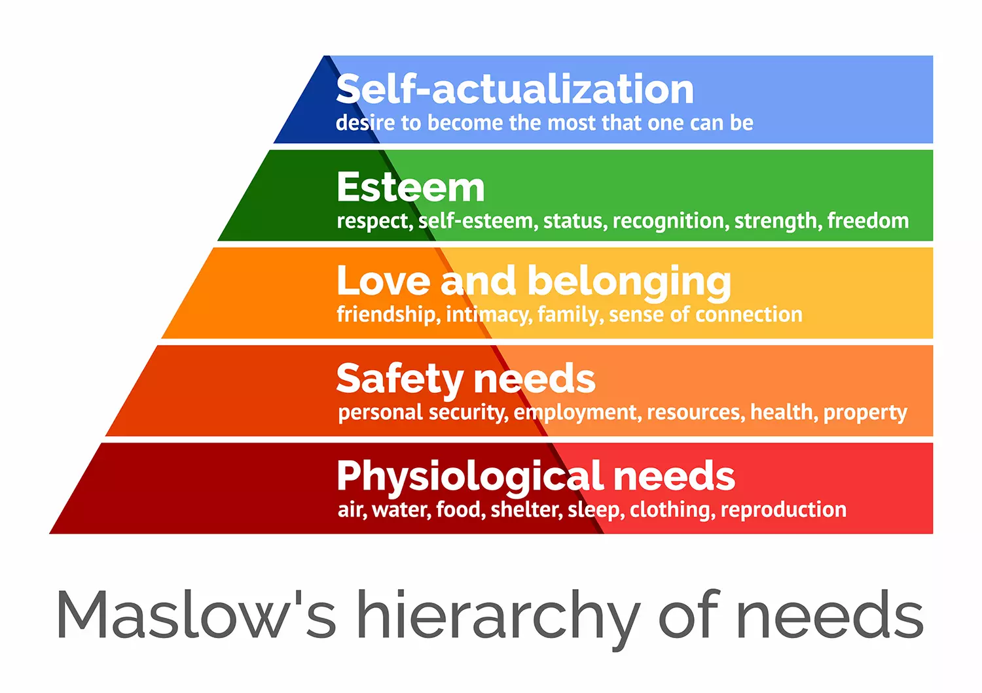
Maslow's hierarchy of needs
Maslow's hierarchy of needs was a theory made by Abraham Maslow. It is a five-tier pyramid which consists of human needs. The needs at the bottom need to be met before someone can move up on the pyramid (Mcloed, 2022).
It is important that youth workers consider this tool in their practice as it would be helpful to figure out what a young person's next step is.
(Mcloed, 2022)
How can Maslow's hierarchy of needs help build meaningful relationship?
Notes:
For example soeone needs to have access to an adequate home with food and water before they can move up to the next tier of employment and security. It is always likely to move up and down these ters throughout life.
Once the young perosn starts to move up maslows hierachy of needs they will reach the love and belonging tier which ill help to build meaningful relationhips

Slide 18
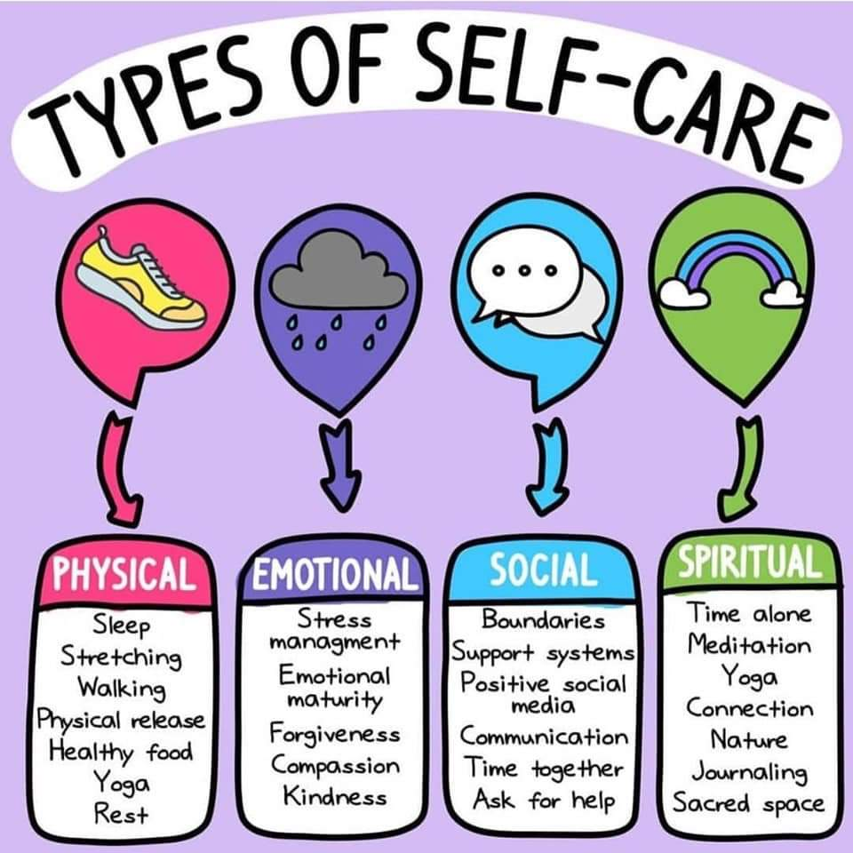
Self-care
  Self-care is acting and doing the things that personally improve someone's mental and physical health (National Institute Of Mental Health, 2022).
  Self-care is unique to the person who is doing it.
  Young people often forget to take part in self-care and as a result youth workers should consider self-care as a tool when planning events and activities.
(St Thomas A Becket C of E Primary School, 2021)
How does self-care help build meaningful relationships?
Notes:
In relation to young people , some young people expereice regualry, reach out to friends to do self care.
Third point- for example relating back to the five ways to well being, one self care action youth workers can use is helping the yong people exercise ore even if it is just a walk.
If a youth worker implements self care into their practice it will help build relationships with young people as it shows the youth worker is implementing what the youth are interested in.

Slide 19
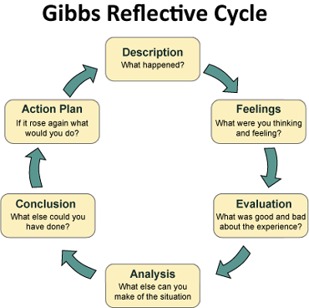
Reflections
"It is an active process of forming a picture, identifying problems and mapping out a way forward" (Harrison and Wise, 2005, p.196).
This explains that reflections are important for improving youth work practice.
It is important that youth workers use reflection as a tool in their practice.
How does reflections help build meaningful relationships?
(Crowe Associates Ltd, 2019)
Notes:
If a youth worker shows that they are improving their practice through reflections it will show the youth that they are making an effort for them and can help build relationships

Slide 20
Approaches!

Slide 21
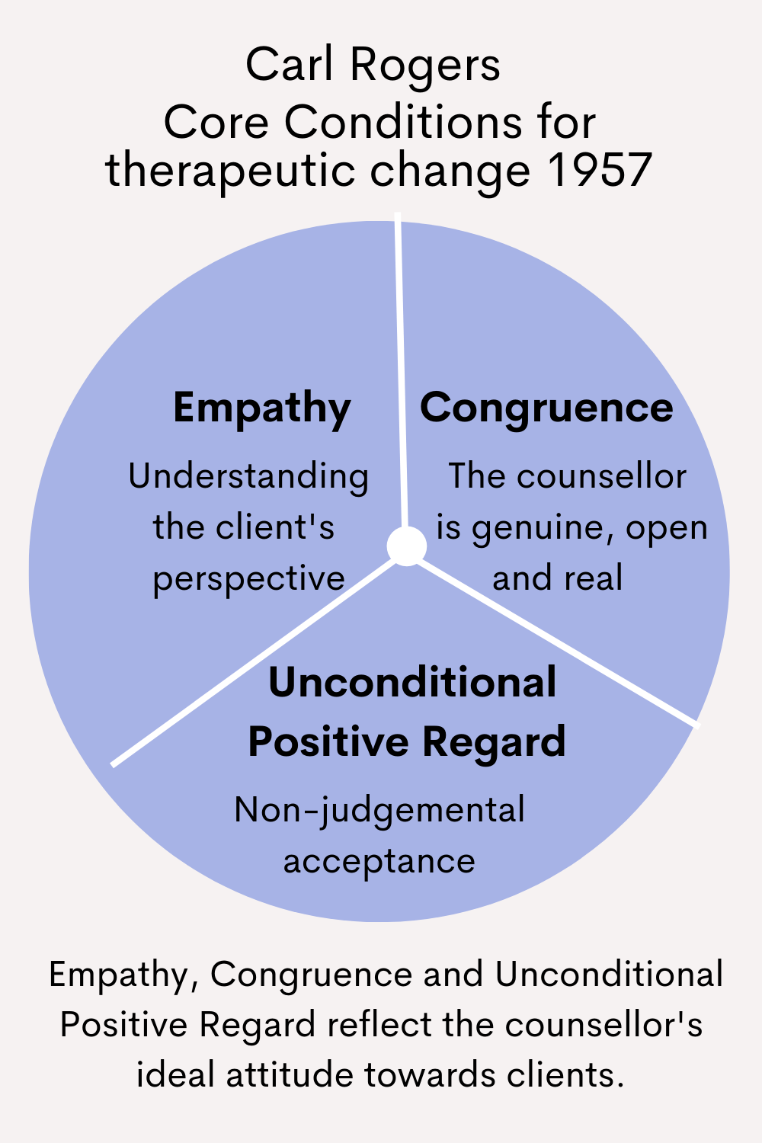
Carl Rogers
Carl rogers produced the theory of the person-centered approach, this includes Empathy, unconditional positive regard and congruences (Counselling Tutor, 2016)
Unconditional positive regard – is when the therapist is non-judgmental towards their client and accept the moment that they are in in their lives (Kirschenbaum and Henderson, 1996, p.136).
Congruence – the Counsellor should be a genuine and nice person (Counselling Tutor, 2016).
It is important for youth workers to use Carl Rogers approach as youth workers use counseling skills.
How can carl rogers' theory help build meaningful relationships?
Notes:
Carl rogers theory helps build meaningful realtionships as it helps show the young person that youth workers are interested in them and that they are listening to them.

Slide 22
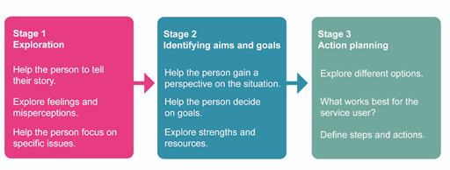
Geral Egan
Geral Egan added to Carl Rogers theory.
Geral Egan uses these three modes to help explain the different stages of skills helpful in the change process. (Lewis, 2023a)
Geral Egans approach is important for youth workers as it makes it clear the different stages a youth workers and young person's relationship goes through.
How does Geral Egans theory help build meaningful relationships?
(OpenLearn, n.d.)
Notes:
Geral egans theory is all about relationships. Because of this , knowing what stage you are in can help keep you motivated to carry on and build meaningful relatonships

Slide 23
Facilitation
Heron a theorist, produced the theory of the three modes of facilitation.
A good facilitator will use all modes effectively when needed and will understand the modes are a continuum. (Lewis, 2023)
Skills of a facilitator:
Communication skills
Time keeping skills
Active listening
Being unbiased.
(Control, 2019)
The three modes of facilitation;
Authoritan mode
Cooperative mode
Autonomous mode
How does facilitation help build meaningful relationships?
Notes:
A lot of skills a facillitator needs helps build meaningful relationships. For example active listening shows the young person you are interested and this ay allow them to open up to the youth worker.

Slide 24
Conclusion
To conclude there are a number of tools, skills and approaches that youth workers should implement in their youth work practice. Using said tools, skills and approaches will help build meaningful relationships. It is also important to notice the link between theory and practice.

Slide 25
Thank you!

Slide 26
References
Chapman, A. (n.d.). Tuckman: Forming, Storming, Norming and Performing - BusinessBalls.com. [online] Businessballs.com. Available at: https://www.businessballs.com/team-management/tuckman-forming-storming-norming-performing-model/.
Chas (n.d.). Why Are Risk Assessments Important? [online] CHAS. Available at: https://www.chas.co.uk/knowledge-base/risk-assessment-importance/.
Control, V. (2019). What are Facilitation Skills and Why are They Important? + Voltage Control. [online] Voltage Control. Available at: https://voltagecontrol.com/blog/what-are-facilitation-skills-and-why-are-they-important/.
Counselling Tutor (2016). Person-Centred Approach to Counselling • Counselling Tutor. [online] Counselling Tutor. Available at: https://counsellingtutor.com/counselling-approaches/person-centred-approach-to-counselling/.

Slide 27
References
Crowe Associates Ltd (2019). Gibbs Reflective cycle | Crowe Associates. [online] Crowe-associates.co.uk. Available at: https://www.crowe-associates.co.uk/coaching-tools/gibbs-reflective-cycle/.
Harrison, R. and Wise, C. (2005). Working with young people. Los Angeles [Etc.] Sage, p.196.
Indeed Editorial Team (2021). 10 Essential Counsellor Skills. [online] Indeed Career Guide. Available at: https://uk.indeed.com/career-advice/career-development/counsellor-skills [Accessed 18 Feb. 2023].
Ingram, G. and Harris, J. (2001). Delivering good youth work : a working guide to surviving and thriving. Lyme Regis: Russell House, pp.57–58.

Slide 28
References
Kaplan, Z. (2022). What Are Collaboration Skills? Definition and Examples. [online] Forage. Available at: https://www.theforage.com/blog/skills/collaboration-skills#:~:text=Collaboration%20skills%20include%20written%20communication.
Kirschenbaum, H. and Henderson, V.L. (1996). The Carl Rogers reader. Constable, p.136.
Lewis, A. (2023a). ECYW4004 COUNSELLING SKILLS, MINDFULNESS AND THERAPEUTIC PRACTICE.
Lewis, A. (2023b). ECYW4004: Counselling Skills, Mindfulness and Theraputic Practice.

Slide 29
References
McLeod, S. (2022). Maslow’s Hierarchy of Needs. [online] Simply Psychology. Available at: https://www.simplypsychology.org/maslow.html.
MIND (2019). Five ways to wellbeing | Mind, the mental health charity - help for mental health problems. [online] Mind.org.uk. Available at: https://www.mind.org.uk/workplace/mental-health-at-work/taking-care-of-yourself/five-ways-to-wellbeing/.
National Institute Of Mental Health (2022). NIMH» Caring for Your Mental Health. [online] www.nimh.nih.gov. Available at: https://www.nimh.nih.gov/health/topics/caring-for-your-mental-health#:~:text=Self%2Dcare%20means%20taking%20the.
NHS (2019). 5 Steps to Mental Wellbeing. [online] nhs.uk. Available at: https://www.nhs.uk/mental-health/self-help/guides-tools-and-activities/five-steps-to-mental-wellbeing/.

Slide 30
References
OpenLearn (n.d.). Introducing social work: a starter kit. [online] Introducing social work: a starter kit. Available at: https://www.open.edu/openlearn/mod/oucontent/view.php?id=104131&section=_unit3.3.
Ord, J. (2016a). Youth Work Process, Product and Practice. Routledge, p.83.
Ord, J. (2016b). Youth work process, product and practice : creating an authentic curriculum in work with young people. London ; New York: Routledge, Taylor & Francis Group, p.81.
St Thomas A Becket C of E Primary School (2021). Different types of self-care |. [online] St Thomas A Becket C of E Primary School. Available at: https://www.st-thomas-a-becket.wilts.sch.uk/wellbeing-resources/different-types-of-self-care/ [Accessed 28 Feb. 2023].

Slide 31
References
Young, K. (1999). The art of youth work. Lyme Regis: Russell House, p.94.
CLD Standards Council Scotland (2019). Youth work national occupational standards.
YouthLink Scotland (n.d.). Youth Work Skills Framework | Leadership. [online] www.youthlinkscotland.org. Available at: https://www.youthlinkscotland.org/programmes/youth-work-and-the-attainment-challenge/skills-framework/leadership/.

