Slide 1
Sex Differences in Landing Error Scoring System Total Score and ACL Injury Risk
BMSS5001 – Biomechanics of Sport and Injury
2405385 – Joshua Harvey
A Biomechanical Analysis

Slide 2
Why Study The Sex Difference In LESS
01
02
03
Aim
To examine whether sex is a predictor of the landing error score
Females higher ACL injury rates, Greater knee valgus, stiffer landing and reduced dynamic knee control (Padua et al., 2009; Griffin et al., 2000).
Background
Relevance
LESS cost effective injury tool
Notes:
Previous literature here about why and comparison to why

Slide 3
Methodology
Participants
20 (10M/10F), Age 18-29, mixed activity level
Equipment
Video analysis, drop landing protocol for LESS Scoring, notating scoring against published norms
Protocol
30cm box, ½ body height of participant measured and marked forwards, land and jump instantly and maximally straight upwards
Statistical Analysis
Descriptive and inferential stats Shapiro-Wilk, Levene’s Test, Independent t-Test, Cohens d, Mann-Whitney U Test, (Backup), Chi-Square Test.
Limitations
Small N, convenience sample, no sport-specific data

Slide 4
Results
Descriptive Statistics (Mean, SD)
t-Test results
Box Plot For Distributions
Risk Category Grouped Bar Chart

Slide 5
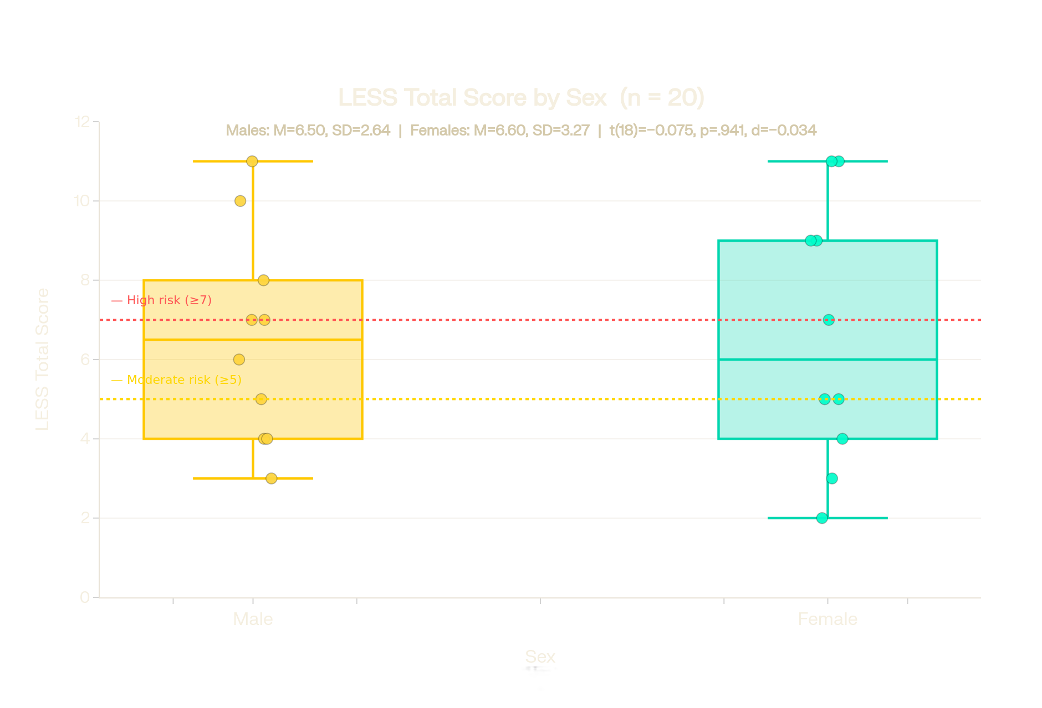
Descriptive Statistics
Male Mean LESS
Female Mean LESS
t-statistic
Mann-Whitney U
Cohen's d
6.50
6.60
−0.075
49.5
−0.034
SD = 2.64 | n = 10
SD = 3.27 | n = 10
p = .941
p = 1.000
Negligible effect
Table 1: Chi-Square Test
Risk Category
 |  | Low | Mod | High | Total
Sex | Male | 3 | 4 | 3 | 10
 | Female | 3 | 3 | 4 | 10
Total |  | 6 | 7 | 7 | 20
Figure 1: Box Plot for Distributions
Notes:
both non-significant, meaning data are normally distributed Shapiro wilk test
BW clear on what this is inferring and the order of the data

Slide 6
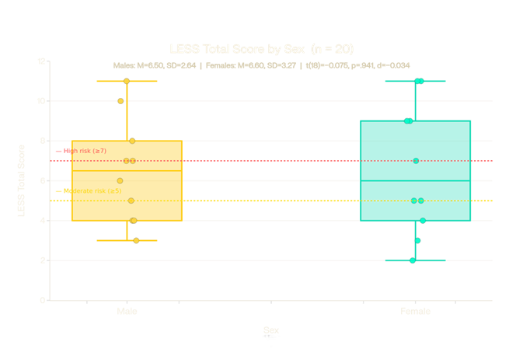
Box Plot For Distributions
Figure 1: Box Plot for Distributions
Notes:
Label figures underneath

Slide 7
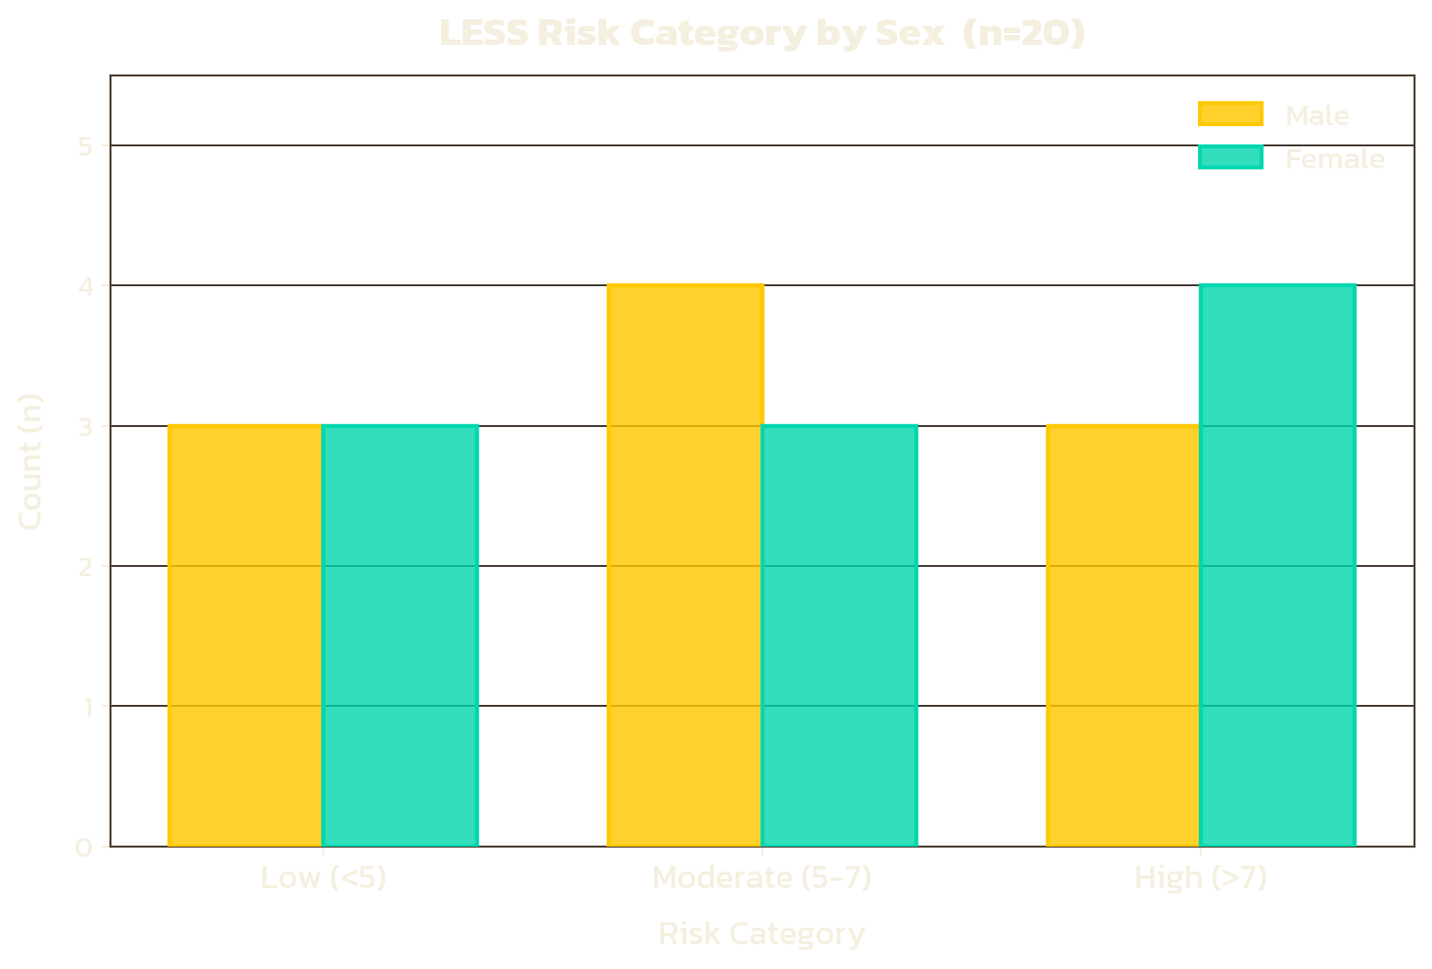
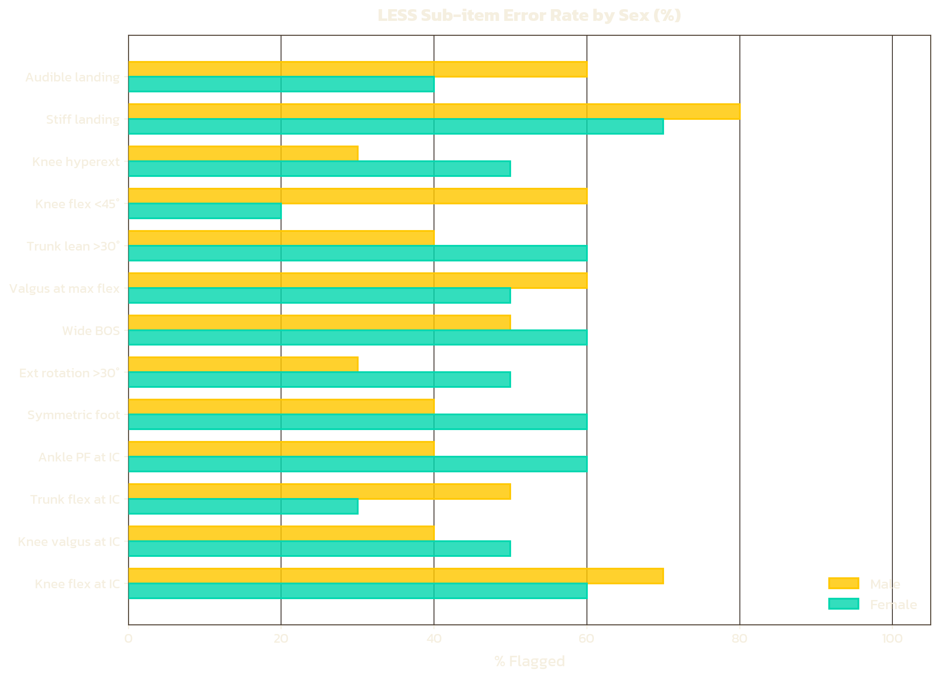
Risk Category Chart
Figure 2:Bar Chart for Risk category by Sex
Figure 3:Bar Chart for sub-items for LESS
Key Observations
▸ Both sexes show broadly similar risk category distribution
▸ Females: 4 High-risk vs Males: 3 High-risk — trend but not significant
▸ Knee valgus at IC and stiff landing most prevalent sub-item errors in both sexes

Slide 8
What the data Shows
What the data reflects
No significant sex difference in LESS Total score: = -0.075, p = .941, d = -0.034
Small sample size statistically underpowers to detect moderate effect sizes (n=10)
Both groups score moderate risk band on average (m = 6.5)
Mixed activity group (Athlete, Recreational, Sedentary), Training status confounds sex sizes
5 F vs 3 M in high risk category – Directional trend not statistically significant
LESS gross screening tool, sensitive to large deficits but may miss sex-based differences
Stiff landing flagged most frequent (80% M 70% F) Largest sub-item difference
Lab drop-jump may not replicate sport-specific cutting/ landing mechanics

Slide 9
Biomechanical Mechanism
Greater Q-Angle in F > increased valgus stress at the knee
Lower hamstring:quadriceps co-contraction ratio > reduced dynamic joint stability
Reduced hip abductor strength > Greater hip adduction during landing
Neuromuscular activation patterns differ > females show delayed hamstring response
Hormonal influence on ligament laxity – oestrogen peaks mid-cycle increasing ACL laxity

Slide 10
Comparison to Literature
My Findings
My Findings
My Findings
No Sex difference p=.941
Males M = 6.50 F M = 6.60
4/10 F in HR vs 3/10 M
Stiff Landing most common error
No sex x activity group interaction examined
Published Literature
Published Literature
Published Literature
Padua et al., (2009)
Griffin et al., (2000)
Ford et al., (2003)
Meehan er al., ()
Notes:
Hewett et al., - females show significantly greater knee valgus and lower flexion angles on landings
Padua et al., (2009) – females typically score 1-2 points higher on LESS than males
Griffin et al. (2000) — females 2–8× more likely to sustain ACL injury
Ford et al. (2003) — stiff landing and knee valgus are strongest biomechanical predictors of ACL injury
Meehan et al. — sport-specific populations show strongest sex differences in landing mechanics
null result is not a failure — it is a meaningful finding that highlights the limitations of small, mixed-activity samples and supports calls for larger, sport-stratified studies.

Slide 11
Practical Recommendations and Future research
Implement LESS screening in both sexes — not females only
Target stiff landing correction as a priority — highest error rate across both groups
Deliver neuromuscular training (e.g., FIFA 11+, ACL prevention programmes) regardless of sex
Sub-item analysis (knee valgus, knee flexion at IC) may be more clinically sensitive than total score alone
Increase sample size (minimum n ≥ 30 per group for adequate statistical power)
Control for activity level — compare Athletic males vs. Athletic females specifically
Longitudinal design — track whether LESS score predicts actual injury incidence
Include hormonal cycle phase as a variable in female participants
Combine LESS with force plate data for a richer biomechanical picture

Slide 12
Conclusion
No significant sex difference in LESS Total score
Trend towards higher female risk – ACL Injury epidemiology
Notes:
No statistically significant sex difference in LESS total score was observed in this sample (p = .941), though a directional trend towards higher female risk categorisation aligns with established ACL injury epidemiology.

Slide 13
References
Padua, D.A., Marshall, S.W., Boling, M.C., Thigpen, C.A., Garrett, W.E. and Beutler, A.I. (2009) ‘The landing error scoring system (LESS) is a valid and reliable clinical assessment tool of jump-landing biomechanics: the JUMP-ACL study’, American Journal of Sports Medicine, 37(10), pp. 1996–2002.
Griffin, L.Y., Agel, J., Albohm, M.J., Arendt, E.A., Dick, R.W., Garrett, W.E., Garrick, J.G., Hewett, T.E., Huston, L., Ireland, M.L., Johnson, R.J., Kibler, W.B., Lephart, S., Lewis, J.L., Lindenfeld, T.N., Mandelbaum, B.R., Marchak, P., Teitz, C.C. and Wojtys, E.M. (2000) ‘Noncontact anterior cruciate ligament injuries: risk factors and prevention strategies’, Journal of the American Academy of Orthopaedic Surgeons, 8(3), pp. 141–150.
Hewett, T.E., Myer, G.D., Ford, K.R., Heidt, R.S., Colosimo, A.J., McLean, S.G., van den Bogert, A.J., Paterno, M.V. and Succop, P. (2005) ‘Biomechanical measures of neuromuscular control and valgus loading of the knee predict anterior cruciate ligament injury risk in female athletes’, American Journal of Sports Medicine, 33(4), pp. 492–501.
Ford, K.R., Myer, G.D. and Hewett, T.E. (2003) ‘Valgus knee motion during landing in high school female and male basketball players’, Medicine & Science in Sports & Exercise, 35(10), pp. 1745–1750.
Myer, G.D., Ford, K.R. and Hewett, T.E. (2004) ‘Rationale and clinical techniques for anterior cruciate ligament injury prevention among female athletes’, Journal of Athletic Training, 39(4), pp. 352–364.
Shultz, S.J., Schmitz, R.J., Benjaminse, A., Collins, M., Ford, K. and Kulas, A.S. (2012) ‘ACL Research Retreat VI: an update on ACL injury risk and prevention’, Journal of Athletic Training, 47(5), pp. 591–603.
Hewett, T.E., Lindenfeld, T.N., Riccobene, J.V. and Noyes, F.R. (1999) ‘The effect of neuromuscular training on the incidence of knee injury in female athletes’, American Journal of Sports Medicine, 27(6), pp. 699–706.
Silvers-Granelli, H., Mandelbaum, B., Adeniji, O., Insler, S., Bizzini, M., Pohlig, R., Junge, A., Snyder-Mackler, L. and Dvorak, J. (2015) ‘Efficacy of the FIFA 11+ injury prevention program in the collegiate male soccer player’, American Journal of Sports Medicine, 43(11), pp. 2628–2637.

