Slide 1
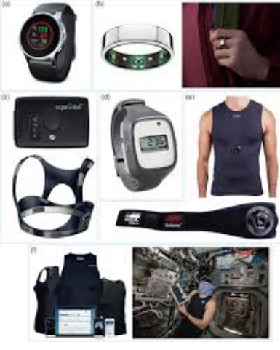
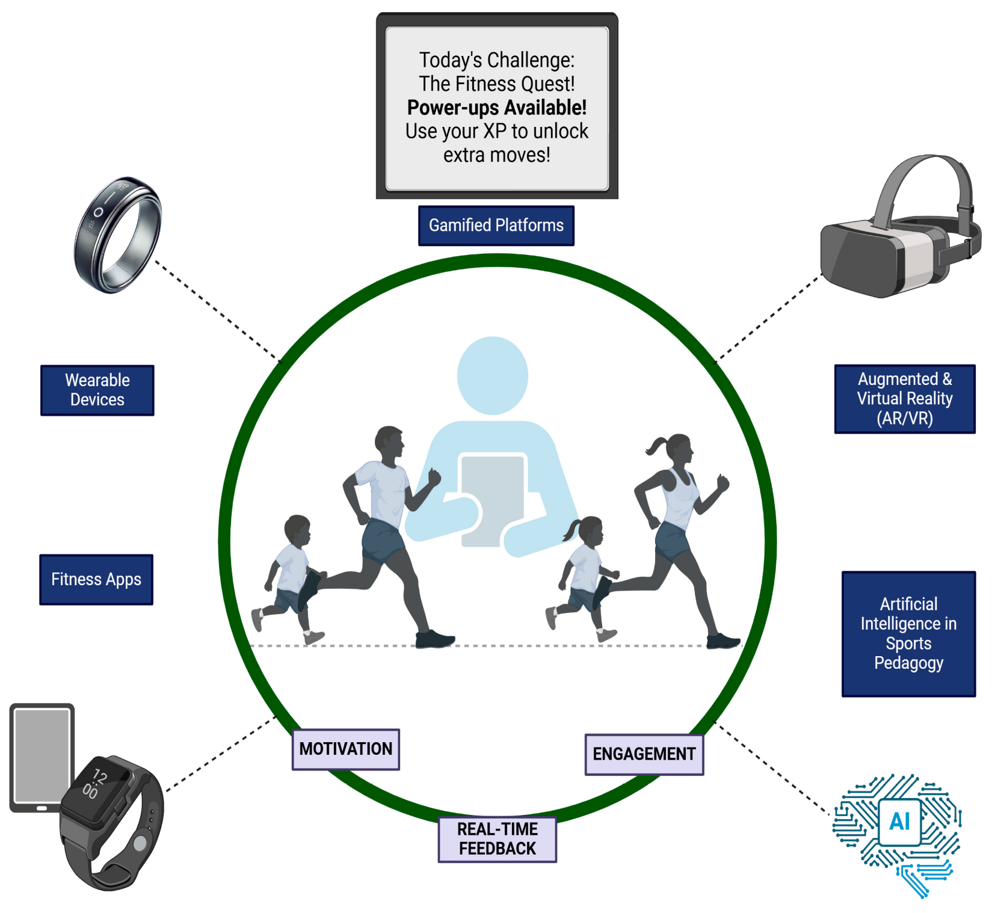
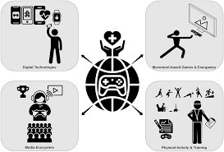
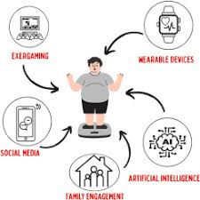
GAMIFIED WEARABLE DIGITAL INTERVENTIONS FOR PROMOTING PHYSICAL ACTIVITY AND REDUCING PHYSICAL INACTIVITY
student name :Riddhi patel Student ID Number: 2506528
1. Background
Physical inactivity is now one of the biggest world-wide population health issues, especially in adults (ranging in age 18 years and older) with 1.4 billion adults failing to meet the suggested standard levels of physical output as per the World Health Organization (WHO, 2021). In adults, prolonged sedentary behaviour and the lack of physical activity contribute to the high rates of cardiovascular diseases, type 2 diabetes, obesity, some types of cancers, and premature deaths (WHO, 2021). Old-fashioned techniques such community-based exercise sessions, public awareness programs, and digital technologies such as bionic wristbands have been introduced. The intervention selected is the Life Lift that is based upon wearable technology but incorporates gamification techniques, real-time tracking and customised feedback to facilitate the continuation of the physical activity and in solving the problem of sedentary lifestyles in adults. Physical inactivity among adults is closely linked with a higher healthcare cost, lower productivity, mental health problems, and chronic disease morbidity. Adults are more than ever prone to sedentary lifestyles due to modern lifestyles typified by office employment, which is combined with a lot of time spent in front of the screen and less time in physical activities. Devoid of proper and involving processes, physical inactivity will remain as a source of increase in non-communicable diseases in the world.
2. Health Promotion Values and Principles
Empowerment: Life Lift empowers the constituents of adults by providing them with control over their health via self-monitoring instruments, individualised goal establishing, and real-time feedback. The users are actively involved in self-management of physical activity.
Equity: The intervention endorses equity because the application is affordable, easy to use and compatible with low-cost smart phones and wearable devices, eliminating digital health disparities (Mohammed et al. 2024).
Participation: The social leader boards, peer challenges and community engagement interfaces will attract participation making use of it more accountable and motivated. Prevention: This intervention is aimed at primary prevention in promoting physical activity on a daily basis to lessen the risk of getting non-communicable diseases before they arise.
Socio-ecological approach: Life lift recognises the contributions of individual and social and environmental aspects to behaviour and incorporates the social support systems to improve behaviour change.
33. Health Belief Model (HBM)
HBM is a model of health behaviours where individual thoughts and perceptions regarding perils of the disease and the advantages of action are explained. The model comprises of perceived susceptibility, perceived severity, perceived benefit, perceived barriers, cues to action and self-efficacy. Life Lift utilises HBM by creating awareness about the vulnerability of adult people to chronic illnesses due to lack of exercise and the severity of health complications in the long term perspective. The app notes the advantages of engaging in physical exercise regularly including cardiovascular health, weight loss and mental health benefits. The perceived barriers, which are lack of time, motivation and awareness, are offered via gamification, reminding and customised goal setting (Zuma et al. 2022).
4. Expected Outcomes
It is assumed that when the Health Belief Model is applied in Life Lift, adults will have a better perceptions of risk awareness, motivation, as well as long-term physical activity behaviour (Rodrigues et al. 2023). It has been found that wearable and gamified interventions have the ability to bring about major improvements in the number of steps walked and moderate to vigorous exercise. Thus, in the short-term, one can expect improvements whereas, in the long-term, the change in behaviour is conditional upon sustained engagement strategies and usability. Victorious intervention might decrease sedentary behaviour and decrease cardiometabolic risk factors in the event that it is successful, and would lead to better population health outcomes, and would reduce the burden on the health care system related to lifestyle diseases.
5. Conclusion
Life Lift shows how physical inactivity can be dealt with through digital health innovation and the use of the behavioural theory. Digital literacy should be enhanced through educational programs in order to reduce health disparities. In the research case, there is the need to do more longitudinal and cost-effectiveness research to assess sustainability and scalability. The wearable technology in combination with gamification provides a prospective, theory-based solution to the active lifestyle promotion and the further development of digital health promotion in the contemporary society of health practitioners.
Reference List
Mohammed, M., Fatemah, A. and Hassan, L., 2024. Effects of gamification on motivations of elementary school students: An action research field experiment. Simulation & Gaming, 55(4), pp.600-636. https://doi.org/10.1177/10468781241237389
Rodrigues, F., Figueiredo, N., Jacinto, M., Monteiro, D. and Morouço, P., 2023. Social-cognitive theories to explain physical activity. Education sciences, 13(2), p.122. https://doi.org/10.3390/educsci13020122
WHO (2021). Physical activity fact sheet. Available at: https://www.who.int/publications/i/item/WHO-HEP-HPR-RUN-2021.2.
Zuma, T., Seeley, J., Hlongwane, S., Chimbindi, N., Sherr, L., Floyd, S., Birdthistle, I. and Shahmanesh, M., 2022. A socio-ecological approach to understanding experiences and perceptions of a multilevel HIV prevention intervention: The determined, resilient, empowered, AIDS-free, mentored, and safe (DREAMS) partnership, SSM-Qualitative Research in Health, 2, p.100138. https://doi.org/10.1016/j.ssmqr.2022.100138

