Slide 1
AHHI 5004 - ORIGINS OF THE GREAT WAR
NIALL FERGUSON – THE WAR OF THE WORLD – HISTORY’S AGE OF HATRED

Slide 2
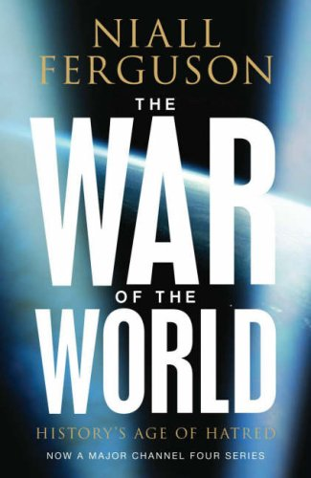
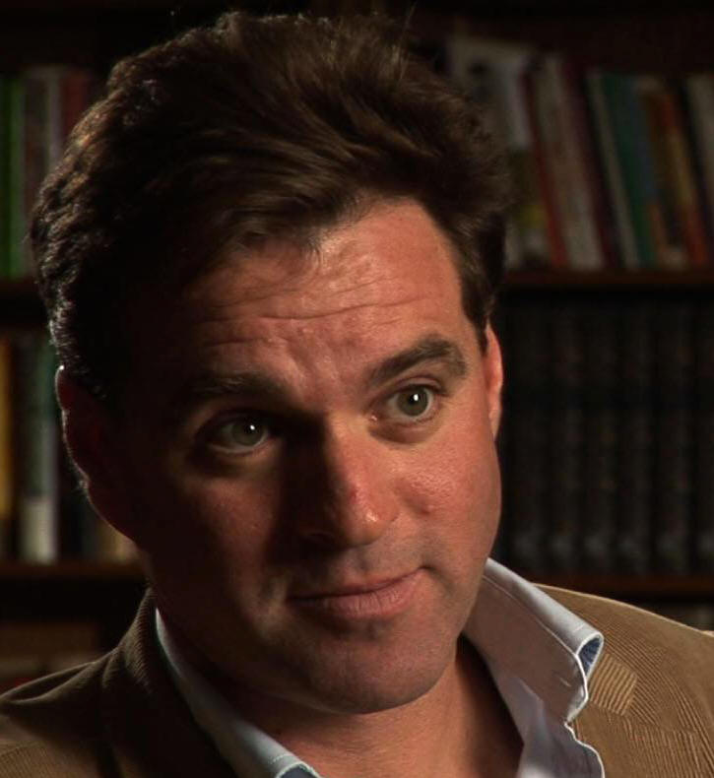
THE WAR OF THE WORLD

Slide 3
‘CRISIS OF CAPITALISM’?
Ferguson questions Marxist interpretation linking the origins of the Great War with ‘a crisis of capitalism’, claiming the war:
‘abruptly terminated a period of extraordinary global economic integration with relatively high growth and low inflation’. p. xxxviii.

Slide 4
VIOLENCE IN THE 20TH CENTURY
‘Three things seem to be necessary to explain the extreme violence of the twentieth century’. p.xli. :-
1. Ethnic conflict – stimulated by theories of racial difference and fragmentation of border regions between ethnic groups
2. Economic volatility ‘Boom and Bust’– changes in growth, prices, interest rates, unemployment levels – polarising effects on society and politics
3. Empires in decline – the multi-national European empires were ‘manifestly nearing their ends’, p.18, and proving more expensive to maintain and police

Slide 5
FERGUSON ON RACE AND ‘RACISM’
1. Quotes:
‘man...is programmed by his genes to protect his kin and fight the other’. p.xliv
‘racial differences may be genetically few, but human beings seem to be designed to attach importance to them’. p.xlvi
Despite the veneer of civilisation ‘we should not lose sight of the basic instincts buried within even the most civilised men’. p. xlvi.

Slide 6
‘THE RACE MEME’
2. Enduring racism (see pp.li-lv)
Despite the challenges to the hereditary principles born out of the Enlightenment and revolutions in America and France i.e.:
Democracy – power backed by popular acclamation
Liberalism – all men equal before the law
Socialism – property redistribution,
Racism and racist views remained generally intact

Slide 7
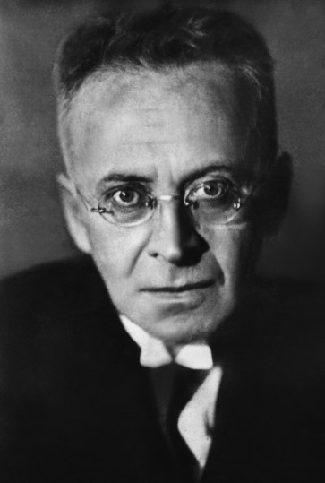
FERGUSON AND THE ROAD TO WAR
1. Austro-Hungarian Empire:
‘the...Central European realm of the Habsburgs was primarily weakened by its ethnic diversity’ (p11)
Austro-Hungarian Empire = ‘a laboratory of world destruction’, p.13. Karl Kraus (1874-1936); journalist and satirist. Reflecting the tensions multi-tiered polity and multi-ethnic society

Slide 8
ROAD TO WAR
2. Russia:
Held together, precariously, by centralisation from the Tsar down
Also by policy of Russification against ethnic minorities
Economy unstable, but able to support industrialisation and militarisation
‘a Russian revolution of rising expectation in the making’, p.15. – dissatisfied peasantry; decaying aristocracy; radical middle class in the cities

Slide 9
ROAD TO WAR
3. ‘RACE MEME’:
‘By 1901 there had been a worldwide revulsion against miscegenation’, p.21 – it meant degeneration
Born out of pseudo-scientific Social Darwinism that provided a rationale for concept of racial hygiene
Evident in Germany, German diaspora, and other parts of Eastern Europe, through growing anti-Semitism in political and cultural life

Slide 10
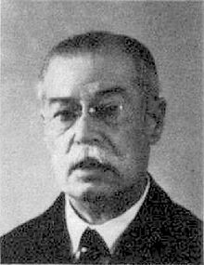
ROAD TO WAR
‘RACE MEME’ contd..
HENRICH CLASS (1858-1953) Pan-German League and anti-Semite:
‘If I were the Kaiser’ (1912); lists restrictions on Jews, e.g. Excluded from public office and armed forces; disenfranchised – see pp.34-5.

Slide 11
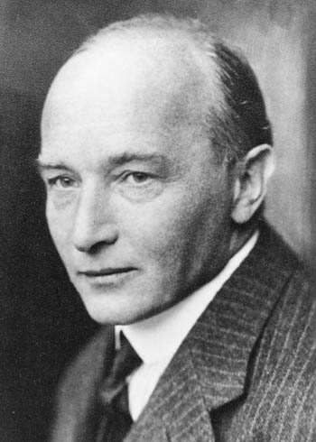
ROAD TO WAR
‘RACE MEME’ contd..
Anti-Semitic pogroms in Russia – from 1881, including 1905
Robert Musil’s (1880-1942) Austrian novelist description of multi-ethnic Austria - ‘Kakania’ p.12, p.42
‘Enormous potential for conflict in this world of empires and races’ p.40.

Slide 12
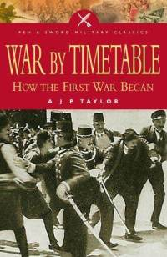
ROAD TO WAR
4. ‘THE GREAT TRAIN CRASH’
Long-held view that war came about following prolonged tensions and crises, and was not ‘a bolt from the blue’
Archduke Ferdinand on June 28th 1914 was ‘driving along one of the world’s great fault lines’ p.74

Slide 13
ROAD TO WAR
On the contrary, Ferguson states:
‘For the reality is that the First World War was a shock, not a long anticipated crisis. Only retrospectively did men decide they had seen it coming all along...it is unforeseen that causes the greatest disturbance, not the expected’ pp.80-1.

Slide 14
ROAD TO WAR
5. THE MARKETS:
Ferguson looks to the reaction of the financial markets (sale of government bonds in particular) as indicators of the approach of war, concluding:
‘far from registering the approach of world war...most financial market indicators in the years leading up to 1914 implied a decline in the risk to investors’ p.85, hence:
‘financial market data...strongly reinforce the impression that the war came as a surprise to the people who had the biggest incentive to anticipate it’ p.83.

Slide 15
ROAD TO WAR
5. THE MARKETS contd...
Ferguson claims that the bond markets did not reflect a sharp rise in the probability of war until the last week of July 1914. This lead to contagion and increased financial instability (see p.86)
He concludes: ‘if this view is correct, then much of the traditional historiography on the origins of the war has, quite simply, over-determined the event’, p.91.

