Slide 1
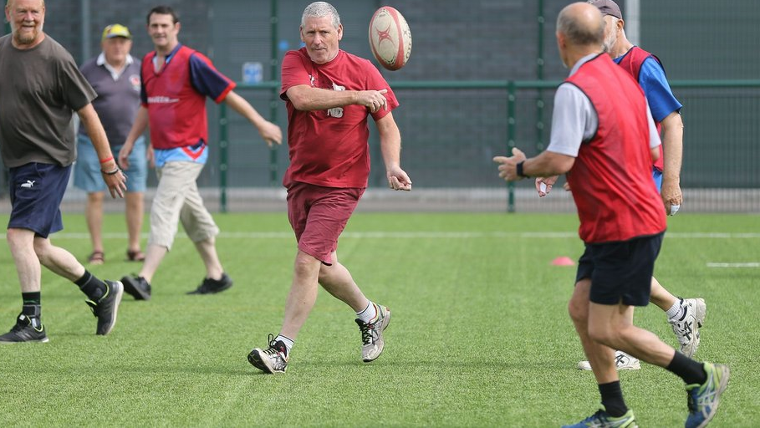
Social inclusion and community cohesion in sport

Slide 2
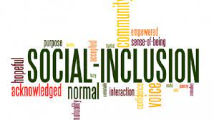
What is social inclusion and community cohesion in sport?
Social inclusion has been defined as a process to ensure that everyone, regardless of their life experiences or circumstances, can achieve their potential in life (Social Exclusion Unit 2006)
Tisdall, et al (2006) suggest that social inclusion is about being allowed or enabled to take part while participation is taking part.
Notes:
Unit, S.E., 2006. A sure start to later life: ending inequalities for older people. London: Office of the Deputy Prime Minister.
Local Government Association, 2004. Community cohesion-an action guide: guidance for local authorities.

Slide 3
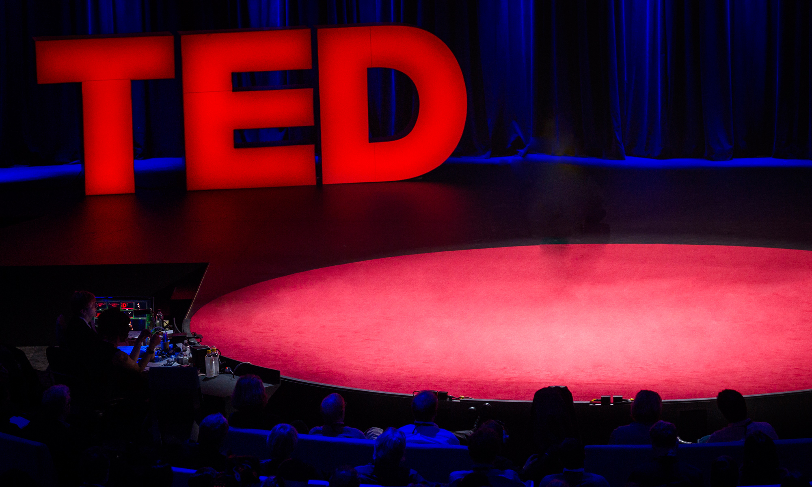
Case Study 1
Watch this short video talking about what sport can do for social inclusion and community cohesion.
https://www.youtube.com/watch?v=UnANbbVLDS8
Notes:
8 minutes 23 second's start
Approx. 3 minutes long

Slide 4
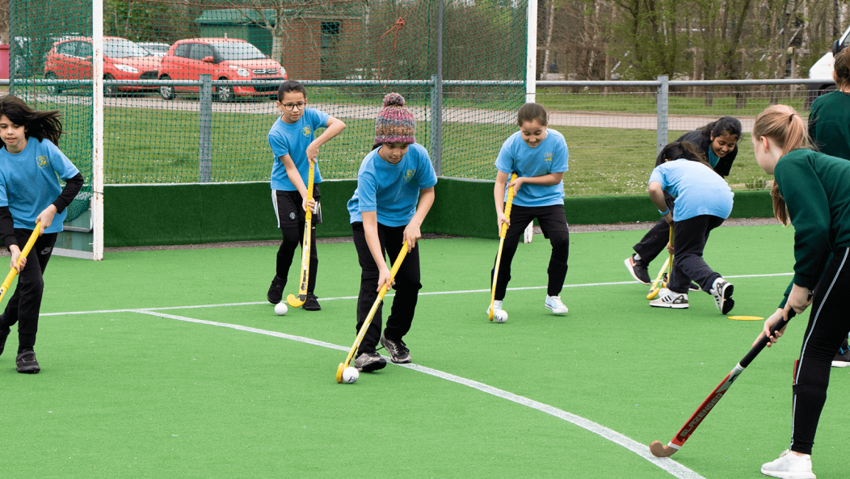
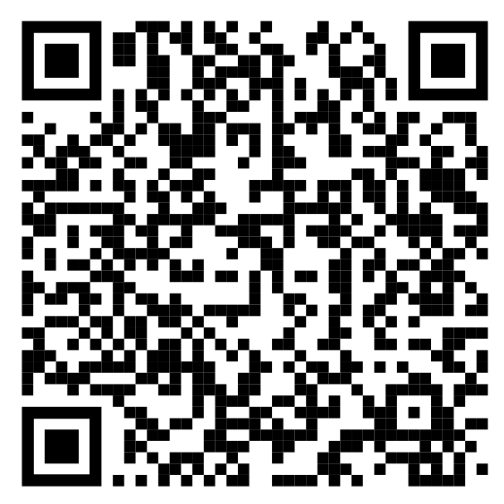
Sport and society
Activity 1
  Scan the QR Code
  Does Sport add any value to society?
  Use post it notes to add your thoughts
Notes:
Society and Sport - Google Jamboard Society and Sport - Google Jamboard

Slide 5
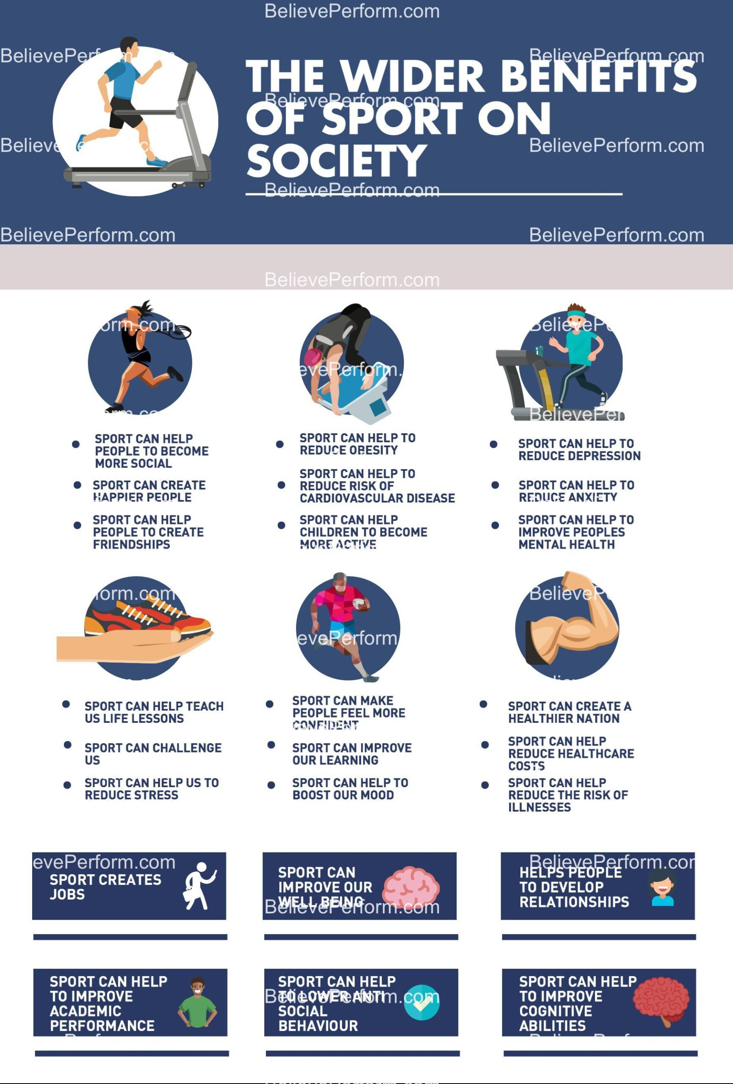
Sport’s role in society

Slide 6
Task
15 minutes
Find out what the 7 pillars of social inclusion are
Find an example of where these have been applied in your local area
Notes:
https://inclusivesportdesign.com/planning-for-inclusion/7-pillars-of-inclusion-using-commonalities-as-the-start-point-for-inclusive-sport/

Slide 7
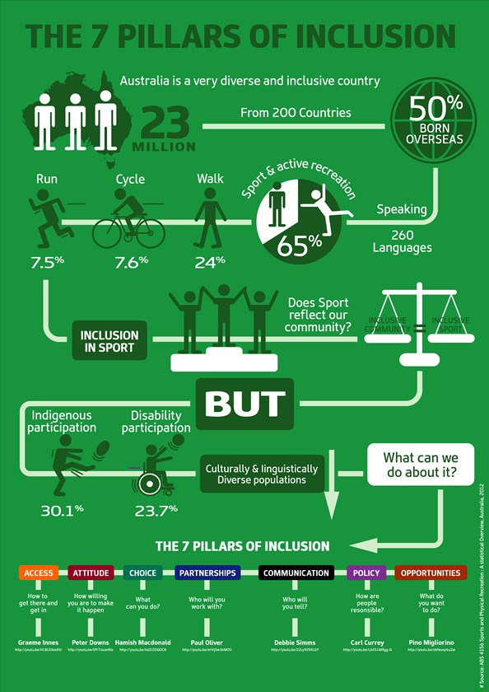
The 7 Pillars of Social Inclusion
Notes:
https://www.nrl.com/community/inclusion/get-involved-get-inclusive/

Slide 8
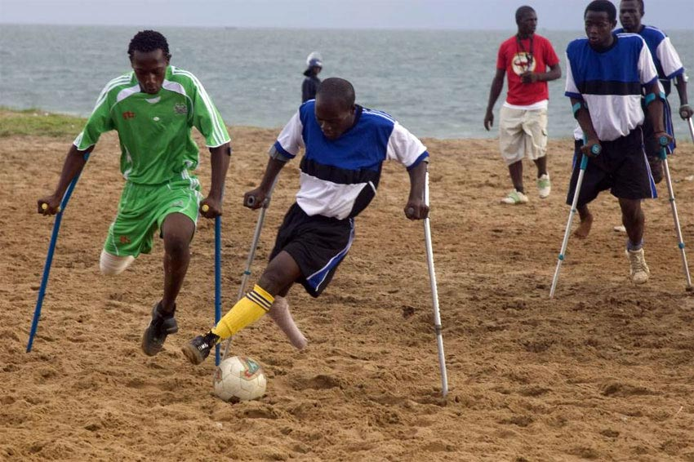
Disability Sport
Let’s look at the stats
Less than 3 in 10 disabled people feel encouraged to return to physical activity post pandemic.
Only 4 in 10 disabled people feel they can be as active as they would like to be, in contrast to non-disabled people, who are more likely to be as active as they want post pandemic.
Only 47% of disabled people think that physical activity and exercise is for ‘someone like them’.
8 in 10 disabled people want to be encouraged into physical activity and exercise.
Notes:
https://www.activityalliance.org.uk/how-we-help/research/annual-survey

Slide 9

What’s being done about it?
Student Task:
Research and find a successful programme that has made an impact on disability sport
Use the library search and web based search but ensure that it is an academic source

Slide 10

Case Study 2: Sport Scotland
School Leaver Recreation Awareness Project:
Aims to provide a programme for pupils with a disability in their final year to encourage continuing postschool involvement in recreational activities.
Pupils are given the tools and training to make their own decisions
Provides a link between pupils and local recreation officers
Funding provided for production of resource materials
Pupils gain valuable leadership experience
Notes:
https://sportscotland.org.uk/documents/resources/disabilityrr.pdf

Slide 11

Case Study 3: Sport Wales
Becoming an Inclusive Leader Programme:
Aimed at senior leaders and managers of NGBs, Local Authorities and Local Leisure Trusts. It is also aimed at anybody already leading diversity and inclusion Programmes.
The Programme runs over a period of 8 months and covers themes such as; Leading and challenging yourself, Leading others who may not feel like they belong there, Leading Strategy, and leading and enabling positive change.
15 new participants are chosen at the end of every 8-month cycle.
Notes:
https://www.sport.wales/partners/akd-become-an-inclusive-leader-programme/
Sport wales

Slide 12
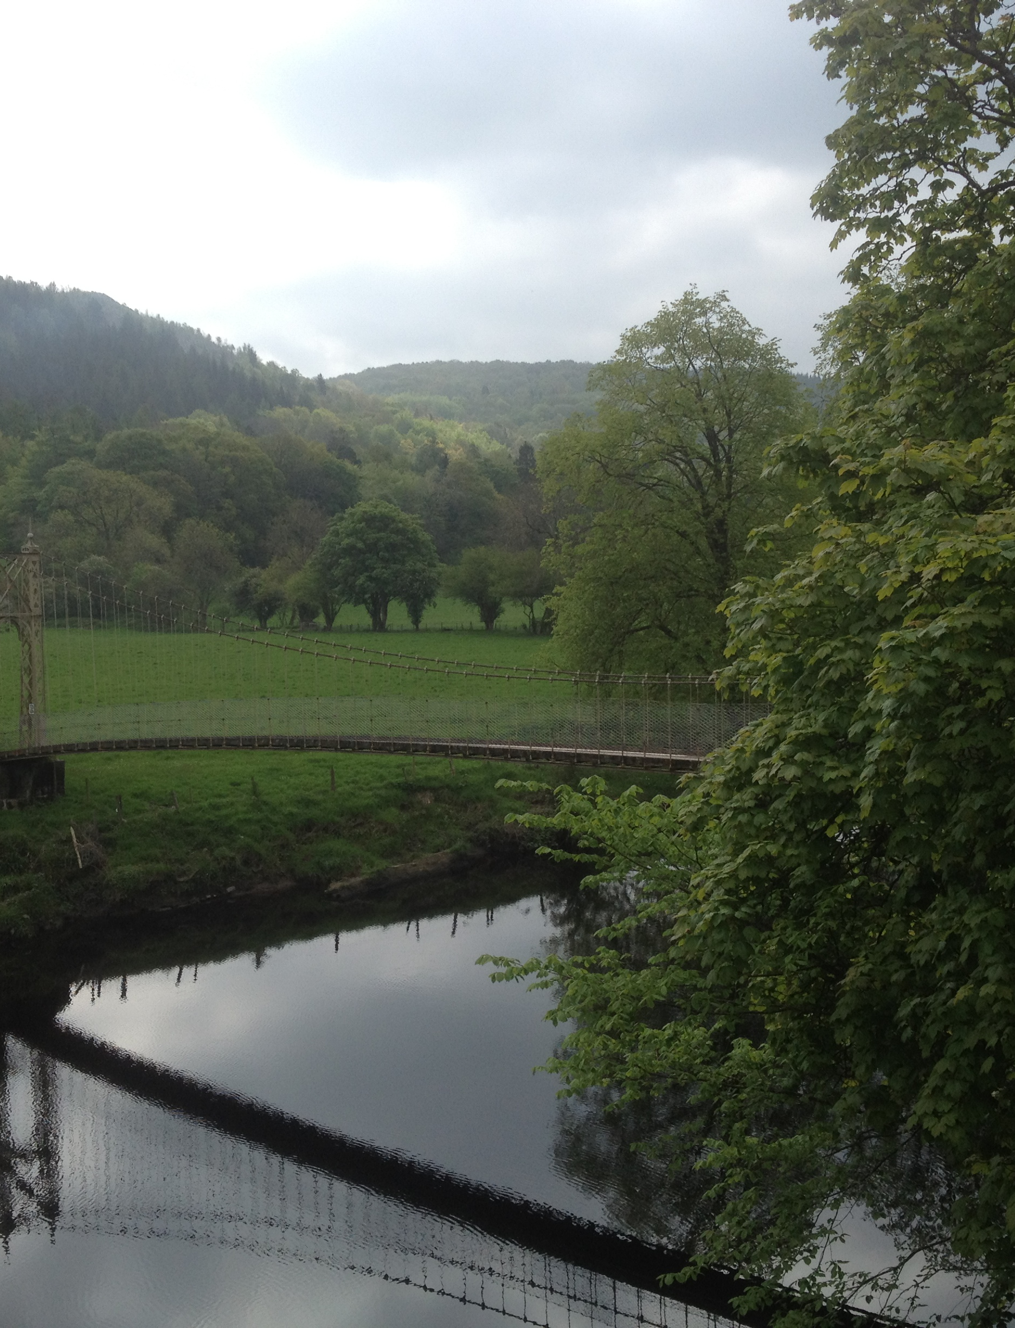
The Benefits of Green Exercise

Slide 13

How do you feel when you go outside for a walk? If it is a green place, whether in the city or countryside, the chances are high that you will feel better. Even when it is bitterly cold, fiendishly hot, or lashing with rain, being close to nature and the elements seems to improve our sense of well-being.
Participating in physical activity in greenspaces – ‘green exercise’ – brings additional mental and physical health benefits, which could form part of a solution to a number of growing health and environmental problems.

Slide 14
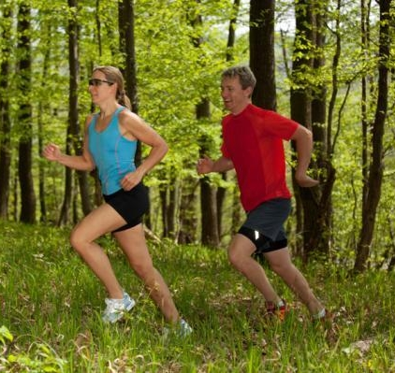
Evidence now shows that there is a positive relationship between exposure to nature and mental and physical health. At the same time, social interactions can be fostered and memories of places are created.

Slide 15
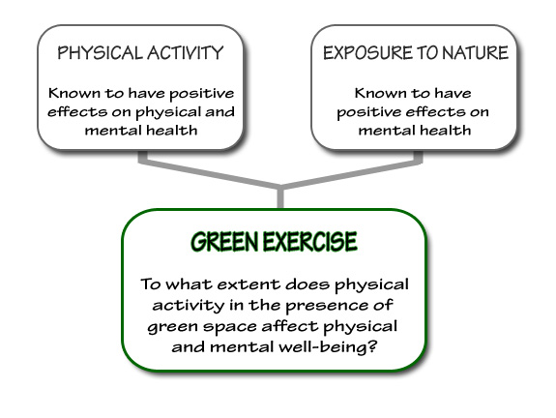
Notes:
https://www.youtube.com/watch?v=QA20LUNVk6o

Slide 16
From recent research, three broad health outcomes are possible:
Improvement of psychological well-being (by enhancing mood and self-esteem, whilst reducing feelings of anger, confusion, depression and tension);
Generation of physical health benefits (by reducing blood pressure and burning calories);
Facilitation of social networking and connectivity (by enhancing social capital).

Slide 17
Key quantitative findings emerging from the large amount of data available show that:
3 out of 4 people feel less depressed, tense and angry after participating in a form of green exercise;
2 out of 3 people experience an overall improvement in their level of mood;
Almost two thirds of people report improved levels of self-esteem;
An improvement in mean self-esteem and mood levels is always reported after participation in different green exercise activities.

Slide 18
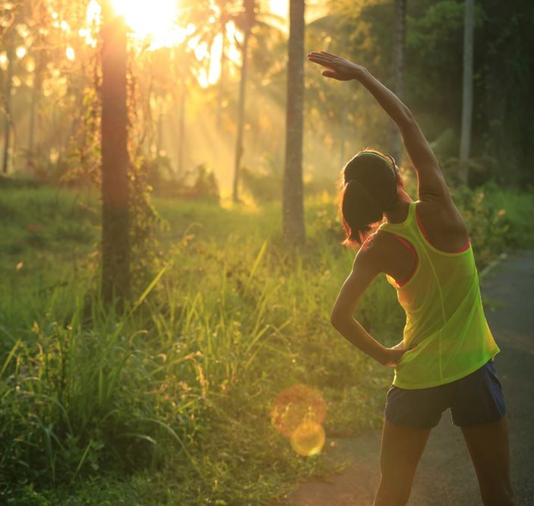
What we Know and What we Suspect
Nature & Health Evidence
Know
Nature (including parks, gardens, countryside and wildernesses) is good for you, bringing mental health benefits.
Nature is a place where physical activity is likely and easy, bringing physical health benefits.
All types of people (age, gender, social groups, ethnic groups) benefit, but vulnerable, ill, disaffected and disadvantaged seem to benefit more (e.g. green exercise is more effective for people who start with poorer mental health).
All types of natures produce positive health and memory outcomes, from nearby nature to countryside's to wildlands.
Nature can act therapeutically, making many people better, but not the severely ill or depressed.

Slide 19
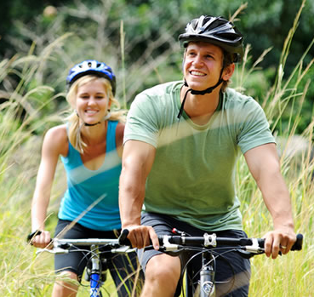
Suspect
Engagements with animals (pets, wild) results in the same kinds of mental health benefits as with nature and places.
There is a hard-wired, genetic component to human engagement with green places (biophilia), resulting in different outcomes depending on the view.
Physiological profiles can be produced to measure GE/GC interventions (eg endocrine indicators, blood pressure).
Danger could offset mental health benefits, as could extreme weather.
Nature or activities in nature could set the context for curing certain conditions or problems.

Slide 20
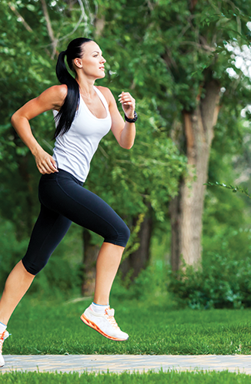
Task-
Work in groups 2-3
Make a poster presentation with the following information:
Define green exercise, find 10 different forms, highlight the benefits and find academic literature / evidence to support these benefits
  You can search google for images / statistics / reports
  You can search the library to support with academic literature

Slide 21
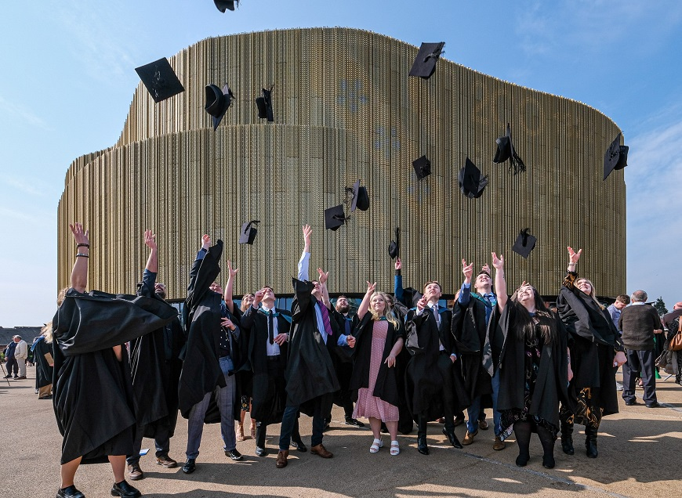
A1 Assignment- 50% of your grade
See assignment brief
Uploaded to turn it in
Start investigating now, use the tools / resources available to you
Enjoy researching!

Slide 22
Assignment
The Covid pandemic has highlighted the importance of sport, exercise, and physical activity. A number of factors influence the health of the nation, targeted activity projects and programmes have been designed to improve the health and wellbeing of the population.
Part 1:
Highlight one activity intervention project and conduct an academic discussion introducing the project / programme, explaining its aims and objectives. Conduct further research to identify if it has been successful and provide recommendations based on this evidence :
Approximately 1000 words -Weighting = 70%
Part 2:
Mental health and well being is important and will play an important part in shaping the new modern world as we move into an ever increasing digital era. Analyse the different forms of exercise that can promote positive mental health and well being and link these to current government priorities. (Approximately 500 words) Weighting = 30%

