Slide 1


Slide 2
Evaluation of Business
Task 2
Student Name: Gabriela Gherasim
Student ID: 2110945
Module code: LCBB 4005
Module name: Global Business Environment
Lecturer: Dr Hossein Shokri

Slide 3

Agenda
1. Introduction
2. Summary
3. Analysis of the environment
4. PEST Analysis
5. Marketing goals and objectives
6. Marketing strategy
7. Conclusion
8. References

Slide 4

Introduction
Base on my research I will write about Reliance Industries PLC which is a UK Company established and they make mostly brake and suspension parts for the auto business.
The company bought Ashton and Shaw UK Ltd., which was losing money and mostly made electrical parts for cars.
Reliance has made this once-struggling business into a cash flow by putting a lot of money into new technology and changing the way it is run.

Slide 5

Summary
Both Ashton and Shaw UK Ltd and Reliance Industries PLC have started to lose sales to competitors with lower prices, and both have recently lost mid-sized and older accounts.
This study will look at the business sector's global market and come up with a new strategic and tactical marketing plan.
They wrote down their marketing goals: "We want to make the best products, offer the most services, reach the most people, and sell at the lowest prices."

Slide 6

Analysis of the environment
According to a summary from Keynotes (2002), the world's auto industry is dominated by the United States, Canada, Western Europe, and Japan, which together produce about 70% of all cars produced worldwide.
He demonstrated that the UK auto sector has a moderate rate of expansion by summarising Keynotes (2002). Thus, even in the absence of much opposition from international suppliers, domestic opportunities would be constrained.
He claimed that the car components sector is quite competitive, as is the case in this instance.

Slide 7

PEST Analysis
The four main external elements that affect the organisation are identified through political, economic, social, and technical study.
PEST analysis is a study of the external macro environment that offers data for making strategic decisions.
These outside elements, which are typically uncontrollable for businesses, are referred to as business threats.
For assessing the viability of a new product and studying the overall organisational plan, PEST analysis is absolutely crucial.

Slide 8
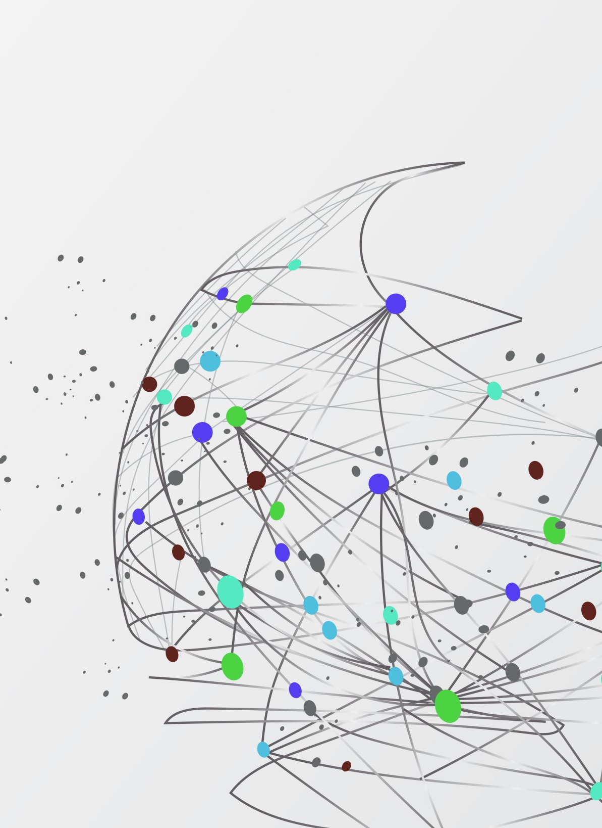
- Political Factors
Everything that the government says or does is a political consideration. It incorporates the official and informal standards necessary for running an organisation.
When making business decisions, political considerations are taken into account.
These considerations include environmental regulations, employment laws, taxation, trade restrictions, tariffs, political stability, and numerous government policies that have an impact on company either directly or indirectly.
- Economic Factors
Customers' ability to spend is affected by the state of the economy.
The price of capital for a company can be affected by a number of macroeconomic variables, including currency fluctuations, inflation, interest rates, and taxes.
Reliance Industries PLC could be severely impacted by economic concerns, leading to massive shifts in the social market.

Slide 9

- Social factors
Social elements include the macroeconomic, cultural, and demographic facets of the outside world.
The needs and size of the possible market are typically impacted by these elements, which have a significant impact on how consumers behave while making purchases.
Social aspects include the population growth rate, age groups, and customer attitudes towards things like safety, careers, and health.
- Technological Factors
Technical expertise is crucial to cost-cutting measures because it decreases entry barriers, affects outsourcing decisions, and influences outsourcing.
It consists of everything that can be used to make a product or provide a service.
Research and development, the rate of technological progress, automation, technological incentives, etc., are all examples of technology-related factors. .

Slide 10

Marketing goals and objectives
The explicit statements of the desired and expected results of the marketing plan are known as marketing goals and objectives.
I devised the following marketing objectives:
- They will pay close attention to important accounts, such as small and large accounts.
- In a year, we will regain any lost long-term and medium-term accounts.
- They will research markets around the world that fit our goals.
Marketing strategy
- The company will describe how it will accomplish its marketing objective in this section.
- Selecting and evaluating target markets and developing and maintaining a suitable marketing mix which including production, distribution, promotion, and price they needs to meet of those markets central of any marketing strategy, as stated by Ferrel (1999).
- Therefore, a company's marketing strategy focuses on how they can manage the relationships client in a way that gives it a competitive advantage.

Slide 11
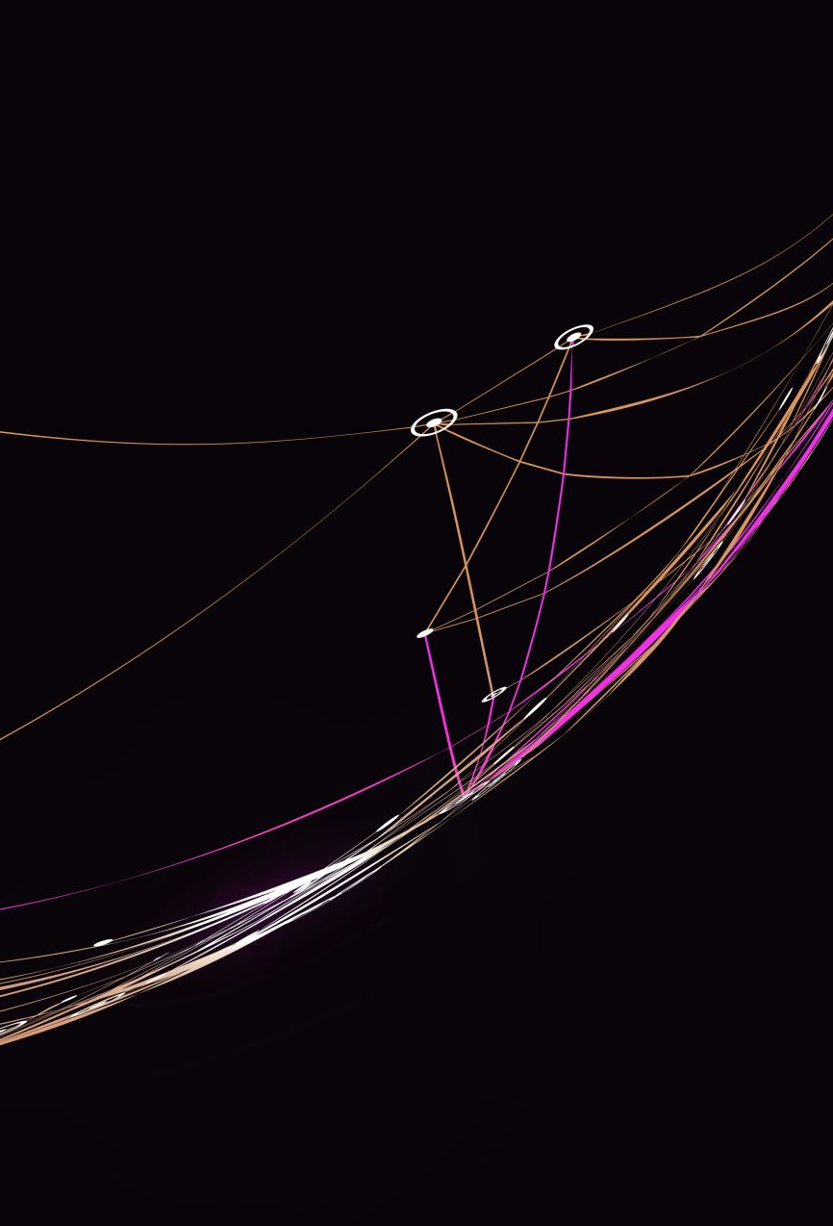
Conclusion
After researching the business climate all over the world, a fresh strategy and tactical marketing plan was designed for Reliance Industries PLC.
According to the marketing objectives, "We want to make the best products, offer the most services, reach the most people, and sell at the lowest prices."
The main objectives are: "We will focus on key accounts, such as small accounts and large accounts."
Long-term and medium-term lost accounts will be recovered after a year. All throughout the world, including in the three largest countries in Asia—Japan, China, and South Korea—we will search for our target regions.

Slide 12
Referinces:
Ferrell, 0., (1999) Marketing Strategy, The Dryden Press: Harcourt Brace college Publisher.
Littleer, D.; Wilson,D., (1995) Marketing Strategy, Butterworth: Heinnemann.
Doyle, P., (1994) Marketing Management & Strategy, Prentice Hall: England.

