Slide 1
Value and the Value Chain
Week 5

Slide 2
Objectives
Explore value innovation through the business model canvas.
Consider wider examples
Hear from the developer of the business model canvas
Determine the elements of the value chain
Has globalisation changed the nature of the value chain?
Who are the winners and losers in the value chain?

Slide 3
the Book approach
Written by Alexander Osterwalder and Yves Pigneur
Design - Alan Smith, The Movement
Editor and Contributing Co-Author - Tim Clark
Production - Patrick van der Pijl
  Co-created by a crowd of 470 practitioners from 45 countries
    Open publishing model – “Alexander and Yves decide they can’t credibly write a book about business model innovation without an innovative business model. They ditch publishers and launch the Hub, an online platform to share their writings from day one. “
Osterwalder and Pigneur Businessmodelgeneration.com

Slide 4
Alexander Osterwalder and Yves Pigneur (2012)
Business Model Generation.com: A Handbook for Visionaires, Game Changers and Challengers
The focus of the book is aimed at managers cantered on two questions –
  Are you thinking about how to create value and build new businesses, or how to improve or transform your organization?
  Are you trying to find innovative ways of doing business to replace old, outdated ones?
Osterwalder and Pigneur Businessmodelgeneration.com
Notes:
In asking these questions of business they saw a gap for developing a practical tool.
In using the business canvas a business would be able to create and recreate their model and refine the model that best fits their needs.

Slide 5
Business Model
A business model can best be described through nine basic building blocks that show the logic of how a company intends to make money.
The nine blocks cover the four main areas of a business: customers, offer, infrastructure, and financial viability.
The business model is like a blueprint for a strategy to be implemented through organizational structures, processes, and systems.
Osterwalder and Pigneur Businessmodelgeneration.com
Notes:
The nine building blocks align well with the ingredients we discussed last week as described by Laudon and Laudon.

Slide 6
BusinessModelGeneration.com
Osterwalder and Pigneur defines a business model –
“A business model describes the rationale of how an organization creates, delivers and captures value”
Osterwalder and Pigneur Businessmodelgeneration.com

Slide 7

nine building blocks
CS
Customer Segments
An organization serve one or several customer segments
Determine which segment to offer and meet customer needs
Is it mass market, niche market, segmented diversified and Multi-sided platforms
Osterwalder and Pigneur Businessmodelgeneration.com
Notes:
Is it mass market, niche market, segmented or diversified?
Mass market – consumer electronics products
Niche - many car part manufacturers depend heavily on purchases from major automobile manufacturers.
Segmented - the watch industry, the medical industry, and the industrial automation sector — and offers each slightly different Value Propositions.
Diversified - 2006 Amazon.com decided to diversify its retail business by selling “cloud computing” services: online storage space and on-demand server usage. Thus it started catering to a totally different Customer Segment — Web companies — with a totally different Value Proposition. The strategic rationale behind this diversification can be found in Amazon.com’s powerful IT infrastructure, which can be shared by its retail sales operations and the new cloud computing service unit.
Multi-sided platforms - an enterprise offering a free newspaper needs a large reader base to attract advertisers. It also needs advertisers to finance production and distribution. Both segments are required to make the business model work

Slide 8

nine building blocks
VP
Value propositions
It seeks to solve customer problems and satisfy customers needs with value propositions
This is the reason customers go to that business, to have the benefits offered.
Some offering may be new or represent a disruptive market.
Osterwalder and Pigneur Businessmodelgeneration.com
Notes:
VP - This is the reason customers go to that business, to have the benefits offered, and get to the products/services that create value for the segment.
Some offering may be new or represent a disruptive market. Or may be similar but additional offerings.
Values may be quantitative (e.g. price, speed of service) or qualitative (e.g. design, customer experience).
Cell phones when they entered the market.
Ethical investment funds disrupted the market.
PC sector has traditionally relied on this factor by bringing more powerful machines to market - however, this is a failed market at present! Most customers do not need the high end.
RollsRoyce to manufacture and service their jet engines. This arrangement allows customers to focus on running their airlines. In return, the airlines pay Rolls- Royce a fee for every hour an engine runs.

Slide 9
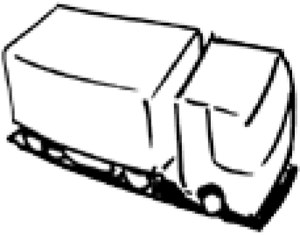
nine building blocks
Channels
Value propositions are delivered to customers through communication, distribution and sales channels
CH
Channels are customers touch points
Through which Channels do our Customer Segments want to be reached?
Osterwalder and Pigneur Businessmodelgeneration.com
Notes:
Channels - Sales forces, web sales, own stores, partner sites, wholesalers

Slide 10

nine building blocks
Customer relationship
CR are established and maintained with each customer segment
CR
What type of relationship does the business want to establish?
What are the motivations:
Customer acquisition, Customer retention,
Boosting sales (upselling)
Online Assistants, communities, co-creation
Osterwalder and Pigneur Businessmodelgeneration.com
Notes:
CR - GlaxoSmithKline launched a private online community when it introduced alli, a new prescription-free weight-loss product. GlaxoSmithKline wanted to increase its understanding of the challenges faced by overweight adults, and thereby learn to better manage customer expectations.
Co-creation More companies are going beyond the traditional customer-vendor relationship to co-create value with customers. Amazon.com invites customers to write reviews and thus create value for other book lovers

Slide 11

nine building blocks
RS
Revenue Streams
RS result from VP successfully offered to customers
The cash a business generates from each customer segment
Sales, Usage fee, subscription fee…….
Osterwalder and Pigneur Businessmodelgeneration.com
Notes:
Revenue Streams
Asset sale The most widely understood Revenue Stream derives from selling ownership rights to a physical product. Amazon.com sells books, music, consumer electronics, and more online. Fiat sells automobiles, which buyers are free to drive, resell, or even destroy.
Usage fee This Revenue Stream is generated by the use of a particular service. The more a service is used, the more the customer pays. A telecom operator may charge customers for the number of minutes spent on the phone. A hotel charges customers for the number of nights rooms are used. A package delivery service charges customers for the delivery of a parcel from one location to another.
Subscription fees This Revenue Stream is generated by selling continuous access to a service. A gym sells its members monthly or yearly subscriptions in exchange for access to its exercise facilities. World of Warcraft Online, a Web-based computer game, allows users to play its online game in exchange for a monthly subscription fee. Nokia’s Comes with Music service gives users access to a music library for a subscription fee.
Lending/Renting/Leasing This Revenue Stream is created by temporarily granting someone the exclusive right to use a particular asset for a fixed period in return for a fee. For the lender this provides the advantage of recurring revenues. Renters or lessees, on the other hand, enjoy the benefits of incurring expenses for only a limited time rather than bearing the full costs

Slide 12
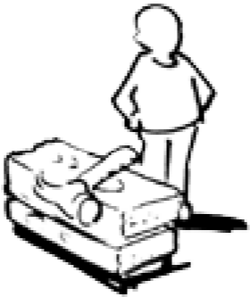
nine building blocks
KR
Key Resources are the assets required to offer and deliver the previous elements
Key resources can be :
physical, financial, intellectual, or human.
Key resources can be owned or leased by the company or acquired from key partners.
Osterwalder and Pigneur Businessmodelgeneration.com
Notes:
KR - Physical, Intellectual, financial, human
Assets such as manufacturing facilities, buildings, vehicles, machines, systems
The business has to determine - What assets are available that do not increase costs?

Slide 13
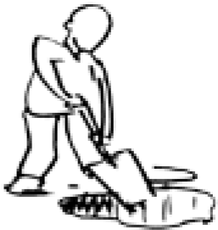
nine building blocks
KA
Key Activities
…by performing a number of key activities
The most important things a company must do to make its business model work
Osterwalder and Pigneur Businessmodelgeneration.com
Notes:
KA - or software maker Microsoft, Key Activities include software development.
For PC manufacturer Dell, Key Activities include supply chain management. For consultancy McKinsey, Key Activities include problem solving.

Slide 14

nine building blocks
Key Partnerships
Some activities are outsourced and some activities are required outside the organisation
KP
The network of suppliers and partners that make the business model work.
Four different types of partnerships:
Strategic alliances between non-competitors
Coopetition: strategic partnerships between competitors
Joint ventures to develop new businesses
Buyer-supplier relationships to assure reliable supplies
Osterwalder and Pigneur Businessmodelgeneration.com
Notes:
KP – Production , problem solving, platform.
the network of suppliers and partners that make the business model work Companies forge partnerships for many reasons, and partnerships are becoming a cornerstone of many business models. Companies create alliances to optimize their business models, reduce risk, or acquire resources. We can distinguish between four different types of partnerships: • Strategic alliances between non-competitors • Coopetition: strategic partnerships between competitors • Joint ventures to develop new businesses • Buyer-supplier relationships to assure reliable supplies
Economies of scale – key is to optimize the allocation of resources and activities.
Reduce risk in a competitive environment
Acquisition - A mobile phone manufacturer, for example, may license an operating system for its handsets rather than developing one in-house

Slide 15

nine building blocks
Cost Structure
The business model elements result in the cost structure
CS
The most important costs incurred while operating
Cost Structures: cost-driven and value-driven
Osterwalder and Pigneur Businessmodelgeneration.com
Notes:
CS - low Cost Structures are more important to some business models than to others. Therefore it can be useful to distinguish between two broad classes of business model Cost Structures: cost-driven and value-driven (many business models fall in between these two extremes): easyJet, and Ryanair typify cost-driven business models, Value driven - Luxury hotels, with their lavish facilities and exclusive services, fall into this category
Cost Structures can have the following characteristics:
Fixed costs Costs that remain the same despite the volume of goods or services produced. Examples include salaries, rents, and physical manufacturing facilities. Some businesses, such as manufacturing companies, are characterized by a high proportion of fixed costs.
Variable costs Costs that vary proportionally with the volume of goods or services produced. Some businesses, such as music festivals, are characterized by a high proportion of variable costs.
Economies of scale Cost advantages that a business enjoys as its output expands. Larger companies, for instance, benefit from lower bulk purchase rates. This and other factors cause average cost per unit to fall as output rises.
Economies of scope Cost advantages that a business enjoys due to a larger scope of operations. In a large enterprise, for example, the same marketing activities or Distribution Channels may support multiple products

Slide 16
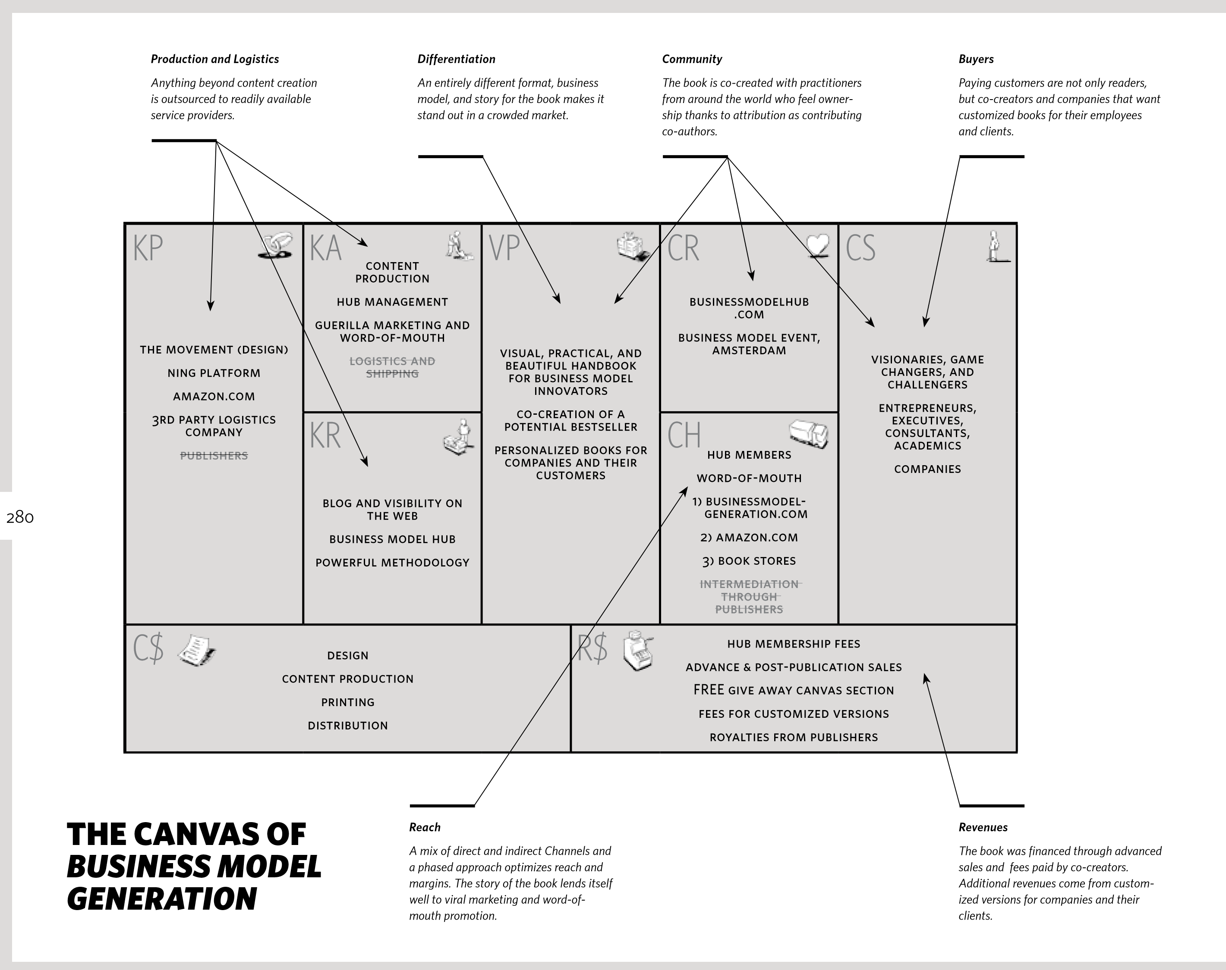
Osterwalder and Pigneur Businessmodelgeneration.com

Slide 17
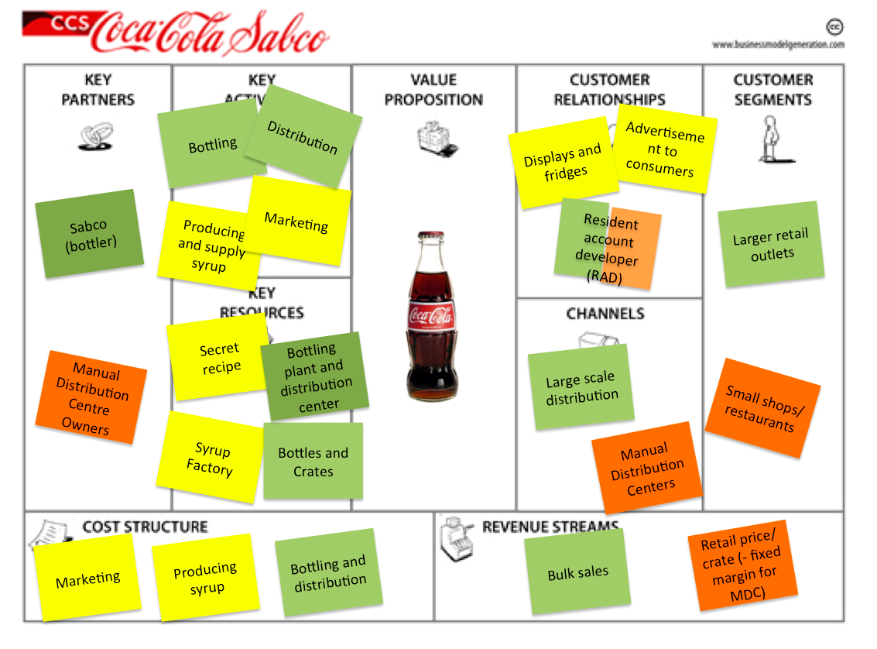
involvement of the Coca-Cola company (yellow stickies)
Partners (green stickies)
Manual Distribution Centers (MDC’s, orange stickies)
MDC’s are owned by independent entrepreneurs who coordinate distribution to the small shops and restaurants
http://valuechaingeneration.com/2012/11/13/coca-colas-inclusive-business-model-in-africa/
Notes:
http://valuechaingeneration.com/2012/11/13/coca-colas-inclusive-business-model-in-Africa (Extracted paragraph)
CCS started experimenting with a system of Manual Distribution Centers (MDC’s, marked with orange stickies). These centers are owned by independent entrepreneurs who coordinate distribution to the small shops and restaurants. MDC owners invest up front in things like crates, bottles, push carts, and they hire the labor for distribution. CCS sales agents out in the field (called resident account developers) maintain relations with the customers, and try to get their orders out with sales price arrangements. The MDC’s then deliver the order, and receive the payment.

Slide 18
PayPal Example
Business innovation model behind the e-payment company PayPal for online transactions
  Brokerage Model - This Revenue Stream derives from intermediation services performed on behalf of two or more parties.
  In this case the credit card providers, can receive revenues by taking a percentage of the value of each sales transaction completed between the credit card sellers and customers.
  The brokers earn a commission each time they successfully match a buyer and seller.
Notes:
In 2000, Elon Musk orchestrated a merger between his company, X.com, and Confinity, and created PayPal’s. They started with an aggressive marketing campaign and the user base grew from 12,000 to 2.7 million between January and August 2000.
Unlike many online e-payment companies who charged merchants setup and fixed account fees, PayPal decided to make account setup free and charge based on a percentage of the transaction. The seller, not the buyer, pays the trannsaction fee, which ranges from 1.9-2.9% depending on monthly transaction volume.
The rapid growth of PayPal continued through 2001. In 2002 the company went public on the Nasdaq exchange, before it was acquired by e-Bay for 1.5 billion in stock that same year.
One of the keys to PayPal’s success has been its ability to keep the platform secure. The company now serves over 300millions users.

Slide 19
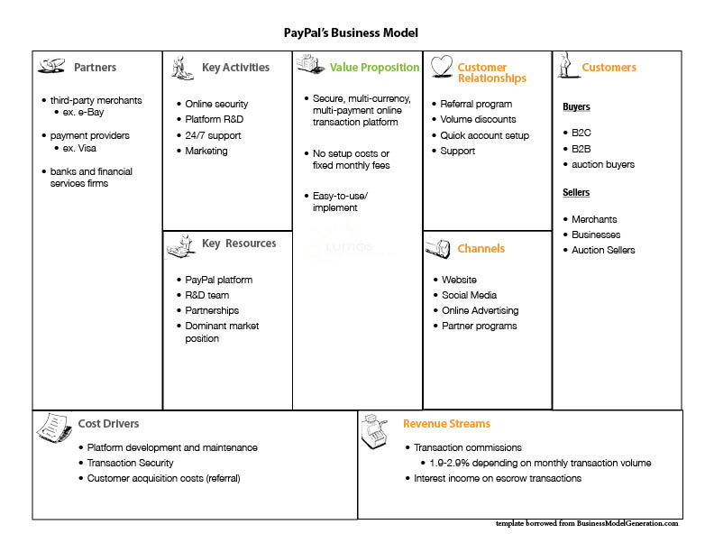
PayPal
Business
Model
http://www.lumosforbusiness.com/blog/752/29-11-2010/Business+Model+Breakdown++PayPal
Notes:
http://www.lumosforbusiness.com/blog/752/29-11-2010/Business+Model+Breakdown++PayPal

Slide 20
Reading - Moodle
From Strategy to Business Models and to Tactics Ramon Casadesus-Masanell Joan Enric Ricart (2009)
The model is comprised of :
Resources and Competences (RC),
Internal and external Organization (O), and
Value propositions (V)

Slide 21
Strategy to Business Models and to Tactics
  Business model refers to the logic of the firm, the way it operates and how it creates value for its stakeholders.
  Strategy refers to the choice of business model through which the firm will compete in the marketplace.
  Tactics refers to the residual choices open to a firm by virtue of the business model that it employs.
Casadesus-Masanell and Enric Ricart (2009)

Slide 22
An Alternative business model representation. Extracted from Figure 2. Ryanair.
No meals
Short-haul ﬂights
Young & leisure travelers
Lowest fares
Reputation for “fair” fares
Low commissions to travel agencies
Non-unionized workforce
Word-of-mouth advertising
Attracts combative team
High-powered incentives
Tough negotiators
Spartan headquarters
Low ﬁxed cost
Low variable cost
Nothing is free
All passengers treated equally
Secondary airports
Ancillary business (bus service...)
Large volume
Casadesus-Masanell Joan Enric Ricart (2009)

Slide 23
Operational Processes have Different Characteristics
Volume of their outputs
Variety of their outputs
Variation of their outputs
Degree of visibility which customers have of the production of their output
Notes:
The models start when these characteristics are given due consideration.

Slide 24
Characteristics
Volume – how many products or services are made by the operation?
Variety – how many different types of products or services are made by the operation?
Variation – how much does the level of demand change over time?
Visibility – how much of the operation’s internal working are ‘exposed’ to its customers?
Notes:
Examples of these in actions are -

Slide 25
Globalisation
Globalisation is defined as the pervasive decline in barriers to the global flow of information, ideas, especially capital and skilled labour, technology and goods.
Casualties’ of Globalisation
those who have been excluded from globalisation
those who have suffered from globalisation
those who have gained, but remain poor
Raphael Kaplinsky and Mike Morris (2000)
Notes:
A great need to explore innovative models when new trade barriers and deal will affect the current mode of operating , especially in terms of globalisation

