Slide 1
Acknowledge AI
I acknowledge the use of Grammarly (https://www.grammarly.com/) on 06 June 2025 to check my work using the prompt(s):
Please check the following text for readability, grammar and syntax.
I confirm that I have not presented any AI generated text as my own work. I confirm I have copies of my drafts, notes, and other resources I used before, and after the use of AI tools which I may be asked to provide in evidence.

Slide 2
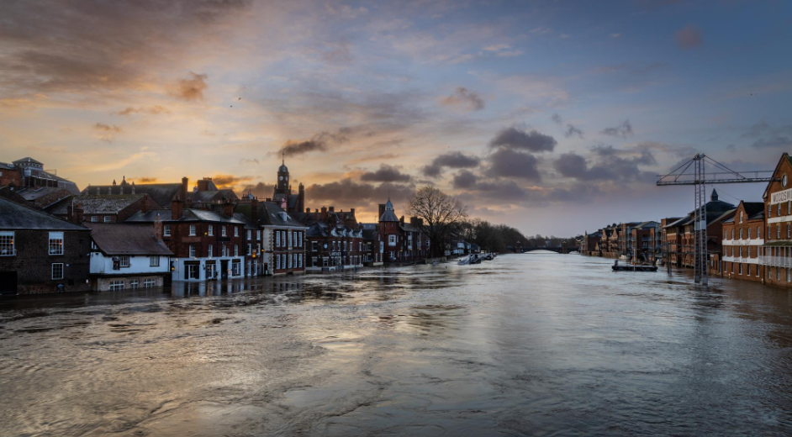
Hotel Strategies in Uncertain Times: A Case Study of Floods 2020 in York and Derby
Module Title: Contemporary Themes in the Hospitality Sector (BMIH6001)
Student Name: CRISTINA ILIUTA
Student number: 2212526
Module lead: CHRISTOPHER WILKIN

Slide 3

Introduction
The hospitality industry is prone to being affected by natural disasters such as stoppage of operation and financial sufferings.
In York and Derby, the 2020 floods badly affected local hotels in the form of physical damage, service disruption, and tremendous economic losses.
This modern issue is extremely important because climate-related disasters are becoming more frequent, which requires strong crisis management within the hotel industry.
This research explores resilience strategies implemented by hotels to manage the crisis in an emphasis of the importance of crisis management under uncertain circumstances.

Slide 4
Impacts of Floods on Hotel Operations
The hotels infrastructure was severely damaged during 2020 floods such as lower floors flooding, power system failure among others; equipment damage.
This resulted in hotels closures and interrupted services as well as low occupancies of guests. The revenue from bookings decreased by 50% to 80%.
These effects point out the vulnerability of the hospitality industry to disaster resulting from climate.
The Environment Agency (2020) has underlined the mounting danger of the given damage related to the changing climate and growing prevalence of extreme weather events
Contemporary Themes in the Hotel and Hospitality Sector (BMIH6001)
BA International Hotel management 4

Slide 5
Physical and Operational Disruption
Hotels directly felt physical damage to their buildings, leading to service disruption.
Power outages, water failure, and breakdown in communication made it difficult for hotels to carry on with normal operations.
Several hotels had to discontinue their operations, which led to loss of revenue and reputation (Lagiewski and Perotti, 2023). .
This emphasizes the need to have backup systems whereby such interruptions can be well managed.
Contemporary Themes in the Hotel and Hospitality Sector (BMIH6001)
BA International Hotel management 5
Contemporary Themes in the Hotel and Hospitality Sector (BMIH6001)

Slide 6
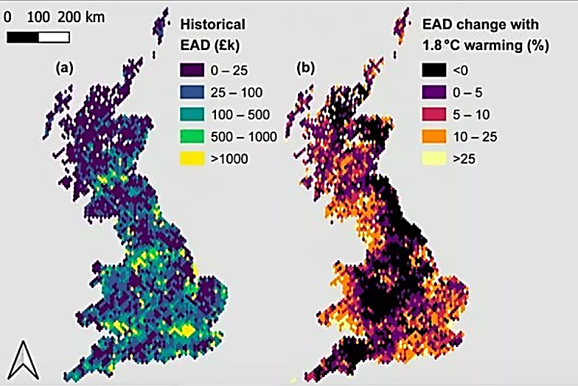
Economic Losses
2020 floods led to huge losses of hotels’ revenues.
Independent hotels, especially those which are not highly capitalized, suffered the most.
Such hotels in the flood-hit areas experienced a decrease in occupancy rates between 50% to 80% thus resulting in huge financial loses (Derby, 2025).
In addition, repair cost was between £30,000 and £100,000 and insurance premiums skyrocketed after the flood (Environment Agency, 2021).
For example, after the floods, York’s hotel revenues crashed by 38% in the next month.
Source: (Gamble and Smith, 2023)
Contemporary Themes in the Hotel and Hospitality Sector (BMIH6001)
BA International Hotel management 6

Slide 7
Pre-Flood Preparedness
Many hotels carried out flood risk assessment and made efforts to limit likely damages.
Such measures include construction of flood barriers, raising floor elevations and protecting critical assets (Lamond et al., 2019).
Hotels also established elaborated emergency plans covering evacuation processes, the safety of the guests, and continuity of services.
Flood defenses, which cost somewhere between £ 500 – £ 1,500 per meter, were bought to minimize the risk of serious damage (UK Government, 2024).
Contemporary Themes in the Hotel and Hospitality Sector (BMIH6001)
BA International Hotel management 7

Slide 8
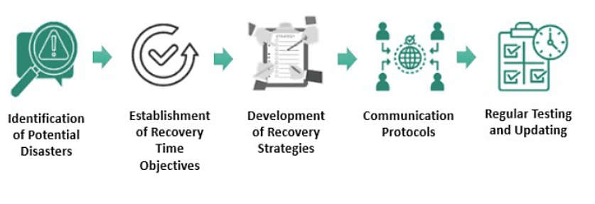
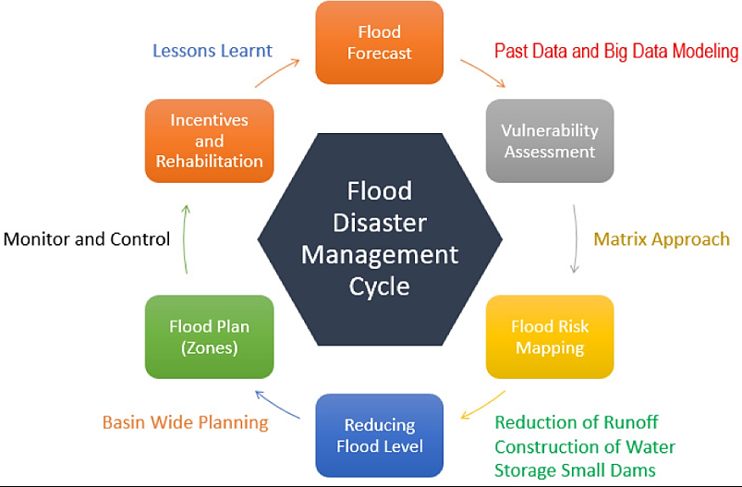
Post Flood Recovery Strategies
After the floods, hotels were more concerned with how they could resume operations fast.
Recovery measures involved moving operations, implement backup system and communication with guests and staffs (ERC, 2020).
Damage assessment and repair work needed to be swift to reduce long-term disruption.
Many hotels also interacted with contractors and insurance firms to speed up repair works, and some properties were even able to restore normal operations within two months.
Due to the winter floods of 2019/2020, Calderdale, West Yorkshire, was affected with £43.3 millions of direct losses (Neill, 2021).
Source: (Team, 2023)
Source: (Muzamil et al., 2022)
Contemporary Themes in the Hotel and Hospitality Sector (BMIH6001)
BA International Hotel management 8

Slide 9
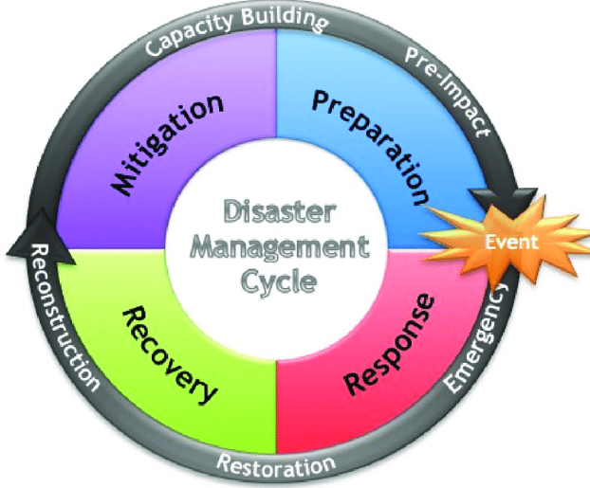
Crisis Management Frameworks
This research took the framework of crisis management in examining the response of hotels.
For analysis of signal detection, preparation, containment, recovery and learning was Crisis Management Model (Vašíčková, 2020).
The insights into how hotels adopted to the crisis could be derived from the Tourism Resilience Framework (Becken, 2013).
Such frameworks facilitated in the identification of main themes such as leadership, readiness, and strategies for adaptations.
Source: (Becken, 2013)
Contemporary Themes in the Hotel and Hospitality Sector (BMIH6001)
BA International Hotel management 9

Slide 10
PESTLE Analysis
In order to understand the wider factors that affected the hotel strategies during the floods, a PESTLE analysis was carried out.
Political: Government intervention was very essential but was hampered by late release of funding and support (World Vision UK, 2024).
Economic: The floods resulted in massive revenue loss and especially to the independent hotels (Visit York, 2025).
Social: Hotels that aided the local community from its small gestures like providing accommodation to the NHS staffs got positive media reporting (Hawley, 2025).
Technological: Hotels which had cloud-based property management were in a better place to sustain operations as compared to those that did not (Staff, 2024).
Legal: Regulatory duties of ensuring health and safety in times of emergencies exposed loopholes in other hotels’ crisis response (Lee and Sharma, 2024).
Environmental: The floods highlighted the need for improved environmental risks management, particularly, in flood prone areas (Channel, 2020).
Contemporary Themes in the Hotel and Hospitality Sector (BMIH6001)
BA International Hotel management 10

Slide 11
SWOT Analysis
The hotels witnessed strengths, weaknesses, opportunities, and threats during the floods as indicated through the SWOT analysis.
Strengths: Those hotels which had the crisis management plan and the staff trained, were better prepared (Dyball, 2023).
Weaknesses: Many small and medium hotels were not well-prepared for floods and did not have adequate resources that would be necessary in the event of floods (Strange, 2017).
Opportunities: As a result of the floods, some of the hotels were encouraged to undertake operational resilience and invest in flood protection (British Assessment Bureau, 2020).
Threats: Hospitality industry faces continuous threat of climate-related disasters, therefore, planning for the future is vital (Environment Agency, 2021).
Contemporary Themes in the Hotel and Hospitality Sector (BMIH6001)
BA International Hotel management 11

Slide 12
Recommendations for Hotel Resilience
Some of the important recommendations given regarding enhancing hotel resilience include:
Developing Site-Specific Emergency Plans: Customised emergency plans that identify evacuation, protection of assets, and utilities management (Tsai, et al., 2020).
Making Investments in Cheap Flood Protection Measures: Use of cost-effective aspects like sandbags and barriers against floods (Rehman, 2024).
Strengthening Communication Channels: Prompt and clear communication with guests and workers through digital platforms and social media (Maazzah Mustafa and Muhammad Noor Al Adwan, 2023).
Enhancing Staff Training: A period crisis management training and emergency drills for the staff.
Contemporary Themes in the Hotel and Hospitality Sector (BMIH6001)
BA International Hotel management 12

Slide 13
Conclusion
The 2020 floods in York and Derby brought out the hotels’ weakness to climate-related disasters.
The pre flood preparation, the crisis management and the post flood reparations are given great attention in the study.
The hotels need to invest in the flood protection; they should prepare for the emergency plans and cooperate with local authorities in order to make it possible to be safe themselves.
If hotels follow these recommendations, they will be able to survive future environmental threats, and the guests will remain safe.
Contemporary Themes in the Hotel and Hospitality Sector (BMIH6001)
BA International Hotel management 13

Slide 14
References
Becken, S. (2013). DEVELOPING A FRAMEWORK FOR ASSESSING RESILIENCE OF TOURISM SUB-SYSTEMS TO CLIMATIC FACTORS. Annals of Tourism Research, 43, pp.506–528. Available at: https://doi.org/10.1016/j.annals.2013.06.002.
British Assessment Bureau (2020). What Are the ISO 14001 Requirements? [online] British-assessment.co.uk. Available at: https://www.british-assessment.co.uk/insights/what-are-the-iso-14001-requirements/.
Channel, T.W. (2020). Severe Floods From Storm Dennis Still Threaten Large Parts of the UK | The Weather Channel. [online] The Weather Channel. Available at: https://weather.com/news/news/2020-02-15-storm-dennis-impacts-waves-england-scotland-wales-ireland [Accessed 15 May 2025].
Derby (2025). Before, during and after a flood - Derby City Council. [online] Derby.gov.uk. Available at: https://www.derby.gov.uk/environment-and-planning/flooding-land-drainage/before-during-after-a-flood/index.html#page-1 [Accessed 15 May 2025].
Dyball, R. (2023). London Shocks: A Comparative Analysis of Urban Political Institutions and their Responses through Fire, Pollution, and War. Available at: https://hull-repository.worktribe.com/OutputFile/4706386 [Accessed: 15 May 2025]
Environment Agency (2020). Environment Agency annual reports and accounts. [online] GOV.UK. Available at: https://www.gov.uk/government/collections/environment-agency-annual-reports-and-accounts.
Environment Agency (2021). Evidence on the costs of floods in England and Wales. [online] GOV.UK. Available at: https://www.gov.uk/flood-and-coastal-erosion-risk-management-research-reports/evidence-on-the-costs-of-floods-in-england-and-wales.

Slide 15
References
ERC (2020). State of Small Business Britain 2020. [online] Available at: https://www.enterpriseresearch.ac.uk/wp-content/uploads/2020/12/92744-ERC-State-of-Small-Business-2020-Final.pdf.
Gamble, J. and Smith, C. (2023). Flood damage in UK ‘will rise by nearly a quarter in next century’. [online] Stoke on Trent Live. Available at: https://www.stokesentinel.co.uk/news/uk-world-news/dramatic-map-shows-annual-flood-8223466.
Vašíčková, V. (2020). Crisis Management Process - A Literature Review and a Conceptual Integration. Acta Oeconomica Pragensia, 27(3-4), pp.61–77. Available at: https://doi.org/10.18267/j.aop.628.
World Vision UK (2025). Emergency Response. [online] www.worldvision.org.uk. Available at: https://www.worldvision.org.uk/our-work/emergency-response/.
Hawley, Z. (2025). Mystery over future of two Derby hotels used to house asylum seekers. [online] Derbyshire Live. Available at: https://www.derbytelegraph.co.uk/news/derby-news/home-office-refuses-drawn-end-9993149 [Accessed 15 May 2025].
Lamond, J.E., Bhattacharya-Mis, N., Chan, F.K.S., Kreibich, H., Montz, B., Proverbs, D.G. and Wilkinson, S. (2019). Flood risk insurance, mitigation and commercial property valuation. Property Management, 37(4), pp.512–528. Available at: https://doi.org/10.1108/pm-11-2018-0058.
Lee, S.W. and Sharma, A. (2024). Beyond rate parity: Examining offer uniqueness and channel credibility in hotel pricing. Tourism Economics. Available at: https://doi.org/10.1177/13548166241273881.

Slide 16
References
Maazzah Mustafa and Muhammad Noor Al Adwan (2023). The Content of Media Message and Digital Media – Al-Jazeera Media Network as a Model. Journal of Namibian Studies : History Politics Culture, 33. Available at: https://doi.org/10.59670/jns.v33i.533.
Muzamil, S.A.H.B.S., Zainun, N.Y., Ajman, N.N., Sulaiman, N., Khahro, S.H., Rohani, M.Md., Mohd, S.M.B. and Ahmad, H. (2022). Proposed Framework for the Flood Disaster Management Cycle in Malaysia. Sustainability, 14(7), p.4088. Available at: https://doi.org/10.3390/su14074088.
Neill, P. (2021). Flooding leads to millions of pounds worth of economic damage. [online] Environmentjournal.online. Available at: https://environmentjournal.online/water/flooding-leads-to-millions-of-pounds-in-economic-damage/ [Accessed 15 May 2025].
Rehman, A. (2024). Modular Emergency Relief: A Proposal for Integrating Modular Buildings into Post-Flood Reconstruction and Recovery. Theseus.fi. [online] Available at: http://www.theseus.fi/handle/10024/868097.
Staff, L. (2024). IHG Hotels & Resorts Names HotelKey as Tech Platform. [online] LODGING Magazine. Available at: https://lodgingmagazine.com/ihg-hotels-resorts-names-hotelkey-as-companys-tech-platform/.
Strange, M. (2017). The Old Dersingham Vicarage. [online] Dersinghamhistory.info. Available at: https://dersinghamhistory.info/the_old_vicarage.html [Accessed 15 May 2025].
Team, W. (2023). Disaster Recovery Plan. [online] WallStreetMojo. Available at: https://www.wallstreetmojo.com/disaster-recovery-plan/.

Slide 17
References
Tsai, C.-H., Linliu, S.-C., Chang, R.C.Y. and Mak, A.H.N. (2020). Disaster prevention management in the hotel industry: Hotel disaster prevention literacy. Journal of Hospitality and Tourism Management, 45, pp.444–455. Available at: https://doi.org/10.1016/j.jhtm.2020.09.008.
UK Government (2024). Government payments for communities affected by flooding. [online] GOV.UK. Available at: https://www.gov.uk/government/news/government-payments-for-communities-affected-by-flooding.
UK Parliament (2024). Flood resilience eroded by poorly maintained defences with Government in the dark on progress - Committees - UK Parliament. [online] Parliament.uk. Available at: https://committees.parliament.uk/committee/127/public-accounts-committee/news/199357/flood-resilience-eroded-by-poorly-maintained-defences-with-government-in-the-dark-on-progress/ [Accessed 15 May 2025].

