Slide 1

Evaluate the plausibility of mind-body dualism.
Catrin Hughes
Student Number: 2205660

Slide 2
Introduction
What is Mind-Body Dualism?
The mind and body are fundamentally distinct substances (Robinson, 2023).
The nature of consciousness, personal identity, and the relationship between mental and physical processes (Robinson, 2023).
Is Mind-Body Dualism a plausible theory?
An immaterial mind interacting with a physical body is philosophically and scientifically problematic (Calef, n.d.).

Slide 3
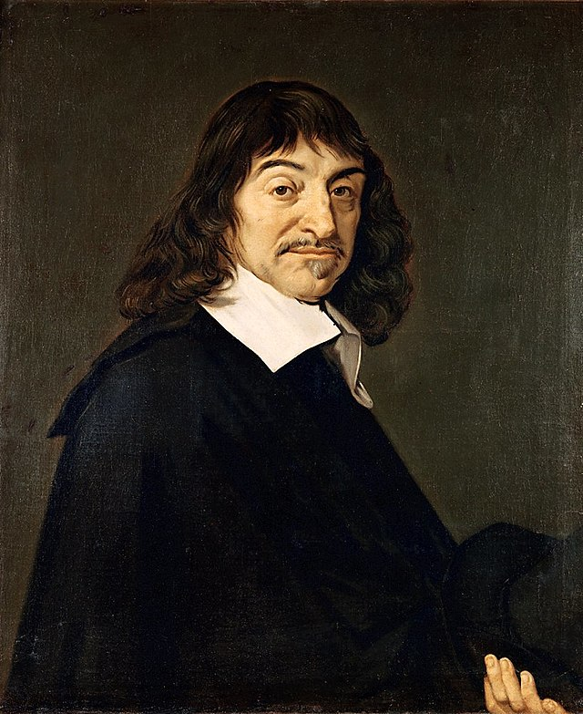
Cartesian Dualism by René Descartes
Asserts a fundamental distinction between two kinds of substances: mind and body (Skirry, 2022).
Mind = an immaterial, thinking substance (Descartes, 1997, p. 181).
Body = a material, extended substance (Descartes, 1997, p. 181).
Cartesian Method of Radical Doubt
‘Methodological Scepticism’ (Grene, 1999, p. 554).
Reconstruct the foundations of knowledge (Cottingham, 2008, p. 21).
Conclusion
“I think, therefore I am” (Descartes, 1997, p. 92).
The self is the foundation for knowledge (Descartes, 1997, p. 143).
The pineal gland might be the site of this interaction (Lokhorst, 2021).

Slide 4
How does the immaterial mind interact with the physical body?

Slide 5
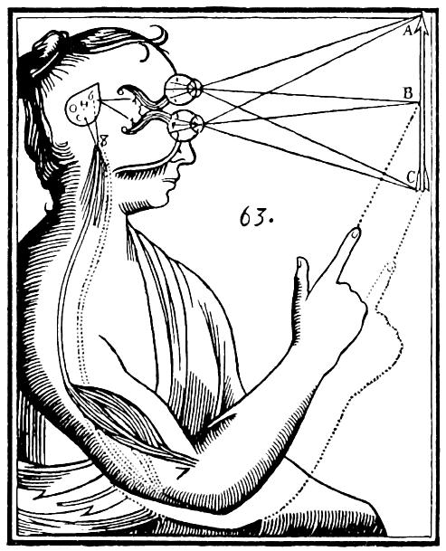
The Mind-Body Problem
What is the relationship between mind and body?
Discrepancy between the mental and the physical aspects of human experience (Robinson, 2023).
Example: Deciding to pick up a glass of water causes physical movement in the arm.
Touching fire or a sharp object generates the mental experience of pain.

Slide 6
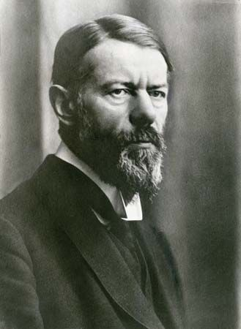
The Ghost in the Machine: Gilbert Ryle’s Critique
The Concept of Mind’ (1949).
Rejects the entire framework of Cartesian Dualism.
‘Category mistake’ (Cottingham, 2008, p. 251).
A ‘ghost’ that inhabits the ‘machine’ of the body (Ryle, 2002, P.17).
Ryle’s Theory
Logical behaviourism (Tanney, 2022).
Mental phenomena are better understood in terms of behaviours and dispositions (Tanney, 2022).
Does not solve but attempts to dissolve the mind-body problem.

Slide 7
Reducible to absurdity
Mind-Body Problem
Evaluation of Cartesian Dualism
Conceptually Incoherent
Inconsistent with known laws or truths of science

Slide 8
Conclusion
Significant challenges that undermine mind-body dualism’ plausibility.
The mind-body problem: remains a critical flaw in Cartesian Dualism.
Struggles to offer a coherent and satisfactory account of the mind-body relationship.

Slide 9
References
Alison, J., (2011). A Look at Cartesian Dualism. Available at: https://www.hep.upenn.edu/~johnda/Papers/Dualism.pdf
Calef, S., (n.d). Dualism and Mind. Available at: https://iep.utm.edu/dualism-and-mind/
Cottingham, J., (2008). Western Philosophy: An Anthology. Second ed. Oxford: Blackwell.
Descartes, R., (1997). Discourse of the Method. In: Chavez-Arviso, ed. Key Philosophical Writings. s.l.:Wordsworth Editions Limited, pp. 71-109.
Descartes, R., (1997). Meditations on First Philosophy. In: Chavez-Arviso, ed. Key Philosophical Writings. s.l.:Wordsworth Editions Limited, pp. 123-190.
Grene, M., (1999). The Review of Metaphysics. Descartes and Skepticism, 52(3), pp. 553-571.
Lokhorst, G.-J., (2021). Descartes and the Pineal Gland. Available at: https://plato.stanford.edu/entries/pineal-gland/
Robinson, H., (2023). Dualism. Available at: https://plato.stanford.edu/entries/dualism/
Ryle, Gilbert. (2002). The Concept of Mind, with an introduction by Daniel C. Dennett. (London: Penguin), pp. 1-336.
Skirry, J., (2022). René Descartes: The Mind-Body Distinction. Available at: https://iep.utm.edu/rene-descartes-mind-body-distinction-dualism/
Tanney, J., (2022). Gilbert Ryle. Available at: https://plato.stanford.edu/entries/ryle/

