Slide 1










University of Wales
Trinity Saint David
London
INARI PI
A project by
1805315
Giuseppe Ventimiglia
25 March 2021

Slide 2
Introduction
Motivation and Goals
Aim and Objectives
Literature review
Methodology
Design overview
Gantt Chart
Demo
Conclusion
Q&A
AGENDA

Slide 3
Introduction
INARI PI

Slide 4



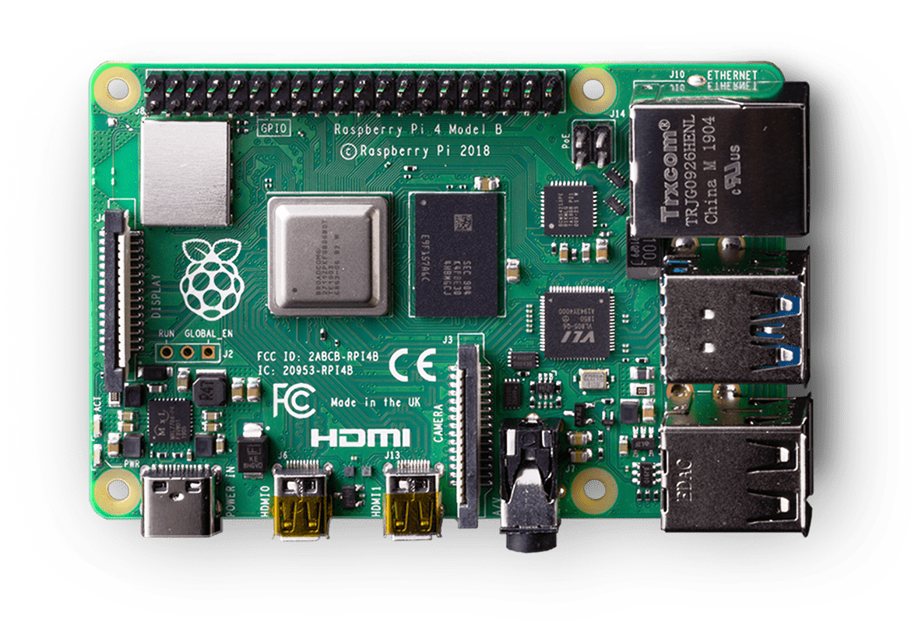
Inari PI is a project based on a single-board computer that combines networking and cybersecurity principles to protect Home Area Networks.
A HOME NETWORK SECURITY DEVICE
Fig.1 Raspberry PI [6]

Slide 5
Motivation & Goals
INARI PI

Slide 6







MOTIVATION
The choice for this project is related to four main topics:
1
2
3
4
Passion and
experience
Users in
Cybersecurity
New technologies, new threats
Data is the
“new oil”
GOALS
This project is intended for students, researchers, users and anyone interested in cybersecurity and networking.
Create a blueprint for safer home networks
Advance research in academia and spread awareness
Showcase and
learn new skills

Slide 7
Aim & Objectives
INARI PI

Slide 8


The project's aim consists in developing an effortless and effective home network security device to mitigate security threats.
AIM AND
OBJECTIVES
The project implies the achievement of three significant objectives :
1
To develop an automated, easy-to-use device.
2
To protect the network from common network attacks.
3
To examine and evaluate the performance of the proposed solution.

Slide 9
Literature review
INARI PI

Slide 10
LITERATURE REVIEW
The literature review is structured in four parts:
1
2
3
4
Security
principles
Home network issues
Common attacks
Previous
works
Tripathi and Kumar
Karahan and Kaya
Nagy and Coleşa
Jonsdottir et al.
Jeremiah
Confidentiality
Integrity
Availability
Authentication
Authorization
Accountability
Heterogeneity
Wi-Fi Protocols
Fixed Hardware
Default configurations
More
Traffic analysis
Eavesdropping
MITM
DOS
Wormhole
Sinkhole
More

Slide 11


PREVIOUS WORKS
# | Authors | Functionalities
1 | Tripathi and Kumar [1] | IDS SSH Honeypot Packet analyser
2 | Karahan and Kaya [2] | IDS Firewall
3 | Nagy and Coleşa [3] | DNS, DHCP Web Portal Mac and IP filtering Packet analyser
4 | Jonsdottir et al. [4] | Password scanner Packet analyser Traffic sensitivity analysis
5 | Jeremiah [5] | IDS SSH Honeypot Malware Honeypot Web app honeypot
Robust features
Innovative mechanisms
Limited individual protection
Limited automation
Towards a completed and automated approach.

Slide 12
Methodology
INARI PI

Slide 13

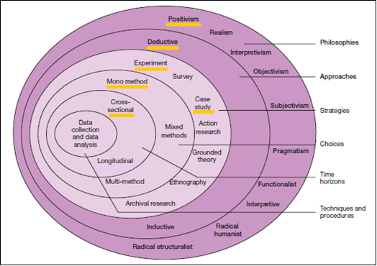
METHODOLOGY
The project's research methodology is built upon the “research onion” concept.
Onion’s layer | Method
Philosophy | Positivity
Approach | Deductive
Strategy | Experiment / case study (Primary and secondary source)
Choice | Mono-Method (Quantitative)
Time Horizon | Cross-sectional
Fig.2 Research onion [7]
The SDLC approach adopted is the Agile methodology.

Slide 14
System design overview
INARI PI

Slide 15
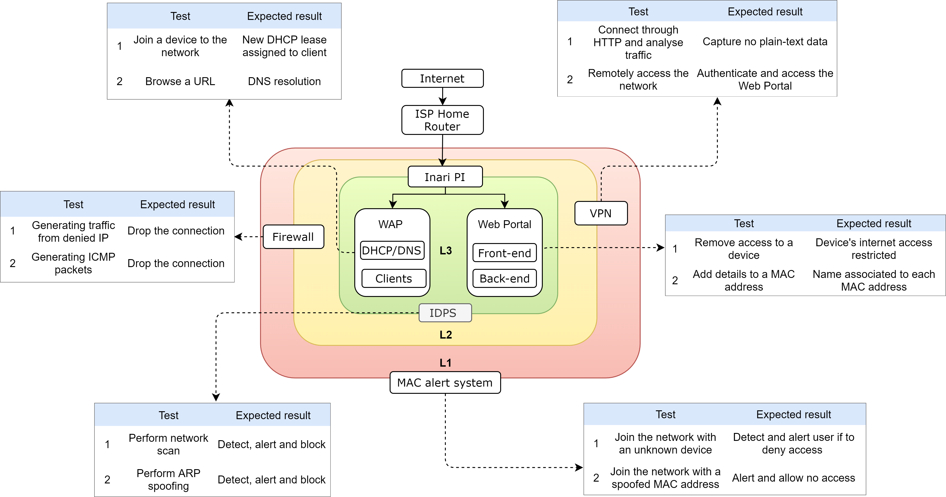
DESIGN OVERVIEW
Defence-in-depth: a multiple-layer defence approach

Slide 16
Gantt Chart
INARI PI

Slide 17
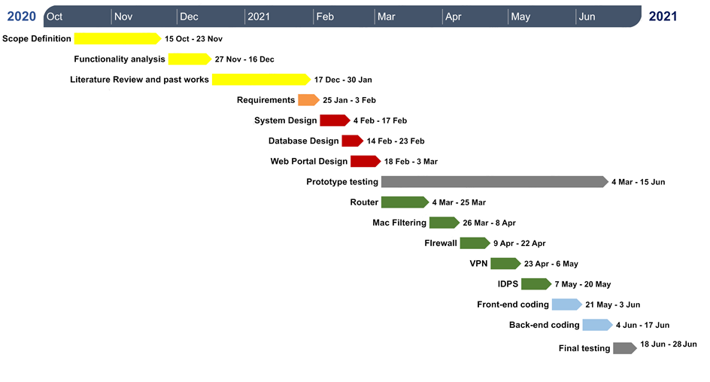

GANTT Chart

Slide 18
Demo (5min 03sec)
INARI PI

Slide 19
Conclusion
INARI PI

Slide 20







CONCLUSION
Aim and Objectives
Previous experiments
Design
Motivation and goals
Literature review
Research Methods
Gantt Chart
I N A R I P I
HOME NETWORK SECURITY DEVICE

Slide 21
REFERENCES
[1] S. Tripathi and R. Kumar, 'Raspberry Pi as an Intrusion Detection System, a Honeypot and a Packet Analyzer', in 2018 International Conference on Computational Techniques, Electronics and Mechanical Systems (CTEMS), Dec. 2018, pp. 80–85, doi: 10.1109/CTEMS.2018.8769135.
[2] O. Karahan and B. Kaya, 'Raspberry Pi Firewall and Intrusion Detection System', Journal of Intelligent Systems: Theory and Applications, pp. 21–24, Dec. 2020, doi: 10.38016/jista.653486.
[3] L. Nagy and A. Coleşa, 'Router-based IoT Security using Raspberry Pi', in 2019 18th RoEduNet Conference: Networking in Education and Research (RoEduNet), Oct. 2019, pp. 1–6, doi: 10.1109/ROEDUNET.2019.8909551.
[4] G. Jonsdottir, D. Wood, and R. Doshi, 'IoT network monitor', in 2017 IEEE MIT Undergraduate Research Technology Conference (URTC), Nov. 2017, pp. 1–5, doi: 10.1109/URTC.2017.8284179.
[5] J. Jeremiah, ‘Intrusion Detection System to Enhance Network Security Using Raspberry PI Honeypot in Kali Linux’, in 2019 International Conference on Cybersecurity (ICoCSec), Sep. 2019, pp. 91–95, doi: 10.1109/ICoCSec47621.2019.8971117.
[6] W. Donat, Learn Raspberry Pi Programming with Python: Learn to Program on the World’s Most Popular Tiny Computer, 2nd ed. 2018. Berkeley, CA: Apress : Imprint: Apress, 2018.
[7] M. N. K. Saunders, P. Lewis, and A. Thornhill, Research methods for business students, 4th ed. Harlow, England ; New York: Financial Times/Prentice Hall, 2007.

Slide 22
Q&A
INARI PI

