Slide 1
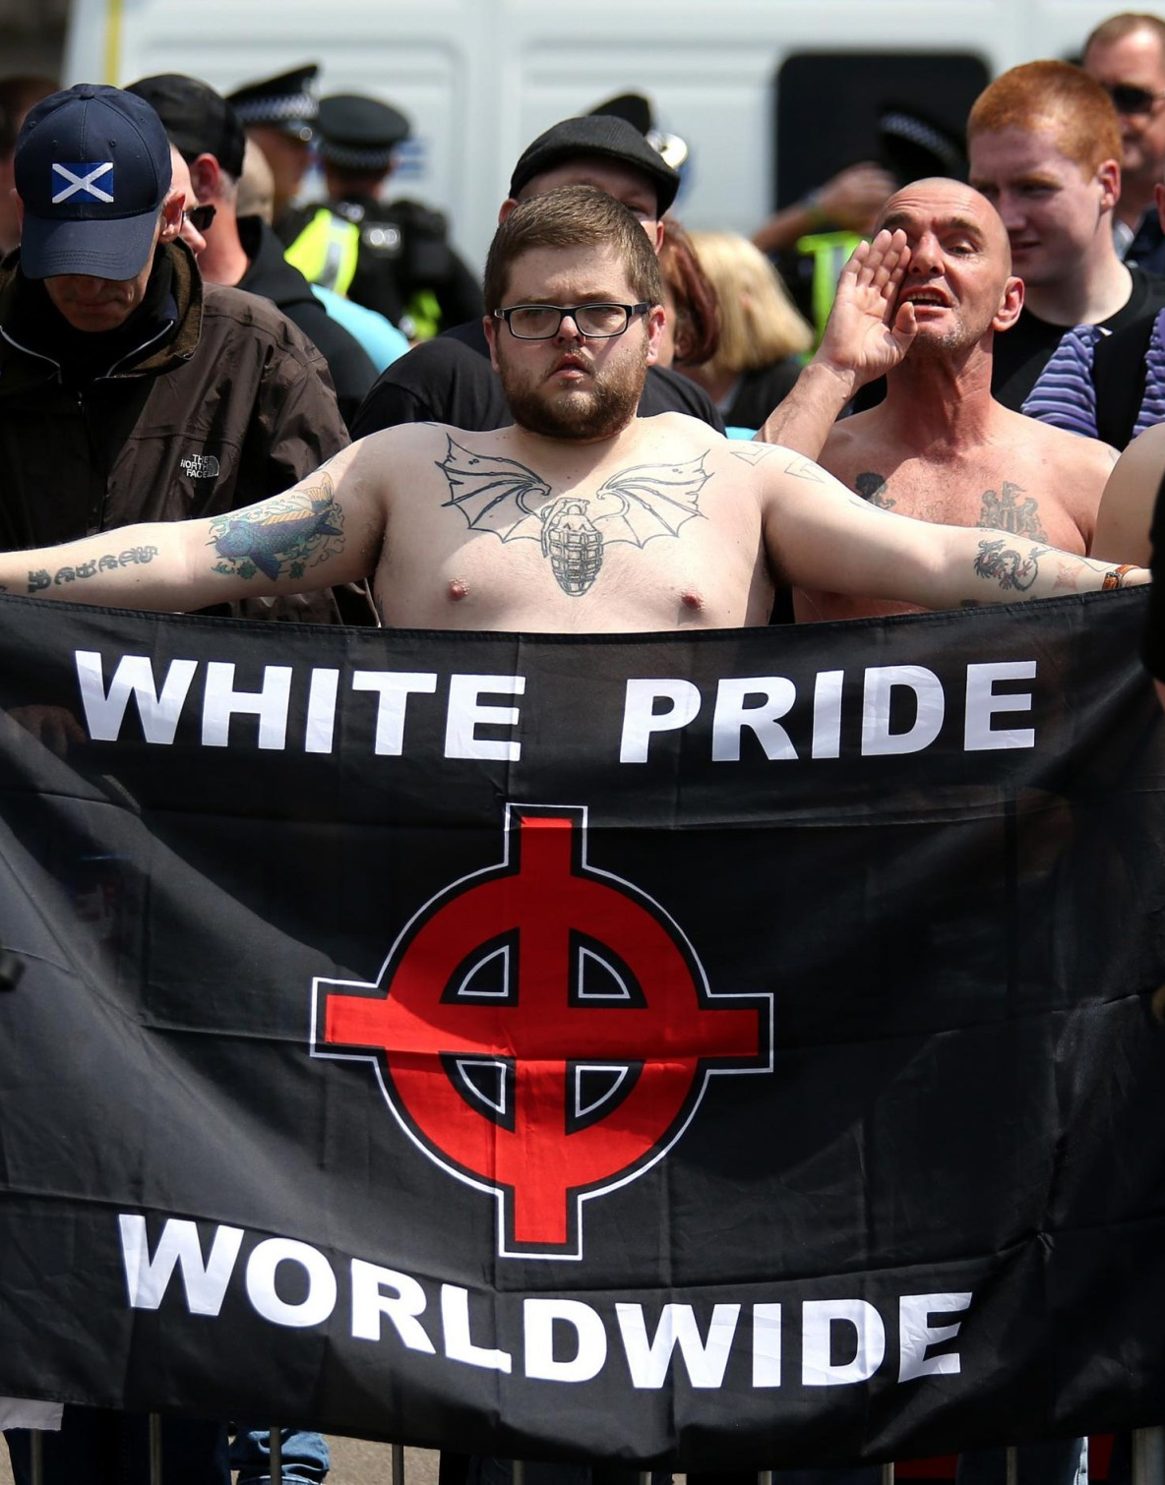
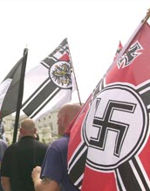
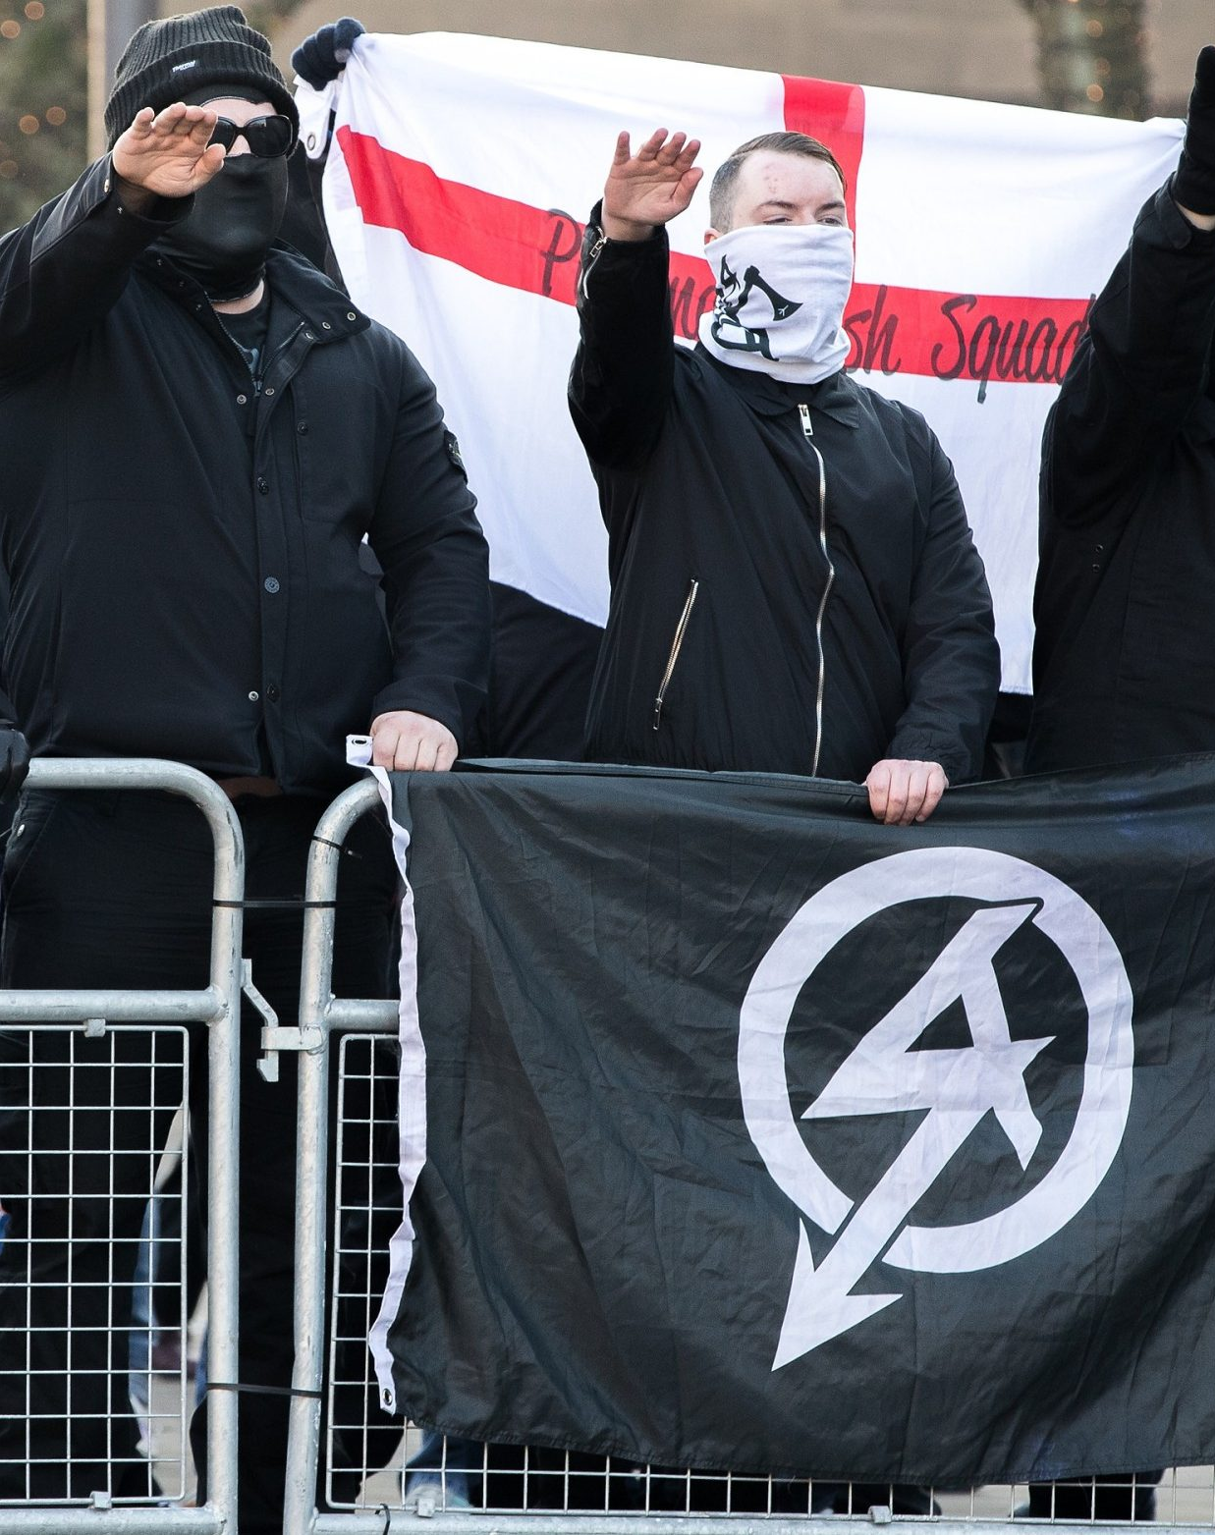
Policing Terrorism
Week 5 – Right Wing Terror
Dr. Luke Roach
l.roach@uwtsd.ac.uk

Slide 2
Aims
To establish what is right wing terrorism by looking at two examples.
Consider the UK’s response to RWT and the definitional challenges.

Slide 3
Objectives
Identify – what right wing terrorism is and the issue of RWT.
Establish – right wing terrorists' overall ideologies, motives and goals.
Examine - two examples of right-wing terrorism: National Action and the Ku Klux Klan.
Explore – the response to right wing terrorism by the UK.
Distinguish – how right-wing terrorists utilise the internet.

Slide 4
What is Right Wing Terrorism?
“Far-right” refers to a political ideology that is centred on one or more of the following elements: strident nationalism (usually radical or exclusivist in some fashion), fascism, racism, anti-Semitism, anti-immigration, chauvinism, nativism and xenophobia (Institute for Economics and Peace).
Ravndal and Bjorgo (2018) consider ’far-right’ an over-arching term that includes a range of ideologies encompassing of both the radical right and extreme right and holds the narrative that there is a racial and/or cultural threat to a native group arising from perceived alien groups in society.

Slide 5
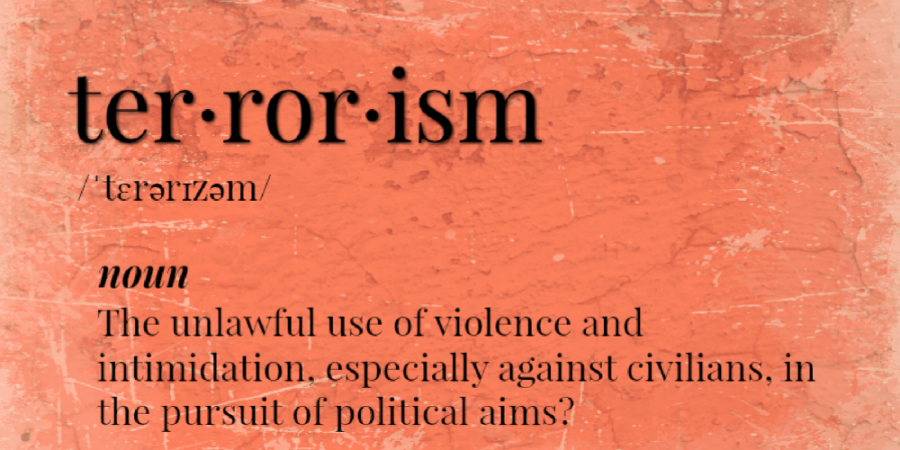
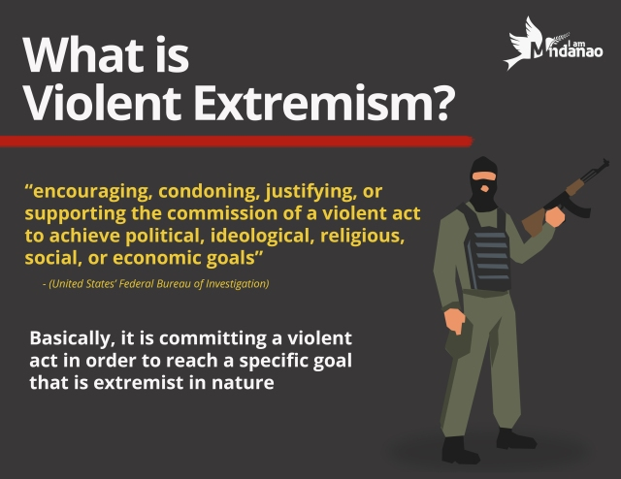
Challenges with defining Right Wing Terrorism
Lack of academic consensus when defining far-right or right wing terrorism.
In academia and policy – the terms ‘far-right extremism’ and ‘far right terrorism’ are used interchangeably.
Extremism – “the vocal or active opposition to our fundamental values, including democracy, the rule of law, individual liberty and the mutual respect and tolerance of different faiths and beliefs.” (HM Government, 2015, p. 9).
UK’s definition of extremism can promote Islamophobia due to unclear wording.
Discussion: what effect does this have on understanding right-wing terrorism.

Slide 6
Task
What are the issues using ‘terrorism’ and ‘extremism’ interchangeably?
How does this effect understanding of right-wing terrorism?

Slide 7
Problems using ‘terrorism’ and ’extremism’ interchangeably
Violent extremism is defined as ‘’the beliefs and actions of people who support or use violence to achieve ideological, religious and political goals’’.
(Attorney-General’s Department, 2011).
Terrorism is defined in the UK as the use or threat of action to influence the government or intimidate the public for the purpose of advancing political, religious, racial or ideological causes.
Adds to the confusion – violent extremism is a synonym for terrorism?

Slide 8
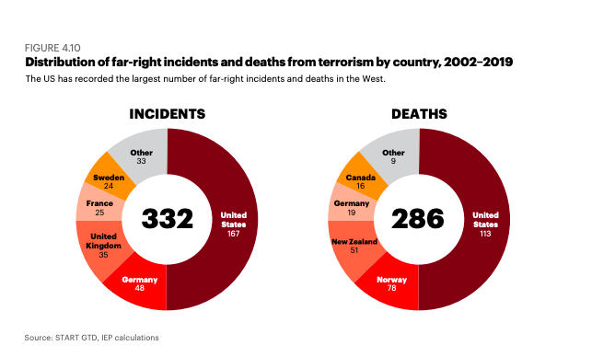
The issue of Right-Wing Terrorism

Slide 9
The issue of Right-Wing Terrorism
Institute for Economics & Peace (2020) :
“One of the more worrying trends in the last five years is the surge in
far right political terrorism”
“far-right attacks have increased by 250 percent since 2014, with deaths
increasing by 709 per cent over the same period”
Growing issue – between 2002-2014 far-right terror accounted for 14% of the total attacks in the West. By 2019 that percentage has risen to 46%.

Slide 10
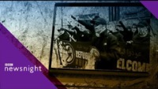

Slide 11
Right Wing Terror and the Media
Muslim extremists 3xs more likely to be labelled as terrorists by media than far-right extremists.
Study – 200,000 news articles
Muslims extremists labelled terrorist 78.4%
Far Right extremist labelled terrorist 23.6%
Media reports on Islamist terrorism focuses on – previous offence, early release from prison and links to terrorist organisations. But when reporting on far-right extremists they draw on – mental health, working class and immigration concerns.

Slide 12
Ideologies
Nationalism – cultural, ethnic and racial nationalist beliefs.
Fascism – protection from corrupting influences
Neo-Nazism – dominant model for fascism with groups incorporating the Nazi ideology within their group.
Populism – liberal and democratic norms are under threat.
Racism – minorities corrupting culture and racial nationalism.

Slide 13
Nationalism
Nationalism is an orientation that holds that western civilisation and values are under threat from non-native elements – people and ideas. According to Bjorgo and Ravndal there are three classes of nationalism: Cultural nationalists – promote a version of nationalism in which the nation is defined primarily in terms of culture and history. Ethnic Nationalists – emphasise the differences between ethnic groups and believe that ethnic groups have a right to protect their identity and culture. Racial nationalists – embracing the idea of the original state of society that existed before the ethnic makeup was altered.
The starting point for understanding far-right ideology is inter-war fascism as embodied by regimes that came into power in Fascist Italy and Nazi Germany. Fascism at its most basic level is a form of populist ultra-nationalism. Ultra-nationalism is used as a label for nationalism that goes beyond existing norms and liberal understandings of the nation to view it as a higher goal in need of protection from corrupting influences. Fascism is also a revolutionary ideology that aims for political change with a distinct political vision rather than reforms.

Slide 14
Nationalism
Neo-Nazism became a dominant model for fascism and a range of groups have incorporated elements of Nazism in their ideology. This includes the use of Nazi symbols and rhetoric’s. The terms Nazism and neo-Nazism are generally reserved however, for groups that seek to imitate the politics of the German National Socialist Party as it existed between 1920-1945.
Far-right ideologies hold for populism that liberal and democratic norms are under threat. Mudde (2007) defines populist radical right as one with an ideology that combines nativism, authoritarianism and populism. Populism is the belief that societies' are split. Mudde suggests that radical groups accept society but oppose some democratic norms such as protection for minorities.

Slide 15

Fascism – Umberto Eco (1995)
14 Principles of General Fascist Ideology:
The Cult of Tradition
The rejection of modernism
The cult of action for actions sake
Disagreement is treason
Fear of difference
Appeal to a frustrated middle class
Obsession with a plot
Enemy is too strong and too weak
Pacifism is trafficking with the enemy
Contempt for the weak
Cult of the hero’s death
Selective populism
Newspeak

Slide 16
Motives and Goals
Hold various motivations and goals due to the fact it refers to an umbrella of different groups holding similar ideologies.
These ideologies often overlap but the goals of right-wing terrorists may differ.

Slide 17
Right Wing Terror Groups
Atomwaffen Division (AWD)
Nationalist Socialist Order
Feuerkrieg Division (FKD)
Sonnenkrieg Divison (SKD)
The Base
National Action

Slide 18
Right Wing Terrorist Attacks World Wide
2011 Norway Attacks.
2013 – Murder of Mohammed Saleem.
2016 – Murder of Jo Cox.
2016 – Munich Shooting.
2017 – Quebec City Mosque Shooting.
2017 – Finsbury Park Attack.
2017 – Charlottesville Car Attack.
2019 – Christchurch Mosque Shootings.
2019 El Paso Shooting.
2020 Hanau Shootings.
2021 – Ontario Truck Attack
Task: In pairs or groups, google one of these attacks and summarise for the class

Slide 19
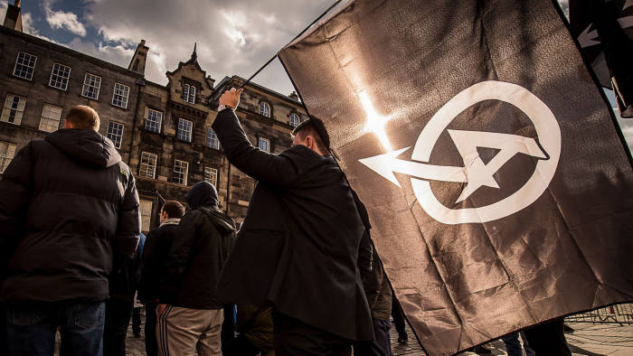
National Action
Formed in 2013.
Reviving Nazi Activism
Militant Street Action
Distancing themselves from newer radical right movements that targeted Muslims.
Proscribed as terrorists in 2016

Slide 20
National Action
National Action first began developing its web presence in the summer of 2013 with their first blog being posted August 2013.
Purpose of reviving Nazi Activism in the UK focusing on militant street action such as leafletting, banner drops and demonstrations. They distanced themselves from newer radical right movements that target Muslims.
National action is a hate group that embraces all forms of hatred, that respects Adolf Hitler’s ideologies - they call themselves the white-jihadis.
National Action became the first radical right group to become proscribed as a terror group in 2016. Since 2016 there has been approximately 14 trials involving national action members. These cases deal with membership charges, hate crimes and terror plots by individuals affiliated with neo-Nazi groups.
Since its proscription in 2016 there has been various splinter groups.

Slide 21
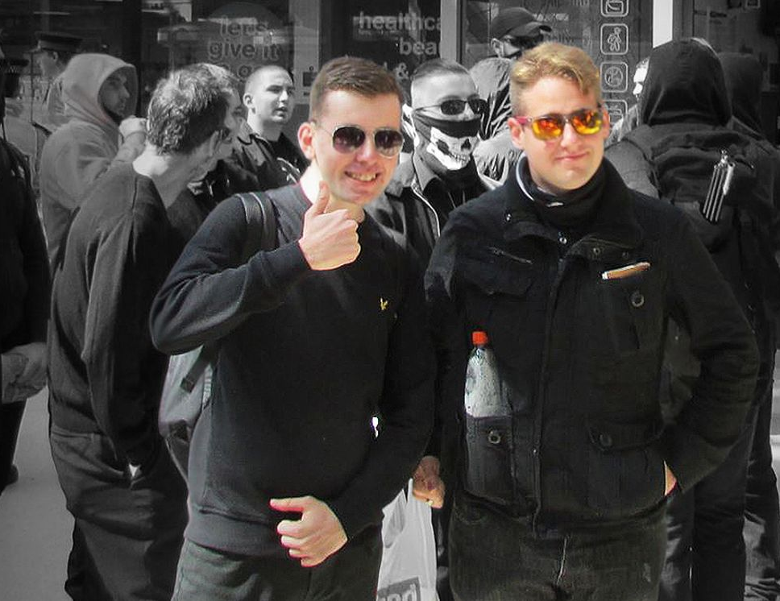
Leaders
Ben Raymond – ’’As a teenager, Mein Kampf changed my life. I am not ashamed to say I love Hitler’’.
Alex Davies – ‘’I don’t want to say what I’d like to do to Jews – its too extreme’’.

Slide 22
Members and Convictions since 2016
Zack Davies attacked a dentist in a supermarket with a knife and hammer in 2015. However, National Action tried to disassociate itself from Davies when it became apparent that authorities would begin to look into NA wider activities. Davies posted images of himself in a balaclava and large knife with the flag of NA in the background just hours before he carried out the violent racist attack in his local tesco on 14th January 2015 and shouted ’’This is for Lee Rigby’’. Davies said he chose his victim because he looked Asian
Ryan Fleming – a NA activist from West Yorkshire who also has a conviction for the sexual assault on a vulnerable young male. Ryan Fleming was a regional organiser for National Action. Counter terror police raided his home in to find indecent messages being sent to minors via Instagram

Slide 23
Members and Convictions since 2016
Jack Renshaw – a student who got kicked out of Manchester Metropolitan University for hateful views against Jewish people. Jack Renshaw continued activities following the NA proscription in 2016 praising the murder of Jo Cox in 2017 and admitted to wanting to replicate the murder of Jo Cox. He pleaded guilty in 2019 to buying a machete to kill the West Lancashire MP and making threats to kill police officer Victoria Henderson.
Thomas Mair – was a racist and terrorist whose home was stuffed with far-right books and Nazi Memorabilia. In the days before Jo Cox’s murder he sought out information about the KKK, IRA, Waffen SS.

Slide 24
Members and Convictions since 2016
11 men have been arrested under anti-terror laws as part of an investigation into National Action from 2016-2017. These arrests include 6 people from the North-West of England, 2 from South Wales, 2 from West Yorkshire and 1 from Wiltshire.
June 2020 four more National Action members were jailed. Alice Cutter the former Miss Hitler Beauty pageant contestant and her partner Mark Jones. Alongside Gerry Jack and Connor Scothern.
Mark Jones was said to have played a significant role in the continuation of National Action. However, Cutter was not believed to have held an organisational or leadership role but was a trusted confidante with one of the groups leaders as well as being a committed relationship with Jones.
Connor Scothern was an active member even after the groups ban and attended almost every meeting of NA’s Midlands subgroup and distributed stickers calling for a final solution about Jewish people in Britain. He was sentenced to 18 months. Whilst Garry Jack was sentenced to four and a hald years due to being so committed to the groups ideology.

Slide 25
Ideology, Motive and Goals
The group is racist, anti-Semitic and homophobic. Its ideology promotes the idea that Britain will inevitably see a violent race war. The group rejects democracy and is hostile to the British state and seeks to divide society by endorsing violence against ethnic minorities and ‘race traitors’.
National Action states that ideologically it is a national socialist movement. NA distances itself from all forms of populism and openly states that the only way to ensure racist or nationalist views are brought into the political mainstream is to support those ’’not afraid to swing a bat at the enemy’’.

Slide 26
Ideology, Motive and Goals
NA ideology can be positioned with traditional Nazism which has elements of ultra-nationalism, racism, anti-Semitism, disablism, homophobia, anti-liberalism and anti-capitalism.
They often put emphasis on the issue of race – routinely speaking about the need to ‘save Britain’ to establish a white Britain. NA resonate with Hitler’s Mein Kampf – they want to reclaim their soil and purify their blood to become strong again.

Slide 27
Ideology, Motive and Goals
As discussed in previous slides, Jews and Judaism feature significantly in the ideology of NA – with Davies saying what he would do to Jewish people would be too extreme. NA has also participated in some counter-jihad demonstrations but Islamophobia is not as significant as anti-Semitism ideology.
Homosexuality is also seen as undesirable to NA just like Nazi ideology. Davies called for the reintroduction of Section 28 legislation that prohibits teaching about homosexuality in schools. NA are also intolerant towards people with mental and physical disabilities calling them ‘natures’ rejects’ and ‘fucktards’ to give some examples.
They view women also resonates with traditional Nazism – they think women should be confined to public and private spaces and emphasise the reproductive role of women that was exemplified by Hitler in 1935. NA has the desire to recruit women to show the traditionalist role of women.

Slide 28
Tactics
NA refers to itself as carrying out stunts and demonstrations and other activities to grow and spread their message of National Socialism.
Supporters would meet and congregate in certain areas and then march through a certain location while carrying banners and flags that have their symbols and slogans on. NA supporters typically wear all black streetwear reflecting its youth demographic.
Publicity stunts include examples like protests; one was outside the South African Embassy in London where 20 activities protested. Then White Man Marches in Liverpool and Newcastle, taking selfies doing the ‘Seig Heil’ salutes.
NA has also participated in ‘trolling’ campaigns. One which was launched in 2014 against Jewish Labour MP Lucina Berger which led to her being subjected to 2500 anti-Semitic tweets using hashtags like FilthyJewBitch.
Violence – stabbings of ethnic minorities; like the one Zack Davies committed in his local Tesco and Thomas Mairs murder of Jo Cox.

Slide 29

Murder of Jo Cox
Thomas Mair shot Jo Cox twice and then stabbed her 15 times during the EU Referendum campaign June 2016 whilst shouting ‘’This is for Britain’’ ‘’Keep Britain Independent’’. Jo Cox then died shortly after in the back of an ambulance.
Amber Rudd, Home Secretary said that the murder of Jo Cox was a ‘’shocking and senseless’’ attack on values of democracy and tolerance and that she was ‘’determined that we challenge extremism in all its forms including the evil of far right-extremism and the terrible damage it can cause to individuals, families and communities.
Evidence quickly gathered from the police about Mairs and found extremist books in his home and his online activities showed that he was obsessed with Nazis and white supremacy.

Slide 30
Murder of Jo Cox
In court Mairs – said ‘’Death to traitors, freedom for Britain’’ which is listed alongside National Actions website. NA endorsed her killing - "Our thoughts go out to Thomas Mair #Britain-First #JoCoxMP' and, 'Don't let this man's sacrifice go in vain. #JoCox would have filled Yorkshire with more subhumans."
It was then decided to ban and proscribe National Action under the 2000 Terrorism Act which meant that it was a criminal offence to be a member of NA or support them. Rudd described National Action as a ‘’Racist, anti-Semitic and homophobic organisation’’ and said that NA ‘’promotes vile ideology, and I will not stand for it’’

Slide 31
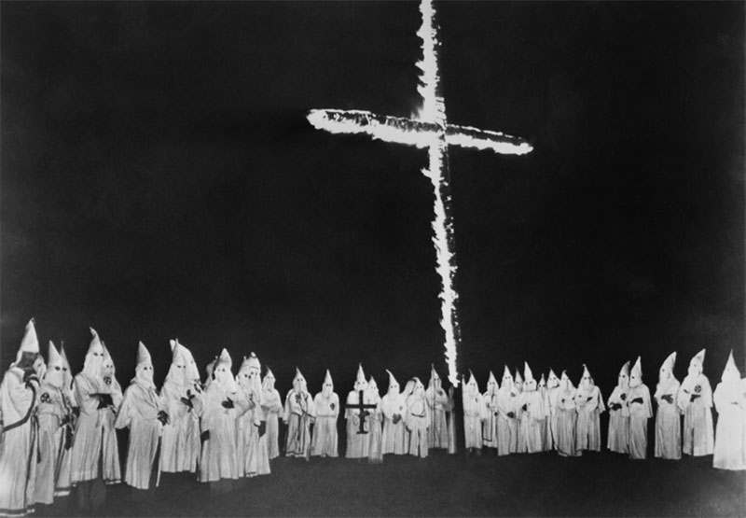
The Ku Klux Klan
The Ku Klux Klan was founded in 1865 and extended in almost every Southern State by 1870.
The Ku Klux Klan is two distinct U.S hate organisations that employed terror in pursuit of their white supremist agenda. Two eras of the KKK – First era; 1865-1915 and Second era erupted in 1915 and has continued to the present.
Following the Civil War in America – the KKK was founded as a secret organisation that used terror tactics to target the newly freed African Americans. As the end of the civil War brought freedom to enslaved African Americans. The 14th and 15th Amendments to the Constitution protected the civil rights of the freed people however, when they tried to exercise these rights they encountered intimidation and violence by the Klan.
The Klan performed crimes against African Americans, white republicans and sympathisers. The Ku Klux Klan dedicated much of their efforts to keeping White Democrats in the majority and getting rid of anyone who they saw to be a threat.

Slide 32
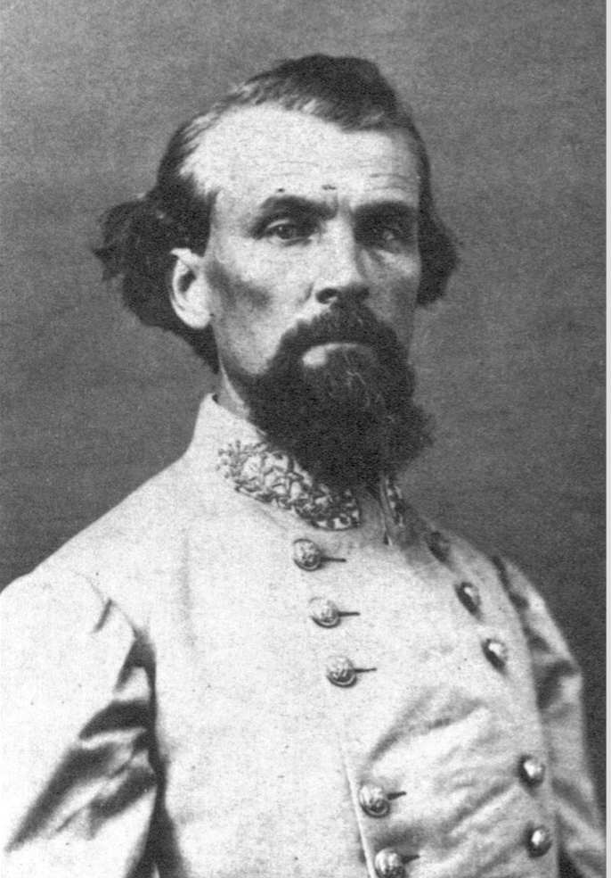
The First KKK
General Nathan Bedford Forrest founded the Ku Klux Klan in 1865 in Tennessee as a ‘social club’. The Klan operated as a local terrorist group – and referred to themselves as the invisible empire of the South.
The Klan committed acts of violence undercover wearing the disguise of the long flowing white robes that were hooded and capped by horns. The KKK is estimated to have performed over 3500 racially motivated lynching's in the south between 1865-1900.
The Democrats relied on the Klan to secure election victories as Klansmen often threatened or killed competing Republican candidates – many southern Republicans actually abandoned their campaign due to the inability to hold meetings and attract voters due to living in constant fear. The Klan would also commit voter fraud to dilute the Black vote.
In response to the Klan’s violence Congress passed the Force Acts 1870 which required the South to fully recognise the 14th Amendment. However, this Force Act inadequately addressed the violence of the KKK. Therefore, in 1871 Congress passed the Ku Klux Klan Act which made it punishable under federal law for hate crimes or disenfranchising crimes on the basis of race.

Slide 33
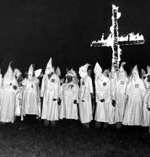
Revival of the Ku Klux Klan 1915.
The KKK remerged in the South in 1915. As the clock struck midnight on Thanksgiving 1915 a group of med clambered to the top of Georgia’s Stone Mountain, and lit wooden cross to symbolise the revival of the KKK and pledged their allegiance to the Constitution, Christianity and persevering an America rife with racism.
The revival promoted fundamentalism and devout patriotism along with advocating white supremacy. In 1the 1920s the Klan moved into many states to dominate local and state politics. In 1924, the Klan succeeded in engineering the elections placing Klansmen in positions of power to control the state government – known as the ‘’Invisible empire’’.
At its peak – in the 1920s the Klan membership exceeded 4 million people nationwide.
The revival of the KKK during the 1900s reflected a society struggling with the effects of industrialisation , urbanisation and immigration.

Slide 34
Ideology and Goals
First wave – narrow ideology – African Americans subordinate.
Second wave – strong ideology – focusing their hatred on African Americans, Catholics, Jews and foreigners.
Todays ideology – fuelled by hatred of Muslims, anti-immigration, anti-Semitism and anti-LGBT. As well as the continued racism to African Americans.
Establishment of white supremacy through protecting and maintaining the distinct institutions, rights, privileges, principles and ideals of a pure Americanism.

Slide 35
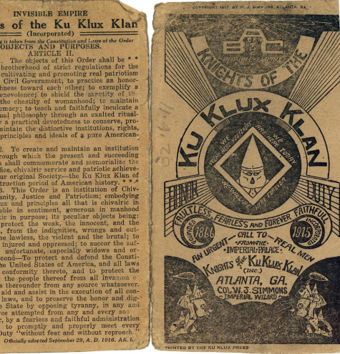
The Ku Klux Kreed
This is a pamphlet published by Joseph Simmons in 1916 stating the objectives and purposes of the Ku Klux Klan.
Section 1 – states that they hold the objective of creating a common brotherhood of strict regulation for the purpose of cultivating and promoting real patriotism towards our civil government. They want to shield the sanctity of the home and chastity of womanhood; maintain white supremacy; to teach and faithfully inculcate a high spiritual philosophy through exalted ritualism and practical devotedness, maintain the distinctive institutions, rights, privileges, principles and ideals of Americanism.
Section 2 – create and maintain and institution by and through which the present and succeeding generations shall commemorate and memorialise the great sacrifice and achievements of the Ku Klux Klan.
Section 3 – protect and defend the Constitution of the US.

Slide 36
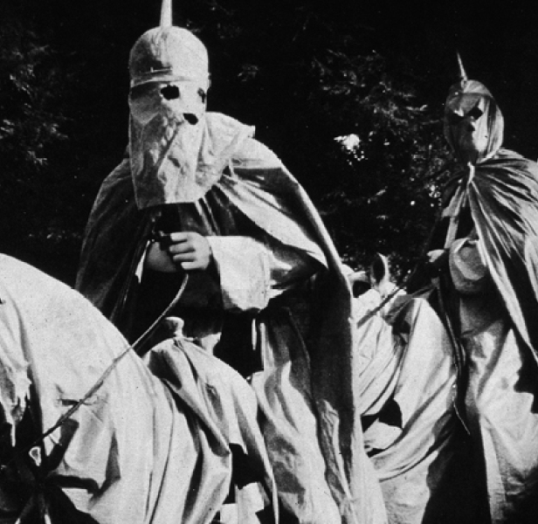
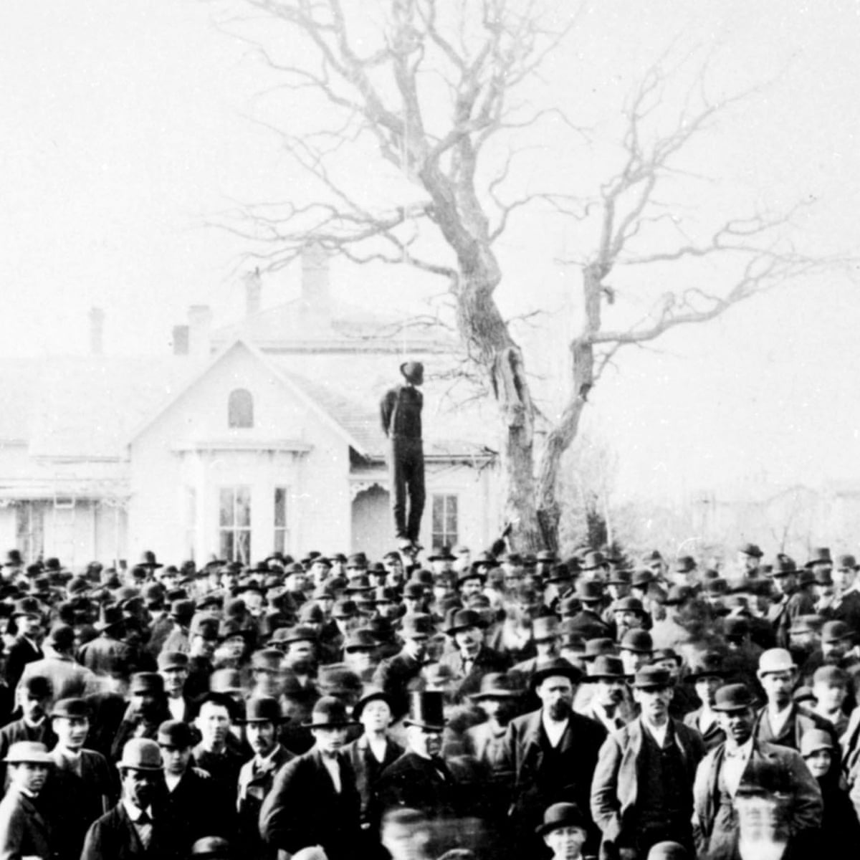
Tactics
Intimidation tactics. One of these were night patrols that composed of white men who saw these patrols as their civic duty. They used these patrols to enforce curfews for slaves, looking for runaways and guarding rural areas against the threat of the black uprisings. They also terrorised black people through ‘supernatural’ means. For example, going to black houses and demanding water in a white sheet and ghoulish ask. They would demand gallons of water which poured into a bottle under their robes then would say they hadn’t drunk enough because he died in battle. Then he would gallop away leaving the impression of confederate ghosts.
Violence to control behaviours and maintain social order. One of the most brutal tactics was lynching – they would carry out shootings, stabbings, beatings and hangings in public view. In many instances the victim was left on display for days. Lynching is when a group of people kill someone for an alleged offence without trail.
Manipulation of politics by excluding certain people and ideas. Early on the KKK intimidate blacks and white republicans to keep them from voting. This fear even led some black families to hide in the woods for their own safety. During the election day armed KKK members would patrol the streets, move election locations to unknown locations. During the second era the KKK gained power on a national level through having KKK members run for office. The KKK then purposefully avoided violence to create a respectable public image.

Slide 37
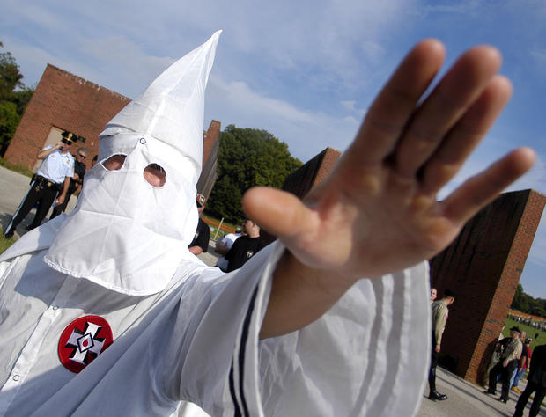
Threat today
David Duke in 1975 founded the Knights of the Ku Klux Klan to attempt to put a kinder and gentler face on the Klan. The knights like many other American hate groups have become Nazified which focuses on Jews rather than blacks as the primary enemy. However, they still launched attacks against African Americans.
The Brotherhood of Klans founded in 1996 in Marion Ohio and keeps alive the ideology of the KKK. On the brotherhood of klans website they say “Are you prepared to FIGHT AGAINST ILLEGAL IMMIGRATION?’’. In 2007 they had a new leader.
There has been a long-term decline of the Ku Klux Klan which is due to various factors such as social rejection of what the Klan stands for, a growing perception by white supremist that Klan groups are outdated. However, despite their diminishing numbers there are still approximately 3,000 Klan members nationwide and an additional unknown number of associates and supporters.
They continue to spread and broadcast racist, anti-Semitic, homophobic and Islamophobic messages. About 50 KKK members march in Charlottesville in 2017 - showing that despite their threat diminishing, they are still active.

Slide 38
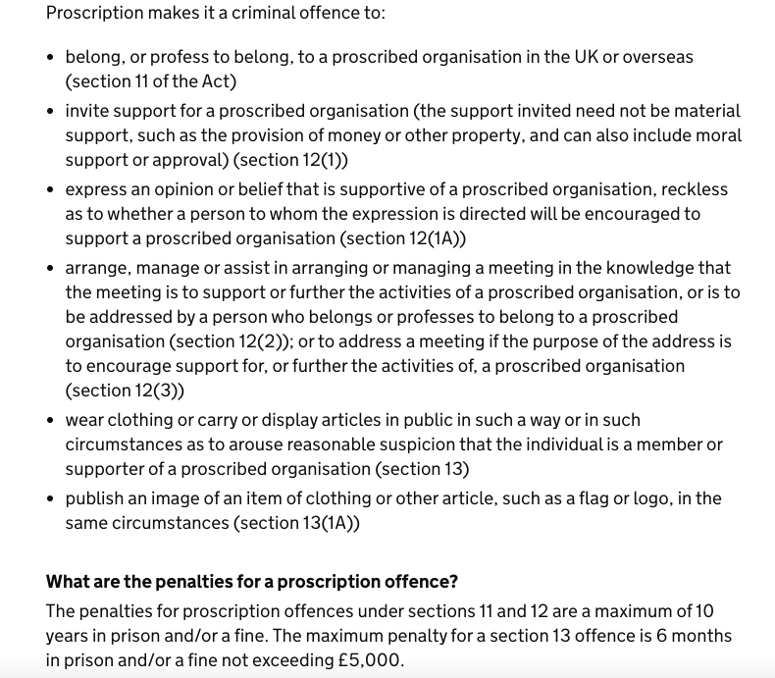
Responses to Right Wing Terrorism in the UK
Since 2017, the police have disrupted eight terrorist plots related to RW ideologies.
Rise in proscribing RW organisations – 2016 proscribed National Action, 2017 Scottish Dawn and National Socialist Anti-Capitalist Action. February 2020 proscribed Sonnenkreig Division and in July 2020 Feukrieg was also proscribed.
A proscribed organisation is one that has been stated under the 2000 Terrorism Act to be concerned in terrorism and is proportionate to do so.
In the 2018 CONTEST strategy the government recognised that extreme right-wing terrorism is a growing threat. The head of MI5 also warned that violent right-wing extremism is now a major threat facing the country with young people being attracted to the ideology.

Slide 39
Responses to Right Wing Terrorism in the UK
Prevent – one of the strands of CONTEST seeks to deal with issues of radicalisation and respond to the ideological challenge of terrorism. Prevent seeks to deal with all forms of terrorism, including far-right terrorism. This has resulted in many referrals of Channel programme – In 2018/19 of the 561 individuals in referred to Channel 45% (254) were related to right-wing terrorism and 37% were concerned with Islamist terrorism.
The HM Government 2015 in the Counter-Extremism recognise how extremists and terrorists use the internet as a means to spread ideological goals. They stated that ‘’Neo-Nazi and extreme right wing groups have also proved adept at using the internet and social media to spread their ideology and seek recruits’’. Therefore, they started working in partnership industry and police to remove terrorist and extremist material.

Slide 40
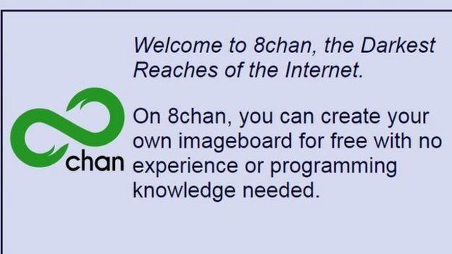
Right Wing Terrorism and the internet
Far right extremism has become a growing problem online. The internet has provided far-right extremists a much wider reach than before and can legitimise themselves through posting their own kind of narrative. The internet has provided a means for extremists to create an electronic community of hate.
Internet chat forums are spaces where virtual meetings can take place. Users can anonymously post blatantly hate filled racist content and messages.
Forums and far right pages on social media ae breeding grounds for far right recruiters.
Social media is used to recruit and radicalise people – predominantly young and vulnerable white men.
‘’The Internet: provides instant and anonymous access to propaganda that inspires and guides criminal activity, helps more effectively coordinate their activities, offers new ways to make money ’’
(Anti Defemination League, 2013, p. 2).

Slide 41
Web 2.0 – Facebook & Twitter
Twitter – came under pressure for large amount of right wing produced and circulating on the platform.
-Hashtags
Facebook – less research on how right-wing extremists use the platforms.
-Livestreams.
More freedom than Islamists.

Slide 42
Web 2.0 – Gab, Telegram, 4Chan & 8Chan
Gab founded in 2016 – most prominent platform for RWT.
-By the end of 2018 had approximately 450,000 users.
Telegram - used by National Action as a means of communicating tactics.
4chan established in 2003 – does not require logins, usernames are optional and threads disappear.
8Chan established in 2013 – more extreme version of 4Chan.

Slide 43
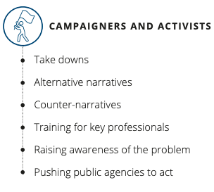
Countering Right Wing Terrorism Online
Removals of extremist content online.
Counter-narratives – picking apart extremist ideology and undermining their framework, mocking, ridiculing and undermining their legitimacy.
Alternative narratives – unite the silent majority against extremism.

Slide 44
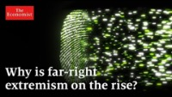

Slide 45
Task
Research one proscribed right wing terrorist group in the UK and provide an overview of:
1. Their ideology, motivation and goals.
2. What led to them becoming proscribed as a terrorist group?

Slide 46
Conclusions
Identified what right wing terrorism is, the challenges with defining RWT and the issue of RWT.
Explored the generic ideologies and motives of RWT.
Discussed some of the proscribed RWT groups and attacks worldwide from RWT.
Enquired into two examples of RWT - National Action and the KKK in depth examining their ideologies, motives and tactics.
Summarised the response to RWT in the UK and the issue of the internet.

Slide 47
Workshop Task
Conway, M., Scrivens, R., and Macnair, L. (2019). ‘Right-Wing Extremists’ Persistent Online Presence: History and Contemporary Trends. URL: https://icct.nl/app/uploads/2019/11/Right-Wing-Extremists-Persistent-Online-Presence.pdf
Make notes and attempt to answer these questions for the workshop:
1. What was the purpose of Web 1.0 for right wing terrorists/extremists?
2. How do RWT utilise social media platforms? Both generic and less prominent platforms such as Gab, Telegram, 8Chan and 4Chan.
Think about the prominence of the internet and RWT operations: Would RWT be the threat it is today without the internet?

Slide 48
Any Questions?
About todays content?
About the assessment?
About anything else?

Slide 49
References
https://www.jstor.org/stable/pdf/26918302.pdf?refreqid=excelsior%3A90141788069a84fe26a565238643d8e9
https://crestresearch.ac.uk/resources/understanding-far-right-landscape/#:~:text=Guide%3A%20Understanding%20the,pdf%20-%20934%20kB
https://assets.publishing.service.gov.uk/government/uploads/system/uploads/attachment_data/file/834424/Ben_Lee_-_Overview_of_the_far_right.pdf
https://christchurchattack.royalcommission.nz/the-report/part-2-context/harmful-behaviours-right-wing-extremism-and-radicalisation/
https://visionofhumanity.org/wp-content/uploads/2020/11/GTI-2020-web-1.pdf |
https://www.tandfonline.com/doi/epub/10.1080/1057610X.2021.1956063?needAccess=true
https://assets.publishing.service.gov.uk/government/uploads/system/uploads/attachment_data/file/470088/51859_Cm9148_Accessible.pdf

Slide 50
References
https://core.ac.uk/download/pdf/42492009.pdf
https://www.opendemocracy.net/en/countering-radical-right/many-faces-neo-nazism-uk/
https://hopenothate.org.uk/research-old/investigations/briefing-national-action/
https://www.jstor.org/stable/pdf/26544646.pdf?refreqid=excelsior%3Aa315c4c40cd3c6211f76dfe3b43f1eb5
https://www.bbc.co.uk/news/uk-41414164
https://www.theguardian.com/uk-news/2020/jun/09/four-uk-neo-nazis-jailed-for-membership-of-national-action
http://pure-oai.bham.ac.uk/ws/files/39736467/PQ_NATIONAL_ACTION_ChrisAllen_Janary_2017.pdf
https://www.theguardian.com/uk-news/2016/nov/23/thomas-mair-found-guilty-of-jo-cox-murder
https://cwnc.omeka.chass.ncsu.edu/exhibits/show/kkk-methods/background/background
https://www.nationalgeographic.org/article/ku-klux-klan/
https://www.khanacademy.org/humanities/us-history/civil-war-era/reconstruction/a/the-first-kkk
https://smallstepsconsultants.com/the-far-right-threat/how-does-the-far-right-use-the-internet-to-recruit/
https://www.adl.org/sites/default/files/documents/assets/pdf/combating-hate/The-Consequences-of-Right-Wing-Extremism-on-the-Internet.pdf

Slide 51
References
https://www.lawfareblog.com/150-years-hate-resurgence-ku-klux-klan
https://www.khanacademy.org/humanities/us-history/rise-to-world-power/1920s-america/a/the-reemergence-of-the-kkk
https://www.history.com/topics/reconstruction/ku-klux-klan
https://www.pbs.org/wgbh/americanexperience/features/flood-klan/
https://www.lawfareblog.com/150-years-hate-resurgence-ku-klux-klan
https://credo.library.umass.edu/cgi-bin/pdf.cgi?id=scua:mums312-b009-i215
https://www.readcube.com/articles/10.5130%2Fccs.v10.i3.6026
https://www.splcenter.org/fighting-hate/extremist-files/group/knights-ku-klux-klan
https://www.adl.org/sites/default/files/documents/assets/pdf/combating-hate/tattered-robes-state-of-kkk-2016.pdf
https://homeofficemedia.blog.gov.uk/2019/09/20/fact-sheet-right-wing-terrorism/
https://assets.publishing.service.gov.uk/government/uploads/system/uploads/attachment_data/file/716907/140618_CCS207_CCS0218929798-1_CONTEST_3.0_WEB.pdf
https://www.gov.uk/government/publications/proscribed-terror-groups-or-organisations--2/proscribed-terrorist-groups-or-organisations-accessible-version
https://assets.publishing.service.gov.uk/government/uploads/system/uploads/attachment_data/file/470088/51859_Cm9148_Accessible.pdf

Slide 52
References
https://www.tandfonline.com/doi/pdf/10.1080/09546553.2019.1598391?casa_token=MBqQDXhcY7QAAAAA:Ga5iyB586Y_V39H_gtdGznaIhocyN8IOh5jKYeYBD8hT99Us-hrkV6XP1jDuvEOJy3GwV5McaA
https://dam.gcsp.ch/files/2y10xuCSaBlvYTDbinjPokvyDO2XLpn5jG4va93JVUzppqj08EDHwnC
https://ro.ecu.edu.au/cgi/viewcontent.cgi?article=1046&context=asi
https://www.aa.com.tr/en/europe/media-reluctant-to-label-far-right-as-terrorist-report/1448150#
https://icct.nl/app/uploads/2019/11/Right-Wing-Extremists-Persistent-Online-Presence.pdf
https://assets.publishing.service.gov.uk/government/uploads/system/uploads/attachment_data/file/263181/ETF_FINAL.pdf
https://journals.sagepub.com/doi/pdf/10.1177/1473779521989349
https://homeofficemedia.blog.gov.uk/2018/12/13/factsheet-prevent-and-channel-statistics-2017-2018/
https://rm.coe.int/the-united-kingdom-s-strategy-for-countering-terrorism-june-2018/16808b05f3
https://www.isdglobal.org/wp-content/uploads/2016/03/On_The_Front_Line_Far_RightHANDBOOK.pdf

Slide 53

Week 5 Complete!
Thank you for listening.
See you all next week!

