Slide 1

Week three Twitter Brand

Slide 2
Objectives
Twitter marketing plan
Twitter brand

Slide 3
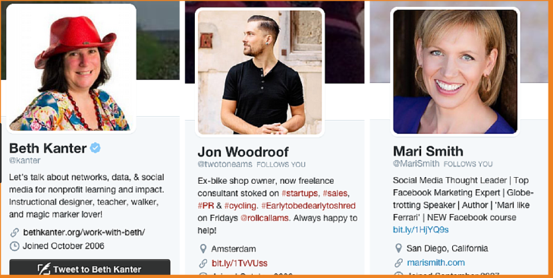
Twitter Brand
Establish a Twitter marketing plan
    Email signature
    Personal/corporate website
    Email newsletter
    Presentations
    Business Card
    Article writing / guest blog posting
    Networking on Twitter: By using the “@” symbol
    Promotional products
Your Twitter brand
Your Bio

Slide 4

Twitter Brand
Choose a solid social
profile photo
Design a cover photo
that tells a story

Slide 5
Twitter Brand
Consistently tweet interesting stories
Communicate with others
Form a Twitter “Mastermind Group”

Slide 6
Twitter Brand
Share articles related to your field
Share what your audience want to read
Follow relevant people
Become known as an expert or resource

Slide 7
Summary
Twitter marketing plan
Twitter brand

