Slide 1
DIGITAL SAFETY AT SUNRISE CARE HOME
Presented by: JUSTYNA GAJEWSKA
Student ID: 2517291
Module: LCHS4007 - Digital Skills and Research Methods
Sunrise Residential Care Home

Slide 2
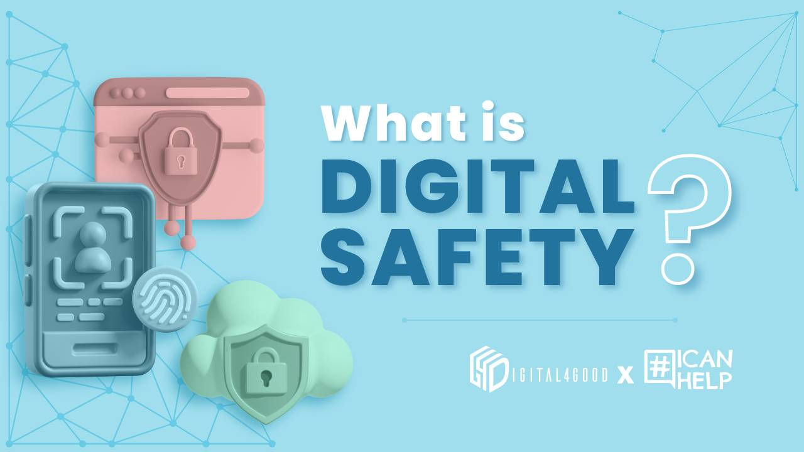
WHAT IS DIGITAL SAFETY?
Digital safety is the protection of electronic information, information systems and computer hardware from unauthorised access or damage. (For example, hacking and malware).
Keeps patient data private, trustworthy, and accessible.
It safeguards the personal and medical information of residents from any breach.
Meeting the requirements of the GDPR and DPA 2018.
According to CQC (2022), trust is essential between residents, families and care providers.

Slide 3
Staff Digital Safety Checklist
✓Secure Logins: Use strong passwords (minimum 8 characters with mix of letters, numbers, symbols); enable multi-factor authentication; never share login credentials (NCSC, 2023)
✓Email Safety: Verify sender identity before opening attachments; avoid clicking suspicious links; report phishing attempts immediately
✓Document Storage: Save files only to OneDrive or approved systems; encrypt sensitive documents; regular backup procedures
✓Patient Confidentiality: Lock screens when leaving workstations; discuss patient information only in private areas; dispose of printed records securely (ICO, 2024).

Slide 4
ADVANTAGES OF DIGITAL SAFETY AT SUNRISE
✓.Safeguards vital personal and health data against unlawful access and cyber attacks.
✓.Follows rules of GDPR and Data Protection Act 2018 and CQC (Gov.uk, 2023).
✓.Creates trust with residents and families through commitment to data protection.
✓.Lowering the risk of data breaches caused by the significant amount of financial penalties fines.
✓.Enhanced overall quality of care through accurate and secure record keeping.

Slide 5
DISADVANTAGES & CHALLENGES
✗.Staff training and system implementation for the initial setup would take time.
✗.Staff may have problems adapting to security protocols due to a lack of digital skills (Skills for Care, 2023).
✗.There will be extra costs for security software, training programs and system maintenance.
✗.Password complexity and multi-factor authentication impede emergency workflows.
✗.Updating and monitoring are required continually to face evolving cyber threats .

Slide 6
References
Care Quality Commission (2022) Guidance for providers on meeting the regulations. Available at: https://www.cqc.org.uk (Accessed: 2 November 2025).
Gov.uk (2023) Data protection: how we collect and share your data. Available at: https://www.gov.uk/government/publications/data-protection (Accessed: 2 November 2025).
Information Commissioner's Office (2024) Guide to the General Data Protection Regulation. Available at: https://ico.org.uk/for-organisations/guide-to-data-protection (Accessed: 2 November 2025).
National Cyber Security Centre (2023) Password guidance: simplifying your approach. Available at: https://www.ncsc.gov.uk/collection/passwords (Accessed: 2 November 2025).
National Cyber Security Centre (2024) Cyber security for care organisations. Available at: https://www.ncsc.gov.uk (Accessed: 2 November 2025).
NHS Digital (2023) Data security and protection toolkit. Available at: https://digital.nhs.uk/data-and-information/looking-after-information/data-security-and-information-governance (Accessed: 2 November 2025).
NHS England (2023) Digital transformation in health and care. Available at: https://www.england.nhs.uk/digitaltechnology (Accessed: 2 November 2025).
Skills for Care (2023) Digital skills in adult social care. Available at: https://www.skillsforcare.org.uk (Accessed: 2 November 2025).

