Slide 1

My Digital journey
Victoria pilcher
26/6/26

Slide 2

The beginning
Not knowing how to use AI tools
Didn’t know how work out excel
Not understanding how to use powerpoint

Slide 3
Skills developed
Word
Excel
Powerpoint
AI

Slide 4
LEARNING PLATFORMS
Linkedin learning
Powerpoint
Moodle
AI
excel

Slide 5
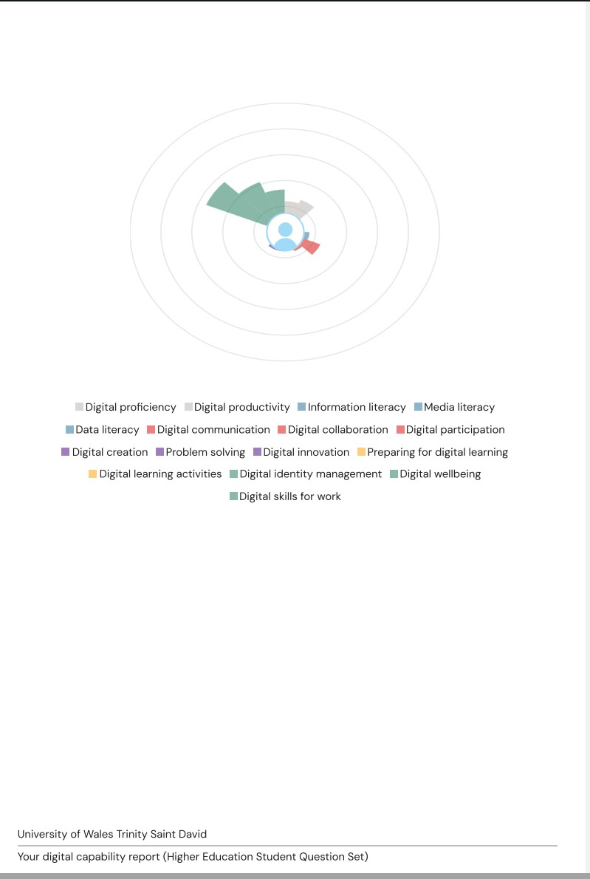

Slide 6

Overall outcome
use AI digital skills
setting up my own business
Being more confident managing a team

Slide 7
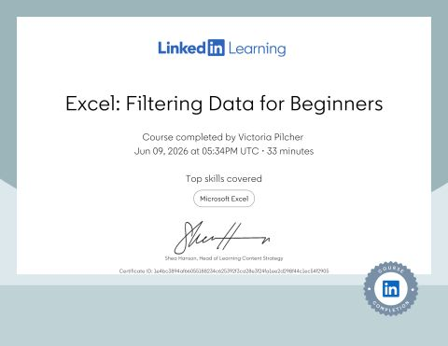
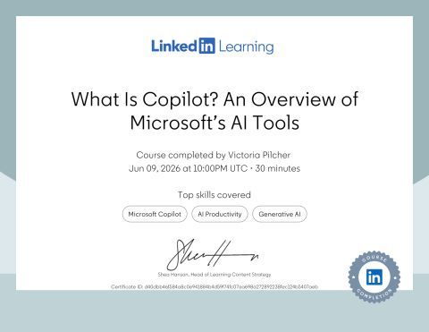

Slide 8


thank you for your time
Any questions or feedback

