Slide 1
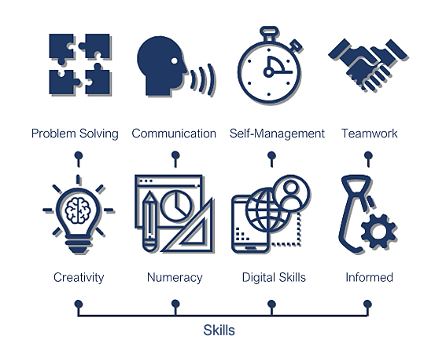
Academic and employability skills – HUMAN RESOURCE
STUDENT : MIRELA ADAMACHE
STUDENT ID : 2115392
LECTURER : LIZETA DEMETRIOU

Slide 2
Table of Content
Introduction
Academic skills
Types of academic skills
Employability skills
Types of employability skills
Understanding world of work
SWOT analysis
Conclusion
References

Slide 3
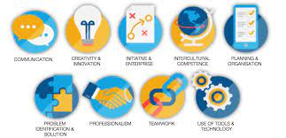
Introduction
The academic and employability skills are very much crucial for the student in order to gain competitive advantage in career related life.
It is important for a learner in academic life to develop professional skills in order to grow at faster pace in the marketplace.
Notes:
The employability skills are also important for an individual in order to gain success in career related life. Academic skills providing in an effective manner will lead to develop competency edge in the career related life. In the era of stiff competition between companies, it is compulsory for a company to demand for professional employability skills in the individual to lead the marketplace.

Slide 4
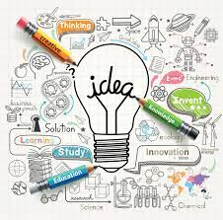
Academic skills and its importance
The academic skills are important for an individual to develop growth and learning in academic life in order to develop effective parameters.
Companies in the international and national marketplace also focus on developing learning skills of the individuals in order to increase their performance in long run.
The business organisations focus on learning skills in an effective manner to develop effective coordination and communication.
Notes:
In the long run also, academic skills play a crucial role for a person in handling major consequences of career growth and development (Bhagra, 2018). For the job market related to human resource management the academic skills play a major role by developing ethics and integrity in the employees. The academic skills are important for a person in human resource to establish professional approach in managing different types of employees in the company. In the Job market related to human resource management, this approach is beneficial for gaining desired growth in career. Most of the successful companies in international and national marketplace focus on precise development of academic skills to gain systematic growth.

Slide 5
Types of academic skill
In the University, there are several types of skills which are required by a student to develop competitive edge. The major skills for human resource management as an intended career are mentioned below:
Communication skills
Time management skills
Technology skills
Notes:
Technology skills- In the recent times, the importance of information and technology is increasing day by day. It is crucial for a company to manage technological skills for the overall development of company using latest technology. The human resources manager should focus on developing technological skills in order to manage the manpower in an effective manner (Wolff, 2017). Technology management skills will also help a person to perform management related operations with ethical manner by taking into consideration time. The achievement of goals and objectives of a company is also possible with the help of time management skills in a precise manner. Companies should also focus on developing advanced technological skills in the employees for increasing stability in operations and functions.

Slide 6
Continue…
Communication skills- The communication skills are most important for a person who is choosing human resource management as an intended career. In the universities, it is the moral duty of management to develop communication skills for long term success of the individual.
Time management skills- These are the most important skills that are important for an individual in order to increase professionalism. The time management skills helps an individual to complete different given tasks on time.
Notes:
Communication skills- These skills are also effective for an individual to increase coordination between different employees which helps the company to achieve short and long terms business goals. It is compulsory for a person who have chosen HR management as an intended career to develop communication skills by keeping in mind various protocols of HR management.
Time management skills- Time management skills are also important in managing day to day routine tasks in a specified manner for sustainable growth. For the human resource management operations, time management helps an individual to perform strategic goals on timely basis. The development of time management skills also helps a company to overcome major issues and challenges at the marketplace.

Slide 7

Employability skills
The employability skills are major type of qualities that are essential for an individual to develop working skills in the company. Most of the successful companies in international and national marketplace focus on developing employability skills in order to perform functions and tasks of the company.
Employability skills also play a major role in developing job opportunities for an individual in the current market scenario.
Notes:
In the overall development of a company, the employability skills play a crucial role by developing parameters of job functioning. In an individual these skills are developed with the help of major training and development practices by the employees (Skoyles, 2019). The professionalism in employability is bought by major practices that are systematic in nature. Major companies also focus on developing employability skills in a specific period of time to lead the marketplace. The value creation in employability skills is developed by top level and strategic management of the company in order to create an advance approach. In universities, many students are taught employability skills in order to facilitate their overall development. These skills are important for a company as it considers professional training and development of the individual for long term success. Major companies in international marketplace focus on developing employability skills in order to increase stability in the marketplace. In order to develop job functions in a set period of time, the employability skills play a major role by providing competitive advantage to the business firm.

Slide 8
  Types of employability skills
In the corporate world there are many types of employability skills which are needed by individuals to develop professionalism in career. The major type of employability skills are mentioned below:
Design thinking
Personal branding and corporate communications
General awareness
Soft skills
Personality development
Notes:
Also the employability skills play a crucial role in developing overall personality of a candidate which is necessary to develop desired professionalism.

Slide 9
Continue…
Design thinking- The design thinking skills are important for a person in order to develop desired logical skills. The design thinking skills are important for a person in order to take major decisions of the company.
Personal branding and corporate communications- The corporate skills are also helpful for an individual in order to developing effective coordination. Companies should develop personal approach while developing personal branding skills in employees for desired success in a set period of time.
Notes:
Design thinking- In order to achieve good market share and manage large number of skills, these skills are important for an employees in order to develop quick decision making. These skills also helps a company to eliminate risk associated with the operations in order to develop effective decisions.
General awareness- This is one of the most important skills, which are important for an individual to take knowledge related decisions (Sotiriadou, 2020). Companies should also focus on hiring employees who have general knowledge related to corporate world. This will help the company to develop precise knowledge about major functions in order to increase sustainability. General awareness of employees also helps them to face most of the difficult consequences in marketplace.
Soft skills- The soft skills are related to develop effective personality traits in the employees which helps in increasing the body language. The soft skills are also helpful in developing coordination in the company for achievement of aims and objectives. Companies should hire employees who have systematic soft skills in order to complete different tasks on timely basis.
Personality development- Personality of an individual also play a major role in determining success in a specific time period. In the development of all functions and activities of the employment, the personality development play a systematic role. Companies hire employees who have dynamic and crucial personality in order to develop them as a perfect leader (Kamaliah, 2018). The leadership also helps a company to manage large number of employees with consistency and discipline.

Slide 10

Understanding of world of work
The major skills which are required in world of work are mentioned below:
Critical problem solving skills-
Tech Savvy-
Leadership skills
Emotional intelligence
Behavioural and attitude skills
Notes:
World of work is a wider term which reflects all the major practices that are adopted by company and employees to remain competitive at the marketplace. Also major companies focus on understanding world of work in order to gain desired success in the marketplace.

Slide 11
SWOT analysis
Strengths: The creative thinking skills of mine are good which will help me in brining creativity in different operations of the company. My presentation and public speaking skills are very good, which makes me a good speaker. | Weaknesses: I have less practical knowledge related to my intended career. I have less practical application knowledge about the subject matter which will create a problem for me to perform professional decision's implementation.
Notes:
In order to analyse own situation, it is compulsory for an individual to use SWOT analysis which helps in development of personality by analysing recent situation. The SWOT analysis of mine is mentioned below:

Slide 12
Continue…
Opportunities: I have a great opportunity to work for famous multinational companies as my HR skills are very good. Developing precise knowledge related to the subject matter with the help of seniors and teachers. | Threats: In the marketplace, there is a risk associated with major decisions of the company and that can be a major threat. One of the major threat for me is development of professionalism in a short span of time for career growth.
Notes:
Analysis- The SWOT analysis will help me to develop career growth with major advantages and it will also help me to identify different hurdles and obstacles (Aliu, 2019). In order to improve my weaknesses I will take the guidance of teachers and seniors which will help me to grow in career related aspect. I will also utilise my strengths in a unique manner for gaining development in a time frame for success.

Slide 13
Conclusion
From the above discussion it can be concluded that developing professionalism in academic field is the major motive of a student which helps in career growth.
This project also concludes that in order to gain effective and designated position in the corporate world it is important for an individual to develop a systematic career plan by analysing major weaknesses and threats.
Notes:
The individuals in career related life should be ready to take help of seniors and professors to develop skills for intended career. This project concludes that in the corporate world, it is important for an individual to focus on developing academic skills for increasing the overall performance. This project also concludes that management and employability skills play a crucial role in order to develop effective personality of the individual. This project also concludes the role of human resource management development in order to manage large number of workforce in the company.

Slide 14
References
Cotronei-Baird, V.S., 2020. Academic hindrances in the integration of employability skills development in teaching and assessment practice. Higher Education, 79(2), pp.203-223.
Bhagra, A. and Sharma, D.K., 2018. Changing paradigm of employability skills in the global business world: A review. IUP Journal of Soft Skills, 12(2), pp.7-24.
Wolff, R. and Booth, M., 2017. Bridging the gap: Creating a new approach for assuring 21st century employability skills. Change: The Magazine of Higher Learning, 49(6), pp.51-54.

