Slide 1

ECGE6001
Skills for Life:
Employability and Future Pathways.
Created by 1602396.

Slide 2
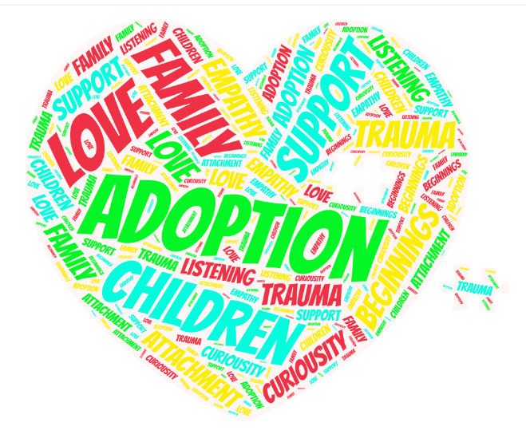
Adoption Support Worker.

Slide 3


The main role of an Adoption Support Worker is to offer practical, emotional and therapeutic support to families before during and after
Adoption.

Slide 4
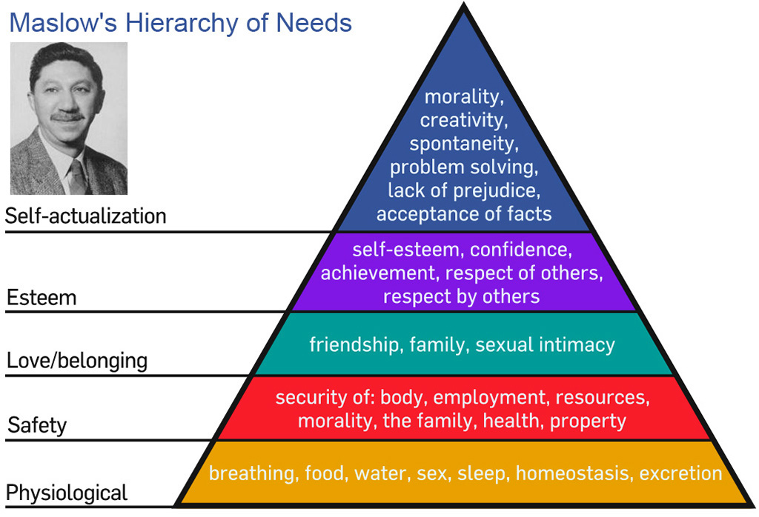
Source:
Koep (2011).

Slide 5
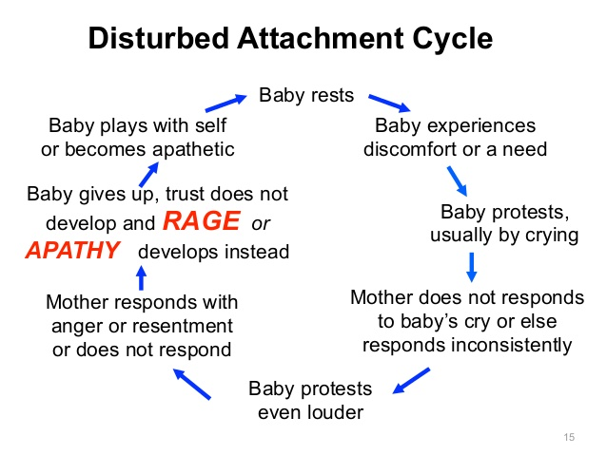
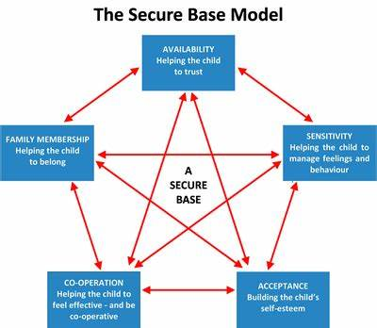
Source: Slideplay.com
Source: Kalim Supporting Special Child.

Slide 6


Slide 7
PACE
Therapeutic Parenting
Non Violent Resistance
Mindfulness
I
nterventions
Life Journey Book
Relationship Based Play
Emotion Coaching
Therapeutic Stories

Slide 8

Skills
Empathy
Team Player
Communication Skills
Organisational Skills
Critical Thinking
Creative Thinking
Enthusiastic
Active Listening Skills
Problem Solving
Transferable Skills
Time Management
Interpersonal Skills
Independent Worker
Energetic

Slide 9



Source: Shutterstock.com

Slide 10
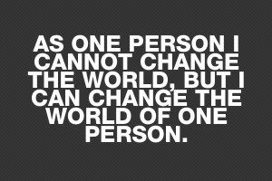

Source: Vector.com

