Slide 1
Ysgol Blynyddoedd Cynnar
School of Early Years
Llundain 2017
London 2017
Notes:
Sustained Shared Thinking and Emotional Wellbeing Scale (SSTEW)
The SSTEW project is an exciting new scale which considers practice that supports children in developing skills in sustained shared thinking and emotional well-being, as well as developing strong relationships, effective communication and aspects of self regulation. Delivered by Doctor Jane Waters, Head of South Wales Centre of Teacher Education, University of Wales Trinity Saint David and Natalie Macdonald, Policy and Research Assistant, Wales Centre for Equity in Education.
Educational theorists throughout history have described the best ways for children to learn, from Socrates to Vygotsky’s and the zone of proximal development many have recognised that the best way children learn is to explore, learn and discover knowledge and the world for themselves.
Our role as educators, parents and guides is to find the best way to support and extend this process and create the best environment for learning and discovery.
But how do we do this?

Slide 2
5-7 Rhagfyr 2017
5-7th December 2017
Teithio ar y Trên
Amgueddfa Plentyndod Cynnar
Meithrinfa McMillan
Siopa
Gweld y golygfeydd
Travel by Train
Museum of Early Childhood
McMillan Nursery
Shopping
Sightseeing
Notes:
The sustained shared thinking scale was devised by Dr Iram Siraj and Denise Kingston developed from the extensive research mentioned.
This scale looks at adult-child interactions and the opportunities provided to allow children to develop their emotional wellbeing and create opportunities for sustained shared thinking.
This scale allows us to consider where we are on the journey to excellence – focussing on the adult and child behaviours that matter.

Slide 3
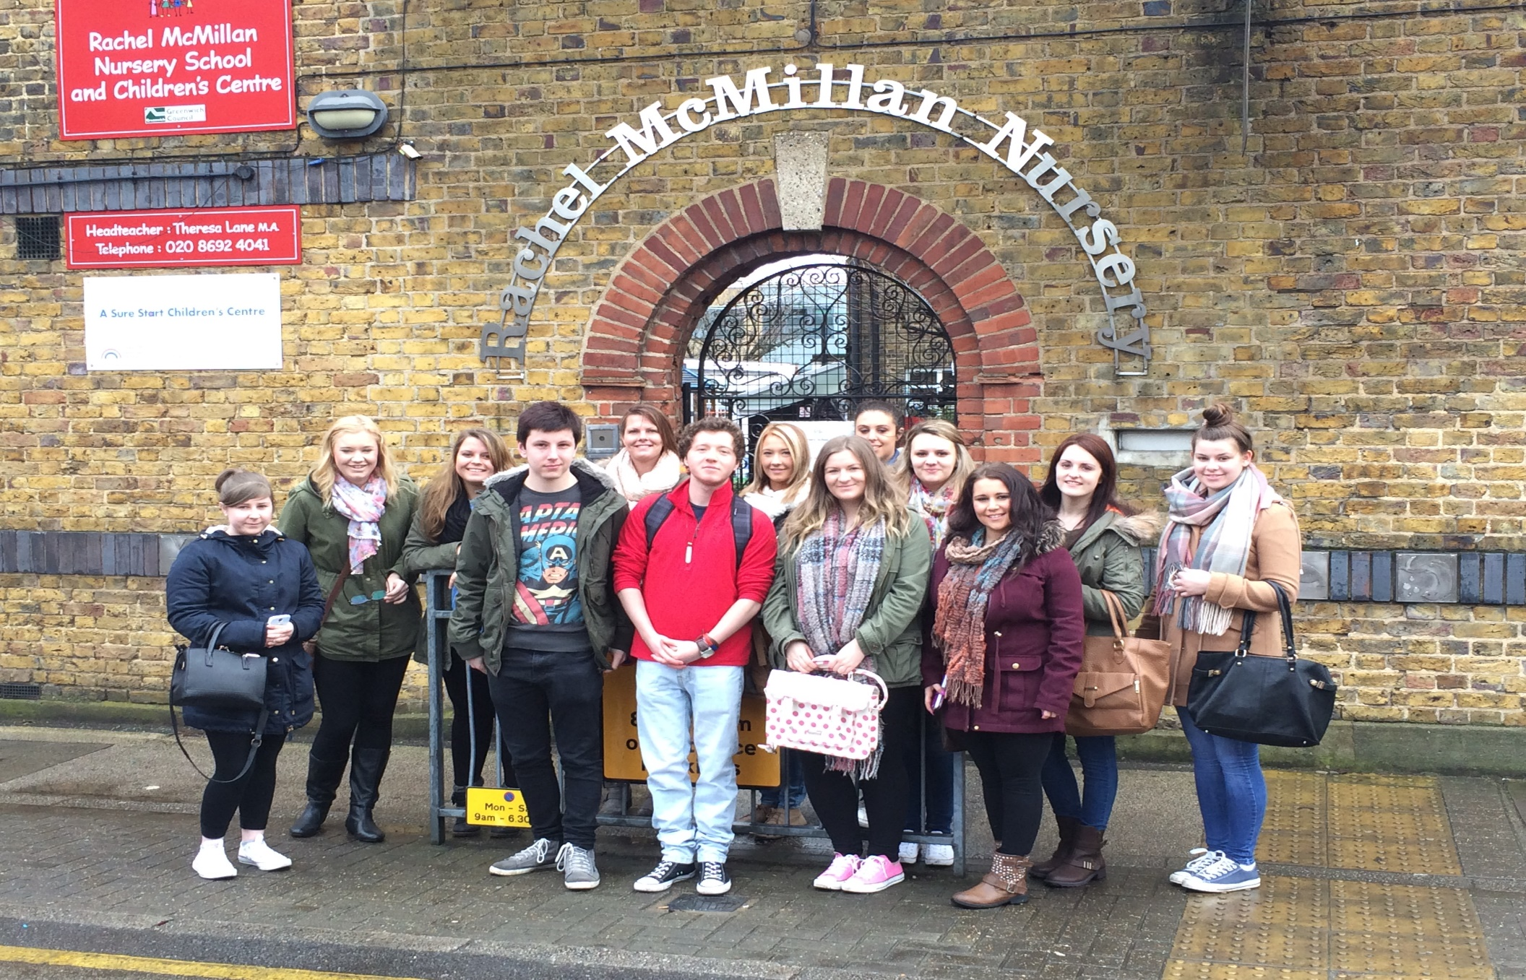

Slide 4
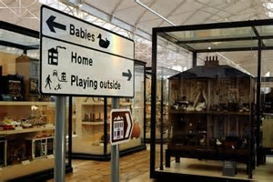
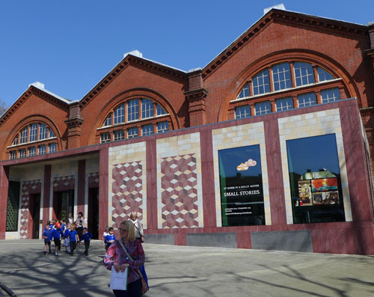

Slide 5

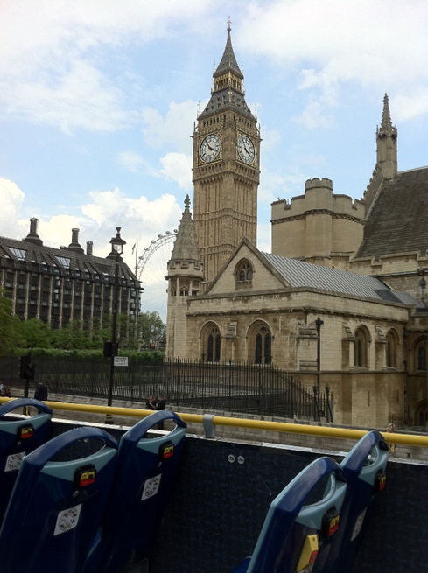


Slide 6
Costau/Costs
£ 310 yn cynnwys:
Teithio Trên
Teithio danddaear / bws tri diwrnod
Gwely a Brecwast dwy noson
Rhandaliadau o
£100 9/10/17 (blaendal)
£110 1/11/17
£100 1/12/17
£310 includes:
Train Travel
Three day Underground/Bus travel
Two nights Bed and Breakfast
Instalments of
£100 9/10/17 (deposit)
£110 1/11/17
£100 1/12/17

Slide 7
Cyswllt/Contact
Natalie.macdonald@uwtsd.ac.uk

