Slide 1
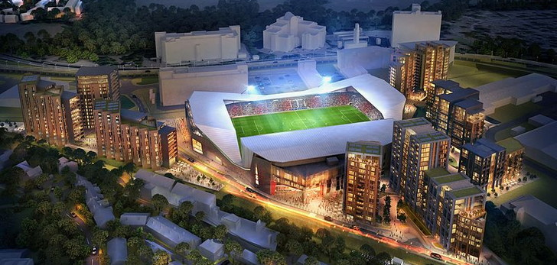

Uk Based Stadiums

Slide 2
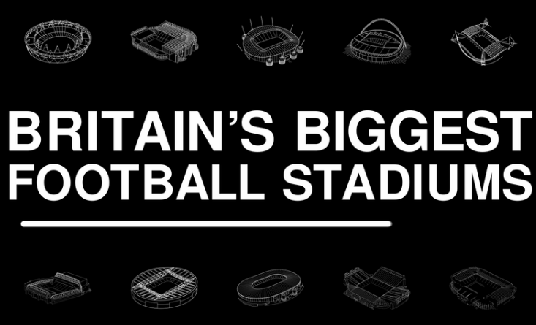
What are the UK's 10 biggest football stadiums in Britain?
https://www.standard.co.uk/sport/football/what-are-the-uks-10-biggest-football-stadiums-a3609006.html

Slide 3
the key features and trends?
Stadiums tend to be by shopping outlets or based in city's.
All stadiums have accesses to Public transport e.g.: a motorway, train station, buss station, taxis for commuting.
The stadiums are multi-purpose venues holding concerts, boxing shows, meetings.
Private hire
Museums and tours

Slide 4
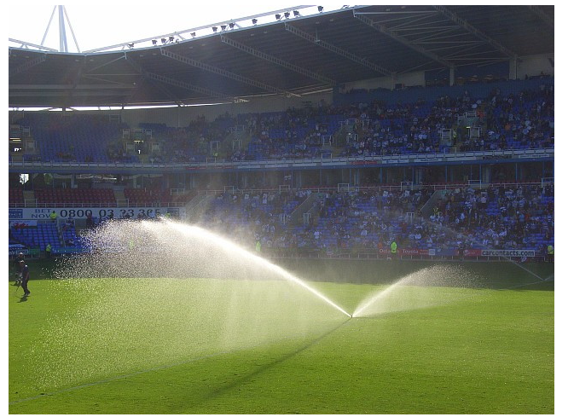
Why Do Football Stadiums Use Sprinkler Systems?
> It is necessary that there is a high maintenance level of a healthy pitch. To grow the grass to the standard of professional football pitch their needs a decent amount of light and the correct amount of water put on it on a regular basis this is maintained by a groundsman.

Slide 5
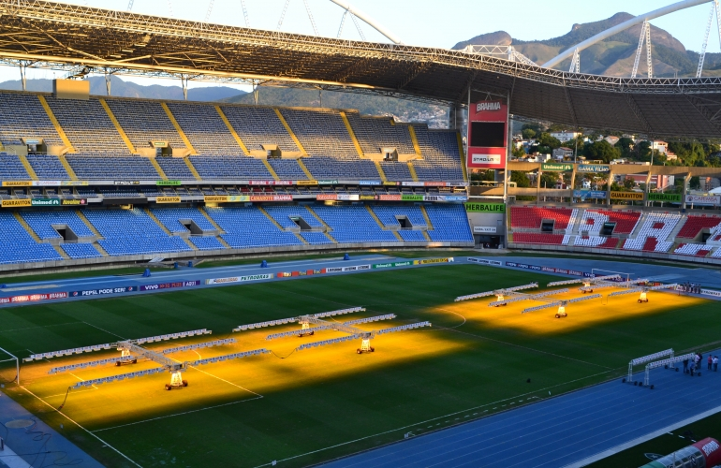
The SGL system has already been implemented by many of the highest rated sports clubs and stadiums worldwide
SGL IMPLIES
A guaranteed top quality pitch
A system applied by stadiums worldwide
High-tech equipment
Highly valued after sales service
State of the art technology
Unique approach and commitment
Unrivalled experience and knowledge
Agronomists with advanced knowledge of grass growth
Offers high-tech equipment
Specializes in revolutionary technology
Is used in more than 250 stadiums worldwide
Boasts a cutting-edge approach and commitment
Guarantees unique pitch quality
Provides a highly valued after-sales service

Slide 6
Liberty stadium pitch
The planning and construction processes are what give the pitch the grand appearance it has today. However, it is also what is contained within the pitch that makes it a good quality pitch.
The pitch is made up of different layers which all help the durability necessary for a pitch. The layers are set out below:
Drainage system
Gravel Carpet
Grit Blinding Layer
Lower Root Zone
Upper Root Zone
Desso Grass
Master Reinforcement
Seeding
http://www.liberty-stadium.com/liberty_stadium_intro_pitch.php

Slide 7
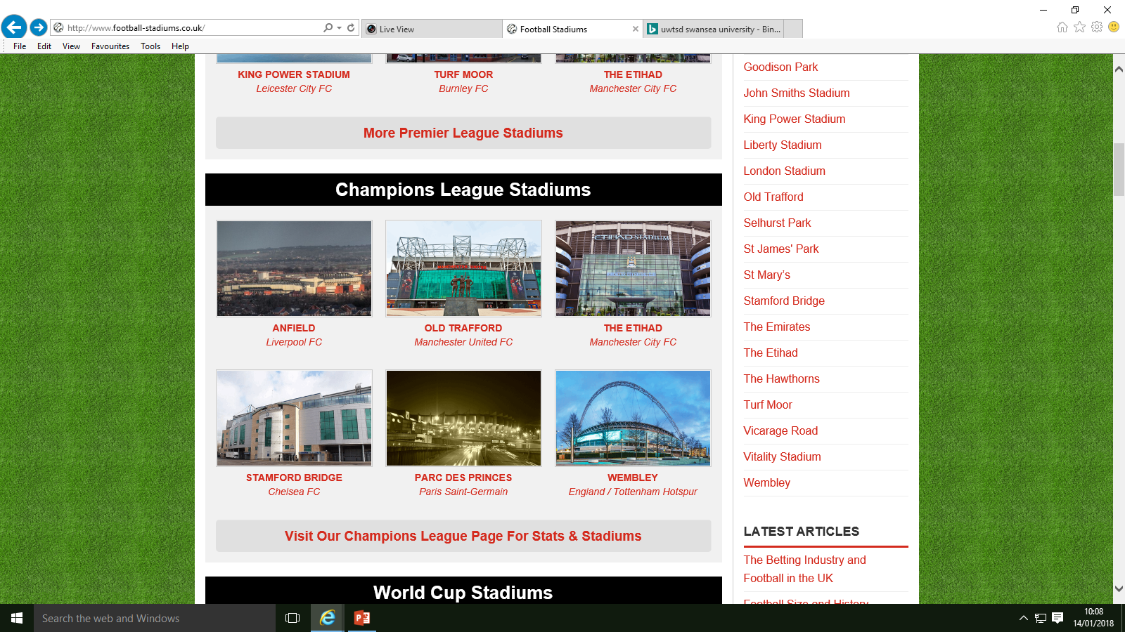
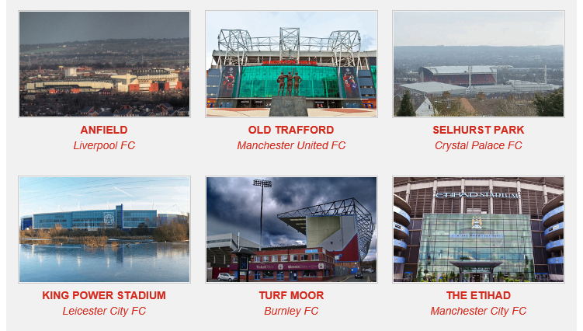
Premier League Stadiums
http://www.football-stadiums.co.uk/

Slide 8
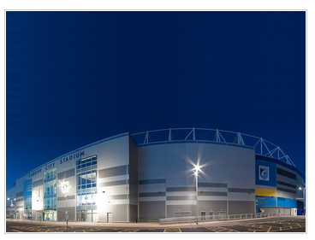
Cardiff City Stadium: Cardiff City / Wales
Cardiff City Stadium Stats
Year Opened | 2009
Capacity | 33,280
Average Attendance | 10,853
Pitch Size | 100 x 68 (6800)
Owner | Cardiff City F.C.
Clubs Hosted | Cardiff Blues, Cardiff City F.C., Wales national team
First Fixture | Cardiff v Celtic (22/07/2009)
http://www.football-stadiums.co.uk/grounds/wales/cardiff-city-stadium/

Slide 9
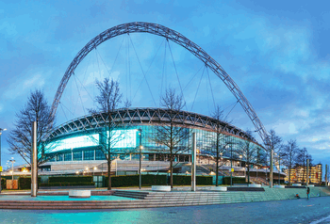
Wembley: England / Tottenham Hotspur
The original stadium was demolished in 2003, the current version of the home of England’s international team was built on the same site and opened to the public in 2007.
Year Opened | 2007
Capacity | 90,000
Average Attendance | 85,000
Pitch Size | 105 x 68 (7140)
Owner | The Football Association
Clubs Hosted | England
First Fixture | Geoff Thomas Foundation Charity XI v Wembley Sponsors Allstars (17/03/2007)
http://www.football-stadiums.co.uk/grounds/england/wembley/

Slide 10
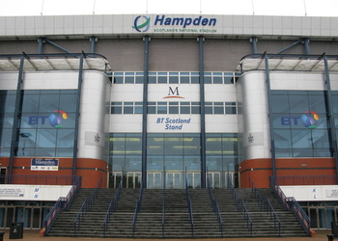
Hampden Park: Scotland / Queen's Park
Year Opened | 1903
Capacity | 51,866
Average Attendance | 50,597
Pitch Size | 105 x 68 (7140)
Owner | Queen's Park F.C.
Clubs Hosted | Queen's Park F.C., Scotland national football team, Glasgow Tigers, Scottish Claymores, Celtic F.C.
First Fixture | Queens Park v Celtic (31/10/1903)
Year Founded1867
http://www.football-stadiums.co.uk/grounds/scotland/hampden-park/

Slide 11
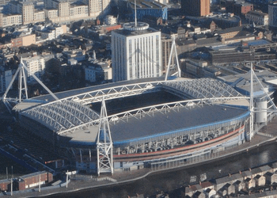
The Principality Stadium: Wales
But wales have not played there since 2011
Year Founded1876
Year Opened | 1999
Capacity | 74,500
Average Attendance | 69,221
Pitch Size | 120 x 79 (9480)
Former Name | Millennium Stadium
Owner | Welsh Rugby Union
Sponsor | Principality
Clubs Hosted | Welsh Rugby Union, Wales National Football
First Fixture | Wales v South Africa (26/06/1999)
http://www.football-stadiums.co.uk/grounds/wales/the-principality-stadium/

Slide 12
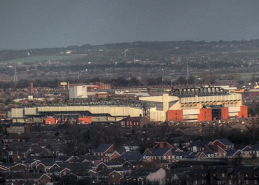
Anfield: Liverpool FC
Year Opened | 1884
Capacity | 54,074
Average Attendance | 44,659
Pitch Size | 101 x 68 (6868)
Owner | Fenway Sports Group
Clubs Hosted | Everton (1884-92), Liverpool (1892-present)
First Fixture | Everton v Earlestown (28-9-1884)
Final Fixture | Mighty Red
Year Founded1892
The Reds
http://www.football-stadiums.co.uk/grounds/england/anfield/

Slide 13
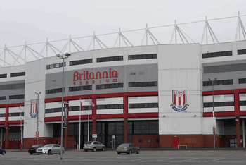
Bet365 Stadium: Stoke City FC
Year Opened | 1997
Capacity | 27,902
Average Attendance | 27,446
Pitch Size | 100 x 64 (6400)
Former Name | Britannia Stadium
Owner | Stoke City
Sponsor | Bet365
Clubs Hosted | Stoke City FC
First Fixture | Stoke v Rochdale (27/08/1997)
Year Founded1863
The Potters
http://www.football-stadiums.co.uk/grounds/england/bet365-stadium/

Slide 14
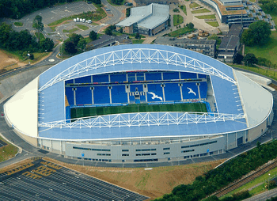
Falmer Stadium: Brighton & Hove Albion
Year Opened | 2011
Capacity | 30,750
Average Attendance | 24,166
Pitch Size | 105 x 69 (7245)
Nickname | The Amex
Former Name | Falmer Stadium
Owner | The Community Stadium Limited
Sponsor | American Express
Clubs Hosted | Brighton & Hove Albion
First Fixture | Brighton v Spurs (30/07/2011)
Year Founded1901
The Seagulls, The Albion
http://www.football-stadiums.co.uk/grounds/england/falmer-stadium/

Slide 15
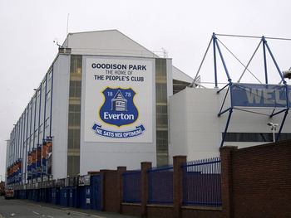
Goodison Park: Everton FC
Year Opened | 1892
Capacity | 39,572
Average Attendance | 36,500
Pitch Size | 100 x 68 (6800)
Nickname | The Grand Old Lady
Owner | The Everton Football Club Company
Clubs Hosted | Everton
First Fixture | Everton v Bolton Wanderers (02/09/1892)
Year Founded1878
The Blues, The Toffees, The People's Club
http://www.football-stadiums.co.uk/grounds/england/goodison-park/

Slide 16
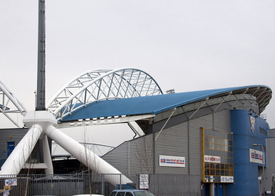
John Smiths Stadium: Huddersfield Town
Year Opened | 1994
Capacity | 24,169
Average Attendance | 12,435
Pitch Size | 105 x 69 (7245)
Former Name | Alfred McAlpine Stadium, The Galpharm Stadium
Owner | Kirklees Met Council (40%), Huddersfield Town (40%), Huddersfield Giants (20%)
Sponsor | John Smith's
Clubs Hosted | Huddersfield Town, Huddersfield Giants
First Fixture | Huddersfield Town v Wycombe Wanderers (20/08/1994)
Year Founded1908
The Terriers
http://www.football-stadiums.co.uk/grounds/england/john-smiths-stadium/

Slide 17
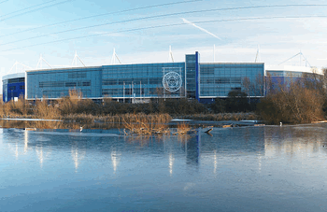
King Power Stadium: Leicester City FC
Year Founded1884
Year Opened | 2002
Capacity | 32,262
Average Attendance | 31,962
Pitch Size | 102 x 67 (6834)
Nickname | The KP
Owner | King Power
Sponsor | King Power
Clubs Hosted | Leicester City
First Fixture | Leicester v Atletico Bilbao (04/08/2002)
The Foxes
http://www.football-stadiums.co.uk/grounds/england/king-power-stadium/

Slide 18
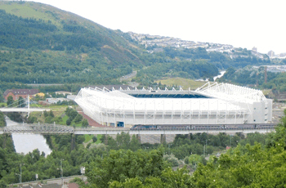
Liberty Stadium: Swansea AFC
Year Founded 1912
Year Opened | 2005
Capacity | 21,088
Average Attendance | 20,619
Pitch Size | 105 x 68 (7140)
Nickname | The Liberty
Former Name | White Rock Stadium, New Stadium Swansea, Swansea Stadium
Owner | Swansea Council
Clubs Hosted | Swansea City, Ospreys
First Fixture | Swansea v Fulham (23/07/2005)
Training Ground | Swansea City AFC Training Academy
The Swans
http://www.football-stadiums.co.uk/grounds/wales/liberty-stadium/

Slide 19
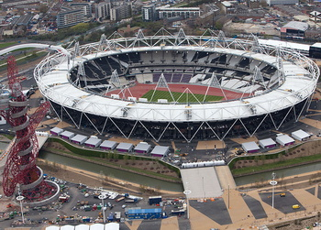
London Stadium: West Ham United
Year Founded1895
Year Opened | 2011
Capacity | 60,000
Average Attendance | 56,966
Pitch Size | 105 x 68 (7140)
Nickname | The Stadium
Former Name | The Stadium at Queen Elizabeth Olympic Park
Owner | Greater London Authority
Clubs Hosted | British Athletics, West Ham United
First Fixture | West Ham v Domzale (04/08/2016)
The Irons, The Hammers, The Academy Of Football
http://www.football-stadiums.co.uk/grounds/england/london-stadium/

Slide 20
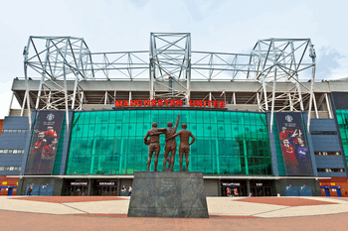
Old Trafford: Manchester United FC
Year Founded1902
Year Opened | 1910
Capacity | 75,635
Average Attendance | 75,530
Pitch Size | 105 x 68 (7140)
Nickname | The Theatre Of Dreams
Owner | Manchester United
Clubs Hosted | Manchester United
First Fixture | United v Liverpool (19/02/1910)
The Red Devils
http://www.football-stadiums.co.uk/grounds/england/old-trafford/

Slide 21
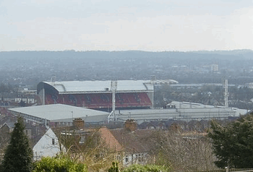
Selhurst Park: Crystal Palace FC
Year Opened | 1924
Capacity | 26,255
Average Attendance | 24,807
Pitch Size | 100 x 67 (6700)
Owner | CPFC 2010
Clubs Hosted | Crystal Palace, Charlton Athletic, Wimbledon
First Fixture | Crystal Palace v Sheffield Wednesday (30/08/1924
Year Founded1905
The Eagles, The Glaziers
http://www.football-stadiums.co.uk/grounds/england/selhurst-park/

Slide 22
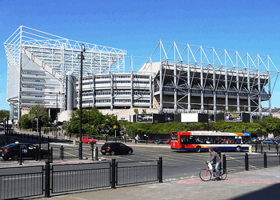
St James' Park: Newcastle United FC
Year Opened | 1892
Capacity | 52,354
Average Attendance | 51,108
Pitch Size | 105 x 68 (7140)
Nickname | St James', Gallowgate, SJP
Owner | Newcastle City Council
Sponsor | Sports Direct
Clubs Hosted | Newcastle Rangers, Newcastle West End, Newcastle East End, Newcastle United
Year Founded1892
Super Saint and Sammy Saint
http://www.football-stadiums.co.uk/grounds/england/st-james-park-newcastle/

Slide 23
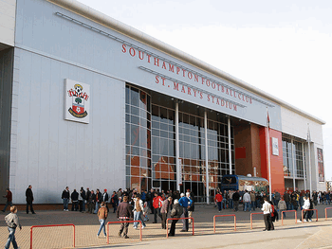
St Mary’s: Southampton FC
Year Founded1885
Year Opened | 2001
Capacity | 32,505
Average Attendance | 30,936
Pitch Size | 102 x 68 (6936)
Nickname | St. Mary's
Former Name | The Friends Provident St Mary's Stadium
Owner | Southampton F.C.
Clubs Hosted | Southampton FC
First Fixture | Southampton v RCD Espanyol (01/08/2001)
Super Saint and Sammy Saint
http://www.football-stadiums.co.uk/grounds/england/st-mary-s/

Slide 24
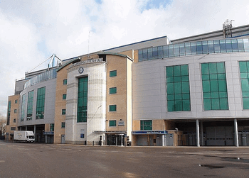
Stamford Bridge: Chelsea FC
Year Founded1905
Year Opened | 1877
Capacity | 41,798
Average Attendance | 41,450
Pitch Size | 103 x 67 (6901)
Nickname | The Bridge
Owner | Chelsea Pitch Owners plc
Clubs Hosted | The London Athletic Club, Chelsea
The Blues, The Pensioners
http://www.football-stadiums.co.uk/grounds/england/stamford-bridge/

Slide 25
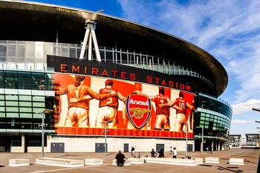
The Emirates: Arsenal FC
Year Opened | 2006
Capacity | 60,260
Average Attendance | 60,031
Pitch Size | 105 x 68 (7140)
Former Name | Ashburton Grove
Owner | Arsenal Holdings plc
Sponsor | Emirates
Clubs Hosted | Arsenal
First Fixture | Arsenal v Ajax (22/07/2006)
Year Founded1886
The Gunners
http://www.football-stadiums.co.uk/grounds/england/the-emirates/

Slide 26
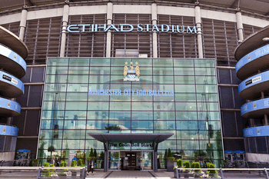
The Etihad: Manchester City FC
Year Founded1880
Year Opened | 2003
Capacity | 55,097
Average Attendance | 53,736
Pitch Size | 105 x 68 (7140)
Nickname | CoMS, The Etihad
Former Name | City Of Manchester Stadium, Eastlands
Owner | Manchester City Council
Sponsor | Etihad Airways
Clubs Hosted | Manchester City
First Fixture | Manchester City v Barcelona (10/08/2003)
The Citizens, City, The Sky Blues
http://www.football-stadiums.co.uk/grounds/england/the-etihad/

Slide 27
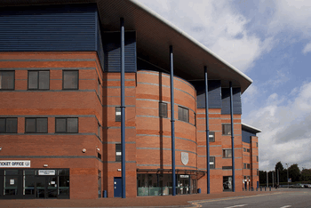
The Hawthorns: West Bromwich Albion FC
Year Founded1878
Year Opened | 1900
Capacity | 26,850
Average Attendance | 25,000
Pitch Size | 105 x 68 (7140)
Owner | West Bromwich Albion F.C.
Clubs Hosted | West Bromwich Albion FC
First Fixture | West Brom v Derby County (03/09/1900)
The Baggies, The Throstles, Albion
http://www.football-stadiums.co.uk/grounds/england/the-hawthorns/

Slide 28
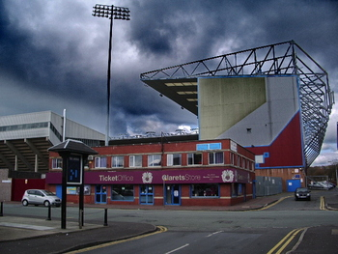
Turf Moor: Burnley FC
Year Founded1882
Year Opened | 1883
Capacity | 21,401
Average Attendance | 20,558
Pitch Size | 105 x 68 (7140)
Owner | Turf Moor Properties Ltd
Clubs Hosted | Burnley F.C.
First Fixture | Burnley v Rawtenstall (17/02/1883)
The Clarets
http://www.football-stadiums.co.uk/grounds/england/turf-moor/

Slide 29
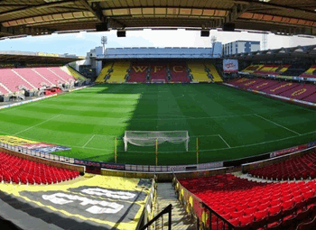
Vicarage Road: Watford FC
Year Opened | 1922
Capacity | 21,577
Average Attendance | 20,101
Pitch Size | 105 x 68 (7140)
Nickname | The Vic
Owner | Watford F.C.
Clubs Hosted | Watford FC, Wealdstone, Saracens RFC
First Fixture | Watford v Milwall (30/08/1922)
Year Founded1881
The Hornets, The Golden Boys, Yellow Army, The 'Orns
http://www.football-stadiums.co.uk/grounds/england/vicarage-road/

Slide 30
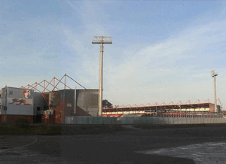
Vitality Stadium: AFC Bournemouth
Year Founded1890
Year Opened | 1910
Capacity | 11,464
Average Attendance | 11,192
Pitch Size | 105 x 68 (7140)
Former Name | Dean Court, Goldsands Stadium, Seward Stadium, Fitness First Stadium
Owner | Structadene
Sponsor | Vitality
Clubs Hosted | AFC Bournemouth
First Fixture | Bournemouth & Boscombe Athletic v Swindon Town (01/09/1923)
The Cherries
http://www.football-stadiums.co.uk/grounds/england/vitality-stadium/

Slide 31
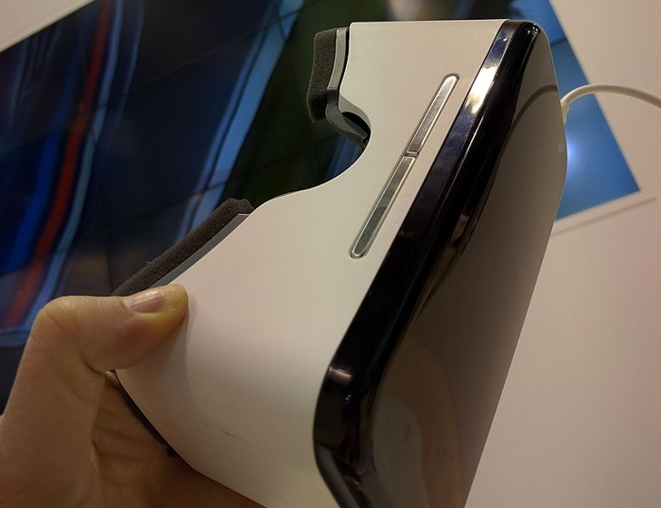
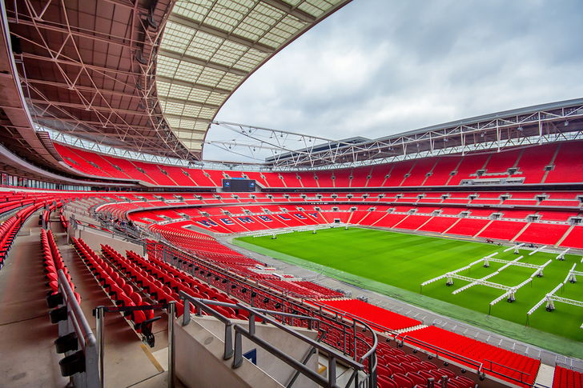
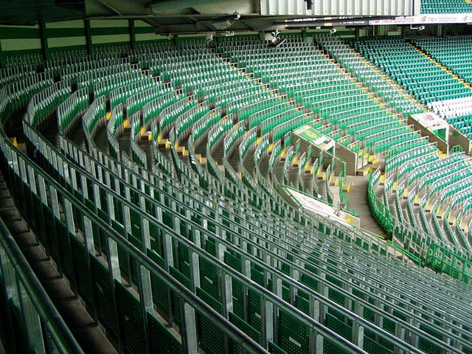
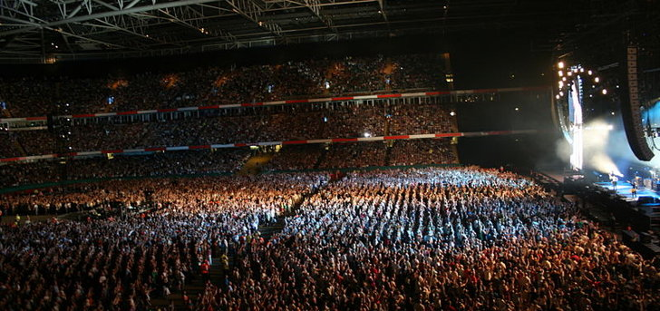
The Future of Football Stadiums
http://www.football-stadiums.co.uk/articles/future-of-football-stadiums/
Private Hire
Bowl Seating
Introduction of Technology
Ticket Sales
Hospitality Tickets
Safe Standing with a good view
Multi-Purpose Venues
Concerts & Other Events
Food & Drink Sales
Museums & Tours

Slide 32
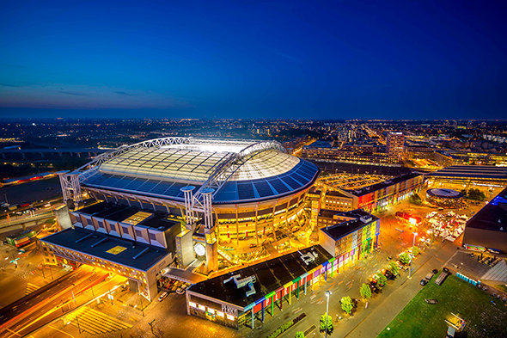
Green Innovation In Sport: How Future Stadiums Will Look
Eco-friendly, cutting-edge sports stadiums will give fans plenty to cheer about.
can we bring this to the UK ?
Nissan, power management company have developed an energy storage system that makes the energy management of the Amsterdam Arena more efficient, sustainable and reliable.
It makes use of repurposed batteries from Nissan’s EV car, the LEAF – 280 of them in total.
These batteries are used for back up power but will ultimately replace the stadiums diesel generators.
The batteries will also enable the stadium to power the surrounding neighbourhood and protect the grid from power-outs, providing a “huge advantage in sustainability” making it the “first stadium in the world that won’t be using fossil fuels anymore”.
http://www.huffingtonpost.co.uk/entry/green-innovation-in-sport-how-future-stadiums-will-look_uk_58eb9eace4b0c89f912014fd

Slide 33
> How Do Football Clubs Make Money?
Articles worth reading …
http://www.football-stadiums.co.uk/articles/how-do-football-clubs-make-money/
> The Future of Football Stadiums
http://www.huffingtonpost.co.uk/entry/green-innovation-in-sport-how-future-stadiums-will-look_uk_58eb9eace4b0c89f912014fd
> How Do Football Stadiums Make Money?
http://www.football-stadiums.co.uk/articles/how-do-football-stadiums-make-money/

Slide 34
Any questions ?

