Slide 1
Evaluating a Classifier
Example
MNIST Dataset

Slide 2
The MNIST dataset
(Modified National Institute of Standards and Technology database)
Yann LeCun, Corinna Cortes, Christopher J.C. Burges
Is a set of 70,00 handwritten digits.
The “hello world” of ML
Each digit is 28x28 greyscale bits=784 features.
Each feature has an integer value between 0 and 255.
Full details here:
http://yann.lecun.com/exdb/mnist/

Slide 3
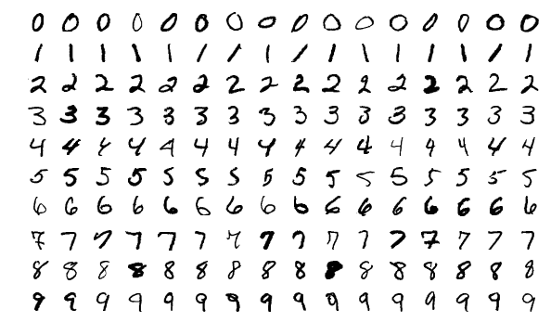

Slide 4
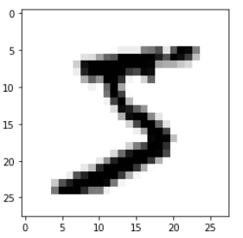
from sklearn.datasets import fetch_openml mnist= fetch_openml('mnist_784', version=1) mnist.keys()
#dict_keys(['data', 'target', 'frame', 'categories', 'feature_names', 'target_names', 'DESCR', 'details', 'url’]) mnist["DESCR"]
X,y=mnist["data"], mnist["target"] import matplotlib import matplotlib.pyplot as plt digit=X[0] imgDigit=digit.reshape(28,28) plt.imshow(imgDigit,cmap='binary') plt.axis='off' plt.show()

Slide 5
Finding out about the MNIST Dataset
Scikit-Learn has a copy of the MINST dataset (recall we used a similar one for the Iris data set?)
Explore this dataset.
Have a look at the Jupyter notebook - ROC and AUC.ipynb on our Moodle page.
Things to try:
Investigate how you would train another classifier and evaluate it using ROC curves and AUC. Compare them.

