Slide 1


Assessment 1: L1CHS4010
Name: DION GRAHAM
Subject: Psychology in Health and Social Care
Student ID: 2441800
Lecturer’s Name: Peace Ukachukwu
Title: Supporting Jenny’s Development: An Attachment Theory Perspective
AI tools (Grammarly) were used to support grammar. All ideas, analyses, and reflections are my own.
Overview
This presentation examines how five years of caregiving responsibilities have influenced the development of a 16‑year‑old young carer. Bowlby’s Attachment Theory is used to analyse the impact of her experiences and to inform a support plan that promotes her wellbeing.

Slide 2

Case Summary:
Jenny is a 16-year-old who has been caring for her mother since she was 11 years old.
The death of her father has created both emotional and practical challenges for their family.
Her mother struggles with mobility issues, memory problems, and low mood, which require Jenny to provide both practical and emotional support.
A significant concern is that Jenny's own developmental, social, and emotional needs may be disregarded.

Slide 3
Adolescence in Lifespan Development
Adolescence is a crucial developmental stage defined by identity formation, autonomy, and peer relationships. Bowlby’s attachment theory highlights the importance of early relationships in shaping this period (Bowlby, 1969).
While social interaction and independence are essential for healthy growth, factors like Jenny's caregiving role can restrict her opportunities for identity exploration and friendships, illustrating the complex interplay between attachment and adolescent development.

Slide 4
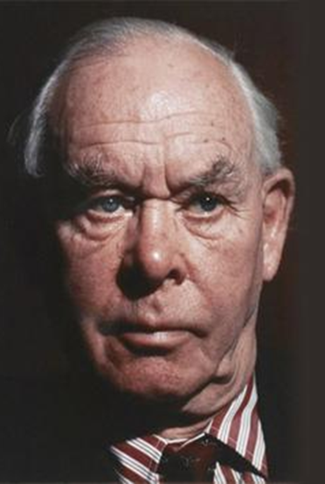
Introducing Bowlby’s Attachment Theory
Bowlby (1969, 1988) proposed that attachment is an innate behavioural system.
Early caregiving plays a crucial role in shaping Internal Working Models of the self and others.
There are secure and insecure attachment patterns, and the continuity hypothesis suggests that early attachment influences later relationships, coping mechanisms, and emotional regulation.
This relevance spans across the lifespan, including during adolescence.

Slide 5
HOW THE THEORY APPLIES TO JENNY
Why Bowlby’s Attachment Theory Applies to This Case:
It explains how early loss and caregiving roles influence emotional development.
It highlights the importance of stable and supportive relationships during adolescence.
It is relevant to Jenny’s experiences with bereavement, responsibility, and a lack of adult support (Bowlby, 1969; Department of Health and Social Care, 2014).
It helps identify risks such as anxiety, isolation, and insecure attachment patterns.

Slide 6
Impact on Jenny’s Development
Biological Factors (Nature):
Chronic stress disrupts cortisol regulation, affecting concentration, memory, and mood (McEwen, 2007; Sapolsky, 2004).
Environmental Factors (Nurture):
Limited peer interaction hampers social development (Hartup & Rubin, 1995). High responsibility can lead to emotional exhaustion (Maslach & Jackson, 1981), while inconsistent adult support may result in underdeveloped coping strategies (Bowlby, 1969). Restricted opportunities for autonomy further affect development (Erikson, 1968)

Slide 7
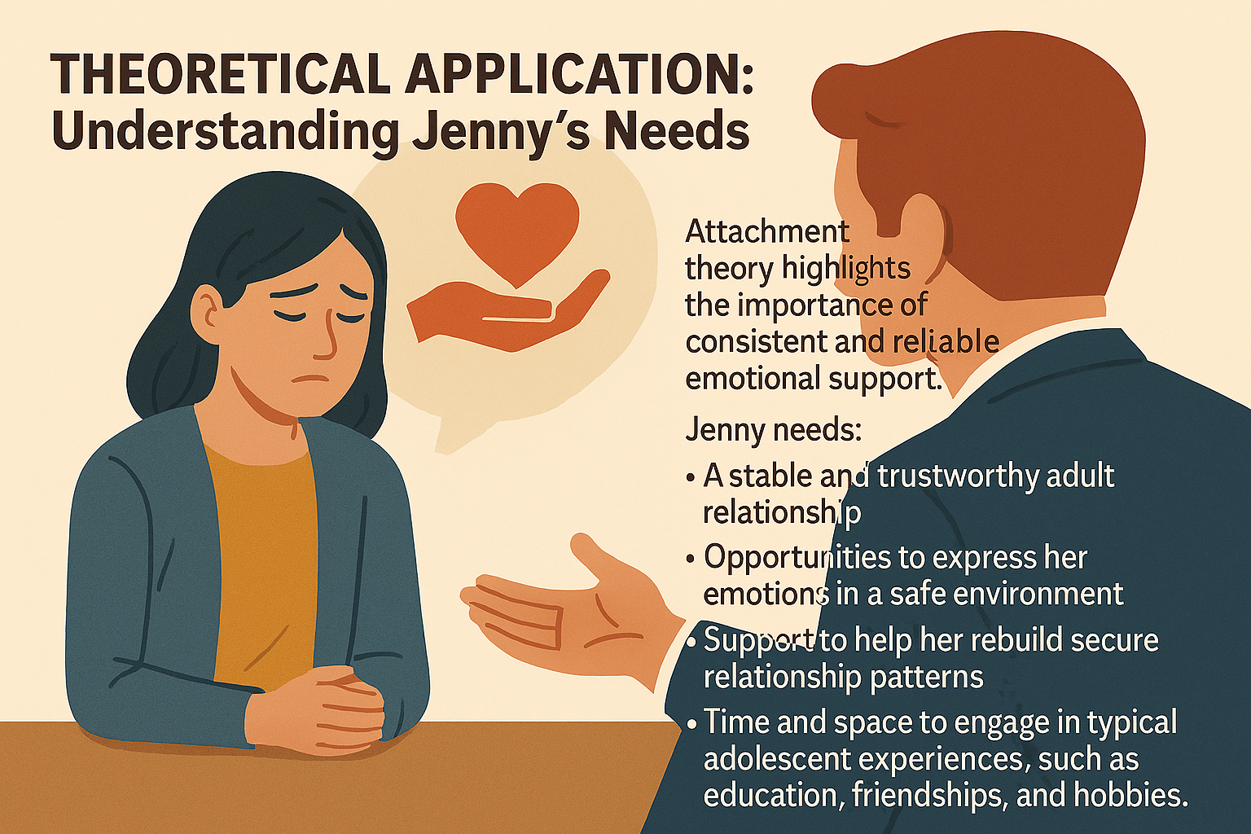
Theoretical Application: Understanding Jenny’s Needs
Attachment theory highlights the importance of consistent and reliable emotional support.
Jenny needs: A stable and trustworthy adult relationship - Opportunities to express her emotions in a safe environment
Support to help her rebuild secure relationship patterns
Time and space to engage in typical adolescent experiences, such as education, friendships, and hobbies.
.

Slide 8
Support Plan Based on Attachment Theory
Practical Strategies:
Key worker/mentor provides consistent emotional support and models secure attachment.
Young carer peer groups reduce isolation and build social identity
Counselling/therapy grief processing, emotional regulation, coping skills
School‑based support, pastoral support, flexible deadlines, and awareness of home context
Respite care and home support reduce caregiving burden and restore balance
Youth activities promote autonomy, confidence, and identity development

Slide 9
Evaluation: Usefulness & Limitations
Usefulness:
Explains the emotional effects of loss and inconsistent caregiving (Bowlby, 1969; Howe, 2011).
Emphasises the role of secure relationships in building resilience (Johnson, 2019; Mikulincer & Shaver, 2019).
Identifies risks like anxiety, isolation, and insecure attachment (Lim et al., 2020).
Offers a relational framework for support planning (Cassidy & Shaver, 2016).
Limitations:
Primarily focuses on early childhood; peers, school, and culture influence adolescence (Gillibrand et al., 2016).
Lacks consideration of structural issues such as poverty and service access (Department of Health and Social Care, 2014).
May oversimplify complex family dynamics (Hartup & Rubin, 1995).
Best used with ecological or sociocultural models (e.g., Bronfenbrenner’s model) (Bronfenbrenner, 1979).

Slide 10
Conclusion
Jenny’s development has been shaped by bereavement, caregiving responsibilities, and limited support
Attachment theory helps explain emotional and relational challenges
A theory-informed support plan can strengthen secure relationships and promote well-being.

Slide 11
REFERENCES
• Aldridge, J. (2018) Working with young carers and their families. London: Routledge.
• Bowlby, J. (1988) A secure base: Parent–child attachment and healthy human development. New York: Basic Books.
• Bronfenbrenner, U. (1979) The ecology of human development: Experiments by nature and design. Cambridge, MA: Harvard University Press.
• Department of Health and Social Care (2014) Care Act 2014: Statutory guidance on young carers. Available at: https://www.gov.uk/ (Accessed: 28 February 2026).
• Gillibrand, R., Lam, V. and O’Donnell, V. L. (2016) Developmental psychology. 2nd edn. Harlow: Pearson.
• Howe, D. (2011) Attachment across the life course: A brief introduction. Basingstoke: Palgrave Macmillan.
• Johnson, S. M. (2019) Attachment theory in practice: Emotionally focused therapy (EFT) with individuals, couples, and families. New York: Guilford Press.
• Johnson, S. (2019) ‘Attachment in action—Changing the face of 21st century couple therapy’, Current Opinion in Psychology, 25, pp. 101–104. doi:10.1016/j.copsyc.2018.03.007.
• Joseph, S. and Murphy, D. (2014) ‘Person‑centred therapy and attachment’, Counselling Psychology Review, 29(2), pp. 45–52.
• Lim, B. H., Hodges, M. A. and Lilly, M. M. (2020) ‘The differential effects of insecure attachment on post‑traumatic stress: A systematic review’, Trauma, Violence, & Abuse, 21(5), pp. 1044–1060. doi:10.1177/1524838018815136.
• Maslach, C. and Jackson, S. E. (1981) ‘The measurement of experienced burnout’, Journal of Occupational Behavior, 2(2), pp. 99–113. doi:10.1002/job.4030020205.
• McEwen, B. S. (2007) ‘Physiology and neurobiology of stress and adaptation: Central role of the brain’, Physiological Reviews, 87(3), pp. 873–904. doi:10.1152/physrev.00041.2006.
• Mikulincer, M. and Shaver, P. R. (2019) ‘Attachment theory as a relational framework for positive psychology’, in Lopez, S. J. (ed.) The Oxford handbook of positive psychology. 3rd edn. Oxford: Oxford University Press, pp. 519–532.
• NHS (2023) Help for young carers. Available at: https://www.nhs.uk/social-care-and-support/support-and-benefits-for-carers/help-for-young-carers/ (Accessed: 28 February 2026).
• NHS England (2024) Supporting young carers – guidance for GPs and staff. Available at: https://www.england.nhs.uk/commitment-to-carers/supporting-young-carers-guidance-for-gps-and-staff/ (Accessed: 28 February 2026).
• Sapolsky, R. M. (2004) Why zebras don’t get ulcers: An updated guide to stress, stress‑related diseases, and coping. New York: Holt Paperbacks.
• Thompson, R. A., Simpson, J. A. and Berlin, L. J. (2022) ‘Taking perspective on attachment theory and research: Nine fundamental questions’, Attachment & Human Development, 24(5), pp. 543–560. doi:10.1080/14616734.2022.2030132.
• Bowlby, J. (1969) Attachment and loss: Volume I – Attachment. New York: Basic Books.
• Bowlby, J. (1988) A secure base: Parent–child attachment and healthy human development. New York: Basic Books.
• Bretherton, I. (1992) ‘The origins of attachment theory: John Bowlby and Mary Ainsworth’, Developmental Psychology, 28(5), pp. 759–775.
• Bronfenbrenner, U. (1979) The ecology of human development: Experiments by nature and design. Cambridge, MA: Harvard University Press.
• Cassidy, J. and Shaver, P. R. (eds) (2016) Handbook of attachment: Theory, research, and clinical applications. 3rd edn. New York: Guilford Press.
• Department of Health and Social Care (2014) Care Act 2014: Statutory guidance on young carers. Available at: https://www.gov.uk/ (Accessed: 28 February 2026).
• Erikson, E. H. (1968) Identity: Youth and crisis. New York: W. W. Norton & Company.
• Gillibrand, R., Lam, V. and O’Donnell, V. L. (2016) Developmental psychology. 2nd edn. Harlow: Pearson.
• Hartup, W. W. and Rubin, Z. (1995) ‘Friendship and its significance in childhood’, in Cole, M. and Cole, S. R. (eds) The development of children. 3rd edn. New York: Worth Publishers, pp. 172–201.
• Howe, D. (2011) Attachment across the life course: A brief introduction. Basingstoke: Palgrave Macmillan.
• Joseph, S. and Murphy, D. (2014) ‘Person‑centred therapy and attachment’, Counselling Psychology Review, 29(2), pp. 45–52.
• McEwen, B. S. (2007) ‘Physiology and neurobiology of stress and adaptation: Central role of the brain’, Physiological Reviews, 87(3), pp. 873–904. doi:10.1152/physrev.00041.2006.
• NHS England (2024) Supporting young carers – guidance for GPs and staff. Available at: https://www.england.nhs.uk/commitment-to-carers/supporting-young-carers-guidance-for-gps-and-staff/ (Accessed: 28 February 2026).
• Johnson, S. M. (2019) Attachment theory in practice: Emotionally focused therapy (EFT) with individuals, couples, and families. New York: Guilford Press.
• Lim, B. H., Hodges, M. A. and Lilly, M. M. (2020) ‘The differential effects of insecure attachment on post‑traumatic stress: A systematic review’, Trauma, Violence, & Abuse, 21(5), pp. 1044–1060. doi:10.1177/1524838018815136.
• Thompson, R. A., Simpson, J. A. and Berlin, L. J. (2022) ‘Taking perspective on attachment theory and research: Nine fundamental questions’, Attachment & Human Development, 24(5), pp. 543–560. doi:10.1080/14616734.2022.2030132.

Slide 12

Questions?

