Slide 1
Leadership and Emotional Intelligence
What is 'Emotional Intelligence'
Definition: Emotional intelligence refers to the capability of a person to manage and control his or her emotions and possess the ability to control the emotions of others as well. In other words, they can influence the emotions of other people also.
Description: Emotional intelligence is a very important skill in leadership. It is said to have five main elements such as - self-awareness, self-regulation, motivation, empathy, and social skills.
Economic Times-https://economictimes.indiatimes.com

Slide 2
Four Behaviours of Compassionate Leaders
Emotional Intelligence skills!
Attending (listening with fascination)
Understanding (needs of staff)
Empathising (caring for staff)
Helping (enabling staff to do their jobs)
The most important skill is listening and the most important task is helping staff to do their jobs.

Slide 3
The ABC of Staff Needs
Autonomy and control over what they do
Belonging (part of a team, feeling cared for)
Contribution (being able to do your job)
Notes:
Nurse and midwives have three core work needs that must be met to ensure wellbeing and motivation at work, and to minimise workplace stress.

Slide 4
Recommendations (The KingsFund, 2020)
1: Authority, empowerment and influence
2: Justice and fairness
3: Work conditions and working schedules
4: Teamworking
5: Culture and leadership
6: Workload
7: Management and supervision
8: Learning, education and development
Notes:
Key recommendation 1: Authority, empowerment and influence
Introduce mechanisms for nursing and midwifery staff to shape the cultures and processes of their organisations and influence decisions about how care is structured and delivered.
Key recommendation 2: Justice and fairness
Nurture and sustain just, fair and psychologically safe cultures and ensure equity, proactive and positive approaches to diversity and universal inclusion.
Key recommendation 3: Work conditions and working schedules
Introduce minimum standards for facilities and working conditions for nursing and midwifery staff in all health and care organisations.
Key recommendation 4: Teamworking
Develop and support effective multidisciplinary teamworking for all nursing and midwifery staff across health and care services.
Key recommendation 5: Culture and leadership
Ensure health and care environments have compassionate leadership and nurturing cultures that enable both care and staff support to be high-quality, continually improving and compassionate.
Key recommendation 6: Workload
Tackle chronic excessive work demands in nursing and midwifery, which exceed the capacity of nurses and midwives to sustainably lead and deliver safe, high-quality care and which damage their health and wellbeing.
Key recommendation 7: Management and supervision
Ensure all nursing and midwifery staff have the effective support, professional reflection, mentorship and supervision needed to thrive in their roles.
Key recommendation 8: Learning, education and development.
Ensure the right systems, frameworks and processes are in place for nurses’ and midwives’ learning, education and development throughout their careers. These must promote fair and equitable outcomes.

Slide 5
Leaders need to start with Self-compassion
What are your stressors?
What are your needs?
You need to be a good role model and also be in a good place yourself to lead others
Also important to show vulnerability, which breeds trust

Slide 6
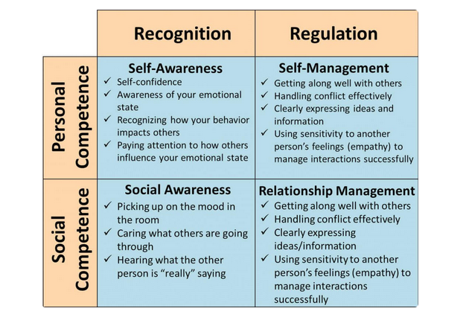
Image: Riopel, (2019)

Slide 7
The link between EI and Mental Health
Being aware of and being able to manage your emotions makes you less susceptible to stress.
Stress, depression and anxiety suppresses your immune system, making you more vulnerable to colds, disease and serious illnesses.
Emotional intelligence skills strengthen your brain’s ability to cope with emotional distress which keeps your immune system strong.
EI skills can also speed recovery from illness.
Notes:
Link between EI and mental health/well-being.
Good EI skills help you manage your response to stress.

Slide 8
Organisational Benefits of EI Training (TalentSmart, 2016)
Improvements in:
Ability to handle conflict
Ability to deal with change
Ability to communicate clearly and effectively
Quality of decision making
Number of outbursts affecting performance
Relationships with customers and co-workers (as a result of increased empathy, understanding and self-control)
Willingness to take accountability for mistakes
Flexibility in challenging environments
Ability to prevent set-backs from affecting their performance (improved resilience)

Slide 9
Emotional Intelligence and Compassionate Leaders
Well being
Stress
Mindfulness
Positive Psychlogy
Empathy

Slide 10
Leadership and Change
Organisations today recognise the need to integrate ‘Emotional Intelligence’ training for leaders, managers and other employees.
Organisations have started to see the benefit in terms of improved motivation, lower employee turnover and less sickness and absence if they engage in this training and have policies and practices in ‘EI’.
Emotional Intelligence should become part of the ‘Culture’ of the organisation and the way it operates.

