Slide 1
Introduction to classics
Dr Matthew Cobb

Slide 2
Today’s Lecture
Athens and Rome as they are popularly known today – legacies.
Chronological and geographical context.
Brief overview of the Athens and Rome and their surrounding territory.
Differences between us and Greeks and Romans.

Slide 3
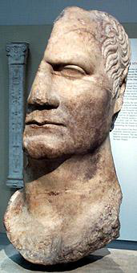
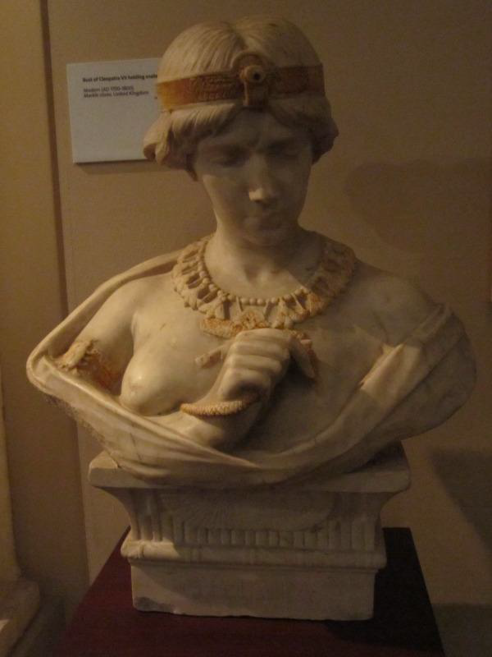
Famous Historical Figures (1)
JULIUS CAESAR
CLEOPATRA VII

Slide 4
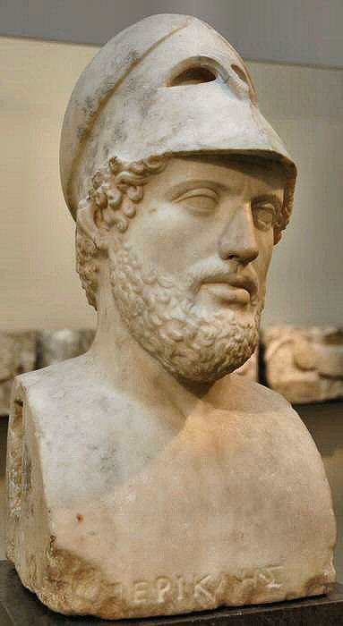
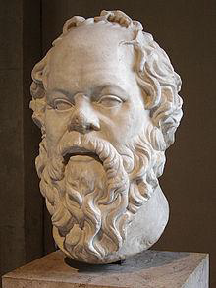
Famous Historical Figures (2)
PERICLES
SOCRATES

Slide 5
Famous Events
Persians invade Greece – Battles of Thermopylae, Salamis, and (lesser known) Plataea.
Trail of Socrates and his forced suicide.
Hannibal marches across the Alps with his elephants.
Julius Caesar and Cleopatra as lovers, and (probably more famously) Antony and Cleopatra as lovers.

Slide 6
Legacies
Politics – e.g. democracy, republic, empire.
Culture – philosophy, literature (epic, tragedy, comedy, satire, poetry), geography, history, biography.
Physical Objects – art, monuments and buildings (in various states of repair).

Slide 7
Political history – a study of major political events and individuals who shaped them.
Social history – a study of a society and its cultural habits and values.
Economic history – diverse areas from demography, productive capacity (esp. agricultural) and other phenomena such as trade.
Interrelation of these aspects in the Ancient World.

Slide 8
Chronological, Geographical, and Demographic Context

Slide 9
Athens and Rome
CLASSICAL ATHENS – C.5TH TO 4TH CENTURIES BC.
RISE AND PEAK OF ROME – C.200 BC – AD 200.
Archaic Greece - 8th to 6th centuries BC.
Classical Greece – 5th to 4th centuries BC.
Hellenistic Period – 323 BC (death of Alexander) to 30 BC (suicide of Cleopatra).
Athens is under Roman hegemony by mid-second century BC, revolts and is crushed between 88-85 BC.
Foundation and Rome under the Kings – 753-509 BC.
Early-Republic – c.500-c.mid-third century BC.
Mid-Republic – 264-146 BC (Punic Wars, 264-41, 218-201, 149-46 BC)
Late Republic – c.130‘s BC to 31/30 BC (Actium).
Imperial Period – Augustus to Alexander Severus.
“Third Century Crisis”.

Slide 10
Mediterranean

Slide 11
City of Athens

Slide 12
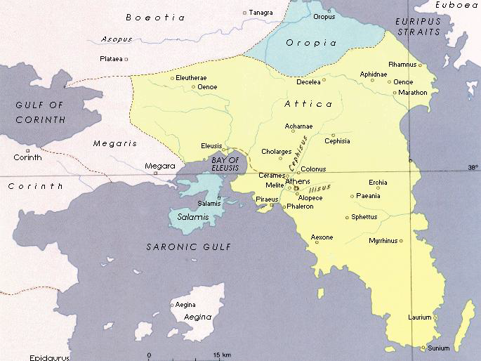
Attica
Attica is roughly 1,000 sq. miles in extent.
Made up of various regions
  Athens itself
  Piraeus (main harbour)
  SE Laurium (silver mines)
  NE Eleusis (mystery cult centre).

Slide 13
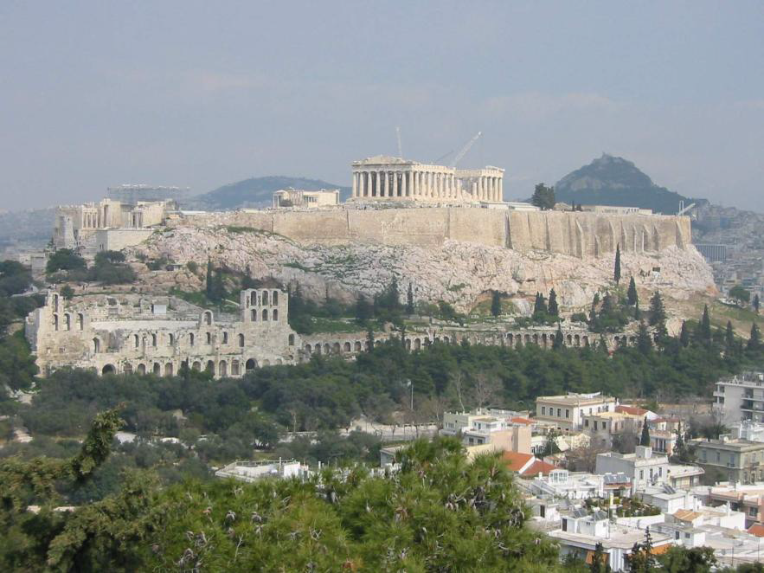
Area of Athens
The area of ancient Athens occupied around 1 sq. mile.
Main centre
  acropolis (Parthenon etc)
  agora (Boule, Royal Stoa etc).
The population of Athens is estimated as being around c.200 thousand.

Slide 14
Population of Athens and Attica
Athens the modern (not the ancient) capitol of Greece.
Citizens (and there families) c.30,000 citizens + families = c.135,000.
Slaves c.30-40,000? - Metics (foreigners resident in Athens) c.10,000.
Athens one of the largest polies some cities fairly small:
  Plataea c.2000-2500?.
  Olynthos c.3500-4200?
  Majority of polies probably had populations around 1000-10,000 people.

Slide 15
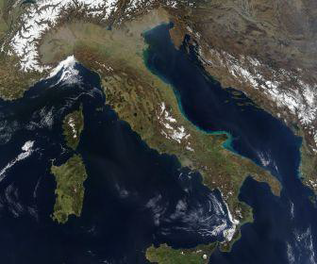
City of Rome
Rome

Slide 16
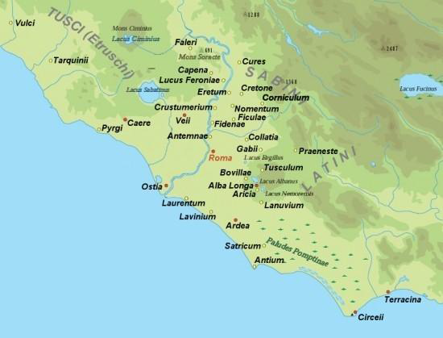
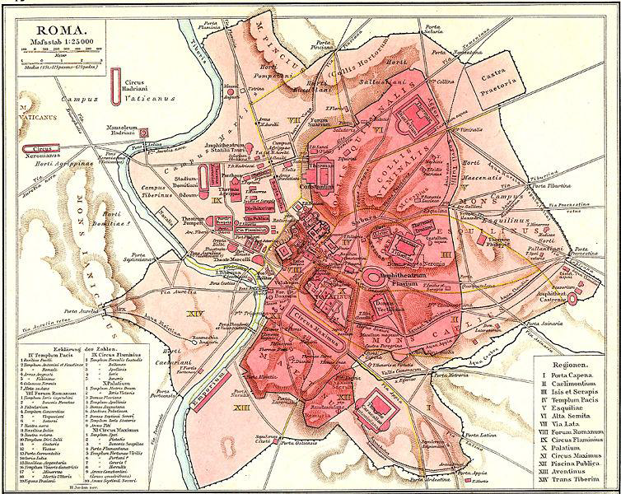
Area of the City of Rome (1)

Slide 17
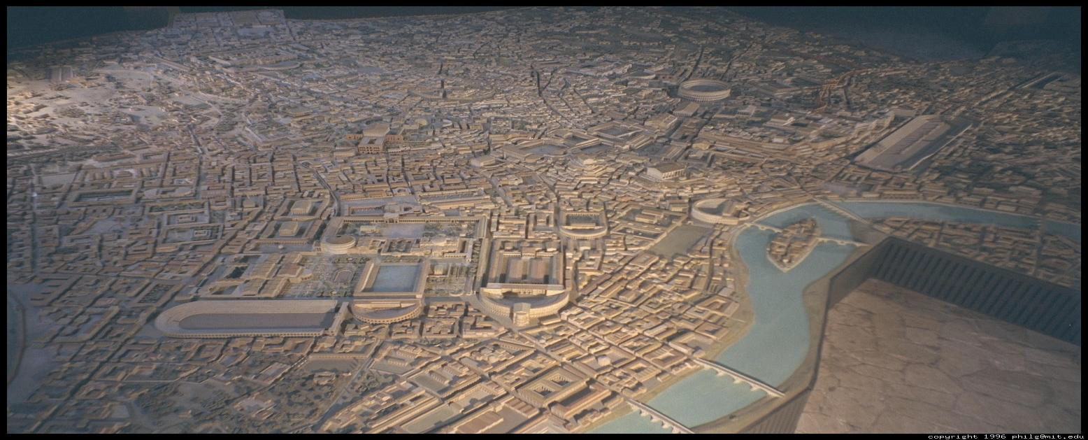
Area of the City of Rome (2)
The area within the Servian walls is about 1.6 sq miles.
Centres – Roman Forum (and Imperial Fora), Imperial Palaces.

Slide 18
Population
During the first and second centuries AD there is a total population in Rome of around ¾ to 1 million people.
Compare
  Alexandria 300,000-600,000?
  Roman Carthage 500,000?
  Antioch-on-the-Orontes (Syria) 200,000?
Population of Roman Empire at its height – 40 to 50 million people.

Slide 19
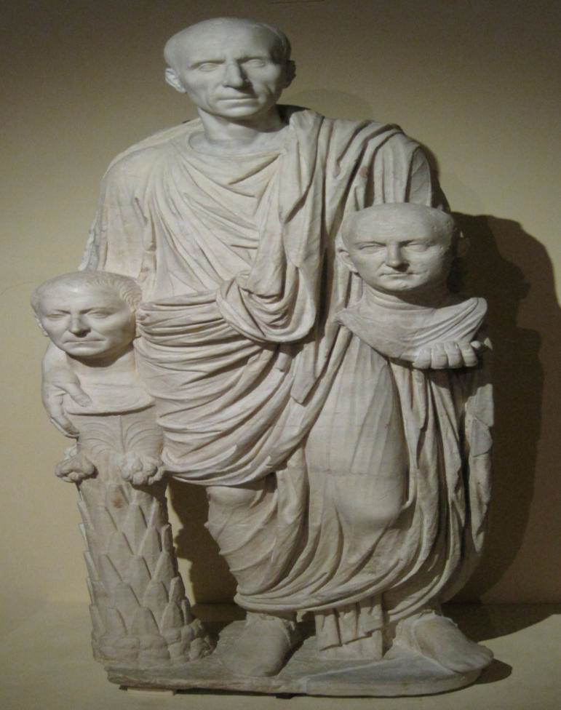
Peoples of Rome
By 1st century AD highly heterogeneous
Elite and wealthy
Urban poor
Immigrants from rural Italy
Slaves and freedmen
Foreigners (peregrini)
Merchant communities
c. 1st century BC
– Montemartini Museum.

Slide 20
Greco-Roman Conceptions of the World
Conception of the world – Mediterranean as the centre.
Human-kind and the environment.
The edges of the known world and the marvels of nature.
Calendars and dating.

Slide 21
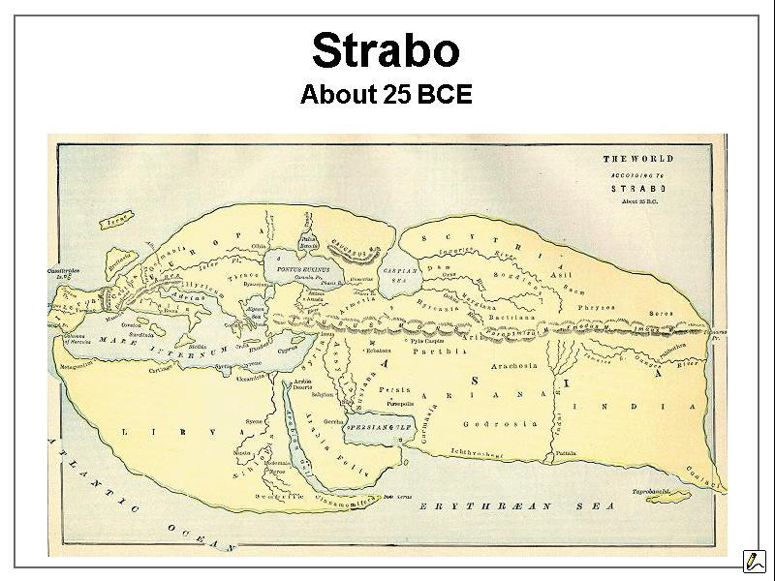
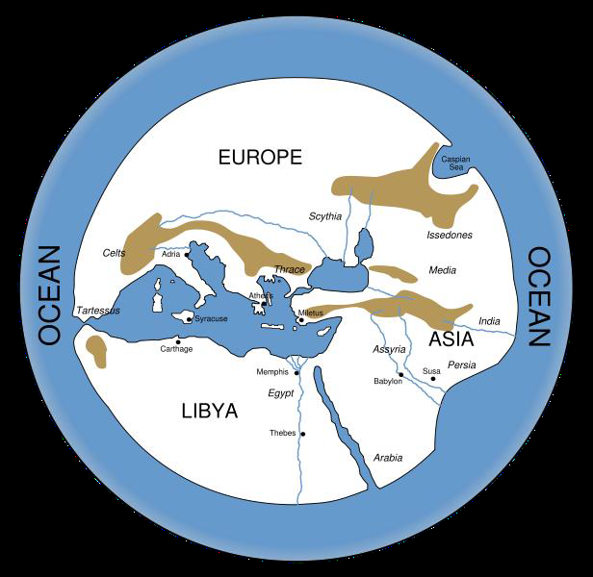
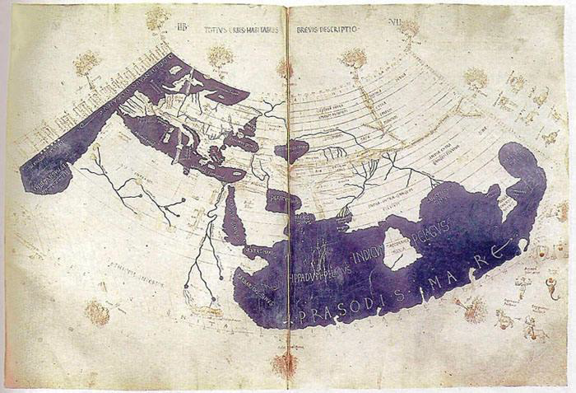
Knowledge increase with conquest and trade.
Mediterranean remains best understood region.
Based on Hecataeus‘ Circuit of the World – c.500 BC
Based on Claudius Ptolemy‘s Geography c.150 AD

Slide 22
Man and Nature
“The study of living creatures in the world is as important as the study of almost any other field… Pride of place will be given to one for whose benefit Nature appears to have created everything else… Man is the only creature whom Nature covers with materials derived from others.” – Pliny Natural History 7.1-2 (mid-first century AD).
“From all this it is evident that the polis [i.e. the Greek city state] exists by natural processes, and that it is natural for a man to live in a polis. Anyone who has no polis, not by accident but by reason of his own nature, must be sub-human — or else superhuman! He is like the man reviled by Homer as ‘without clan, law, or hearth‘ [= Odyssey 9. 63]. Any such man must be a lover of war; he is just like an isolated piece in a game of draughts.” – Aristotle The Politics 1253 a (mid-fourth century BC).

Slide 23
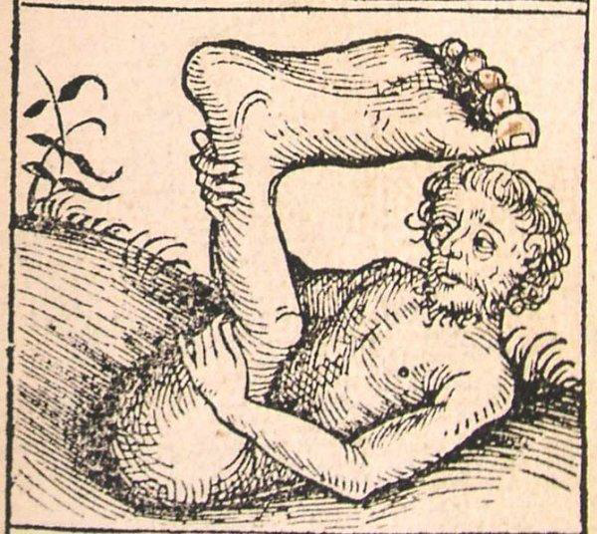
“Ctesias writes … of a tribe of men called the Monocoli, who have only one leg and hop with amazing speed. These people are also called the Shadow-feet, because when the weather is hot they lie on their backs stretched out on the ground and protect themselves by the shade of their feet.” – Pliny Natural History 7.21-23.
Image from the Nuremberg Chronicle (1493).

Slide 24
Calendars and Dates

Slide 25
Modern conventions by which ancient history is dated
  Periodisation (e.g. Hellenistic period)
  BC (Before Christ) and AD (Anno Domini – year of our Lord) modern alternatives BCE and CE.
Ancient calendars often based on religious or political system.
Years may be dated by political offices (e.g. consulships), priesthoods and in some sources (from the Hellenistic period) by Olympiads (first Olympiad 776 BC).

Slide 26
Dating Years
Athens
Rome
Archonships
- Fourteen years after the Thirty Years‘ Peace… [the treaty] remained unbroken, but in the fifteenth year – which was the forty-eight year of the priestess-ship of Chrysis at Argos… Pythodoros still had four months to serve as Archon at Athens… just as the spring was beginning = March 431 BC - (start of Peloponnesian War).
Consulships (consular list begins in 509 BC).
- Ides of March in the year when the consuls were Julius Caesar for the fifth time, and Marcus Antonius = 15 March 44 BC - (assassination of Caesar).

Slide 27
Calendars
Hecatombaeon– Jul/Aug
Metageitnion- Aug/Sep
Boedromion- Sep/Oct
Pyanepsion- Oct/Nov
Maemacterion- Nov/Dec
Poseideon- Dec/Jan
Gamelion- Jan/Feb
Anthesterion- Feb/Mar
Elaphebolion- Mar/Apr
Mounychion- Apr/May
Thargelion- May/Jun
Scirophorion- Jun/Jul
Ianuarius
Februarius
Martius
Aprilis (Neroneus)
Maius
Iunius
Iulius (originally Quintilis)
Augustus (originally Sextilis)
September (Tiberius)
October (Livius)
November
December

