Slide 1
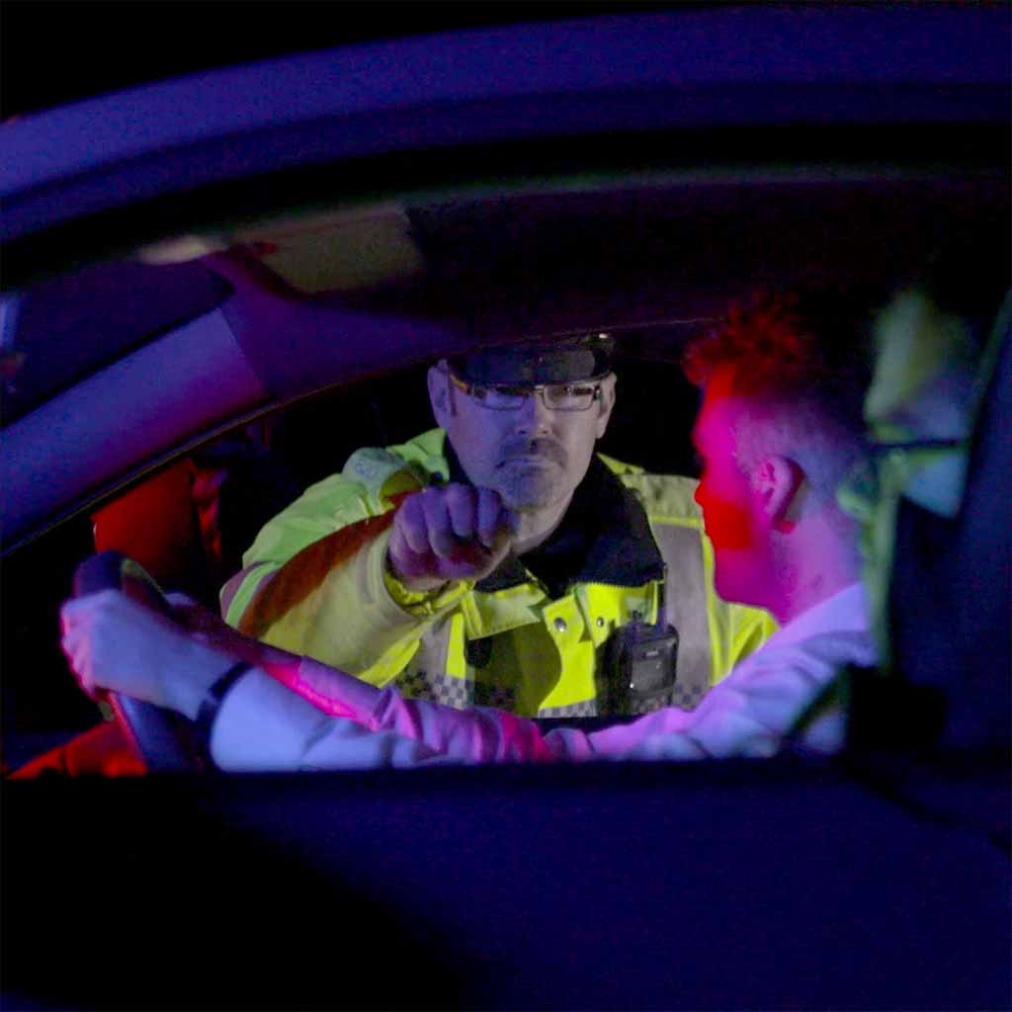
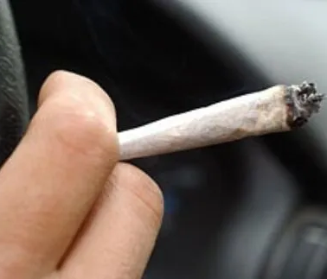
The impact of drugs on driving
Name Student: Elena Cristina Martinica

Slide 2
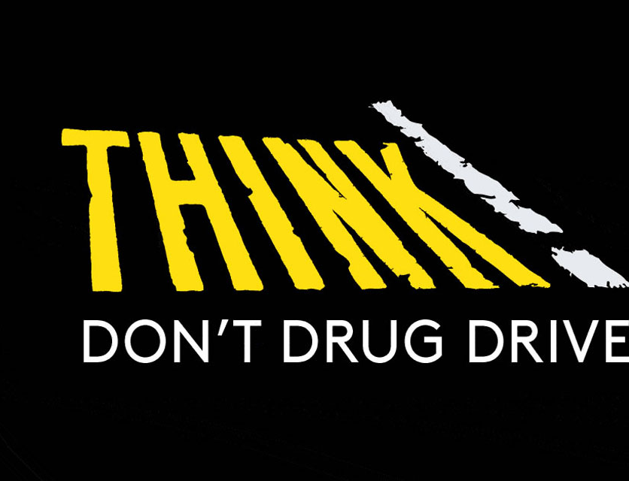
The main objectives of this presentation are to:
1. Explain the campaign against drug-impaired driving.
2. Discuss the impact that drugs can have on driving abilities and the consequences of being caught driving under the influence of drugs.
3. Explore what actions can be taken to prevent drug-impaired driving.
4. Case Study.

Slide 3
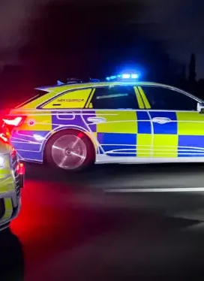
Introduction
Drug trafficking is a key revenue source for organized crime groups, which also engage in other serious crimes like firearms offences and modern slavery. Thus, combating drug trafficking disrupts a broader range of criminal activities. (National Crime Agency).

Slide 4
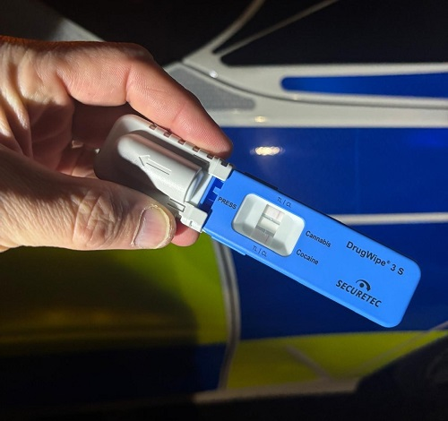
Drugs
Police can stop for a roadside screening or field impairment test if they suspect drug use if you commit a traffic offence, or if you're involved in a collision. They can test for cannabis and cocaine on-site and check for other drugs like ecstasy, LSD, ketamine, and heroin at the police station.
If you are caught driving under the influence of drugs, you may face the following penalties:
- A criminal record,
- Up to six months in prison,
- An unlimited fine,
- A driving ban of at least one year (three years for a second conviction within ten years).
A driver who causes someone’s death while under the influence of drugs can be charged with causing death by careless driving (Section 3A of the Road Traffic Act 1988). The maximum penalty is 14 years imprisonment for offences committed before June 28, 2022, and life imprisonment for those committed on or after that date. (Police.UK).

Slide 5
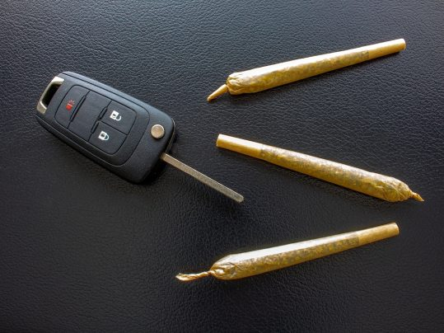
The consequences
A drug driving conviction can lead to job loss, loss of independence, a criminal record, higher car insurance costs, and trouble entering countries like the USA.(Think 2025).

Slide 6
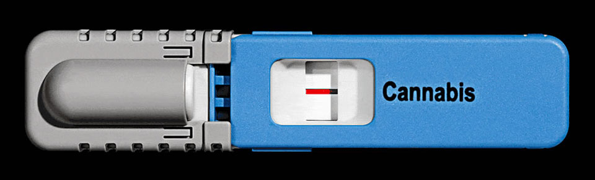
Drugs test
‘’ A new, easy-to-use roadside swab test for detecting drug offenders was introduced on March 2, 2015.’’
Roadside tests detect cannabis and cocaine, while lab tests can identify all drugs. (Department for Transport 2016).

Slide 7
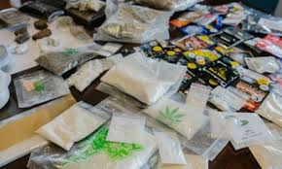
Statistics
In 2020, 4,561 drug poisoning deaths.
In 2019, 4,393 drug poisoning deaths.
(Office for National Statistics 2021).

Slide 8
Statistics
In 2022, 4,907 drug poisoning deaths.
The age-standardized mortality rate due to drug poisoning has been increasing each year since 2012.
(Office for National Statistics 2022).

Slide 9
Reduce harm
The impact of illegal drugs is alarmingly rising. In England, drug misuse resulted in 2,846 deaths in 2021—an 80% increase since 2011. This crisis is further highlighted by 360 drug-related homicides in England and Wales for 2021-22, a 58% rise from 2011-12, representing nearly half of all murders.
In response, the government's 2021 drug strategy, "From Harm to Hope," committed £903 million in funding from 2022-23 to 2024-25.
This includes £768 million for treatment and recovery services,
£105 million to disrupt illegal drug supply,
and £30 million to reduce long-term demand.
Additionally, 106 partnerships have been formed with local communities to coordinate efforts in tackling this urgent issue.(Home Office ,2023).

Slide 10
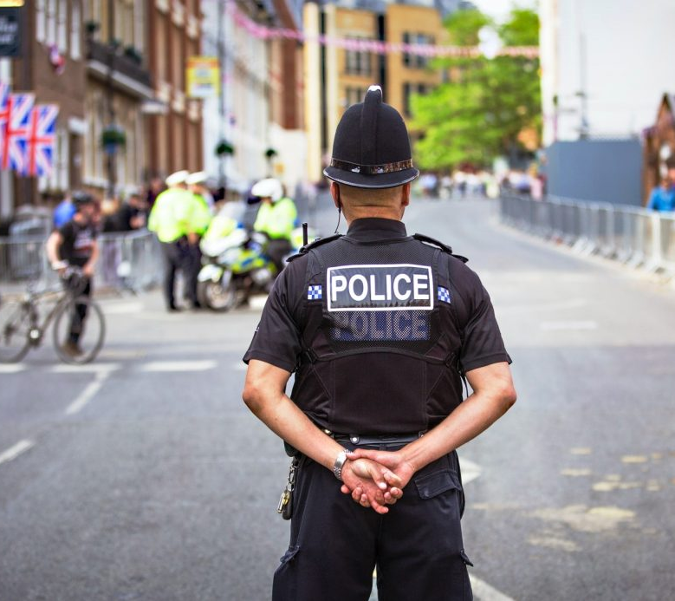

Colaboration
Police forces in England and Wales are collaborating with health partners to improve responses for vulnerable individuals. Under drug diversion schemes, individuals found with small amounts of drugs are referred to treatment services instead of facing prosecution. As of 2024, these schemes are active in Thames Valley, West Midlands, and Durham. The College of Policing and the University of Kent are evaluating these initiatives, with results expected in 2025.(UK Parliament, 2024).

Slide 11
Driving drug
Drug driving is a serious road safety issue, with both legal and illegal substances impairing drivers. In 2022, 2,715 people were injured due to drug-impaired driving, resulting in 97 fatalities and 926 serious injuries.(ROASPA, 2023).

Slide 12
How do Drugs Affect Driving?
Marijuana impairs driving abilities by affecting concentration and perception of time and distance. This can lead to poor judgment, slower reaction times, and distractions. Combining marijuana with alcohol increases these impairments even further.
Cocaine can mask fatigue, but high doses impair judgment and focus, affecting coordination and vision. This leads to impulsive behaviour and increased risk-taking, creating confusion for the user. Despite feeling alert, their physical reactions are compromised.
Opiates can cause drowsiness, confusion, and visual impairment, even at moderate doses, leading to poor judgment and difficulty staying in the correct lane while driving.
Drug combinations, known as poly-drug use, can lead to one of three reactions: additive, synergistic, or antagonistic.
Amphetamines can impair concentration and vision and increase risky driving behavior. They should not be taken with MAO inhibitors due to the risk of a hypertensive crisis. Users often resort to marijuana and depressants to reduce withdrawal effects, leading to multiple drug dependencies.(EMSA).

Slide 13
Campaign
In the 2023 campaign, North Yorkshire police conducted 731 roadside tests, revealing that 18.6% were positive for drunk or drug driving, up 6.9% from 2022.(North Yorkshire Police 2024).
A total of 151 people were arrested for drink and drug-driving-related offences in North Yorkshire from December 1, 2024, to January 1, 2025. This included 102 for alcohol offences, 42 for drug offences, two for both, and 17 for failing to provide a roadside specimen.( North Yorkshire 2025).

Slide 14
Campaign
Officers have made over 90 arrests in the Christmas Anti-Drink and Drug Drive Campaign, which started on December 1st. This includes 40 for drunk driving and 54 for drug driving.
The ages of individuals arrested on suspicion of drug driving range from 17 to 71 years old.(North Wales Police 2024).

Slide 15

Operation Limit
Last year, the campaign resulted in over 56,000 roadside tests and about 6,600 arrests, with nearly 50% of drug tests returning positive, compared to just 9.5% for alcohol tests. This underscores the growing issue of drug driving.(N. Middleton, 2024).

Slide 16
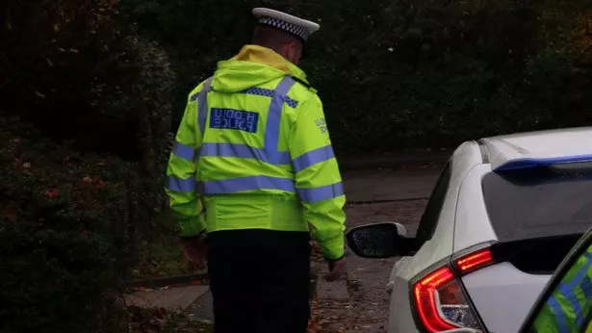
What can be done about drug driving?
Increased campaigning on the dangers of drug driving is necessary, as crash statistics show no improvement in recent years. Some police forces are reporting rising convictions, even exceeding those for drunk driving. (ROSPA).

Slide 17
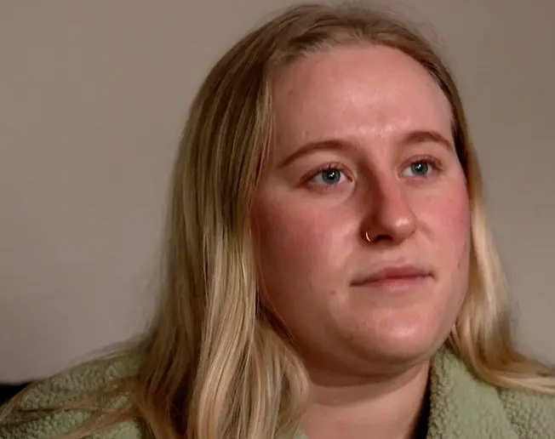
Case Study
In January 2023, her mother, sister, and stepfather were killed in a head-on collision with a drug-impaired driver. Summer describes her life as a waking nightmare: "When they are gone, your whole life is shattered into a million pieces’’.(Bbc 2024).

Slide 18
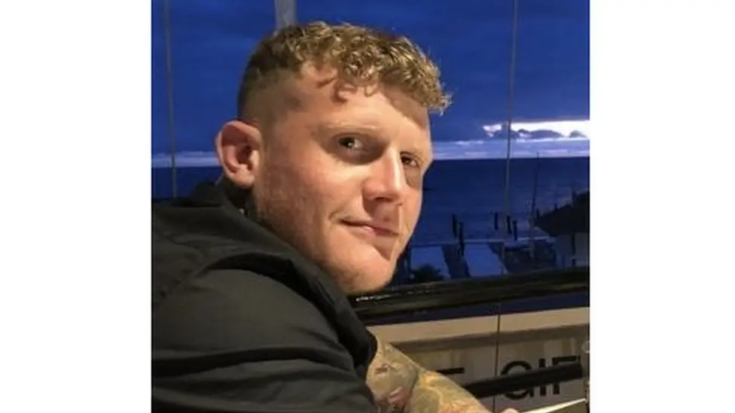
Case Study
Katie's partner and father of her three children, Sam Morris, was killed in a drug-driving collision. She believes people underestimate the dangers of drug driving.
"I think if someone causes a death while driving unlawfully, whether due to alcohol or drugs, it should be treated as manslaughter," Katie said. (Bbc 2024).

Slide 19
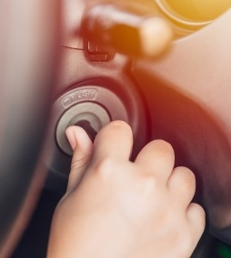
Summary
Driving under the influence of drugs can impair judgment of speed and distance, reaction time, and coordination. It can also create a false sense of confidence, leading to riskier behaviour on the road. (Avon and Somerset, 2024).
The issue of driving under the influence of drugs has been increasing every year since 2011. To improve this situation, we need more awareness campaigns throughout the year, not just during winter and summer. Additionally, we require increased police presence on the roads, along with the implementation of new technologies and strategies to combat drug-impaired driving. It's also important to impose stricter fines and longer prison sentences for individuals who are caught driving under the influence.

Slide 20
Reference
Bbc (2024). More drug than drink-driving arrests by some forces. Available at: https://www.bbc.co.uk/news/business-68361610 (Accessed: 28 February 2025).
Avon and Somerset Police And Crime Commissioner (2024. PCC asks people to speak up about drink- and drug-driving, to help save lives. Available at: https://www.avonandsomerset-pcc.gov.uk/news/2024/12/pcc-asks-people-to-speak-up-about-drink-and-drug-driving-to-help-save-lives/ (Accessed: 28 February 2025).
Departament for Transport (2016). Drug drive arrests on the rise. Available at:https://www.gov.uk/government/news/drug-drive-arrests-on-the-rise. (Accessed: 27 February 2025).
EMSA . How do Drugs Affect Driving? Available at:https://emsaok.gov/resource-library/summer-safety-tips/how-do-drugs-affect-driving/ (Accessed on 13 February 2025).
Essex Police (2025). Drug driving – is the high worth the low? Available at:https://www.essex.police.uk/police-forces/essex-police/areas/essex-police/campaigns/campaigns/drug-driving-is-the-high-worth-the-low/ (Accessed on 14 February 2025). Think (2025). Story of THINK! Available at:https://www.think.gov.uk/about-think/story-of-think/ (Accessed on 14 February
Home Office(2023). Reducing the harm from illegal drugs. Available at: https://www.nao.org.uk/wp-content/uploads/2023/10/reducing-the-harm-from-illegal-drugs.pdf .(accessed on 12 February 2025).
North Wales Police (2024). HGV drivers arrested as part of Christmas Anti Drink and Drug Drive Campaign. Available at: https://www.northwales.police.uk/news/north-wales/news/news/2024/december/hgv-drivers-arrested-as-part-of-christmas-anti-drink-and-drug-drive-campaign/ (Accessed on 14 February 2025).
N Middleton (2024). Fleets urged to get tough on drink and drug-driving as police winter crackdown starts. Available at: https://vanfleetworld.co.uk/fleets-urged-to-get-tough-on-drink-and-drug-driving-as-police-winter-crackdown-starts/ (Accessed on 13 February 2025).
North Yorkshire (2025). More than 150 arrests during our Christmas Drink and Drug Drive campaign. Available at: https://www.northyorkshire.police.uk/news/north-yorkshire/news/news/2025/01-january/more-than-150-arrests-during-our-christmas-drink-and-drug-drive-campaign/ (Accessed on 14 February 2025).
North Yorkshire Police (2024). We don’t want another empty seat this Christmas… Available at: https://www.northyorkshire.police.uk/news/north-yorkshire/news/news/2024/11-november/we-dont-want-another-empty-seat-this-christmas/ (Accessed on 14 February 2025).
NPCC (2023). Nearly 9,000 drivers caught drink or drug driving. Available at:https://news.npcc.police.uk/releases/nearly-9-000-drivers-caught-drink-or-drug-driving-in-six-week-police-operation (Accessed on 13 February 2025).
National Crime Agency. Drug Trafficking. Available at: Drug trafficking - National Crime Agency (Accessed: 25 February).
Office for National Statistics (2021. Deaths related to drug poisoning in England and Wales: Available at: https://www.ons.gov.uk/peoplepopulationandcommunity/birthsdeathsandmarriages/deaths/bulletins/deathsrelatedtodrugpoisoninginenglandandwales/2020#toc (Accessed on 10 February 2025).
Office for National Statistics (2022).Available at: https://www.ons.gov.uk/peoplepopulationandcommunity/birthsdeathsandmarriages/deaths/bulletins/deathsrelatedtodrugpoisoninginenglandandwales/2022registrations. (Accessed on 10 February 2025).
Police.UK. Driving under the influence of alcohol or drugs. Available at: https://www.police.uk/advice/advice-and-information/rs/road-safety/alcohol-drug-driving/ (Accessed: 27 February 2025).
Road Safety Knowledge Centre(2024). Saving Lives: Reducing preventable harm caused by driving under the influence. Available at: https://www.roadsafetyknowledgecentre.org.uk/saving-lives-reducing-preventable-harm-caused-by-driving-under-the-influence-concensus-statement/ (Accessed on 11 February 2025.
ROSPA. Drug driving. Available at: https://www.rospa.com/getmedia/bb2203d6-c8c3-49c5-b6bb-23935ea9e6d3/Drug-Driving-Factsheet-1223_1.pdf (Accessed on 13 February 2025).
Think (2025). Drug driving. Available at:https://www.think.gov.uk/themes/drug-driving/ (Accessed: 28 February 2025).
UK Parliament(2024) ). Policing: a public health approach. Available at: https://post.parliament.uk/policing-a-public-health-approach/ (Accessed on 11 February 2024).

