Slide 1

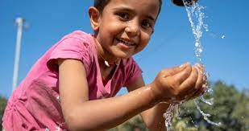
Human Right: Water and Sanitation
Making it clean and accessible

Slide 2
Access to water and sanitation are recognized by the United Nations as human rights – fundamental to everyone’s health, dignity and prosperity. However, billions of people are still living without safely managed water and sanitation.

Slide 3
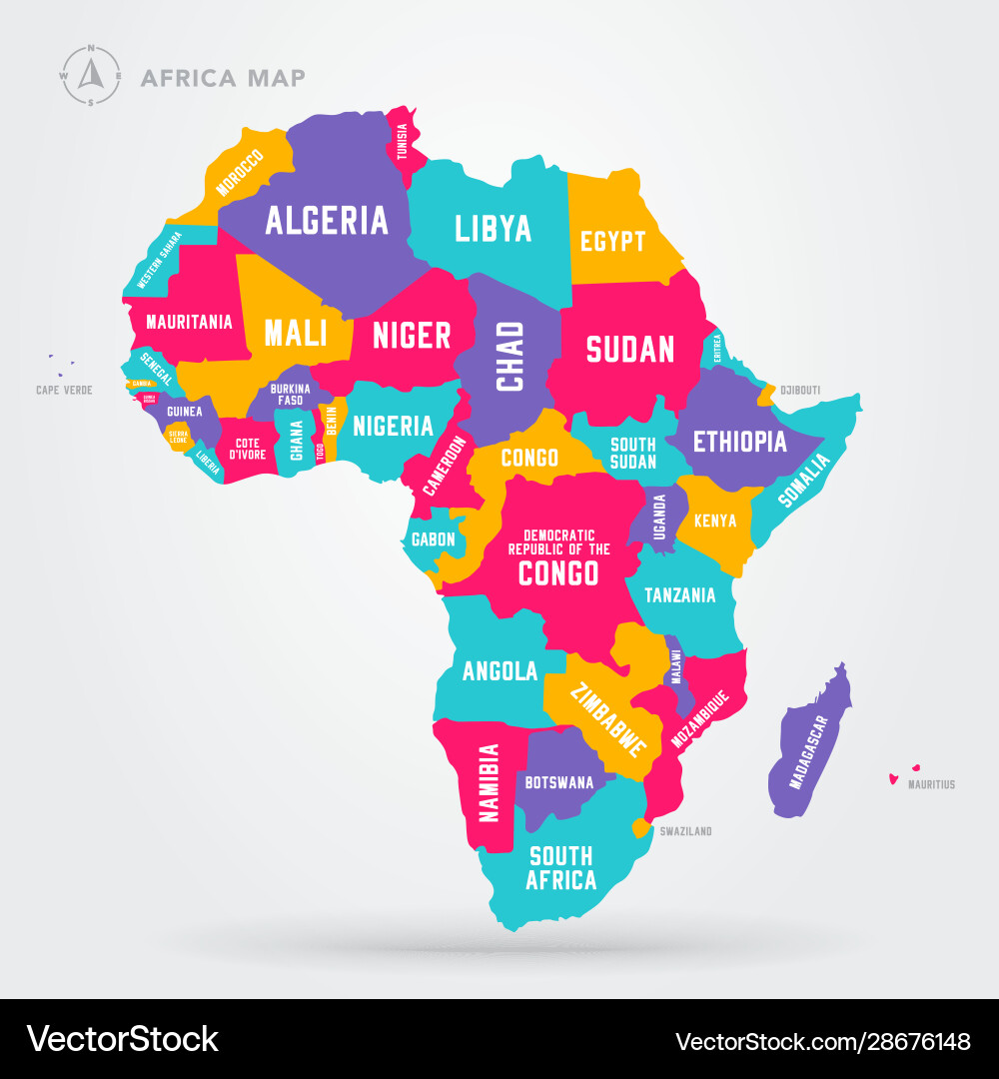
As October 2022, about 226 million people in Eastern and Southern Africa did not have access to basic water services and 381 million people lacked access to basic sanitation services. These statistics have since the increase.
Countries such as Angola, Democratic Republic of Congo, Ethiopia, Kenya, Madagascar, Mozambique, Sudan, Tanzania, Uganda are home to 80% of the underserved people in the region.

Slide 4
Variables
Location
Types of Rocks
Seasons- Wet Seasons and prolong dry seasons
Poor piping system
Little to no availability of sanitation facilities

Slide 5
Solution
Multiple Desalination systems
Proper Piping Systems
Drilling system in near proximities to infrastructure like schools and library.
Community Sanitation facilities
And water truck trips from replenishable water supply
And large storage tanks for water

Slide 6
Recommendation
The existing policy and the sub-context of the policy as no obvious flaws just little funding, NGOs and GOs ad charities should work together help decrease the numbers and in turn, decrease the waterborne diseases affecting the countries.

