Slide 1
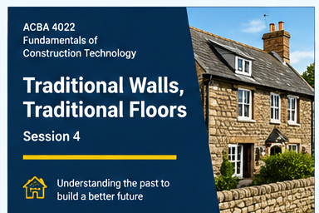
ACBA 4022 | FUNDAMENTALS OF CONSTRUCTION TECHNOLOGY
TRADITIONAL
WALLS & FLOORS
Session 4 • 2-hour interactive class
Understand how older buildings were built —
and how to investigate them today.
• Discuss • Sketch • Diagnose
ACBA 4022 • Fundamentals of Construction Technology
01

Slide 2
SESSION 4
what can an old floor or wall tell us?
THINK — 30 seconds
PAIR — 90 seconds
Imagine a house built around 1900.
What clues might tell you how its walls and floors were constructed?
Compare ideas with the person beside you.
Choose one clue and explain what it might tell you.
SHARE — invite 3 quick answers
Wall thickness, stone/brick pattern or mortar
Floorboard direction, movement or creaking
Damp marks, cracks, ventilation grilles or finishes
ACBA 4022 • Fundamentals of Construction Technology
02

Slide 3
SESSION 4
By the end of the session, you should be able to
Describe common traditional wall materials and construction features.
Explain solid ground floors, suspended ground floors and suspended upper floors.
Recognize common risks and defects: damp, cracking, spalling, decay, noise and heat loss.
Compare traditional solutions with modern expectations for comfort and performance.
Use a simple annotated sketch to explain how a construction works.
You can explain not just what a component is, but why it was used and what can go wrong.
ACBA 4022 • Fundamentals of Construction Technology
03

Slide 4
SESSION 4
Recap: traditional or modern?
The previous session introduced the difference between traditional and modern construction.
TRADITIONAL — often
MODERN — often
Solid masonry; local stone or brick;
lime mortar; timber floors;
methods shaped by local materials and craft.
Cavity wall construction; engineered components; insulation and moisture control designed into the build-up.
Quick vote: which clue would you investigate first in a 1900s house?
A. Wall thickness
B. Mortar type
C. Floor ventilation
D. All three — and the building context
ACBA 4022 • Fundamentals of Construction Technology
04

Slide 5
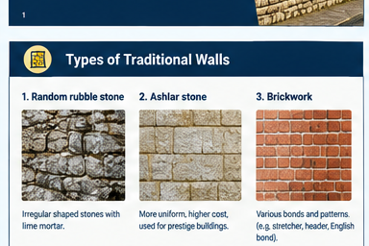
SESSION 4
Traditional walls: materials
Stone
Brick + mortar
• Long-lasting when suitable stone is used
• Random rubble: irregular pieces
• Ashlar/dressed stone: more regular, worked blocks
• Brick sizes support repeatable courses
• Mortar bonds units and accommodates some movement
• Traditional walls commonly used lime mortar
Why local materials matter
Availability and transport costs shaped local building styles.
Local stone and brick can give buildings a strong regional character.
Repair materials should be compatible with the original wall.
what might happen if a very hard modern mortar is used on soft historic brick or stone?
ACBA 4022 • Fundamentals of Construction Technology
05

Slide 6
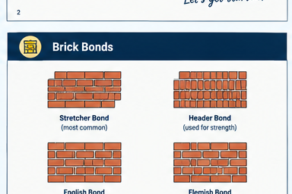
SESSION 4
Three wall forms to recognise
outer masonry
inner masonry
1 Random rubble
2 Ashlar / brickwork
Irregular stone, often bedded in lime mortar.
More regular blocks or repeated brick courses; bond affects appearance and arrangement.
3 Solid wall section
One thick masonry wall rather than two leaves with a cavity.
describe one visible difference between rubble stone, ashlar and brickwork without using the word “old”.
ACBA 4022 • Fundamentals of Construction Technology
06

Slide 7
SESSION 4
What must an external wall do?
Weather
Structure
Fire
Limit rain penetration and help the building dry.
Carry loads and remain stable.
Provide appropriate fire resistance.
Thermal
Acoustic
Durability
Limit unwanted heat loss.
Reduce sound transmission.
Resist wear and remain repairable.
Pair task (2 min): rank the three functions you think matter most in a traditional solid wall. Be ready to defend your top choice.
ACBA 4022 • Fundamentals of Construction Technology
07

Slide 8
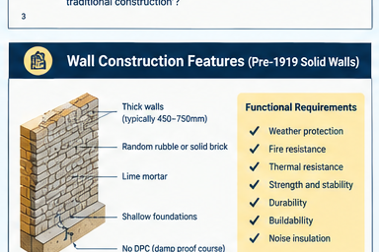
SESSION 4
Mortar matters: lime versus cement
Lime mortar — common historically
Portland cement mortar — widely used later
• Softer and more vapor-permeable
• Can accommodate small movements
• Helps moisture evaporate from traditional masonry
• Often appropriate for compatible historic repairs
• Generally stronger and faster-setting
• Useful in many modern construction contexts
• Can be too hard or less permeable for some soft historic masonry
• Compatibility matters more than “stronger is better”
Key concept: if mortar is much harder than the masonry unit, the brick or stone face may deteriorate (spalling).
Question: in a repair, should the mortar always be the strongest material? Why or why not?
ACBA 4022 • Fundamentals of Construction Technology
08

Slide 9
SESSION 4
Older solid walls: clues, not absolute rules
Features noted in the material
Important caution
These are clues, not a guaranteed checklist. Buildings vary by region, date, alterations and repair history. Inspect rather than assume.
• Thick solid masonry
• Random rubble or brickwork
• Lime mortar
• Shallow or limited foundations in some older properties
• Often no damp-proof course (DPC)
outer masonry
inner masonry
why is it risky to diagnose a building from its age alone?
ACBA 4022 • Fundamentals of Construction Technology
09

Slide 10
SESSION 4
Activity 1 — diagnose the wall
In groups of 3
Choose one possible defect from the image panel. Discuss:
1. What can you observe?
2. What might be causing it?
3. What further evidence would you need?
4. What would you avoid doing immediately?
Report back
One person reports the observation; one gives a possible cause; one names the evidence needed before recommending a repair.
Timing: 5 minutes group discussion + 3 minutes feedback.
ACBA 4022 • Fundamentals of Construction Technology
10

Slide 11
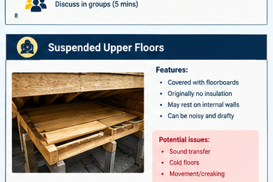
SESSION 4
Now look down: what does a floor do?
Supports occupants, furniture and the floor’s own weight.
Resists or manages moisture, heat and sound transmission.
Provides a surface finish that affects appearance, feel and acoustics.
May be built directly on the ground or suspended from walls / supporting structure.
Quick check
Which floor type would you expect to have an air space beneath it? What might that space be for?
ACBA 4022 • Fundamentals of Construction Technology
11

Slide 12
SESSION 4
Three traditional floor arrangements
A Solid ground floor
B Suspended ground floor
C Suspended upper floor
Built up from the ground; often compacted earth with a stone/concrete layer and a finish.
Timber joists and floorboards above a ventilated void; ventilation is essential.
Timber joists and boards supported by walls or beams; ceiling below may be open or plastered.
Floorboards
quarry tile finish
compacted earth
concrete / stone layer
Timber joists
Ventilated void
Solid ground floor
Suspended timber ground floor
ACBA 4022 • Fundamentals of Construction Technology
12

Slide 13
SESSION 4
Traditional solid ground floors
Typical historic build-up
Compacted earth/ground → stone or concrete layer → finish such as quarry tiles.
quarry tile finish
compacted earth
Possible disadvantages
• Can feel cold and hard
• Moisture may move through the floor
• Often lacks modern damp and thermal layers
concrete / stone layer
Discuss
How might the room feel in winter? What signs might suggest moisture?
ACBA 4022 • Fundamentals of Construction Technology
13

Slide 14
SESSION 4
Suspended timber ground floors
How it works
Floorboards span across timber joists. Joists transfer loads to supporting walls or other structure.
Floorboards
Why ventilation matters
Air movement beneath the floor helps control moisture. Blocked or inadequate vents can contribute to timber decay.
Timber joists
Ventilated void
Modern performance
Insulation may be added carefully, but the design must not block ventilation or trap moisture.
ACBA 4022 • Fundamentals of Construction Technology
14

Slide 15
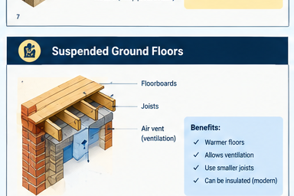
SESSION 4
Suspended upper floors: what can go wrong?
Typical features and issues
• Timber joists support floorboards
• Joists may bear on internal walls or beams
• Older floors may have little acoustic or thermal insulation
• Loose nails / board movement can cause creaking
• Deflection, decay or alterations may need investigation
Think like a building surveyor
A creak is a clue, not a diagnosis.
Check moisture, support, fixings and movement before recommending work.
Do not assume every uneven floor is unsafe — assess it properly.
ACBA 4022 • Fundamentals of Construction Technology
15

Slide 16
SESSION 4
Floorboards, quarry tiles and parquet
Tongue-and-groove boards
Quarry tiles
Parquet
• Boards fit together at the edges
• Traditionally nailed at right angles to joists
• Nails can loosen over time, creating creaks
• Sound boards may be sanded and refinished
• Common traditional finish on solid floors
• Hard-wearing and visually distinctive
• Inspect for loose tiles, cracks and moisture staining
• Short timber pieces arranged in geometric patterns
• Adds visual character
• Can be sensitive to moisture and movement
what clues would help you decide whether a floor finish is original or a later addition?
ACBA 4022 • Fundamentals of Construction Technology
16

Slide 17
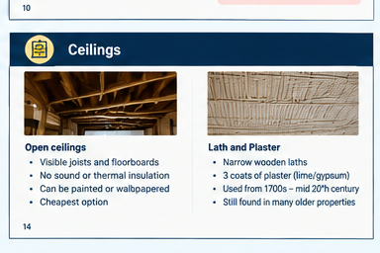
SESSION 4
Ceilings below timber floors
Open ceiling
Lath and plaster
• Joists and floorboards may be visible from below
• Cheapest finish
• Little inherent sound or thermal insulation
• Sometimes painted or wallpapered
• Narrow timber laths fixed across joists/studs
• Wet plaster pushed through gaps to form “keys”
• Traditionally applied in multiple coats
• Used widely from the 1700s until the mid-20th century
Inspection clue
Cracks, bulging or loose plaster may indicate failure of the plaster keys or movement. Avoid disturbing unknown older materials without appropriate checks.
ACBA 4022 • Fundamentals of Construction Technology
17

Slide 18
SESSION 4
Activity 2 — design a floor for a small room
Scenario: you are advising on a small ground-floor room in an older Welsh house.
Your team must decide
Deliverable
1. Solid floor or suspended timber floor?
2. What materials and layers would you expect?
3. How will you manage moisture?
4. What finish would suit the room?
Draw a simple section sketch and label at least 4 components. Add one advantage, one risk and one question you would investigate on site.
Roles: sketcher • materials expert • defect detective • spokesperson
Timing: 7 minutes to design + 1 minute per team to share. Reward clear reasoning, not artistic skill.
ACBA 4022 • Fundamentals of Construction Technology
18

Slide 19
SESSION 4
Traditional and modern: compare carefully
Traditional examples
Modern approaches — broad comparison
• Solid masonry walls
• Lime mortar
• Solid earth-based floors or suspended timber floors
• Often fewer designed-in insulation layers
• Repairs rely on understanding existing materials
• Cavity walls with ties and insulation
• Engineered timber / concrete floor systems
• Designed damp-proofing and insulation layers
• Performance requirements set through current standards
• Still need correct detailing and maintenance
Important: traditional does not automatically mean better, and modern does not automatically mean defect-free. Suitability depends on context, condition and performance needs.
ACBA 4022 • Fundamentals of Construction Technology
19

Slide 20
SESSION 4
Exit ticket — show what you learned
1. Name one material commonly used in traditional solid walls.
2. Why might lime mortar be more suitable than hard cement mortar for some historic masonry?
3. What is the purpose of ventilation beneath a suspended timber ground floor?
4. Give one likely cause of a creaking floorboard.
5. Name one clue you would investigate before recommending a repair.
How to answer
Write short answers independently for 3 minutes. Then compare with a partner and correct one answer in a different colour.
ACBA 4022 • Fundamentals of Construction Technology
20

Slide 21
SESSION 4
Five ideas to take away
Traditional construction varies by location, materials, age and later alterations.
Wall materials and mortar work as a system — compatibility matters.
Solid floors and suspended floors behave differently, especially around moisture and ventilation.
Defects should be observed and investigated before a repair is prescribed.
Annotated sketches help explain construction clearly and professionally.
Next session link
You will build on this by looking at cavity walls and modern floors.
ACBA 4022 • Fundamentals of Construction Technology
21

