Slide 1

Removing ‘single use’ plastic from UWTSD catering – using the 4 P’s of Innovation
Jorna Ali - 1706149

Slide 2
Introduction
University of Wales Trinity St David is a large organisation spread across 6 campuses and 4 outreach locations across the UK.
There are 11,135 students across all campuses -2018/2019.
(HESA, 2020)
(University of Wales Trinity Saint David, 2020)

Slide 3
What the innovation is?
PROBLEM: Over 200 single use plastic cups are bought daily at Swansea Business School campus and 150 at the new SA1 campus. This causes a significant problem for the environment.
INNOVATION:
    Remove single use plastic cups from all UWTSD campuses and replace with reusable cups.
    Replace with bamboo cups which are eco-friendly and made from renewable materials and which are proven safe.
    Provide a financial incentive by reducing the price of the drink bought if using a reusable cup.
(University of Wales Trinity Saint David, 2020)

Slide 4

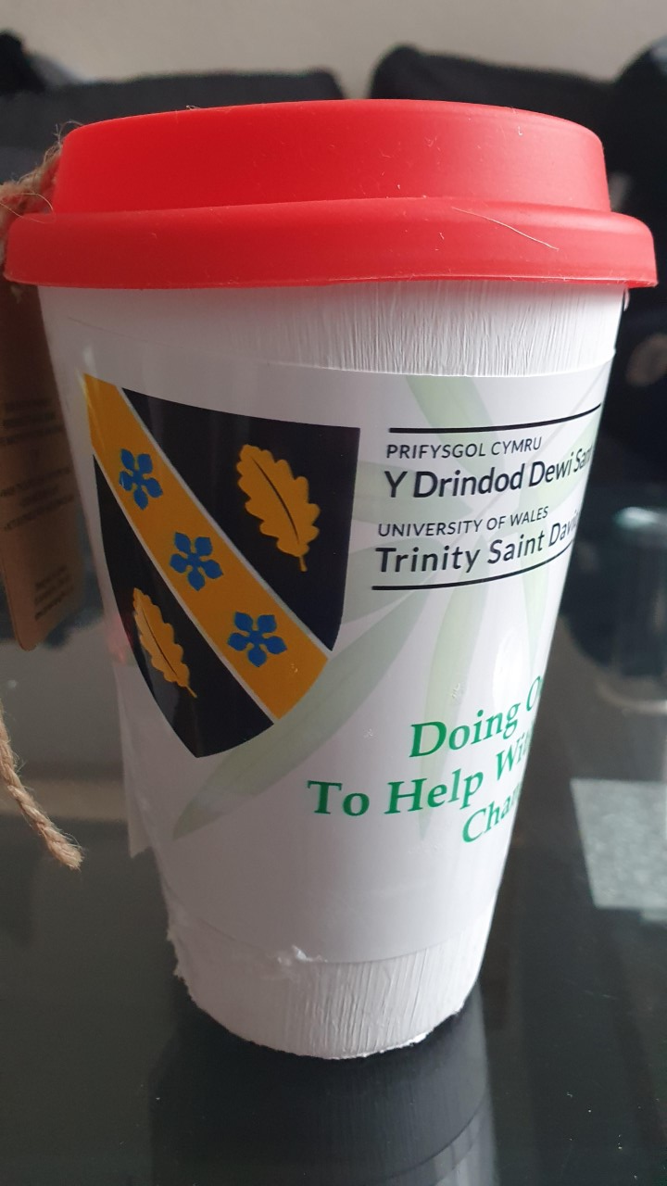
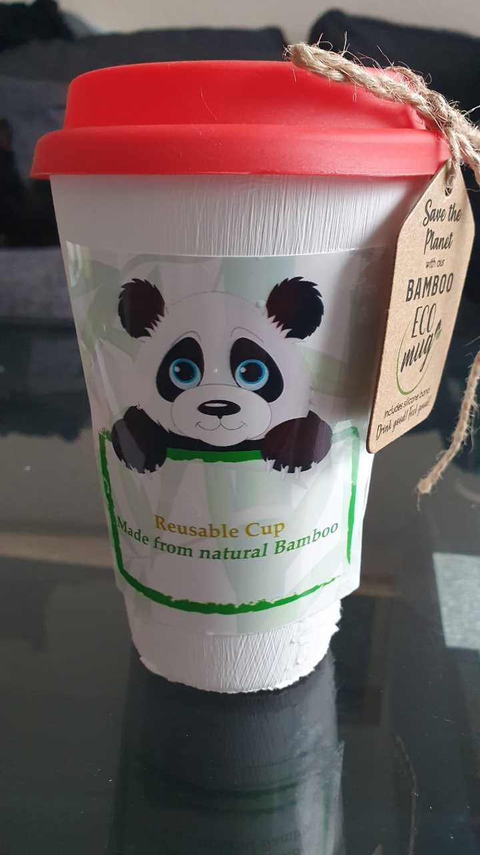
Eco-friendly Reusable Cup –
Prototype
Made from natural bamboo & renewable materials
(Lauren, 2020).
(Lauren, 2020)

Slide 5
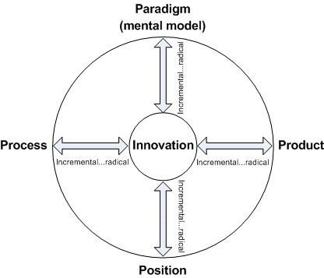
Process
The innovation will follow the 4P’s model of Innovation, Product, Process, Position and Paradigm
For the purpose of this innovation, Paradigm will be the chosen aspect, because all stakeholders will be required to change their mind-set towards single use plastic – as this the definition of a paradigm.
Whilst Paradigm will be main focus, there will be elements of innovation of product (new reusable bamboo cups), process (that includes removing single use plastic through financial incentive) and finally position (students and non students will perceive UWTSD as environmentally good).
(Tidd and Bessant, 2018)

Slide 6

Risk
Cost analysis- cost of cups v single use cups (financial gain v. environmental gain)
Investment – excessive costs
Student unhappiness – students may not want to pay additional cost.
Not a university run coffee shop, so risk of upsetting existing provider (Costa)
Cleanliness – who will be responsible for cleaning cups?
Large organisation- how to implement across all areas (UWTSD is geographically fragmented)
(Victorovna, 2017)

Slide 7
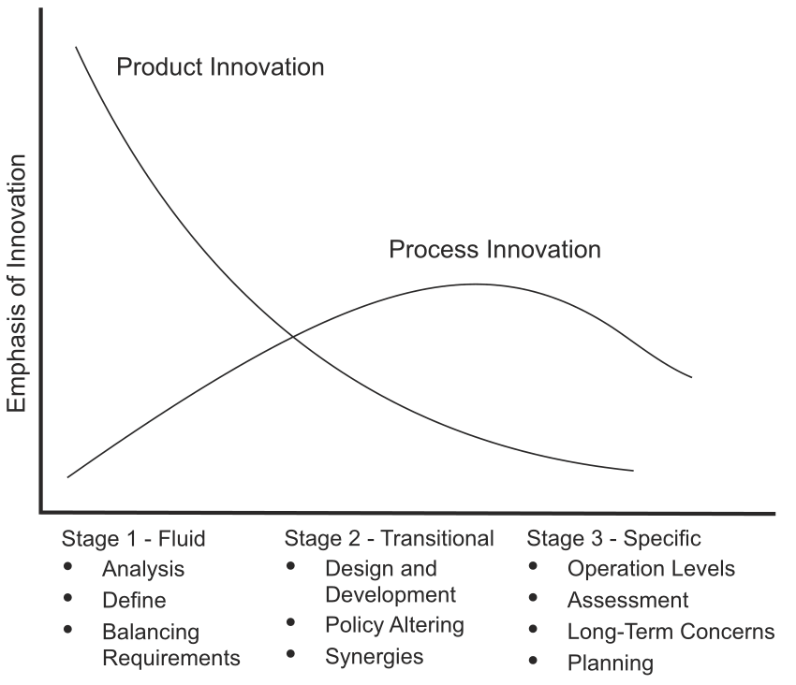
Complexing of a large Innovation
Multi campus location will require strong coordination and leadership to Implement innovation
Trialling and testing the reusable prototype on Swansea Business campus.
Assessing impact on all stakeholder department i.e. department could have several different suppliers.
Elements of Innovation life cycle will be encountered in this particular innovation (Tidd and Bessant, 2018).
(Tidd and Bessant, 2018)

Slide 8

Benefits
Advertising and brand designs; art students to design which could be part of their course
Logo on the cup will advertise the university across the UK as students will be walking around town drinking from their cups.
Increasing university’s ability to meet environmental policy
Give profits to charity which is good for charity and advertising university
Cost saving to the student- save money per cup of hot beverage.
UWTSD Environmental Policy
  Improve resource efficiency using the waste hierarchy, including only procuring what is necessary, maximizing reuse and recycling and avoiding waste to landfill
(St. Louis, 2020)
(University of Wales Trinity Saint David, 2020)

Slide 9
Plan
Change the mindset of the student’s to understand the environmental benefit
Introduce the cups to one campus first as a trial run to test the impact and feasibility of the project.
Assessment to determine whether the trial and prototype are proving successful.
(Banuri, 2020)
(NESTA, 2020)

Slide 10
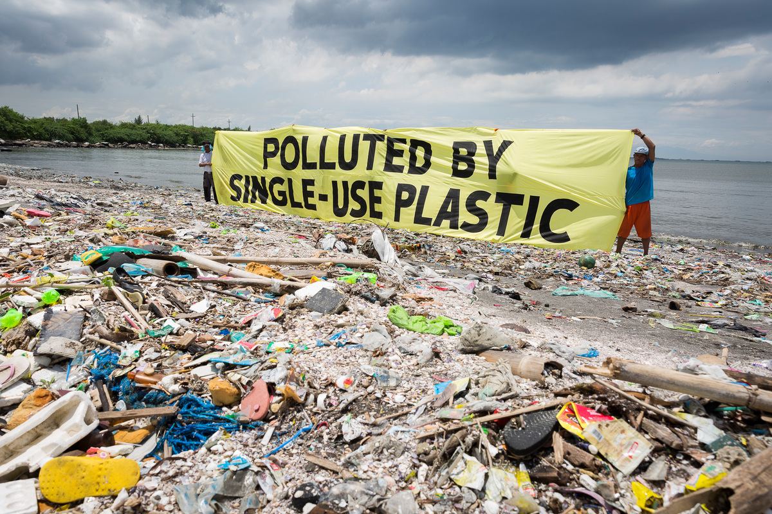
Implementation - How?
Contact suppliers of the cups to ascertain the cost of the cups and how much it will be to print the logo on the cups also
  Can UWTSD art department design the cup?
  Can the advertising and brand design students design the cup as one of their projects thereby getting course credit?
  Changing student mindset through advertising the environmental risks of plastic cups use! Show how much waste is caused by the university.
(Parker, 2019)

Slide 11
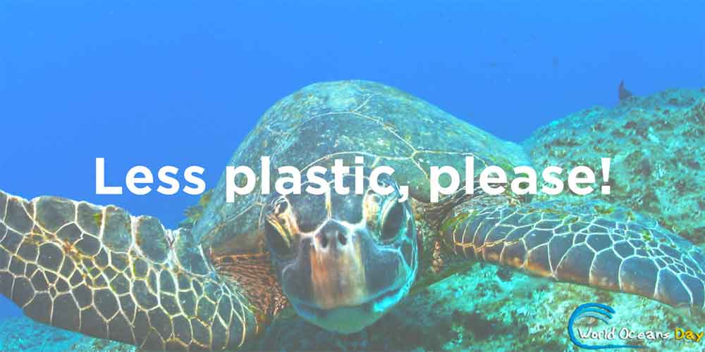
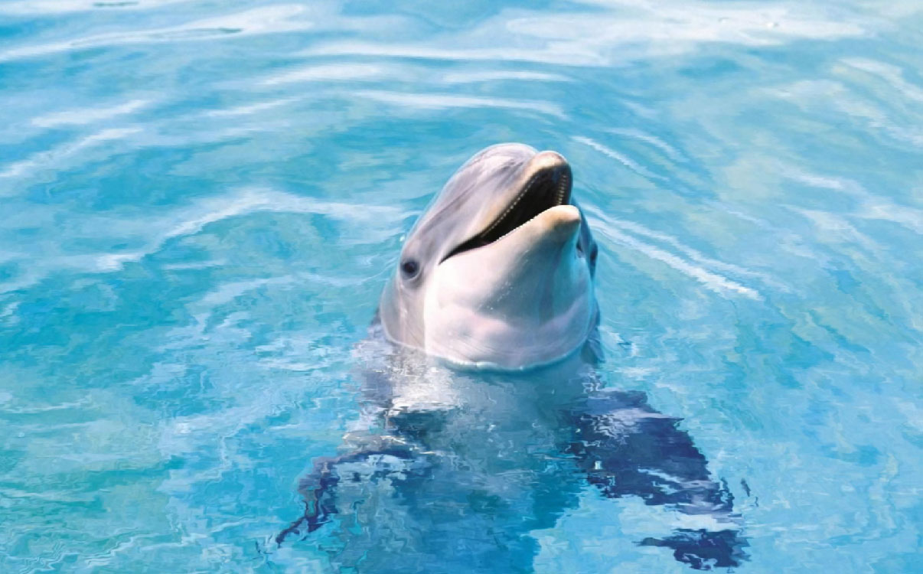
Thank you for listening
SAVE THE WORLD !

Slide 12
REFERENCES
Banuri, T. (2020) Changing Mindsets Climate Change and Sustainable Development. Available at:TB_presentationCCandSDMalmo_1209.pdf (Accessed: 07 February 2020).
HESA. (2020) Where do HE students study? Available at: https://www.hesa.ac.uk/data-and-analysis/students/where-study (Accessed: 08 March 2020).
Lauren. (2020) Are Bamboo Cups Environmentally Friendly? Available at: https://www.advanceddisposables.co.uk/blogs/eco-friendly/are-bamboo-cups-environmentally-friendly/ (Accessed: 04 February 2020).
NESTA. (2020) PROTOTYPING FRAMEWORK: A GUIDE TO PROTOTYPING NEW IDEAS. Available at: prototyping_framework.pdf (Accessed: 05 February 2020).
St.Louis, M. (2020) 4 Ways That Supporting Charity Is Good for Business. Available at: https://www.inc.com/molly-Reynolds/4-ways-that-supporting-charity-is-good-for-business.html (Accessed: 05 February 2020).
Tidd, J. and Bessant, J (2018) Managing Innovation. United Kingdom: Wiley.

Slide 13
University of Wales Trinity Saint David. (2020) Campuses, Centres and Locations. Available at: https://www.uwtsd.ac.uk/campuses/ (Accessed: 02 February 2020).
University of Wales Trinity Saint David. (2020) Environment Policy. Available at: https://www.uwtsd.ac.uk/media/uwtsd-website/content-assets/documents/environment-unit/uwtsd-environment-policy.pdf (Accessed: 05 March 2020).
University of Wales Trinity Saint David. (2020). UWTSD – Swansea [Interview] (28 February 2020).
Victorovna, A, O. (2017) ‘Innovation risks: challenges and prospects’, Advances in Economics, Business and Management Research, 38, pp. 7-12. DOI: 10.2991/ttiess-17.2017.2

