Slide 1
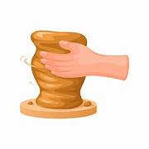
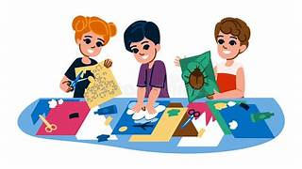
Shaping Emotions: A Trauma-Informed Clay Workshop
2404639|ECYW5013

Slide 2

Overview / Aim of the Presentation
Explain the context and mental health need for the session
Introduce trauma-informed principles
Walk through icebreaker and main clay activity
Show how the session supports emotional wellbeing
Outline evaluation and reflection methods

Slide 3

Why This Workshop Matters
Many young people experience stress, anxiety, or trauma, which can make it hard for them to express how they feel. Creative activities, such as working with clay, give young people a safe, hands‑on way to explore and make sense of their emotions. Research in the UK shows that engaging in creative and arts activities can support emotional wellbeing, help young people feel more confident, and improve coping skills (YoungMinds, 2023).

Slide 4
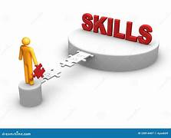
Building Skills and Wellbeing
By the end of this session, young people will have had the opportunity to explore and express their emotions safely using clay, experience a sense of calm and grounding, and make choices about how they express themselves creatively. Creative and participatory activities like this help young people build confidence, develop coping skills, and support their emotional wellbeing as part of youth work practice (Jeffs and Smith, 2010).

Slide 5
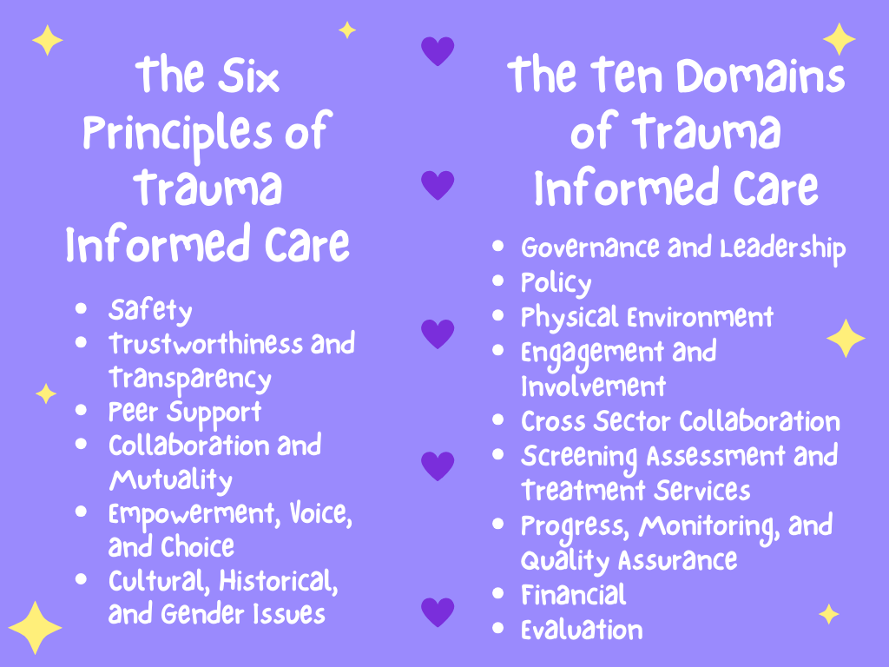
Creating a Safe Space
Trauma-informed practice means understanding how past experiences of trauma can affect young people’s behaviour, emotions, and ability to engage. This approach focuses on creating a safe, empowering, and non-judgmental environment where young people have choice and control over their participation. Activities like clay modelling support this by allowing self-expression in a low-pressure, creative space (Knight, 2015).

Slide 6

Pass the Clay Challenge
Participants sit in a circle
A piece of clay is passed around the group
Each person adds something small to the clay
The group creates one shared sculpture
Aims to relax the group and create a positive atmosphere

Slide 7
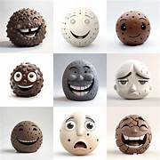
Main Activity: Stress and Calm Clay Modelling
Each participant receives their own piece of clay
Two clay models are created
One model represents stress or pressure
One model represents calm, safety, or comfort
Sharing is optional
You can even make it fun, add some colour!
(Batsleer, 2018)

Slide 8
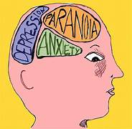
Why Clay Works: Linking to Mental Health & Theory
Clay is a tactile, hands-on medium that helps young people express emotions without needing to talk. Creating shapes can be calming, grounding, and helps develop coping strategies. In youth work, using creative activities like this supports choice, empowerment, and reflection, which are core principles of trauma-informed practice (Batsleer, 2018).

Slide 9

Reflection on the Session
After the activity, it’s important to reflect on how the session went. Asking for voluntary feedback helps understand how the activity impacted wellbeing, and linking these observations to trauma-informed practice ensures that future sessions are safe, supportive, and effective.
So,
How did you find working with the clay?
What was it like using something creative rather than talking?
Did anyone notice a change in how they felt while doing it?

Slide 10

Closing Thoughts
This session showed how clay activities can support young people’s mental health and emotional wellbeing. Participants were able to explore feelings safely, experience choice, and reflect in a supportive environment. The session highlights the importance of participating, trauma-informed approaches that empower young people and promote informal learning.

Slide 11
Referance list:
Arts Council England, 2020. The Value of Arts and Cultural Education for Young People. London: Arts Council England.
YoungMinds, 2023. Mental Health and Creative Activities in Young People. London: YoungMinds.
Jeffs, T. and Smith, M., 2010. Youth Work Practice. London: Bloomsbury Academic.
Knight, C., 2015. Trauma-Informed Social Work Practice. 2nd ed. New York: Routledge.
Batsleer, J., 2018. Youth Working with Girls and Young Women in Community Settings. London: Routledge.
Jeffs, T. and Smith, M., 2010. Youth Work Practice. London: Palgrave Macmillan.

Slide 12

Thank you for Taking part! Any Questions?

