Slide 1



The NHS App as a Digital Innovation in Health and Social Care
Name : Kemisha Bryan
Student ID:2335173
Module code:BMHP6026-Digital Transformation in the Health and Care

Slide 2

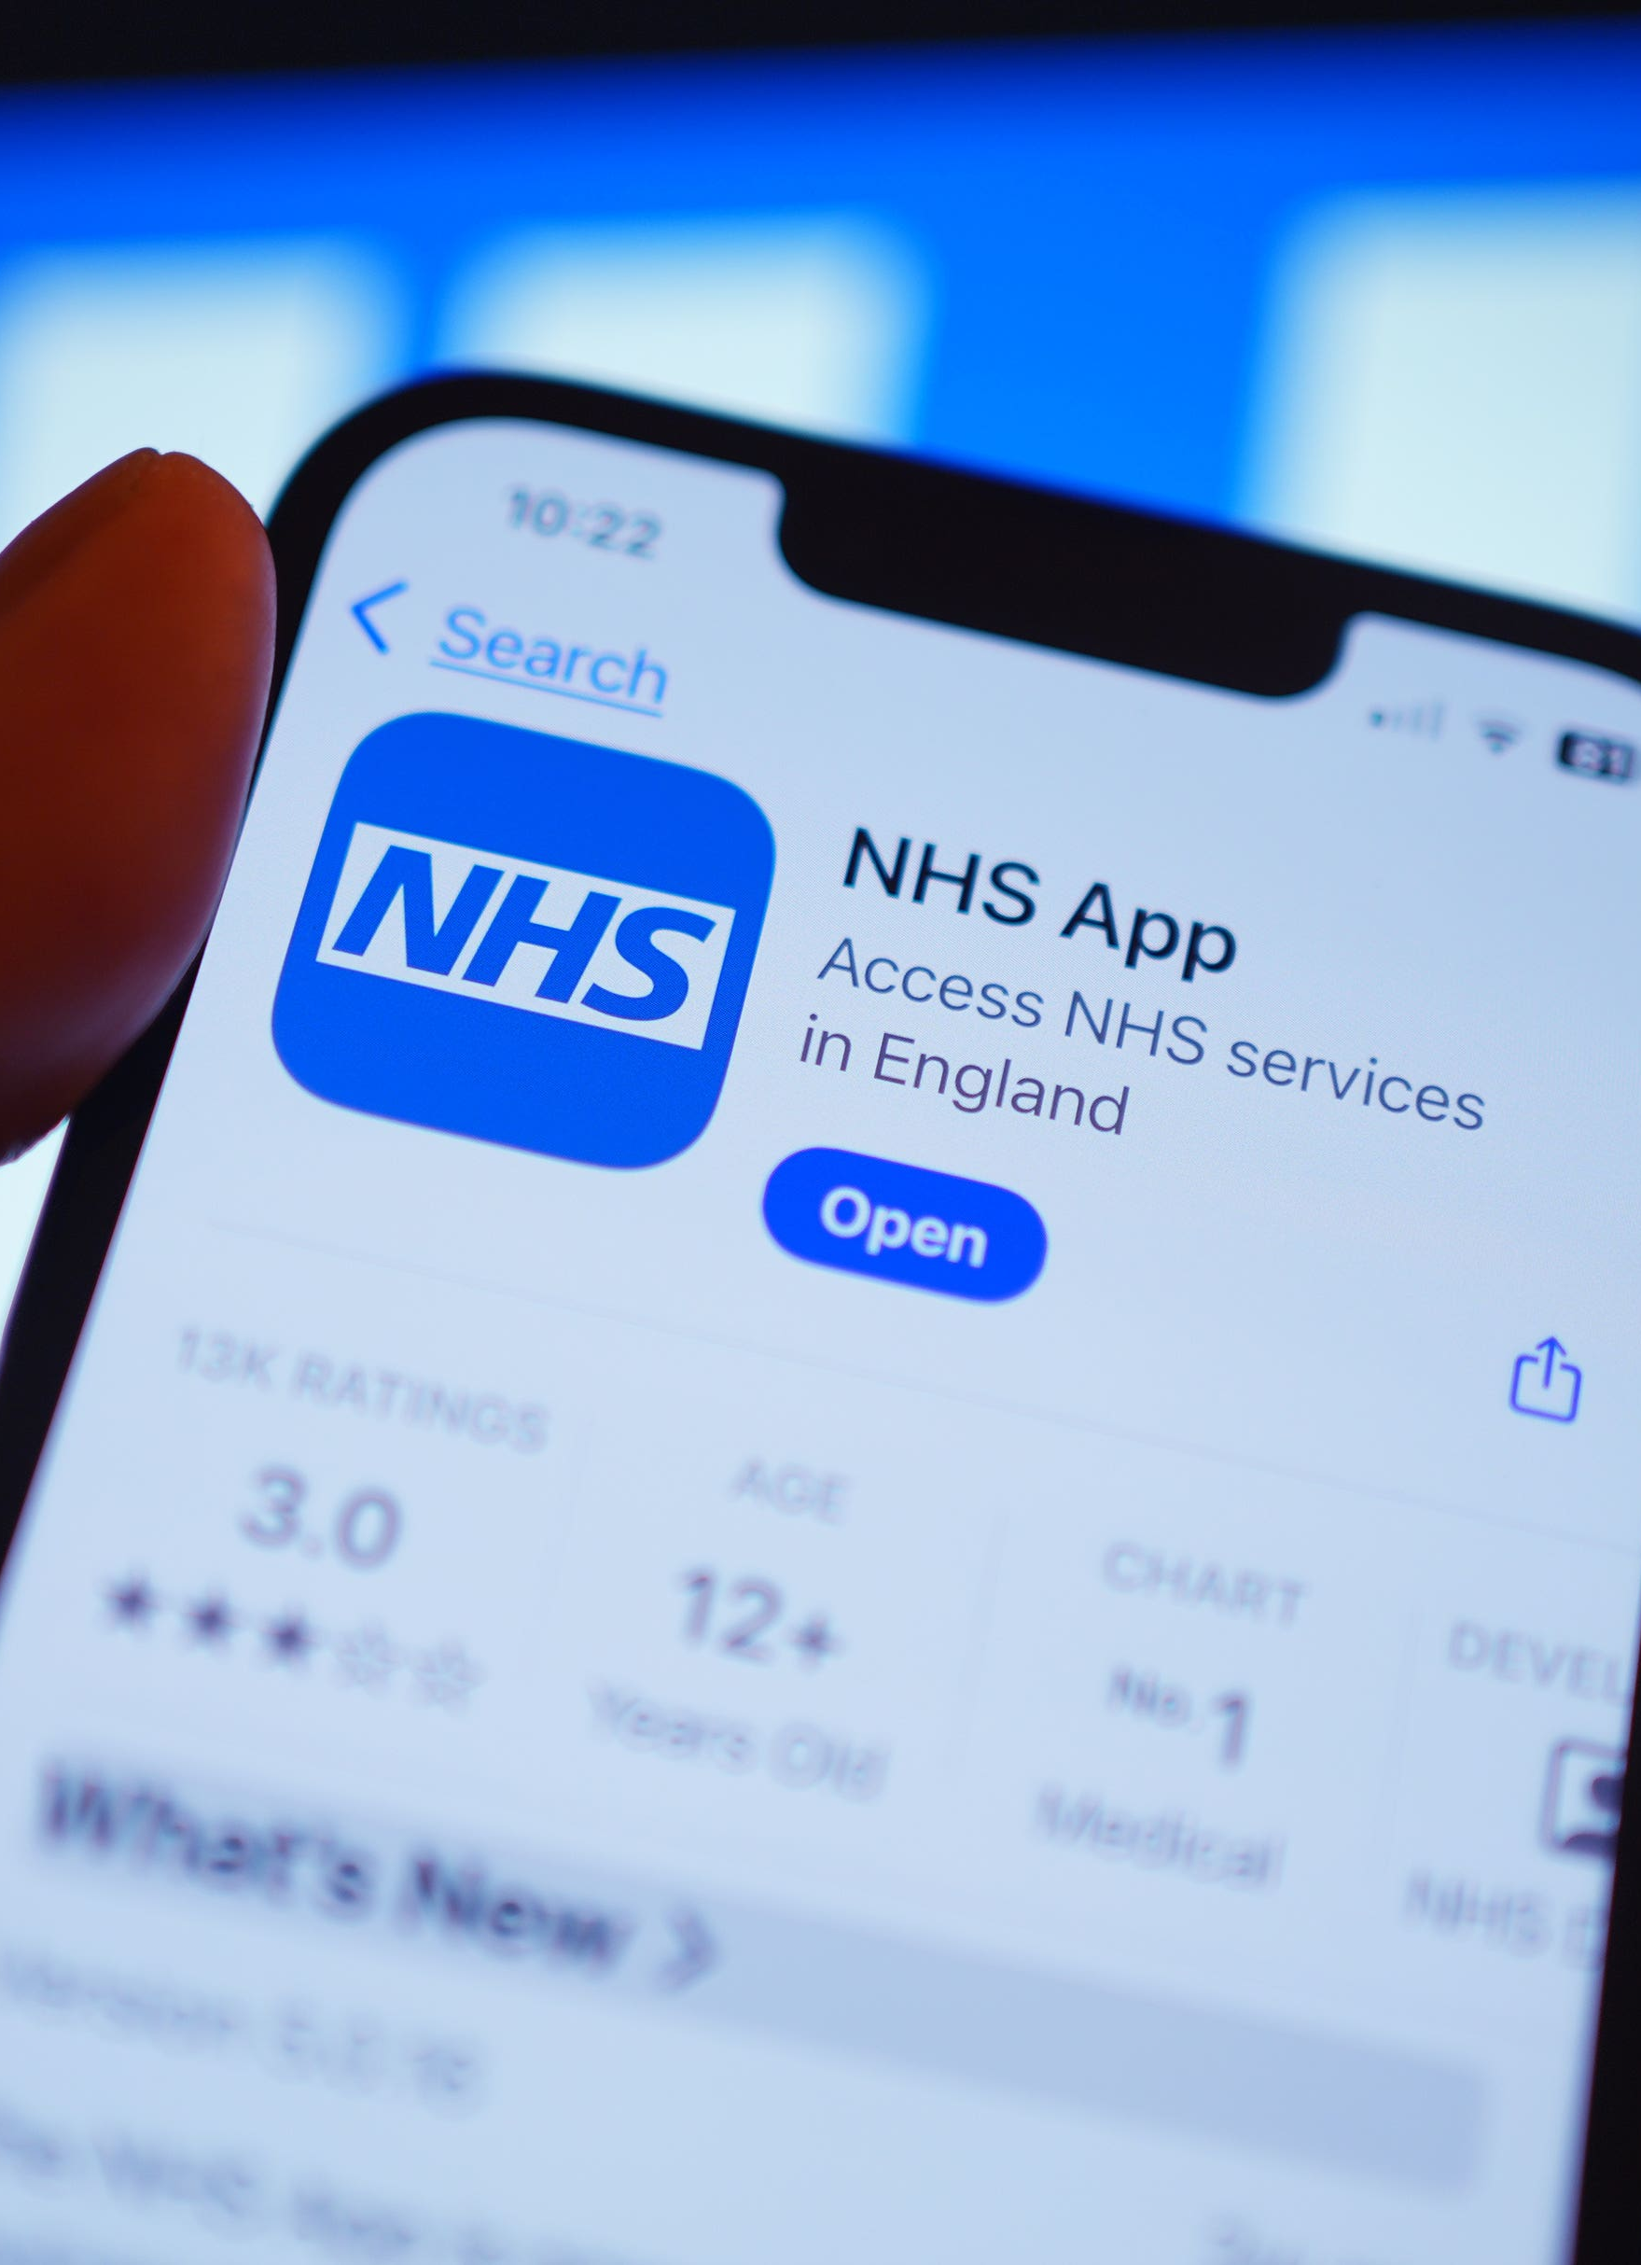



INTRODUCTION
The NHS App was introduced in 2019 to give patients a simpler and more convenient way to access NHS services (NHS, 2024). Using the app, patients can arrange GP appointments, request repeat prescriptions, view sections of their health records, and communicate with healthcare professionals (NHS, 2024). This presentation explores the influence of the NHS App on the healthcare workforce, the way services are delivered, patients and service users, and the wider community. It also considers the key benefits of the app alongside the challenges associated with its use in UK health and social care (The King's Fund, 2023).

Slide 3

Impact on the Healthcare Workforce
The NHS App has reduced some routine administrative tasks, allowing healthcare professionals to focus on patients with more complex needs (NHS England, 2024).
Healthcare professionals now require greater digital skills and often provide support to patients using the app (Department of Health and Social Care, 2022).
Successful implementation depends on staff training, leadership and organisational readiness, rather than technology alone (Greenhalgh et al., 2017).
Digital exclusion means some patients still require face-to-face support, reducing some of the expected efficiency gains (The King's Fund, 2023).

Slide 4

Impact on Service Delivery
The NHS App has simplified access to routine healthcare by allowing patients to manage common tasks, such as arranging GP appointments, requesting repeat medication, and viewing parts of their medical records, all in one place (NHS England, 2024).
High levels of app usage do not necessarily mean that the quality of care or patient outcomes have improved (NHS England, 2024).
Improvements in service delivery are influenced by wider organisational factors, including leadership, funding and staff, rather than the NHS App alone (Alderwick et al., 2021).
Digital services support healthcare delivery but do not replace face-to-face or telephone services (Nuffield Trust, 2024; Greenhalgh et al., 2017).

Slide 5

Patient / Service User
The NHS App has transformed the way many patients access healthcare, making routine NHS services more convenient and accessible (NHS England, 2024). However, the evidence suggests that increased use of the app does not necessarily lead to improved patient experiences or better health outcomes.
Using the NHS App, patients can organise many aspects of their routine healthcare, from booking GP appointments and requesting repeat medication to viewing parts of their medical records (NHS England, 2024).
Not all patients benefit equally, as those with limited digital skills or internet access may experience digital exclusion (The Health Foundation, 2023).
Digital healthcare is most effective when it complements, rather than replaces, face-to-face consultations, particularly for patients with complex or sensitive health needs (Atherton et al., 2018).

Slide 6
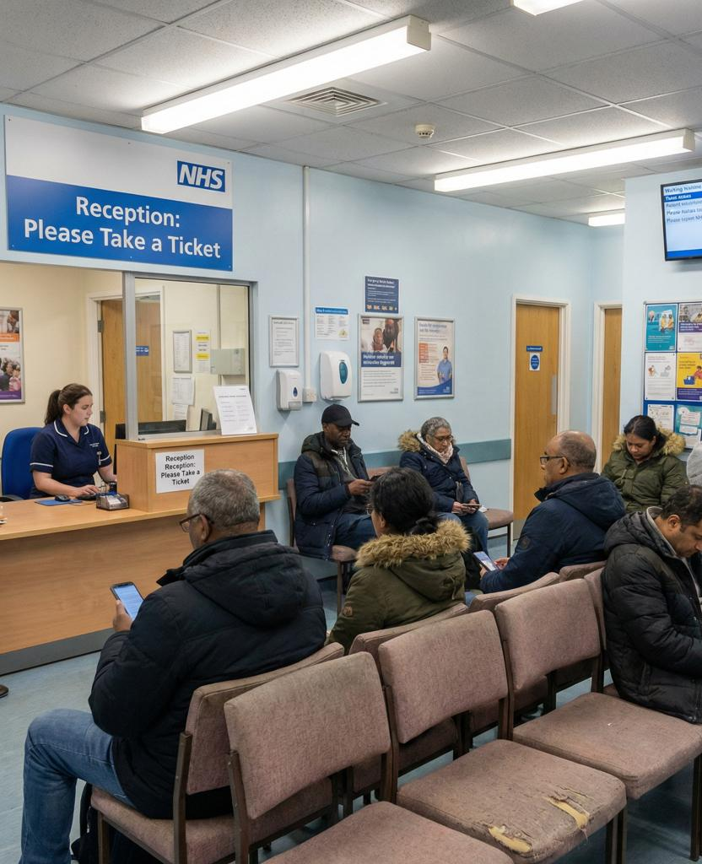
Community
The impact of the NHS App extends beyond individual patients, influencing families, carers and the wider community. While it has improved access to healthcare services, its wider benefits depend on digital inclusion and equal access to technology.
The NHS App has made routine healthcare services more accessible by allowing patients to manage appointments, prescriptions and health records online (NHS England, 2024).
Digital healthcare is not equally accessible to everyone. Older adults and some lower-income groups may experience barriers to using online NHS services because of limited digital access or skills (Office for National Statistics, 2023).
While the app can improve convenience, many patients still rely on family members or carers for digital support, increasing their responsibilities (Health Foundation, 2023).
Overall, the NHS App supports community access to healthcare, but its long-term success depends on reducing digital inequalities and ensuring healthcare remains accessible for everyone (Coulter, 2012).

Slide 7
Critical Analysis
Although the NHS App has become an important part of the NHS's move towards digital healthcare, the evidence suggests that its success should not be measured by app usage alone. Its overall effectiveness depends on wider organisational and social factors.
High app usage demonstrates adoption, but it does not provide sufficient evidence that patient care or health outcomes have improved (NHS England, 2024).
Claims that the NHS App has improved workforce efficiency should be interpreted cautiously, as improvements are also influenced by leadership, staff training, organisational readiness and digital infrastructure (Greenhalgh et al., 2017).
While the NHS App has made it easier for many people to access routine healthcare services, older adults, lower-income groups, and people with limited digital skills may still struggle to use it, making it harder for them to access the same healthcare services as others (The King's Fund, 2023; Office for National Statistics, 2023).
The available evidence does not support replacing traditional healthcare with digital services. Instead, the NHS App is most effective when it complements face-to-face care and is supported by wider NHS investment and inclusive implementation strategies (Atherton et al., 2018; Greenhalgh et al., 2017)

Slide 8

Recommendations
Based on this evaluation, the following recommendations could strengthen the effectiveness of the NHS App:
Improve digital inclusion by providing digital skills training and support for older adults and individuals with limited digital literacy (The King's Fund, 2023).
Maintain alternative routes to care, such as face-to-face and telephone services, to ensure healthcare remains accessible for all patients (Atherton et al., 2018).
Continue investing in staff training and digital infrastructure to maximise the benefits of digital healthcare (Greenhalgh et al., 2017; Department of Health and Social Care, 2022).
Monitor patient outcomes, not just app usage, to better evaluate the effectiveness of the NHS App in improving healthcare quality (NHS England, 2024).

Slide 9

CONCLUSION
This evaluation found that the NHS App has become an important part of the NHS's digital transformation by improving access to routine healthcare services. However, its success cannot be measured by app usage alone.
The NHS App has improved convenience and access for patients while supporting service delivery (NHS England, 2024).
Its effectiveness depends on staff training, organisational readiness and continued investment in digital infrastructure (Greenhalgh et al., 2017).
Digital exclusion remains a significant challenge, highlighting the need for inclusive healthcare that meets the needs of all communities (The King's Fund, 2023).
Overall, the NHS App is a valuable digital innovation, but its long-term success depends on delivering healthcare that is accessible, inclusive and sustainable for everyone.

Slide 10
REFERENCES
Alderwick, H., Dunn, P., Gardner, T., Mays, N. and Dixon, J. (2021) Will a new NHS structure in England help recovery from the pandemic? BMJ, 372, n248.
Atherton, H., Ziebland, S. and Campbell, J.L. (2018) The potential of digital communication to improve patient care: A systematic review. British Journal of General Practice, 68(669), pp. e221–e228.
Coulter, A. (2012) Engaging Patients in Healthcare. Maidenhead: Open University Press.
Department of Health and Social Care (2022) A Plan for Digital Health and Social Care. London: Department of Health and Social Care.
Greenhalgh, T., Wherton, J., Papoutsi, C., Lynch, J., Hughes, G., A'Court, C., Hinder, S., Fahy, N., Procter, R. and Shaw, S. (2017) Beyond adoption: A new framework for theorising and evaluating non-adoption, abandonment and challenges to the scale-up, spread and sustainability of health and care technologies. Journal of Medical Internet Research, 19(11), e367.
NHS (2024) NHS App.
NHS England (2024) NHS App Dashboard.
Nuffield Trust (2024) Getting the best out of the new world of remote and digital general practice.
Office for National Statistics (2023) Exploring the UK's Digital Divide.
The Health Foundation (2023) Developing Learning Health Systems in the UK: Priorities for Action.
The King's Fund (2023) Digital Technology and Health Inequalities: A Scoping Review.

Slide 11

THANK YOU!!

