Slide 1

THE ROLE AND IMPORTANCE OF QUALITY SERVICE, HOSPITALITY AND GUEST SERVICES
Student name: Stefano Di Guida
Hospitality and Guest Services
BMIH4003
Student’s ID: 2207147
Notes:
This is a presentation about the role and importance of quality of service, hospitality and guest services for Intercontinental, a brand that is part of the IHG Group.

Slide 2
Contents
Introduction
Brand Identity of Intercontinental
General Role of Guest Services
Guest Services Nature, Scope and Role at Intercontinental
The Role of Facilities
How Guests Services Complement Facilities
Meeting and Exceeding Expectations
Conclusion
Notes:
We are going to start with a brief introduction about the hotel and its brand identity. After this, we will find out what literature says about the general role of guest services, and we will see how Intercontinental makes use of guest services and facilities specifically. A brief discussion about service quality will follow, and how Intercontinental manages to meet and exceed expectations of customers. The conclusion will summaries the main points and ideas of this presentation.

Slide 3
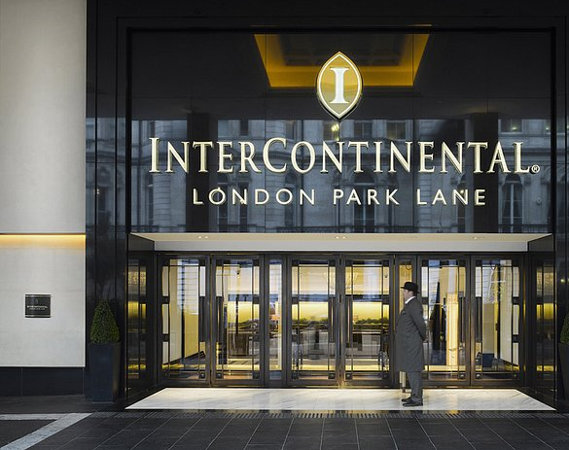
Introduction
InterContinental represents one of the most iconic hotels brands of the IHG Group
208 InterContinental hotels worldwide across all continents
The hotels combine personalised service and exclusive privileges to elevate experiences
(IHG ,2023;, Ribeiro da Cunha, 2007)
Notes:
The consumption of luxury services has been blossoming internationally. Intercontinental Hotel brand, also known as one of the most iconic hotels of the IHG Group represents one of the most luxurious brands of the world. As of January 2023, there were 208 InterContinental hotels worldwide across all continents. Because InterContinental Hotels & Resorts presents itself as one of the largest international luxury hotels, many customers arrive here with very high expectations. Furthermore, the focus of this presentation will fall upon understanding how the InterContinental Brand has created a very popular brand image and how the brand makes use of of quality service, hospitality and guest services to meet and exceed the expectations of their customers.

Slide 4
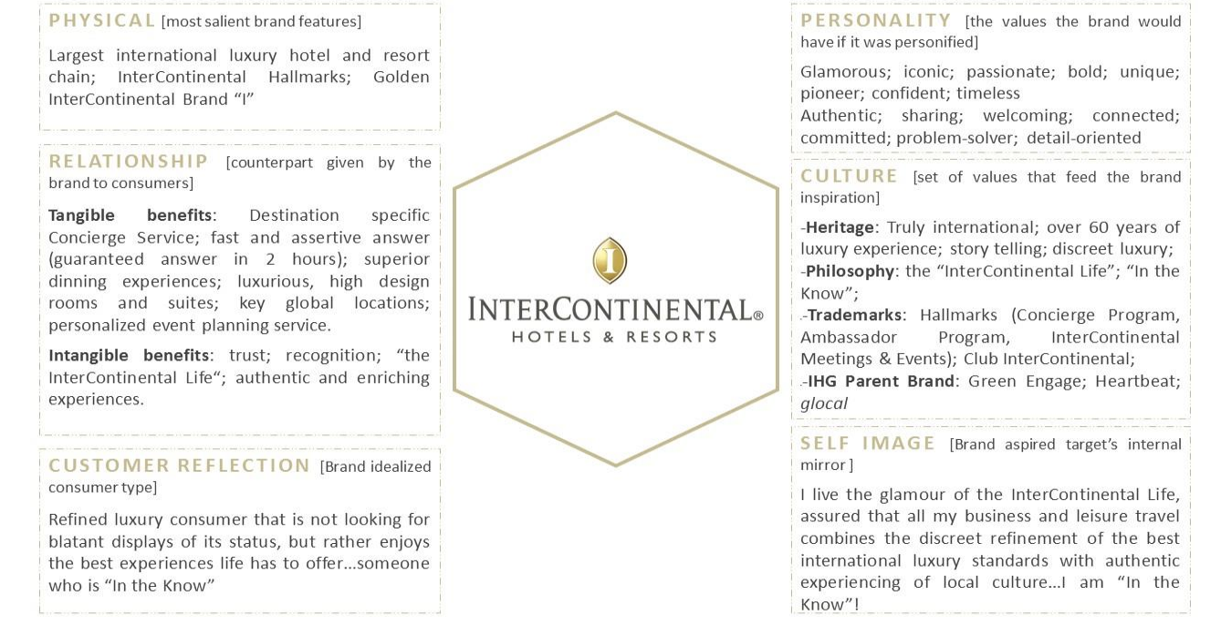
BRAND IDENTITY
(Ribeiro da Cunha 2017; Kapferer, 2015, IHG, 2017)
Notes:
In order to develop a deeper understanding of the brand, Ribeiro da Cunha (2017) established a comprehensive analysis of the brand identity and the current positioning that they hold within the market. When it comes to their physical assets, the brand boasts impressive achievements, such as being the largest international luxury chain.. They are also well known for both tangible and intangible benefits, such as dining experiences and high-end interior design, impressive architectural projects, each with a unique approach to the culture. They claim to offer intangible benefits such as trust and recognition to their customers.
The identity of the brand also comes with the type of customer that they target. Its market segment is known for wanting to gain high value from their travel, and they seek to experience authentic and welcoming experiences. Furthermore, this market segment has a higher budget, and the travel patterns include business travelling ten times a year with some leisure time throughout the seasons. Whilst the customers can be described as refined, they are not looking for display of the status but rather a more comfortable experience.
The values that brand holds “detail orientation”, “authentic”, “welcoming” are at the core of the services that they offer, and they are often integrated in everything that they do. They have a culture of heritage and sustainability as well as taking care of their employee.
Further in this presentation I will discuss how this brand image reflect in the services and facilities that they provide to their guests, and how these are integrated in the customer journey.

Slide 5
Guest services, general role and function general
"The assistance and advice provided by a hotel to those people who make reservations, stay and buy products and services at the hotel."
Step 1: proving safe, secure, clean, modern and comfortable accommodation.
1
Step 2: provide interaction and communication that rises above merely being polite and forms a relationship with the guest.
2
(Baek et al., 2020; Ariffin, 2018)
Notes:
Guest services are defined as the "The assistance and advice provided by a hotel to those people who make reservations, stay and buy products and services at the hotel.”. Essentially, guest service is how a hotel can respond when guests express a need or when things go wrong. Through guest services hotels can meet and exceed the expectations. Guest service is delivering experiences that at least meet, and hopefully exceed expectations. Fundamentally, this requires providing a safe, secure, clean, updated and comfortable accommodation, which of course is the starting point. Oftentimes, guest services require for all different departments, product and services to come together in order to deliver and make the guest feel that they are truly interacting with the hotel.

Slide 6
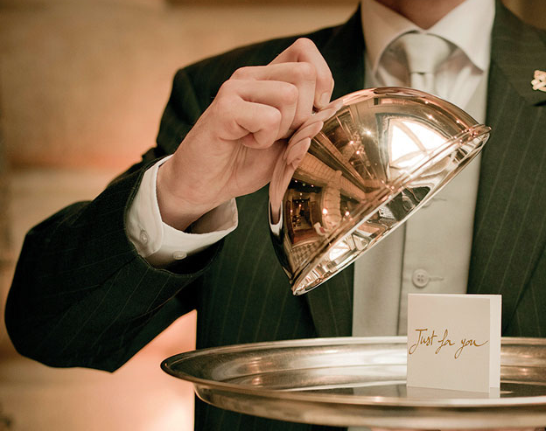
Guest Services of InterContinental: nature, scope and role
Depending on the hotel, the nature and scope of guest services can differ
At Intercontinental Brand, Guest Service play a central, supportive role, communicating both internally and externally with the wider hotel team and local expertise to ensure guests receive personalised experiences
Guest Services cover a wide range of activities including customer care, resolving issues with the bills, taking reservations for restaurants and local activities, arranges special requests and create rewards
(IHG, 2023; Ribeiro da Cunha, 2017)
Notes:
In every hotel, guest services play a supporting role, and the nature and scope of their actions may differ. When it comes to Intercontinental, the Guest Services team support all the other departments to ensure a guest is met with a genuine welcome and that their needs are attended throughout their stay. Guest services are there to ensures that the guests enjoy a laid-back but original and luxurious experiences without any fuss, and therefore a central scope for them is to premediate all needs. For instance, if a guest is there to celebrate a birthday, the guest services team will make all calls and arrangements to ensure that the person has a reservation at a restaurant, that they receive all letters and flowers in time. If a guest had an issue with their bill, the guest services will be there to assist and solve the issue.

Slide 7
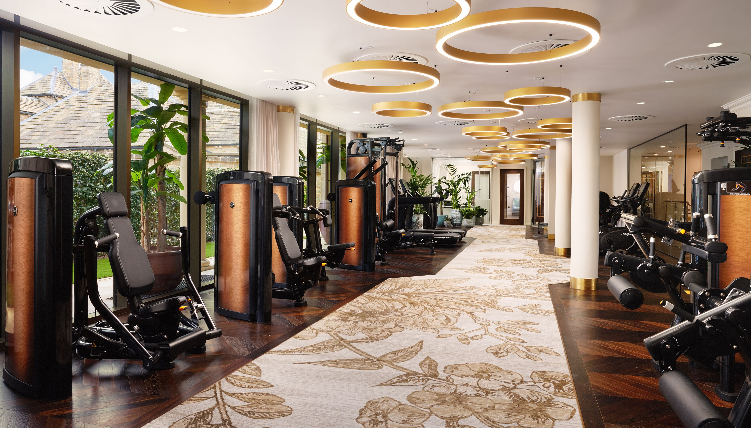

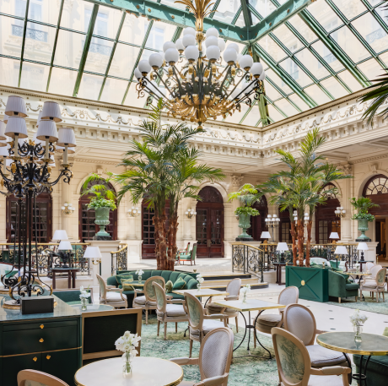
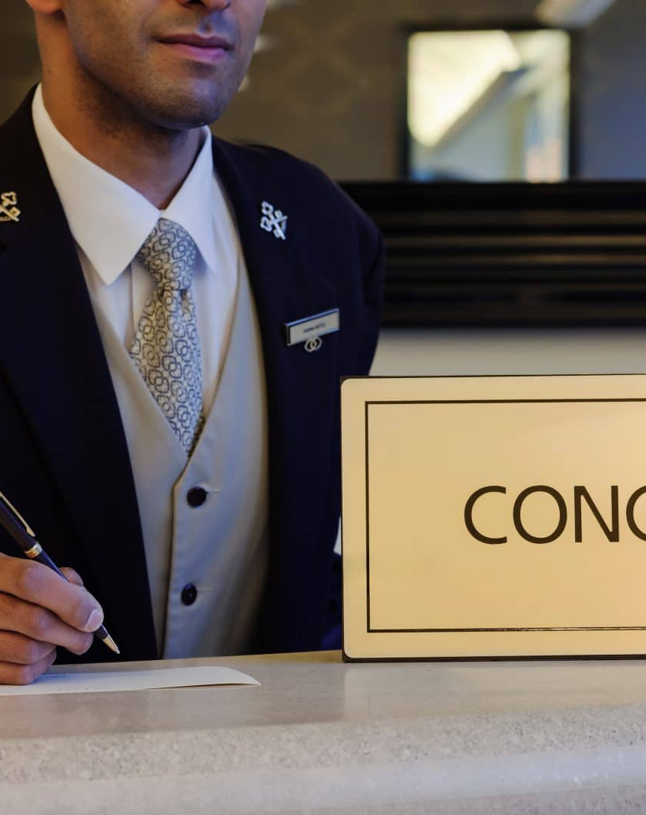
Facilities provided
Prime location
24h Concierge
Luxurious Spa
Gyms
Restaurants
They all provide overlapping comfort in order to meet guest expectations
Strategies focus on upgrading facilities regularly
(IHG, 2023, Heo et al., 2015)
Notes:
Part of InterContinental’s success may have something with do with with its prime location in burgeoning business districts, convention centers, and nearby shopping malls, which enhances its visibility and helps attract international conventioneers. Nevertheless, the hotel’s success depends heavily on its ability to provide high end facilities such as 24h Concierge, luxurious spa, gyms and restaurants, which all provide overlapping comfort in order to meet the guest’s expectation. Because of this, the brand has implemented visible strategies to upgrade facilities regularly in order to demonstrate that they provide the best possible service for customers. Furthermore, it has been argued that customer only rate tangible benefits such as facilities only sixth in rank based on contribute to service quality. Therefore, service quality does not mean only providing luxurious facilities but dealing with requirements effectively.

Slide 8
How Guests Services Complement the Facilities
Coyle and Dale (1993) identify other critical aspects that customers place before facilities
Problem solving was ranked the highest (e.g., being able to solve problems, having ability, responsibility and authority to put things right and if required, offer compensation)
Staff attitude (e.g., positive, can-do attitude)
Keeping promises (e.g., living up to expectations and being able to rely that things will be delivered )
(Lu et al., 2015; Coyle and Dale, 1993)
Notes:
To give more examples of how Guest Services support the operation of the hotel, complementing the facilities, Coyle and Dale (1993) identify other critical aspects that customers place before facilities. For instance, problem handling such as problems with the invoices and staff attitude as well as keeping promises are top critical aspects that customers consider.

Slide 9
Quality Service in Hospitality
Why is quality of service important in hospitality?
Gaining a sustainable competitive advantage in the highly competitive market
Gives the hotel a great chance to create competitive differentiation and gaining loyalty
How does Intercontinental ensure high rates of quality service?
Well known established loyalty program that helps memories guest information. Guest services use the information to create tailored experiences
Constantly upgrading and using a combination of high-end facilities and Guest Services to ensure a full experience
(Zhou et al, 2014, Brady et al., 2005)
Notes:
Furthermore, the delivery of quality service explains the need to consider the role and function of guest services in general. Delivering quality of service can help to gain a competitive advantage over the market and it gives the hotel and change to be different and gain loyalty. When it comes to Intercontinental, the guest services team do two things that help deliver outstanding service. Firstly, they use a loyalty program to memorize guest information, and they use that in order to tailor unique experiences. Secondly, they are constantly upgrading and reviewing their guest services in order to ensure an up-to-date full experience is created.

Slide 10
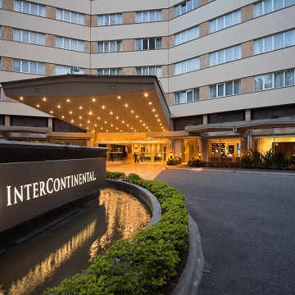
Conclusion
Guest Services at Intercontinental Group are critical in ensuring quality of service
core of the business that puts information together, they interact with the guest in order to create unforgettable experiences
They complement luxurious facilities for an experience that goes above the standard
This creates a positive brand image on a competitive market
Notes:
To conclude, the role of Guest Services at Intercontinental Group are critical in ensuring quality of service. They are the core of the business that puts information together, they interact with the guest in order to create unforgettable experiences. Combined with luxurious facilities The Guest Services allow for the customer to receive an experience that goes above the standard, and they establish customer satisfaction which contributes to business imagine, customer loyalty and provide sustainable advantage in the competitive market.

Slide 11
References:
Ariffin, A.A.M., Maghzi, A., Soon, J.L.M. and Alam, S.S., 2018. Exploring the influence of hospitality on guest satisfaction in luxury hotel services. E-review of Tourism Research, 15(1).
Baek, J., Choe, Y. and Ok, C.M., 2020. Determinants of hotel guests’ service experiences: an examination of differences between lifestyle and traditional hotels. Journal of Hospitality Marketing & Management, 29(1), pp.88-105.
Brady, M.K., Bourdeau, B.L. and Heskel, J., 2005. The importance of brand cues in intangible service industries: an application to investment services. Journal of services marketing
Coyle, M.P. and Dale, B.G., 1993. Quality in the hospitality industry: a study. International Journal of Hospitality Management, 12(2), pp.141-153.
Heo, C.Y. and Hyun, S.S., 2015. Do luxury room amenities affect guests’ willingness to pay?. International Journal of Hospitality Management, 46, pp.161-168.
IHG. 2017. The Uncompromising Customer: Addressing the Paradoxes of the Age of I
IHG. 2023. Live the Intercontinental Life. [online] Available at:https://www.ihg.com/intercontinental/hotels/gb/en/reservation [Accessed on 31 January 2023]
Kapferer, J.N. 2015. Kapferer on Luxury: How Luxury Brands can Grow Yet Remain Rare. London: Kogan Page
Lu, C., Berchoux, C., Marek, M.W. and Chen, B., 2015. Service quality and customer satisfaction: qualitative research implications for luxury hotels. International Journal of Culture, Tourism and Hospitality Research, 9(2), pp.168-182.
Zhou, L., Ye, S., Pearce, P.L. and Wu, M.Y., 2014. Refreshing hotel satisfaction studies by reconfiguring customer review data. International Journal of Hospitality Management, 38, pp.1-10.

