Slide 1






INTERNATIONAL HOTEL MGMT
Operating Hotel Facilities
Pitching your idea!
Week 8

Slide 2

News
Learning Outcomes
Assignment 3
Pitching
Presentation Statistics
The Rule of 3
How to start a pitch
How to give the perfect pitch
The pitch canvas
Booking a slot
References
Content Summary
PITCHING AN IDEA

Slide 3

MODULE FEEDBACK
Take 10 minutes to complete the module evaluation form on Moodle…
Please complete the module feedback form on Moodle. It is really important that we hear your voice! Tell us what you thought!
NEXT WEEK…
Book your slots on Moodle for your presentations, if you haven’t already. You will receive a Teams invite for your individual slots. You will only need to present for your allocated slot. Be ready to share your presentation and ensure it has been uploaded on Turnitin prior to you presenting it.

Slide 4
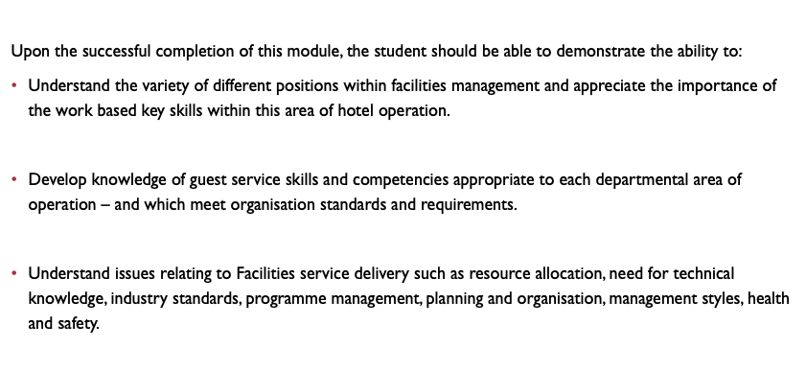



Learning Outcomes

Slide 5
Ensure you sign-up for your slot on Moodle.
Assignment 3
NEXT WEEK
A hotel’s employees often are the first defence in the profitability game. A lack of engagement in their respective roles or during guest interactions can lead to declining customer satisfaction, and in turn, decreasing profitability power. And in such a high-turnover industry as hospitality, successfully engaging with and retaining team members can prove challenging. It is your task, as an Associate of Hotel Trinity, to convince the General Manager that employee engagement is critical in the success of the hotel. You are therefore recommending to hold a staff engagement event / party.
Your task is to create and prepare a pitch (10mins) that you will present to the General Manager of Hotel Trinity, detailing your event design proposal and rationale for a Staff party.
Notes:
An opportunity to be creative – let’s see your ideas! What will the event design look like? Consider catering, content, entertainment, environment, production, programme / activities and theme. Create a presentation (PowerPoint / Canva / Prezi / Keynote) to pitch your event design idea to the General Manager. Consider effective pitching skills, like the Rule of 3, relating your ideas to business needs and using persuasiveness, and how you will incorporate these skills when pitching to the GM. Consider the design domain of the EMBOK model, when pitching your design, along with other sources of literature. Include theoretical evidence of the benefits of employee engagement. You must include one engagement theoretical model to include and discuss within your pitch. Ensure your pitch is well-paced and enjoyable.

Slide 6
Notes:
This guide has been placed on Moodle.

Slide 9
LIST OF INSPIRATIONAL VIDEOS TO WATCH :
How to give the perfect pitch - with TedX speech coach David Beckett https://youtu.be/Njh3rKoGKBo
Science Of Persuasion https://youtu.be/cFdCzN7RYb
How To Eliminate Stress And Anxiety FOREVER - Srikumar Rao https://youtu.be/uLDz7emCnZI
How To Improve Self Esteem - Marisa Peer Motivational Video https://youtu.be/2i0E12PbGCg
Start with why - how great leaders inspire action - Simon Sinek | TEDxPugetSound https://youtu.be/u4ZoJKF_VuA
How to speak so that people want to listen - Julian Treasure https://youtu.be/eIho2S0ZahI
Your Body Language May Shape Who You Are - Amy Cuddy https://youtu.be/Ks-_Mh1QhMc
The Business Model Canvas - 9 Steps to Creating a Successful Business Model https://youtu.be/IP0cUBWTgpY
Steve Jobs' 2005 Stanford Commencement Address https://youtu.be/UF8uR6Z6KLc
Steve Jobs - iPhone Introduction in 2007 https://youtu.be/9hUIxyE2Ns8
Think Fast. Talk Smart - Matt Abrahams - TEDxMontaVistaHighSchool https://youtu.be/o3K_HbpWNpg
The art of innovation - Guy Kawasaki - TEDxBerkeley https://youtu.be/Mtjatz9r-Vc
The 110 techniques of communication and public speaking - David JP Phillips https://youtu.be/K0pxo-dS9Hc
Nancy Duarte uncovers common structure of greatest communicators https://youtu.be/1nYFpuc2Umk
The magical science of storytelling - David JP Phillips - TEDxStockholm https://youtu.be/Nj-hdQMa3uA
Know You Can Have It All - Marisa Peer https://youtu.be/IKeaAbM2kJg

Slide 10




Slide 11
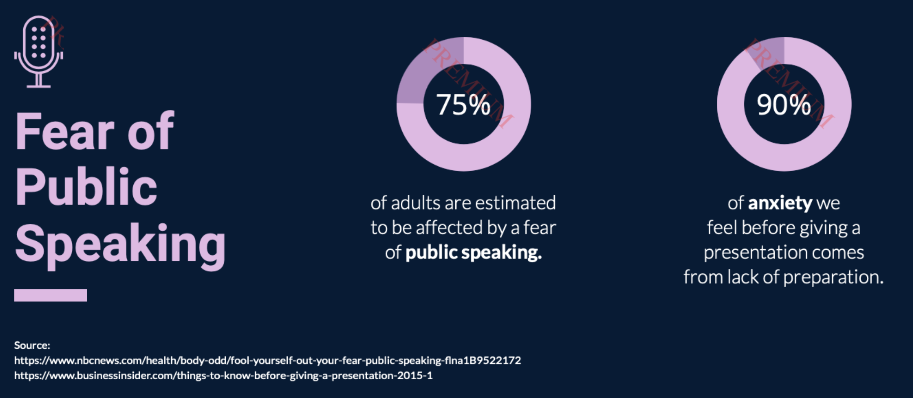




75%
90%

Slide 12
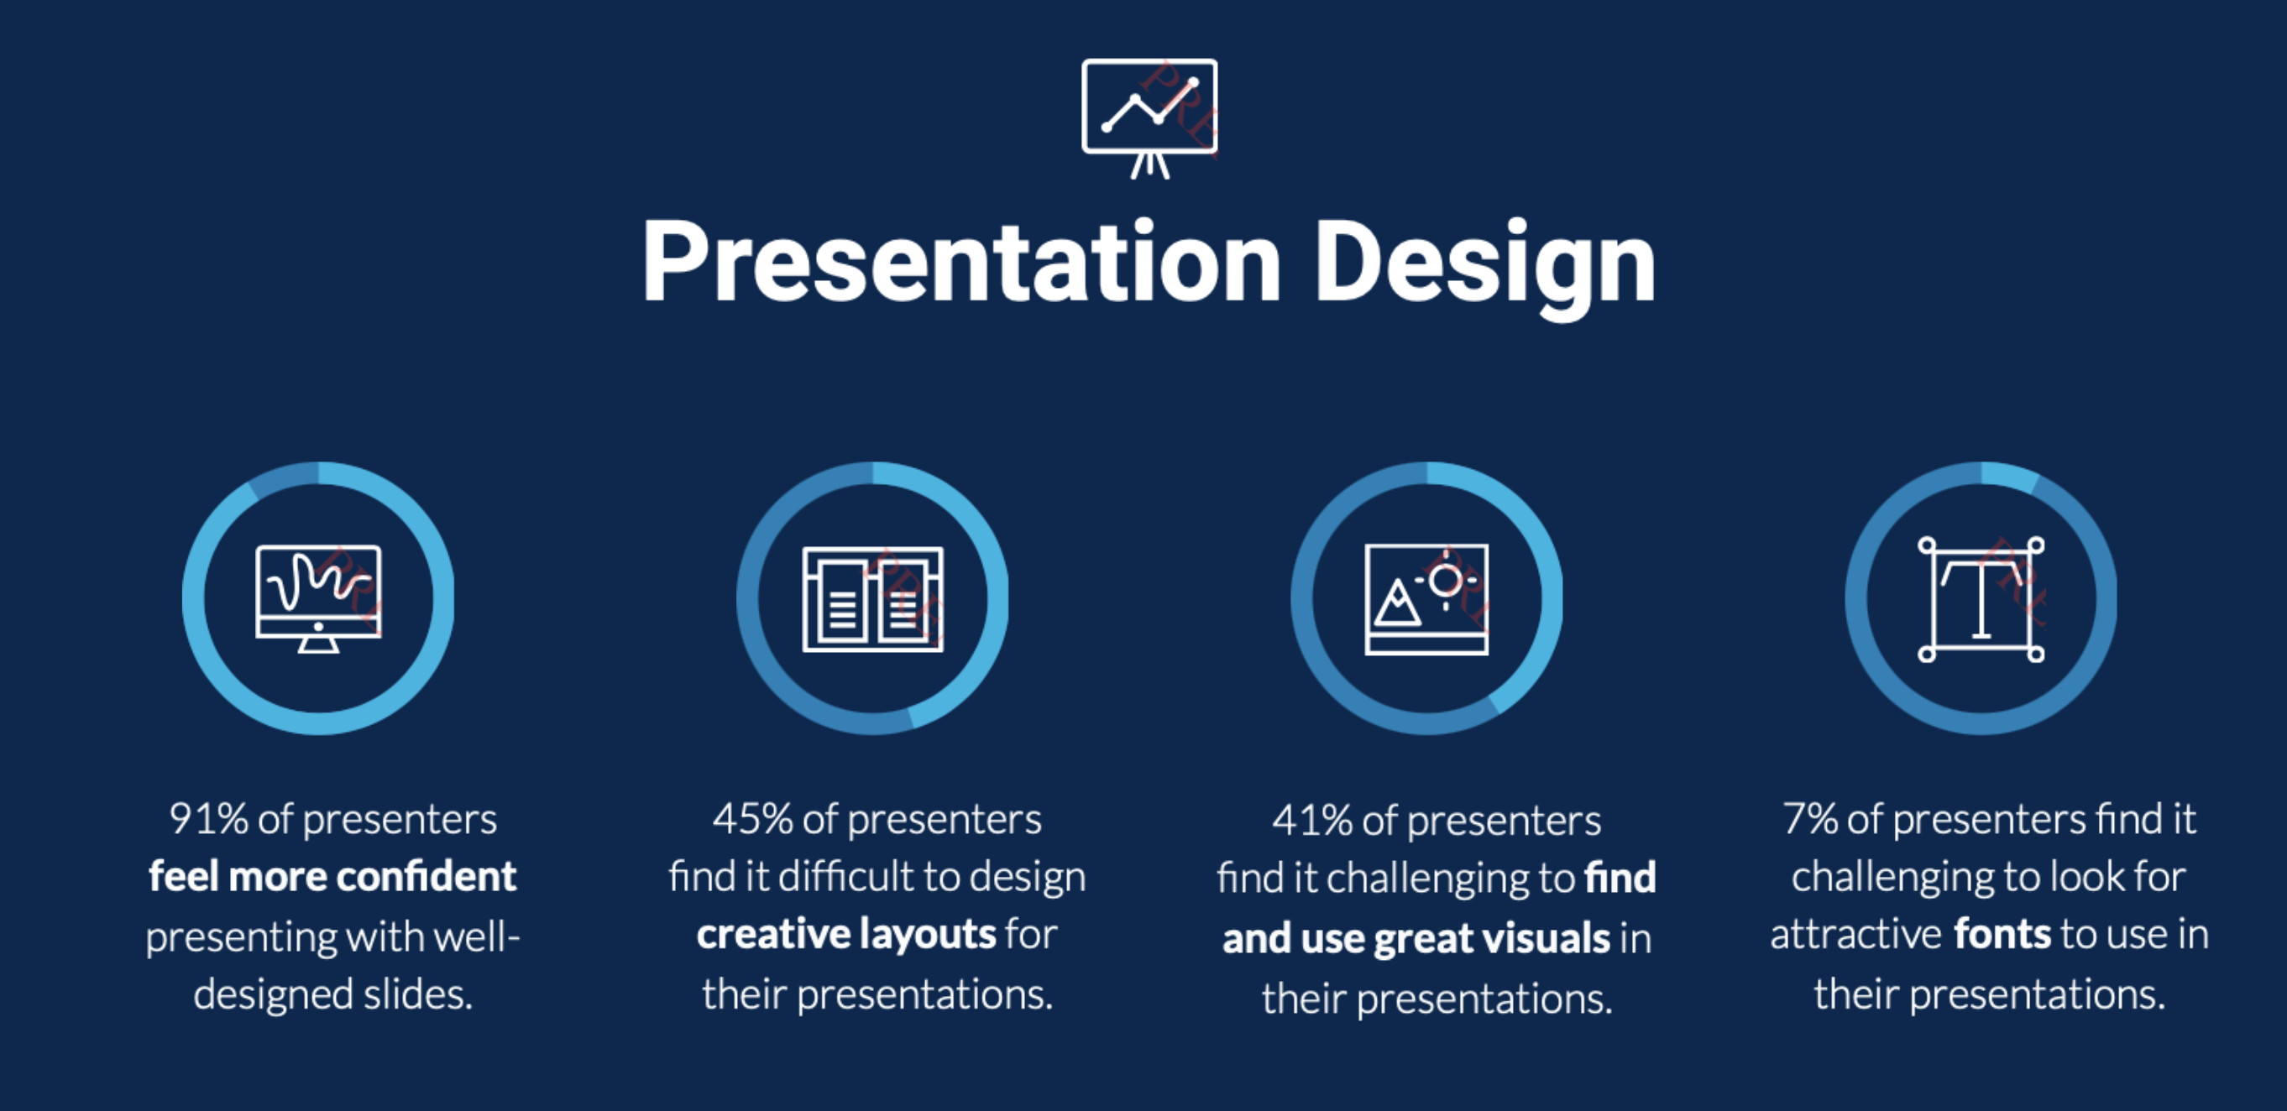

Slide 13
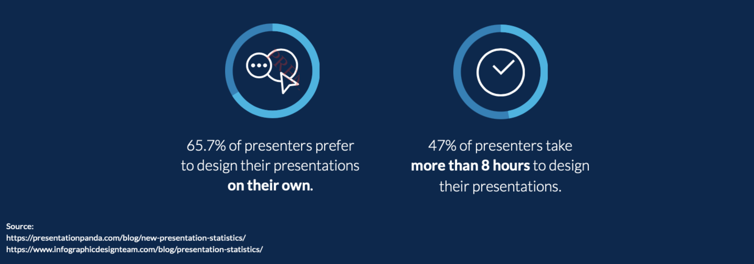

Slide 14
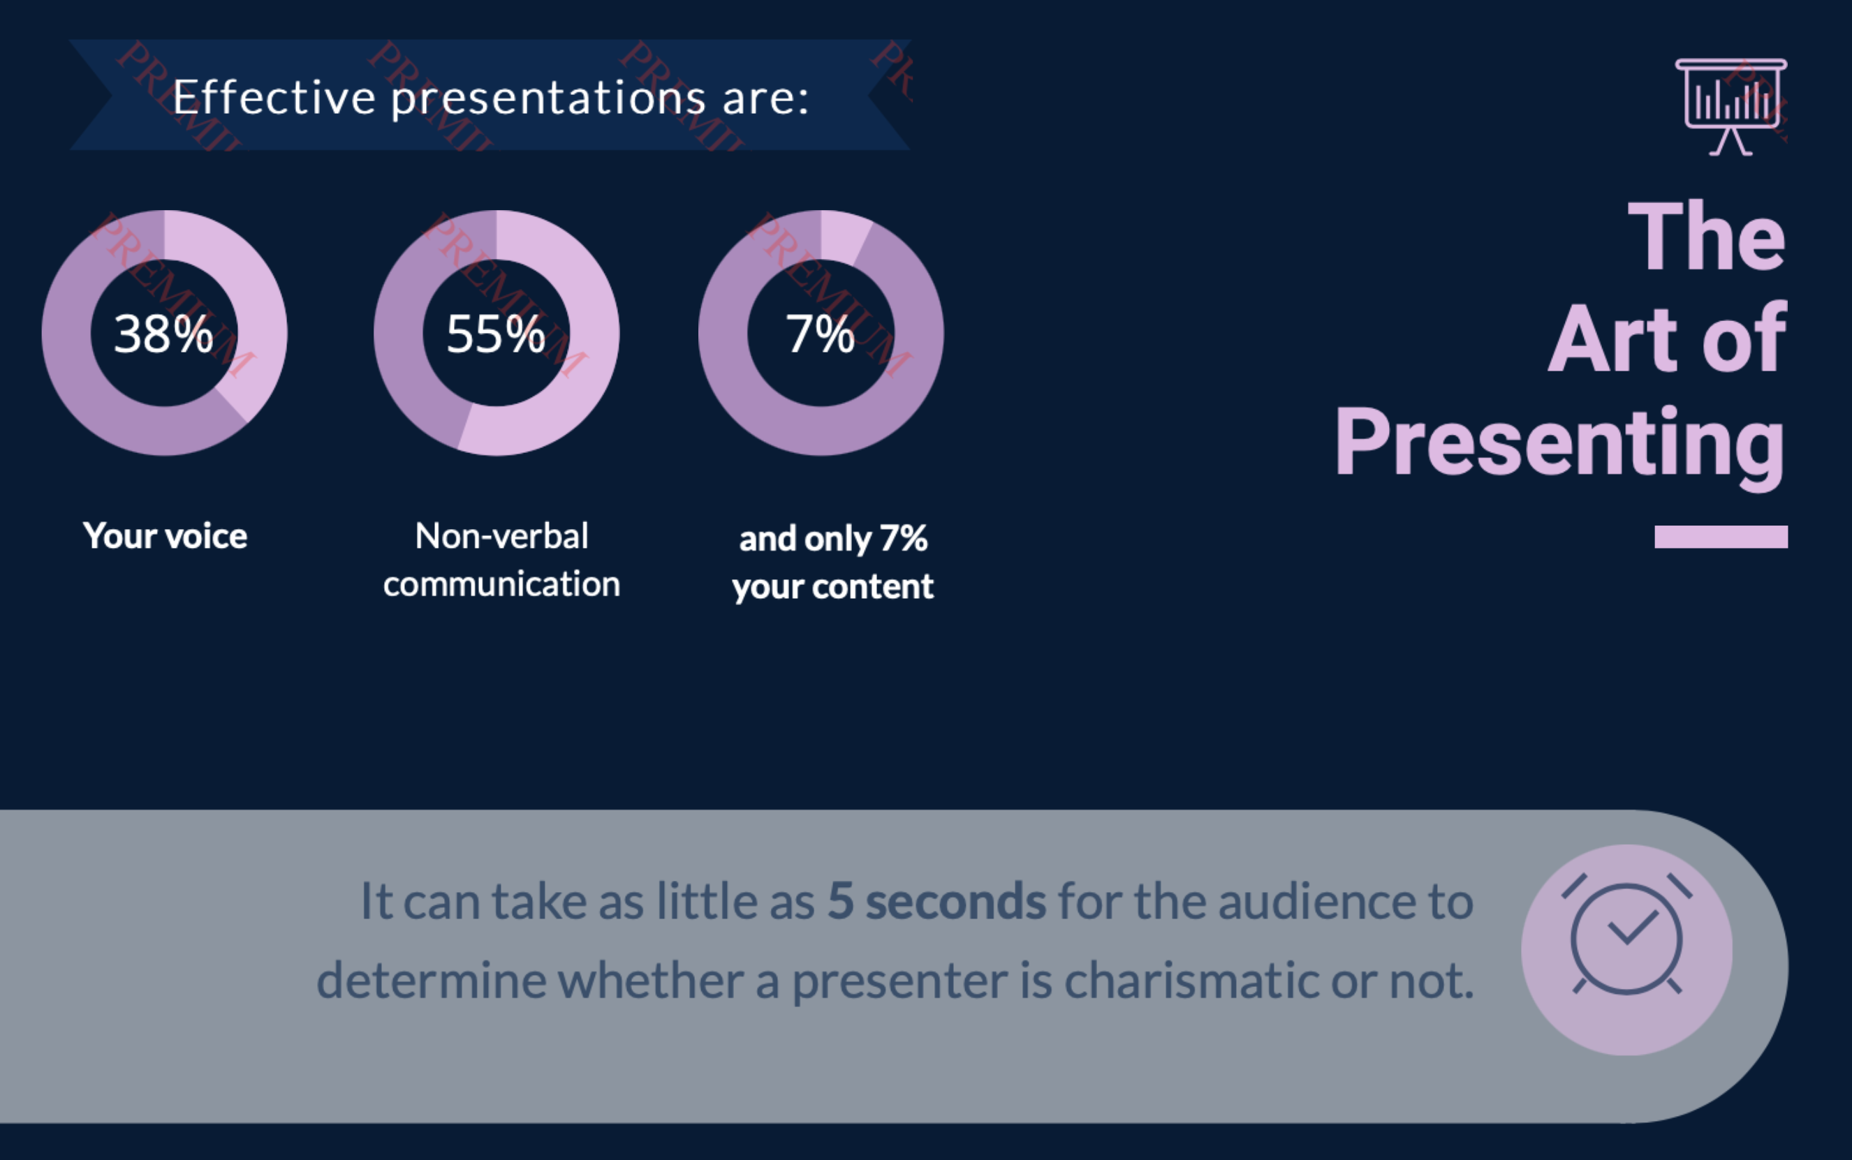
Effective presentations are:
38%
55%
7%

Slide 15
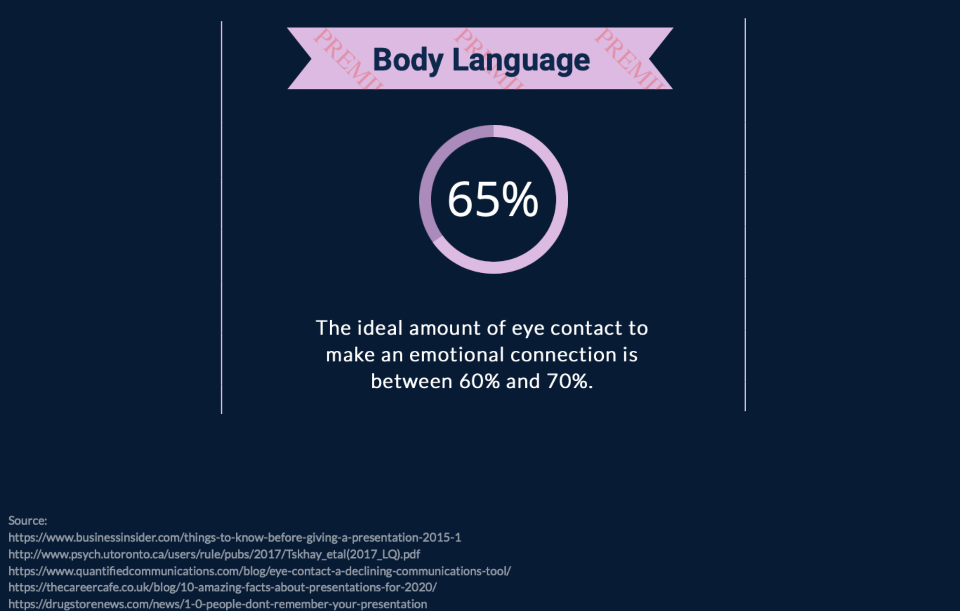
Body Language

Slide 16
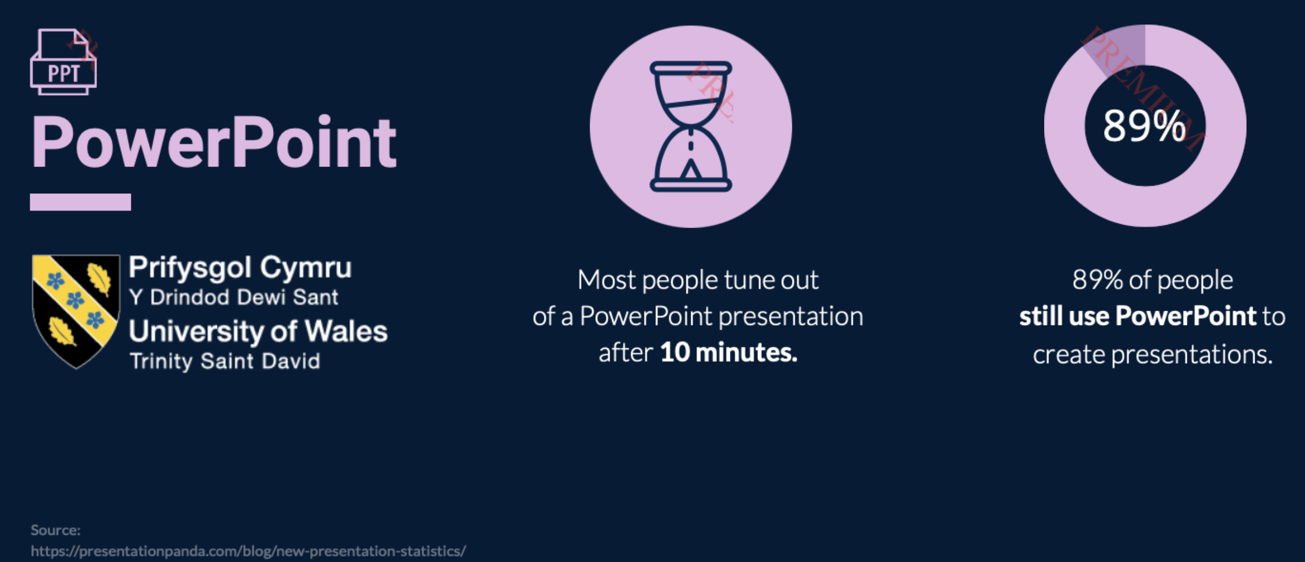
10m
89%

Slide 17
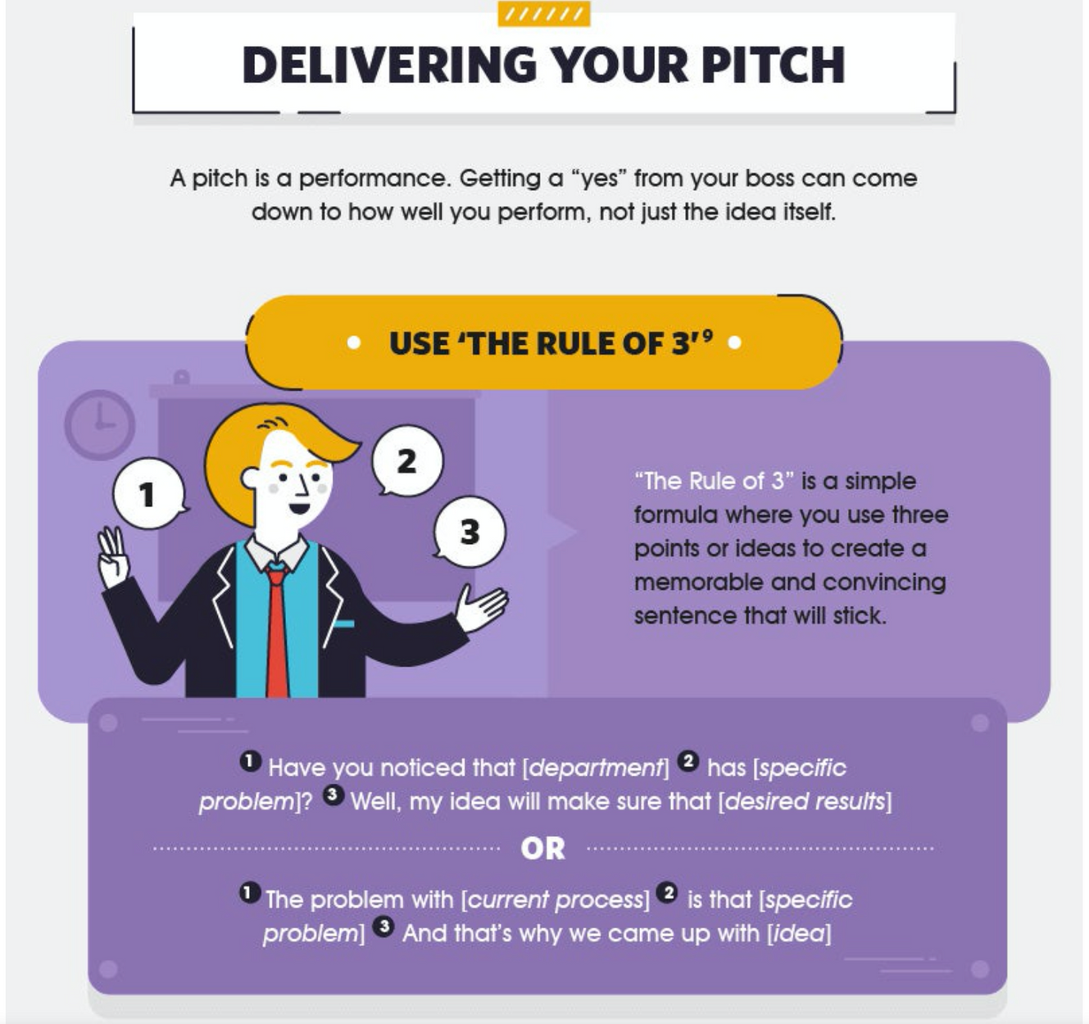
The Rule of 3
(LEADEM, 2017)
Notes:
Have you noticed that our team don’t seem very engaged at the moment? Well, my idea will make sure that we turn that around!
Or
The problem with covering shifts is that our team don’t feel part of a family. And that’s why I came up with A December to Remember!

Slide 18
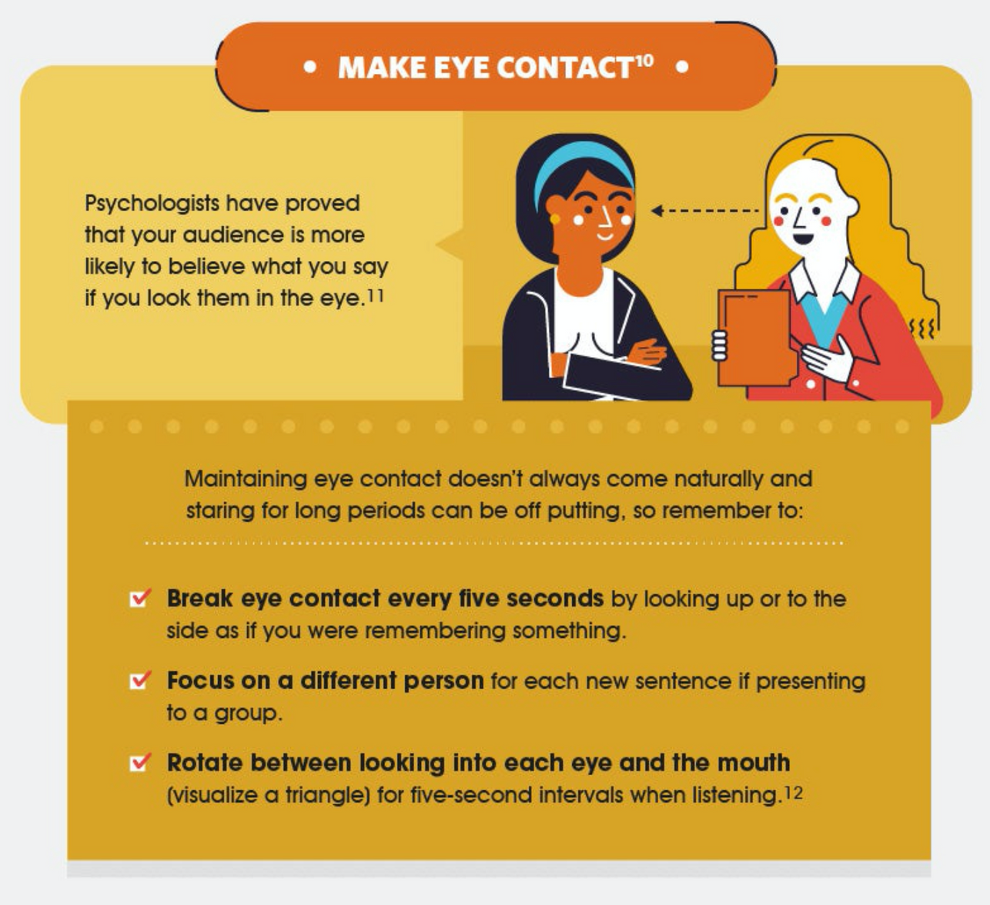
Pitching your idea...
(LEADEM, 2017)

Slide 19
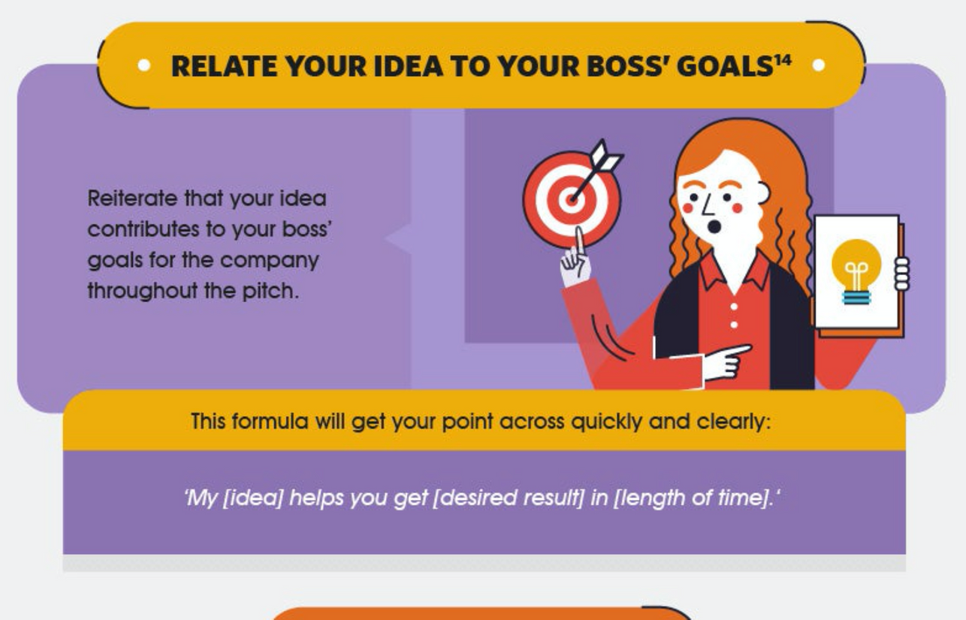
Pitching your idea...
(LEADEM, 2017)
Notes:
A December to Remember will help you achieve growth on our Team engagement target this year and will also create a platform to continue engaging with our team next year and beyond.
Next slide (automatic play):

Slide 20
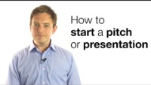
Notes:
Dominic from https://inflow.global​ here with two simple ideas about how to start your pitch or presentation. #1. Dispense with the niceties! Too may people start their presentations and speeches with boring small talk. If you want to get your audience off their iPhones and Blackberries you need to grab their attention, so dispense with all the niceties and get them to engage with what you are saying straight away. #2. Start with a bang! Do something a little bit different when you start your speech. I don't mean anything crazy, so no big stunts! What I mean is start with something that captures the imagination. Start with a fact, with a figure, with a quote, with a story, maybe a bit of video or a bit of music; something that’s going to really get them engaged. You want people to realise that you have started and for them to start paying you the attention you deserve.

Slide 21

Notes:
Pitching in the Dragons' Den has proved to be a tricky task for many entrepreneurs over the years. Whether it’s nerves, a poor product or just a grumpy dragon holding a contestant back, a bad pitch is usually TV comedy gold. Here’s the 4 most disastrous pitches and biggest fails ever in the Dragons' Den.

Slide 22
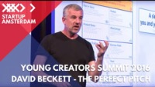
BECKETT (2016)
HOW TO GIVE THE PERFECT PITCH
Notes:
At the Young Creators Summit 2016 in Amsterdam, David Beckett talks about how to give the perfect pitch. And if you want your ideas to have impact, you need to make sure that they are heard.
As an experienced pitch and TedX speech coach, David shares his insights on how to pitch and get your ideas heard. According to four principles, his 'Open, three, close' Model and The Pitch Canvas, he explains how to get your audience to engage with your story.
Have you ever heard of the crocodile brain? How many words do you think fit into a 3 minute pitch?
David Beckett explains all..

Slide 23
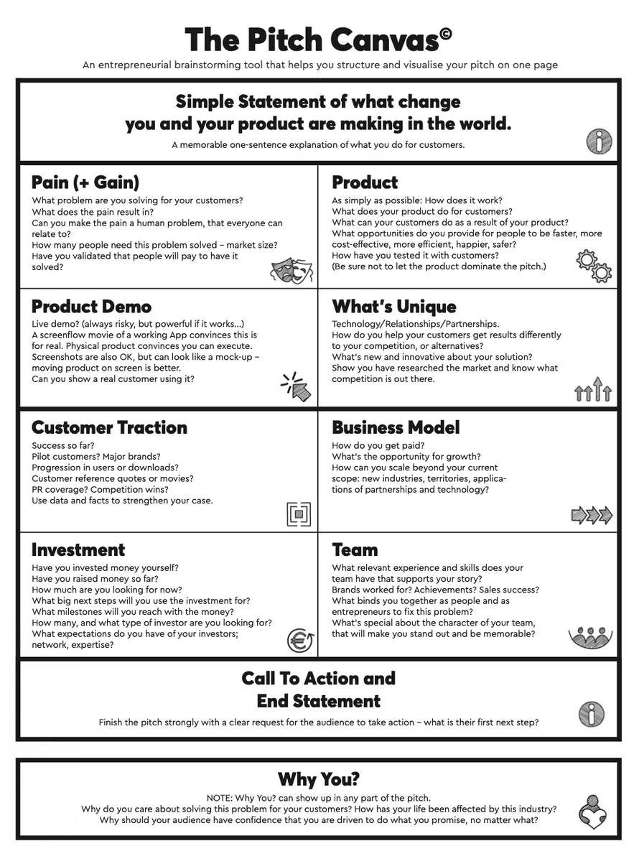
BECKETT (2016)
HOW TO GIVE THE PERFECT PITCH
THE PITCH CANVAS
Available on Moodle & Teams

Slide 24
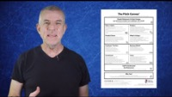

Slide 25
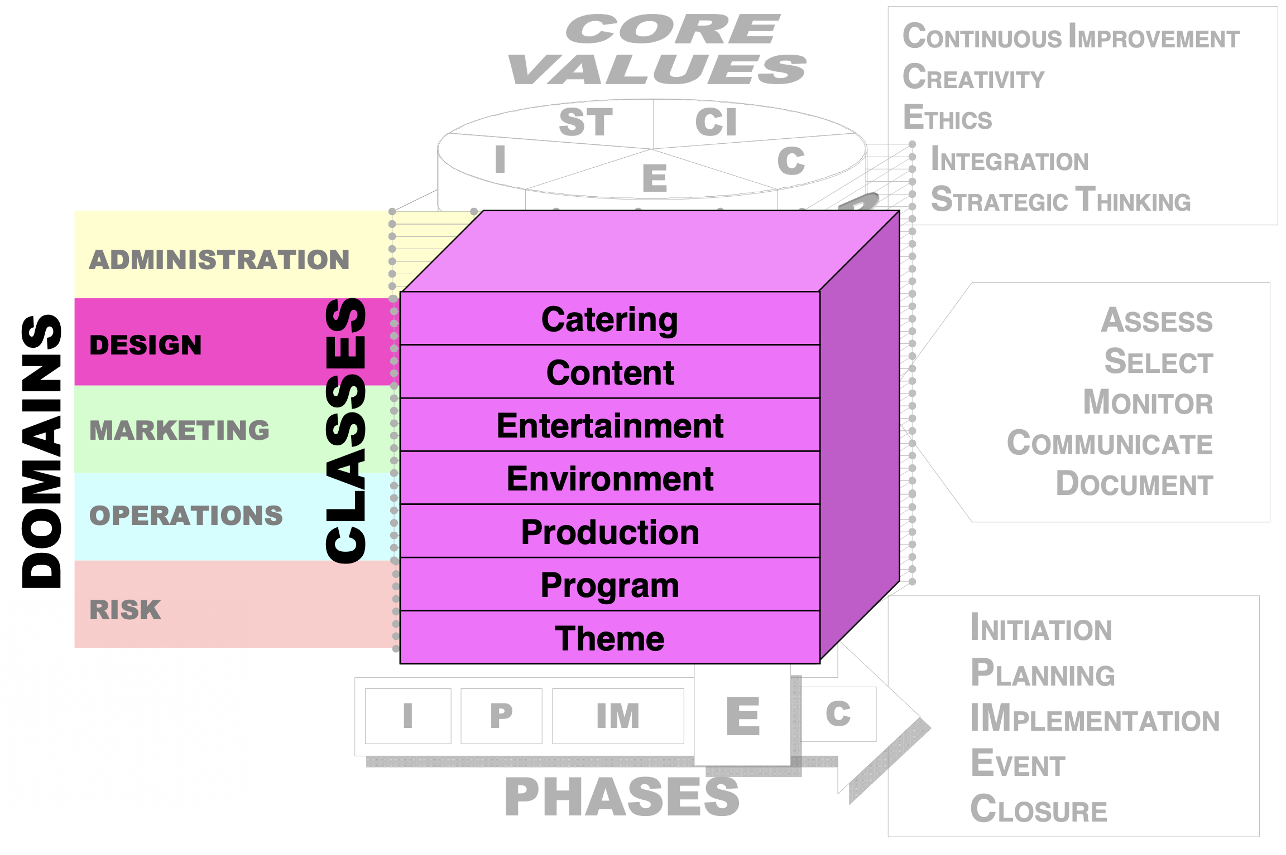

Slide 26
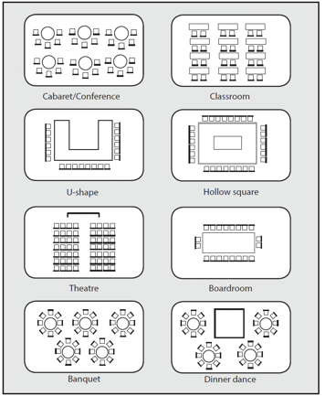
Which layout is
Appropriate for
Your event?
Why?

Slide 27
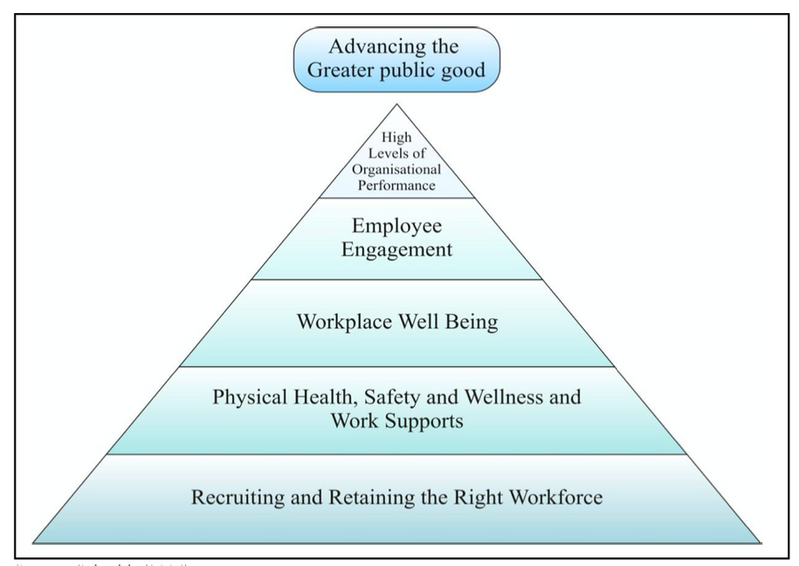
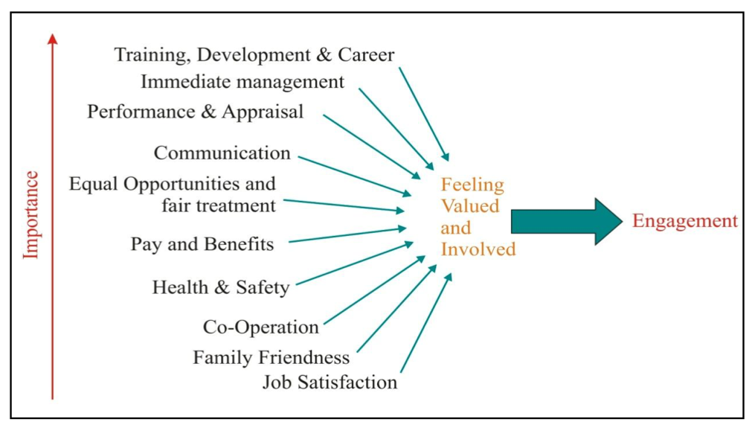

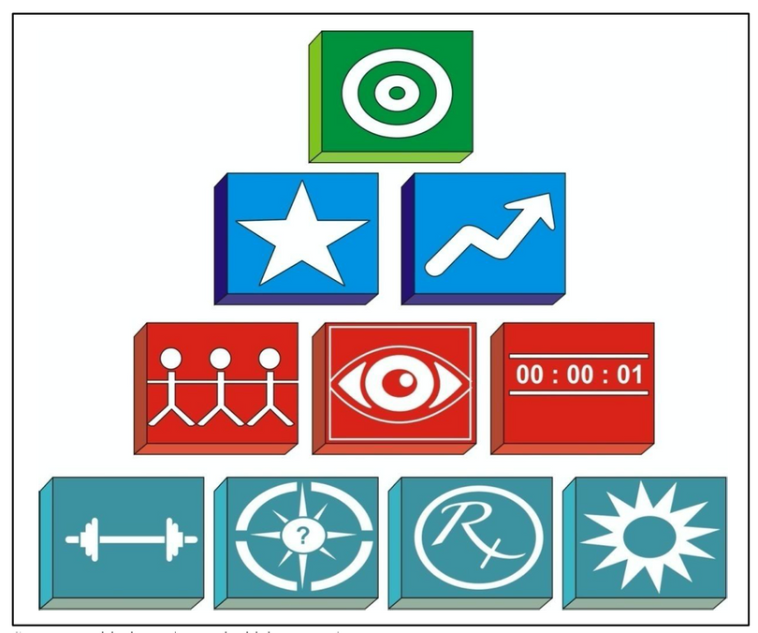
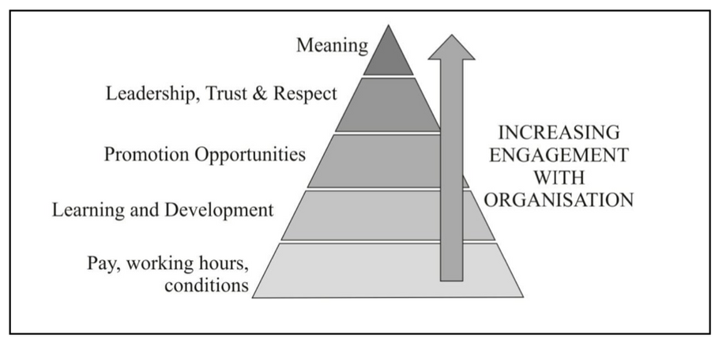
Consider the engagement models...
This is relating to the business needs.

Slide 28
Ensure you sign-up for your slot on Moodle
Assignment 3
NEXT WEEK
A hotel’s employees often are the first defence in the profitability game. A lack of engagement in their respective roles or during guest interactions can lead to declining customer satisfaction, and in turn, decreasing profitability power. And in such a high-turnover industry as hospitality, successfully engaging with and retaining team members can prove challenging. It is your task, as an Associate of Hotel Trinity, to convince the General Manager that employee engagement is critical in the success of the hotel. You are therefore recommending to hold a staff engagement event / party.
Your task is to create and prepare a pitch (10mins) that you will present to the General Manager of Hotel Trinity, detailing your event design proposal and rationale for a Staff party.
Notes:
An opportunity to be creative – let’s see your ideas! What will the event design look like? Consider catering, content, entertainment, environment, production, programme / activities and theme. Create a presentation (PowerPoint / Canva / Prezi / Keynote) to pitch your event design idea to the General Manager. Consider effective pitching skills, like the Rule of 3, relating your ideas to business needs and using persuasiveness, and how you will incorporate these skills when pitching to the GM. Consider the design domain of the EMBOK model, when pitching your design, along with other sources of literature. Include theoretical evidence of the benefits of employee engagement. You must include one engagement theoretical model to include and discuss within your pitch. Ensure your pitch is well-paced and enjoyable.

Slide 29
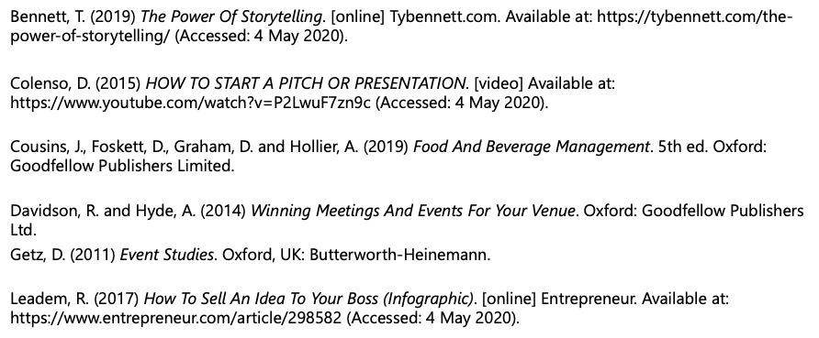
Reference List
Beckett, D. (2016) How To Give The Perfect Pitch - With Tedx Speech Coach David Beckett - Young Creators Summit 2016. [video] Available at: <https://www.youtube.com/watch?v=Njh3rKoGKBo> (Accessed: 20 October 2020).

Slide 30
INTERNATIONAL HOTEL MGMT
Operating Hotel Facilities
Pitching your idea!
Week 8
Notes:
Recordings can be found on Teams.

