Slide 1

Natural resources
ACNA6005 (Sustainable Urban Communities)
ACBA7009 (Sustainable Development)
Lara Hopkinson

Slide 2

Outline
Why do we need to protect our resources?
Examples
Categories
Impacts of over-consumption
Human needs vs wants
Critical materials overview

Slide 3

Why do these need protection?

Slide 4
Why do we need to protect?
Managing resources for the good of all
  Animal, plant, water, atmosphere
“provide resources for the present population without compromising availability for future generations”
“without causing environmental damage that challenges survival of other species & natural ecosystems”

Slide 5
Examples of natural resources
Natural resource | Ways in which used
Air | Generate energy
Animals | Food, clothing
Coal | Heating, electricity
Minerals | Medicines, technology
Oil | Fuel, electricity
Plants | Wood, paper, cotton
Sun | Energy, photosynthesis
Soil | Crops

Slide 6
Categories of natural resources
Non-renewable and renewable
  Replenished over significant period vs replenished quickly
Abiotic and biotic
Actual and potential
Ubiquitous and localised

Slide 7
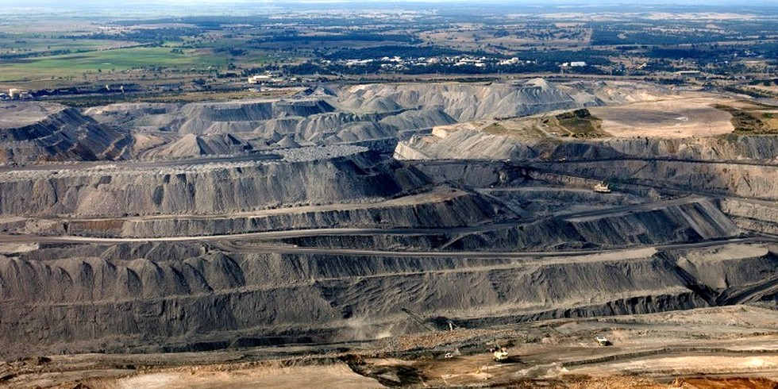
Impacts of overconsumption

Slide 8
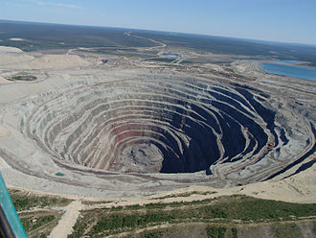
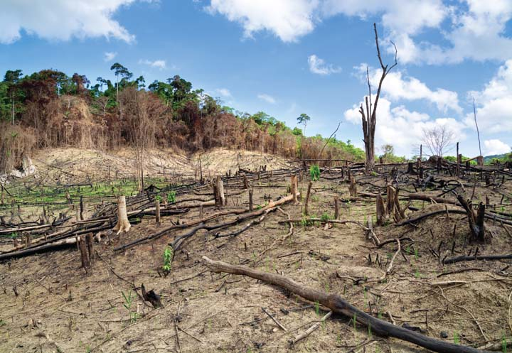

Slide 9
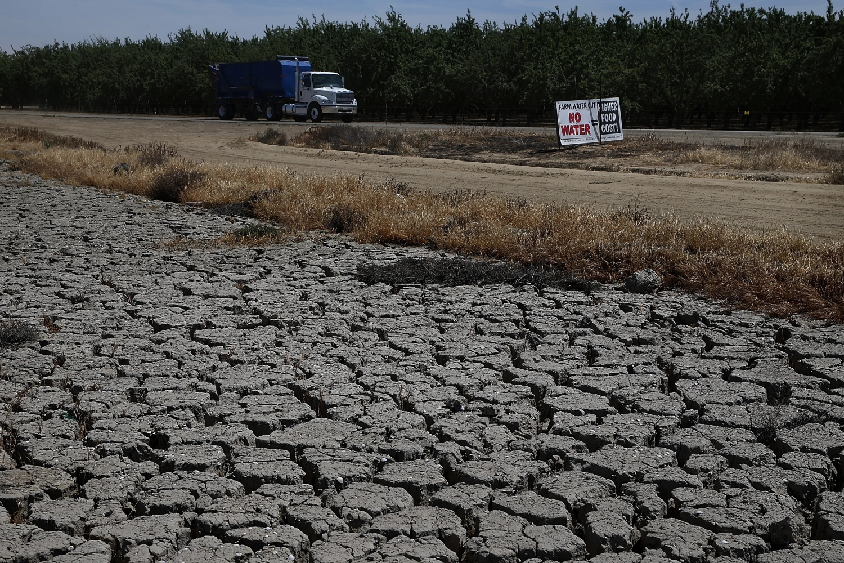

Slide 10


Slide 11


Slide 12

Consumerism = happiness?

Slide 13
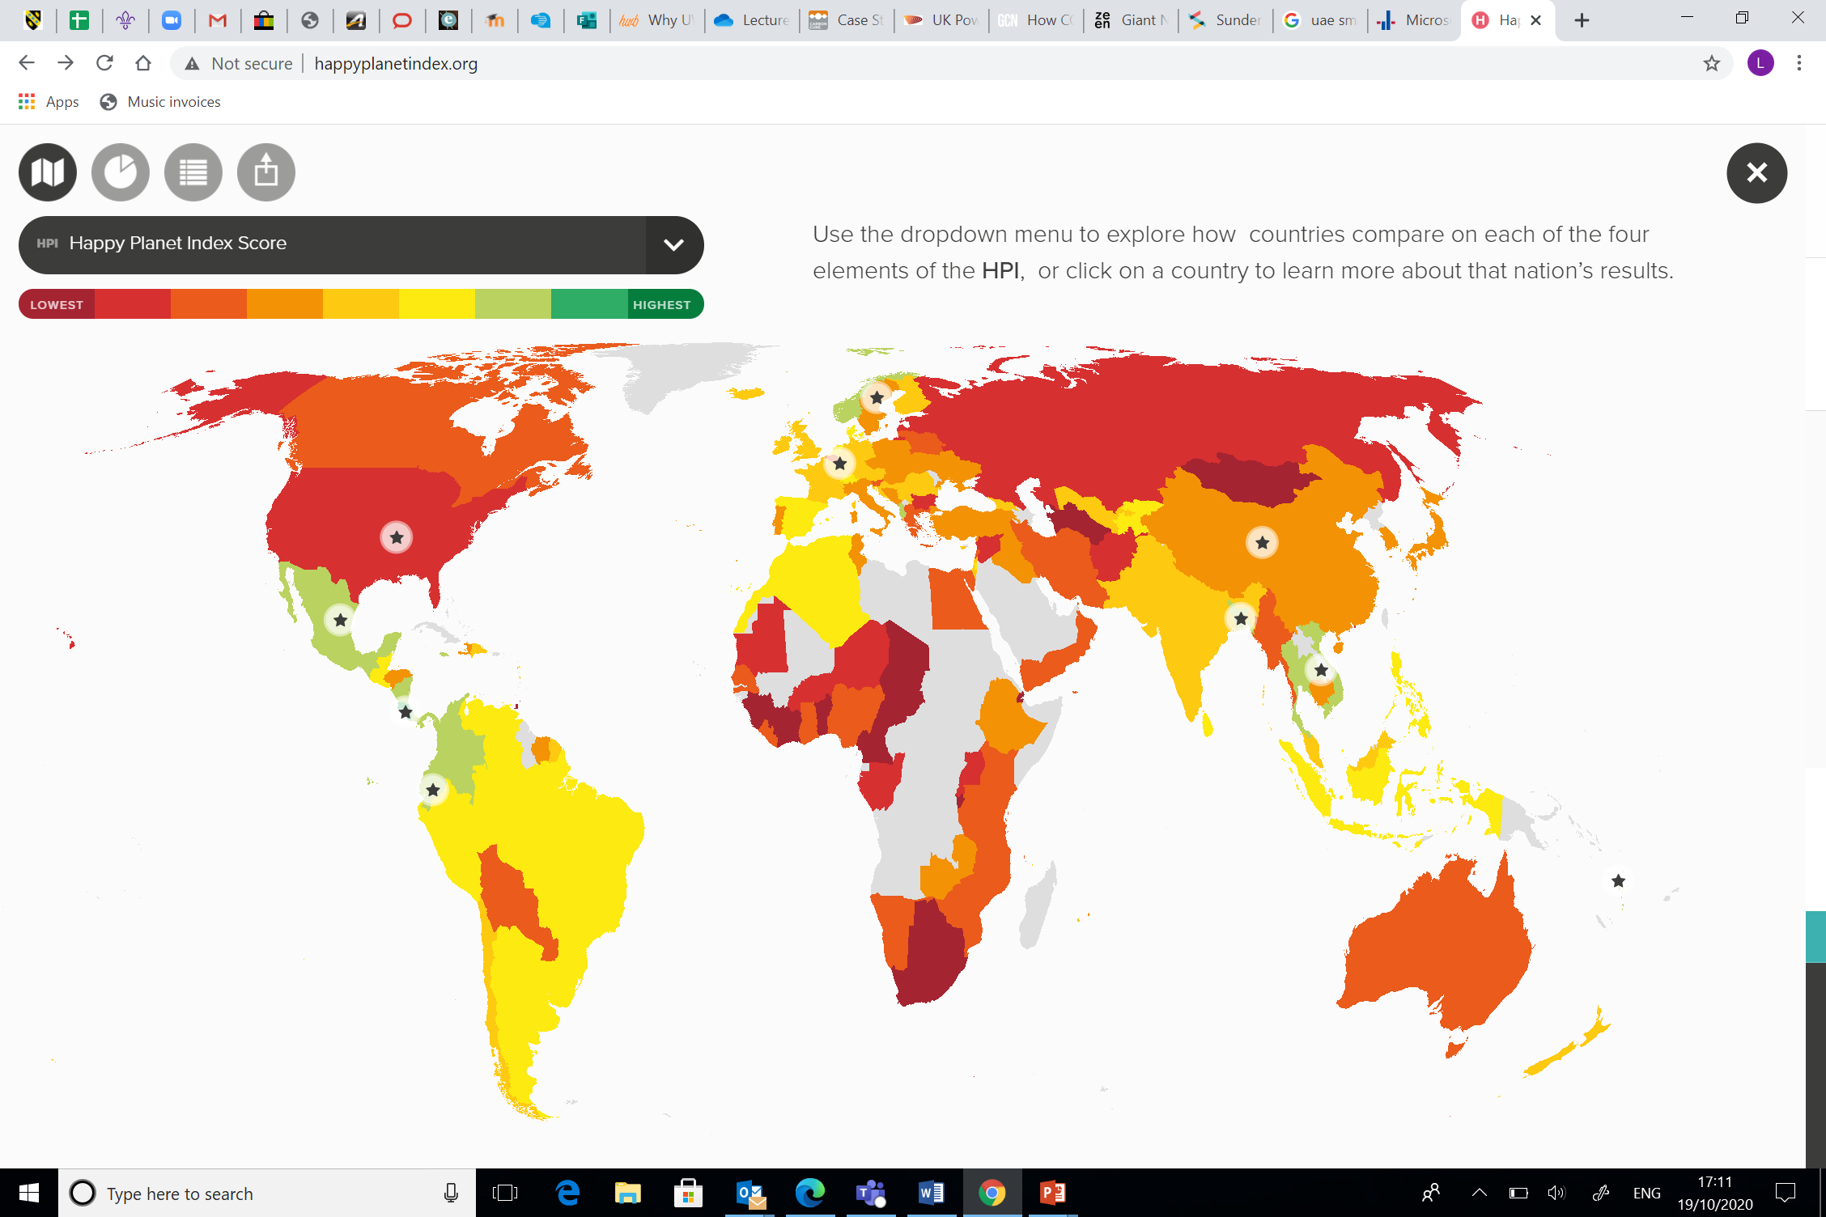

Slide 14
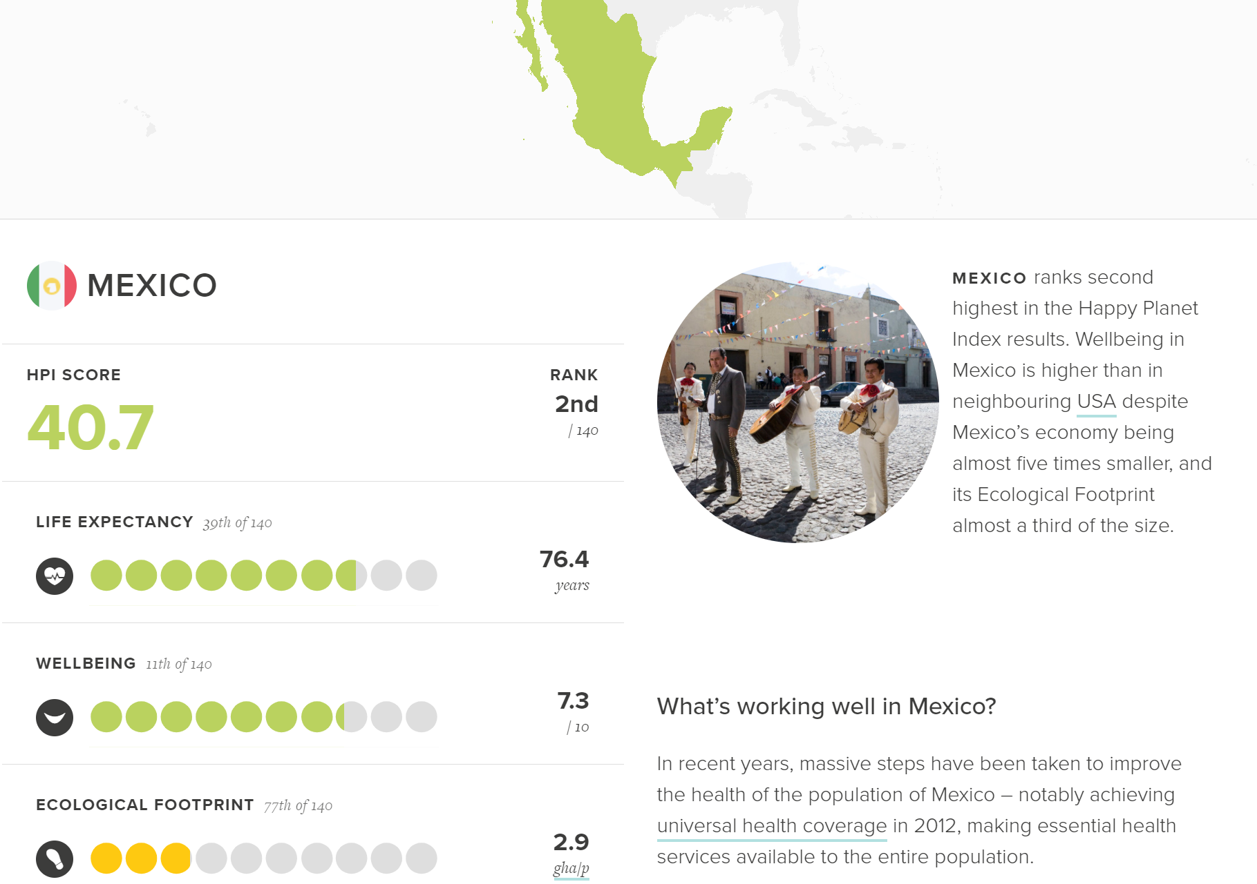

Slide 15
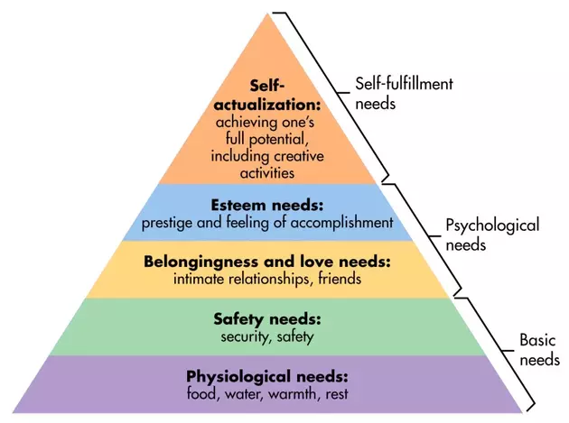
Maslow’s hierarchy of needs

Slide 16
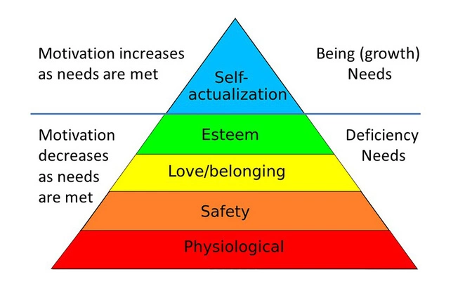
Deficiency and growth needs

Slide 17
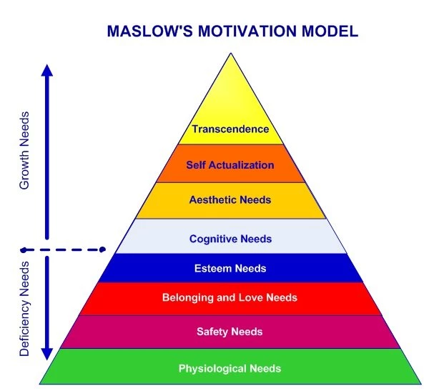

Slide 18
Behaviours of a self-actualised
Behaviours like a child (absorption & concentration)
Trying new things
Listening to your own feelings
Avoiding pretence, being honest
Challenge opinion
Take responsibility & work hard
Identify defences, and give them up

Slide 19

Buyerarchy of needs?

Slide 20
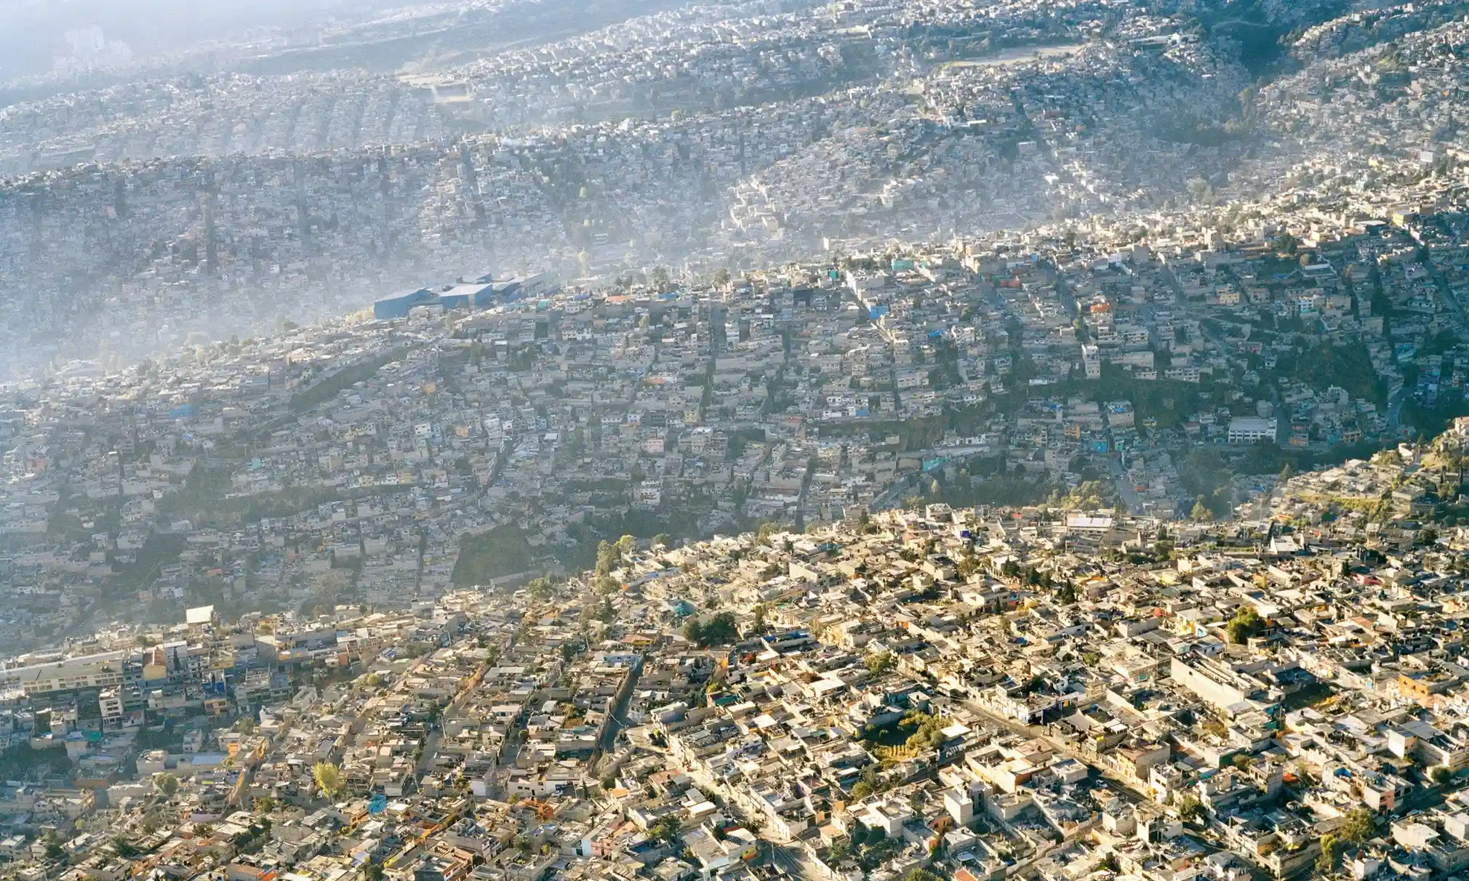
Over population

Slide 21
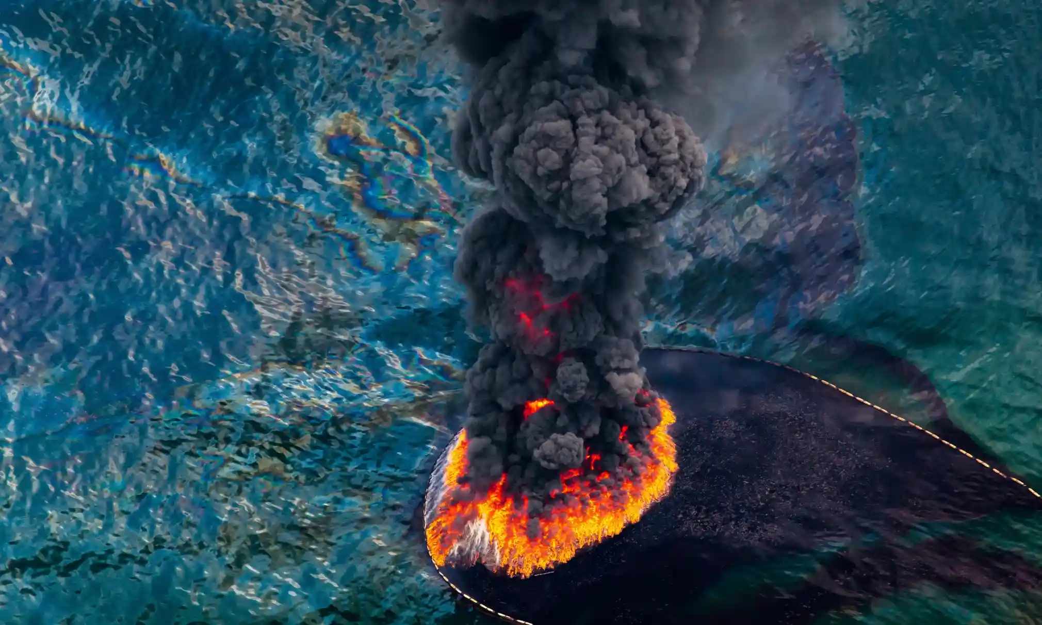
Effects of overpopulation

Slide 22
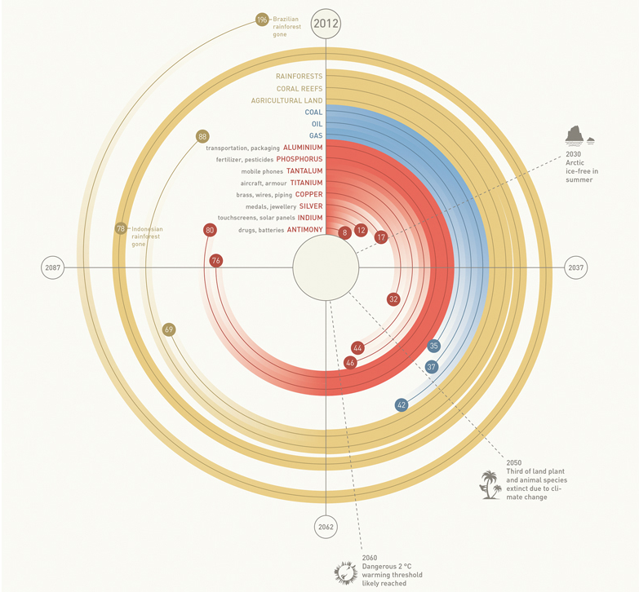

Slide 23
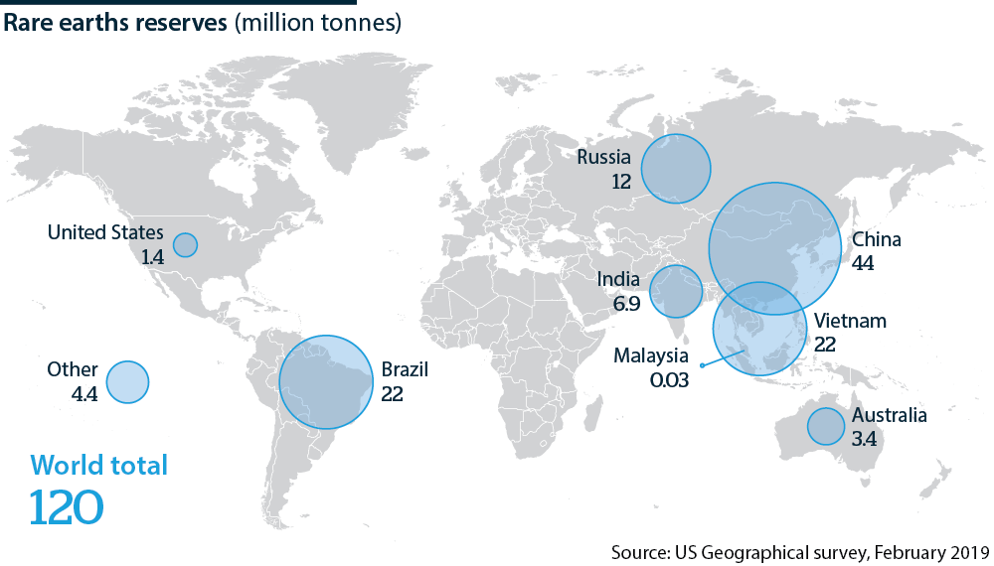
Rare Earth Elements

Slide 24
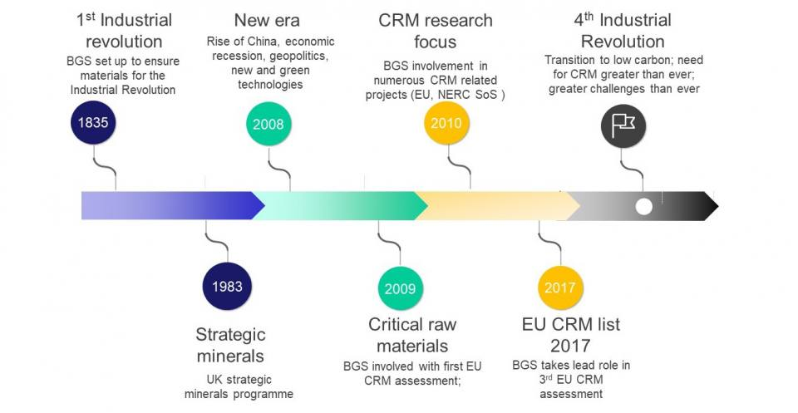
Critical Raw Materials

Slide 25
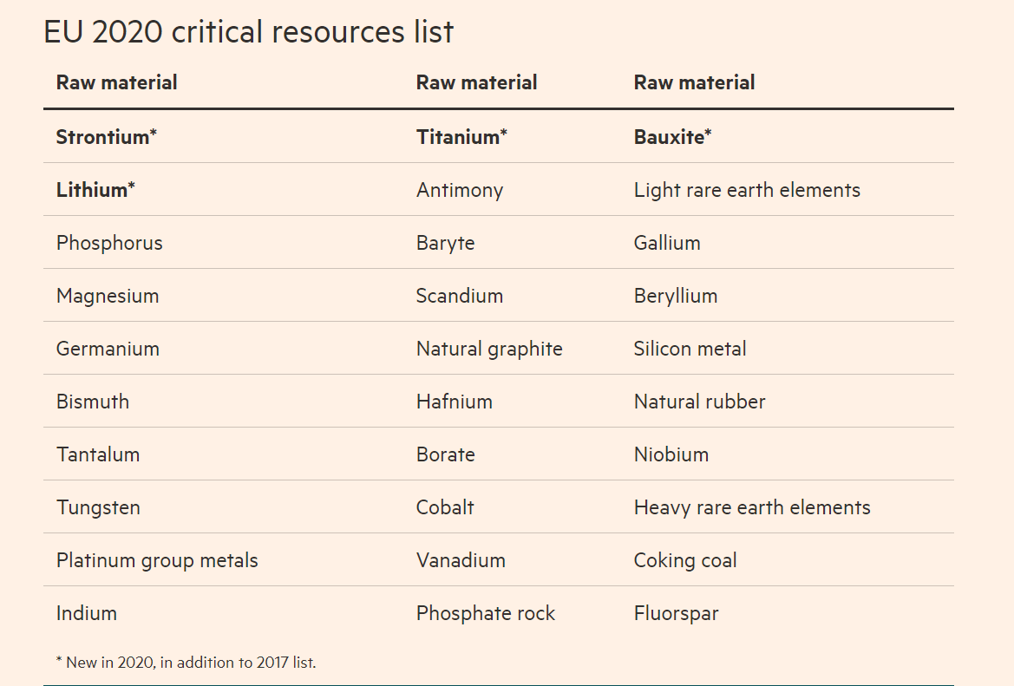

Slide 27
Where they are found

Slide 28
Criticality Assessment (EU)
Material | Stage | Supply risk | EOL-RIR | Uses
Cerium | Processing | 6.2 | 1 | Catalytic convertors
Dysprosium | Processing | 6.2 | 0 | Control rods
Erbium | Processing | 6.1 | 1 | Control rods, lasers
Europium | Processing | 3.7 | 38 | Superconducting alloys
Lanthanum | Processing | 6 | 1 | Carbon arc lighting
Neodymium | Processing | 6.1 | 1 | Strong permanent magnets
Praseodymium | Processing | 5.5 | 10 | Aircraft engines
Samarium | Processing | 6.1 | 1 | Optical lasers
Terbium | Processing | 5.5 | 6 | Solid state devices

Slide 29
Useful information
Happy Planet Index (www.happyplanetindex.org/)
Simply psychology – Maslow (www.simplypsychology.org/maslow.html)
The Guardian (www.theguardian.com/global-development-professionals-network/gallery/2015/apr/01/over-population-over-consumption-in-pictures)
FT (www.ft.com/content/8f153358-810e-42b3-a529-a5a6d0f2077f)
CRM Report 2020 (www.ec.europa.eu/docsroom/documents/42883/attachments/1/translations/en/renditions/native)

