Slide 1

THE WINE CAVE
Presented by: Frederic Legris
Student no: 1715708

Slide 2
Apart from my daily tasks, as a Maintenance Manager I am also responsible to overlook all new projects happening at the resort. Below are some of the projects accomplished for this year by my team and I;-
Gin Bar
The Flute
Herb Garden
Sandy Toe Bar
Chef Table
Alfresco
The Pergola
And the Wine Cave was the most recent project at the resort.

Slide 3

Objectives and outcomes
To have the best wine cave on the East Coast
To have a dedicated area for wine tasting
To generate more revenues through the wine cave

Slide 4

Why wine?
Wine has evolved as part of life, culture and diet since time immemorial.
Although the wine industry faces the challenge of meeting the demands of an ever-larger market without losing the individual character of its wines, technology helps to ensure a consistent supply of quality wines.

Slide 5
In-depth research
?
A study of the local market – what was the current demand for wine, on the East Coast?
The place – Would it fit the criterion for a perfect wine cave?
Design – how to make it trendy?
Logistics – identifying the different materials needed (software and hardware)
Costs – would it be cost effective and generate more revenues?
Constraints – Competitors position on the market

Slide 6
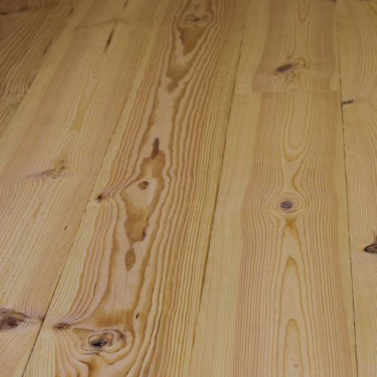
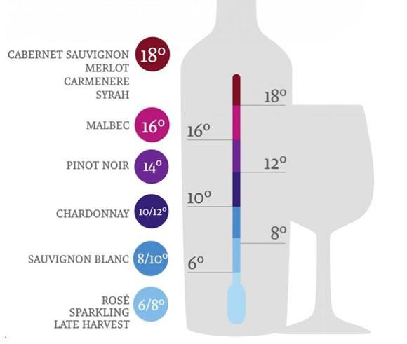
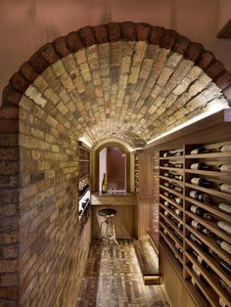
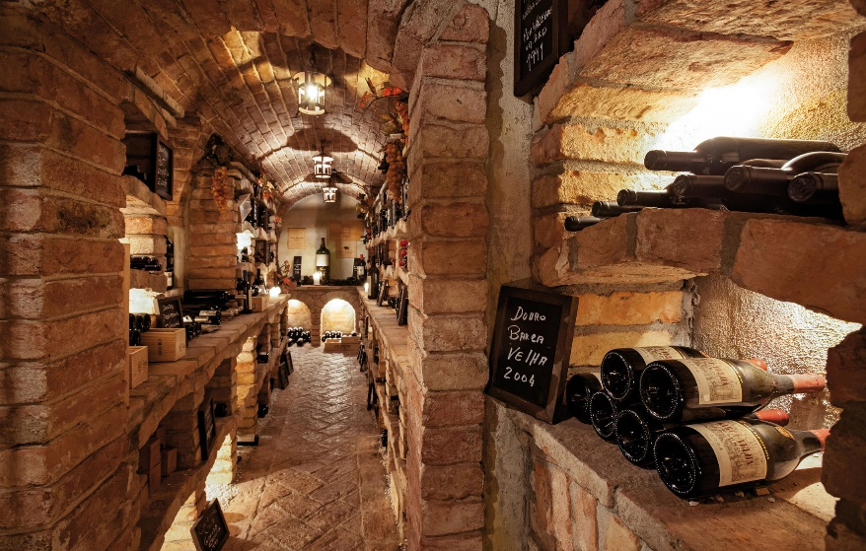
Moodboard
No 3:
Dry pine wood more resistant to humidity
No 1:
Adequate temperature for storage 6˚ to 18˚
No 2:
Bricks wall helps to keep the level of humidity high without wetness; all while maintaining the quality
No 4:
Warm lights creating the perfect ambiance

Slide 7
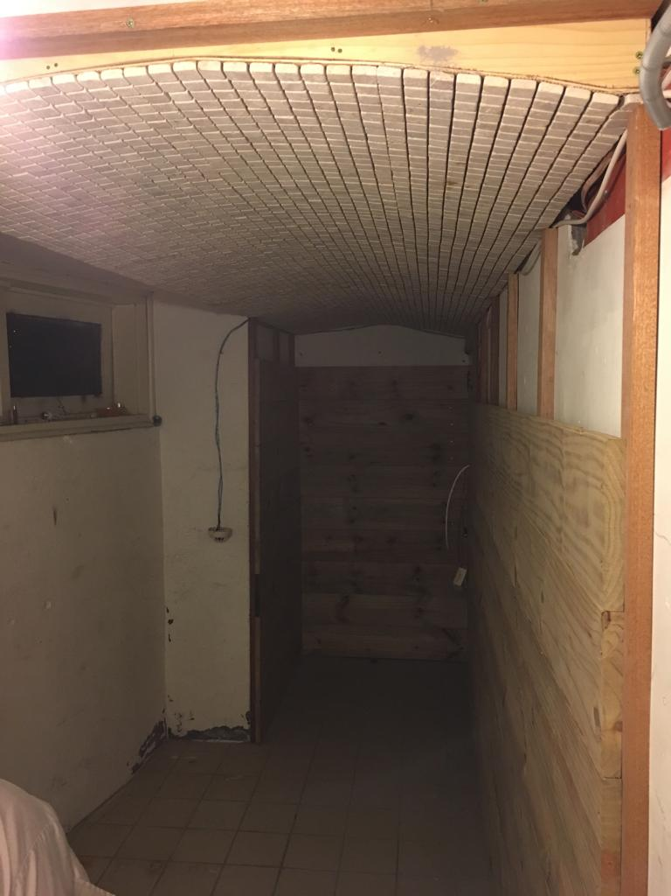
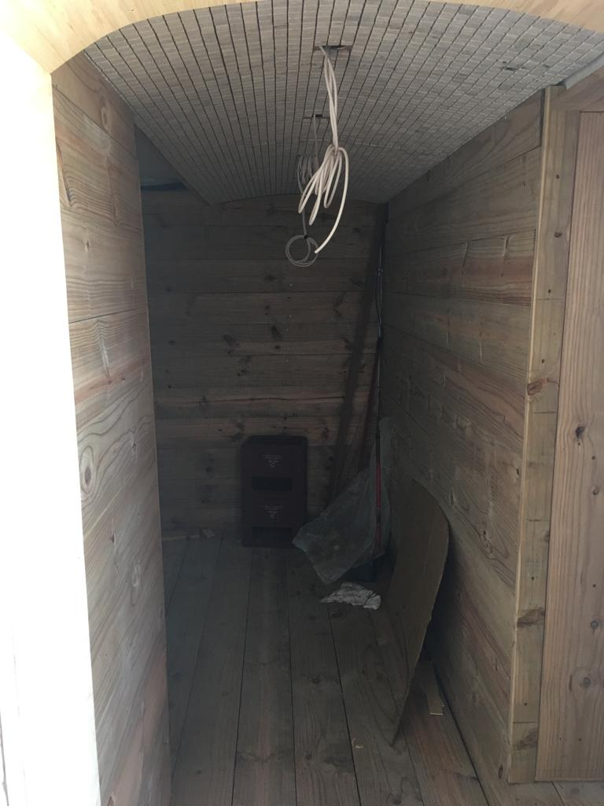
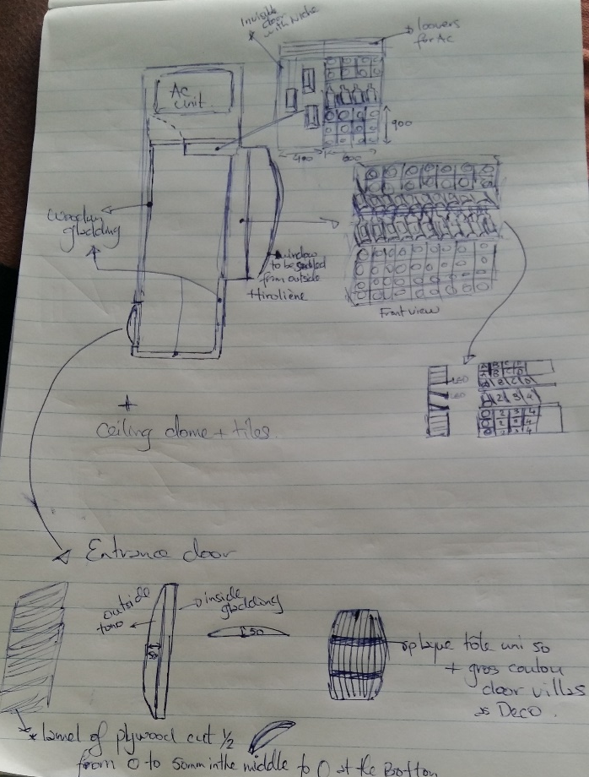
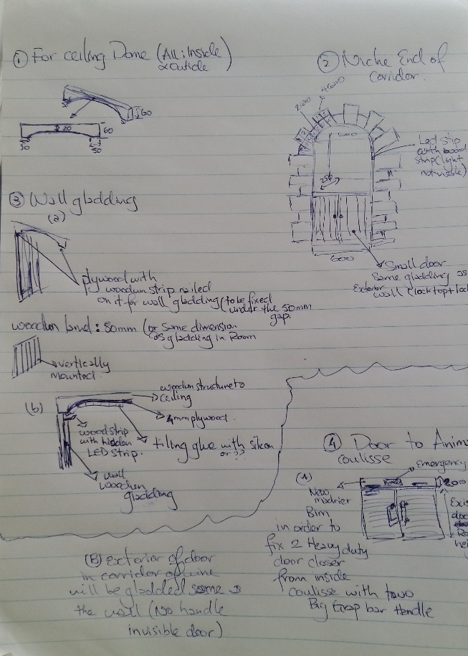
Realisation phase

Slide 8
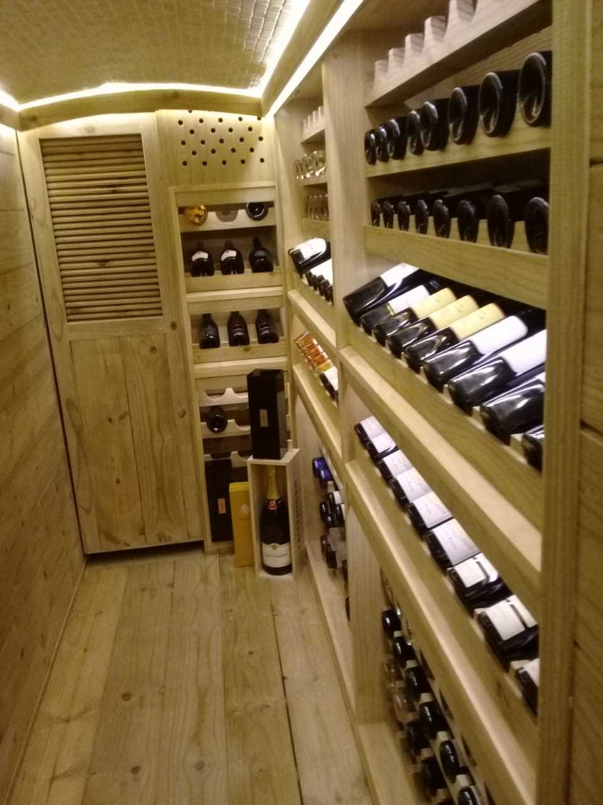
And voila!

Slide 9
conclusion
The aim of this project was to make LUX* Belle Mare Wine cave the most popular on the East Coast
The project started with just a simple idea – I managed to conceptualize, visualize, create a drawing, input all technical elements and lead my team to implement and execute all tasks pertaining to that project.

