Slide 1
DIGITAL Marketing
The Internet
macro-environment

Slide 2
Recap on last week…

Slide 3
Learning objectives
Identify how the macro-environment might affect an organisation’s digital marketing strategy, planning, implementation and performance
Consider legal, moral and ethical constraints of digital marketing
Evaluate the wider significance of macro-environmental-forces
Identify aspects of each of the macro-environmental forces that are particularly relevant to digital marketing.

Slide 4
Questions for marketers
How important are macro environmental changes to my digital marketing strategy?
How can I ensure my online marketing activities are consistent with evolving culture and ethical standards of online communities?
How important is it for me to understand technological innovations?
Which laws am I subject to when marketing online?
How is social media marketing likely to impact on my business and what changes do I need to make in order to react to social changes in the online market place?
What are the political influences which could influence my digital marketing planning?
How do I keep up in a constantly changing marketing environement?

Slide 5
Why review the macro-environment?
“The main reason for keeping track of changes in the macro-environment is to be aware of how changes in social behaviour, new laws, technological innovation can create opportunities or threats. Organisations that monitor and respond effectively to their macro-environment can create differentiation and competitive advantages which enable the business to survive and prosper.

Slide 6
Key micro-environment factors
Political forces
Economic forces
Social forces
Technological forces
Legal forces
Environmental forces
Or PEST, SLEPT if you prefer

Slide 7
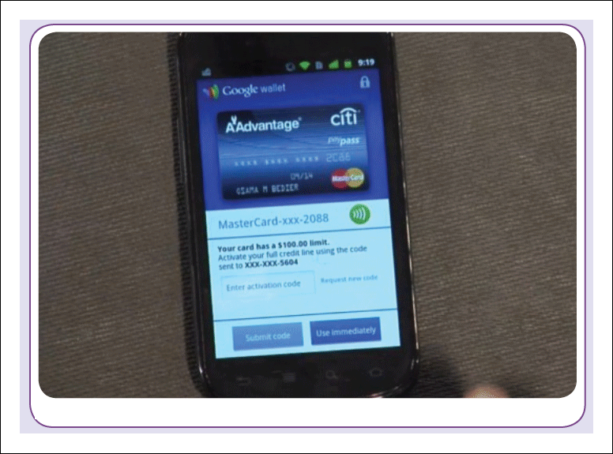
Figure 3.1 Google Wallet: The rate of environmental change

Slide 8
https://www.youtube.com/watch?v=BAhXK-ATKWw
https://www.youtube.com/watch?v=FVKwbZOFh3o

Slide 9
New technologies and changes in their popularity tend to occur frequently
Government and legal changes tend to happen over longer time scales.
Digital marketers need to be alert to changes in the environment to stay competitive.
  Develop the ability to respond
    Collect information
    Review the information

Slide 10

Figure 3.3 Nitromedia (www.nitromedia.co.uk)

Slide 11
Technology
Visit: www.nitromedia.co.uk and watch film clip on home page:
How does Nigel Douglas suggest digital marketers might use film to enhance the performance of a website?
What are the wider implications of using film rather than text-based content in a company website?

Slide 12
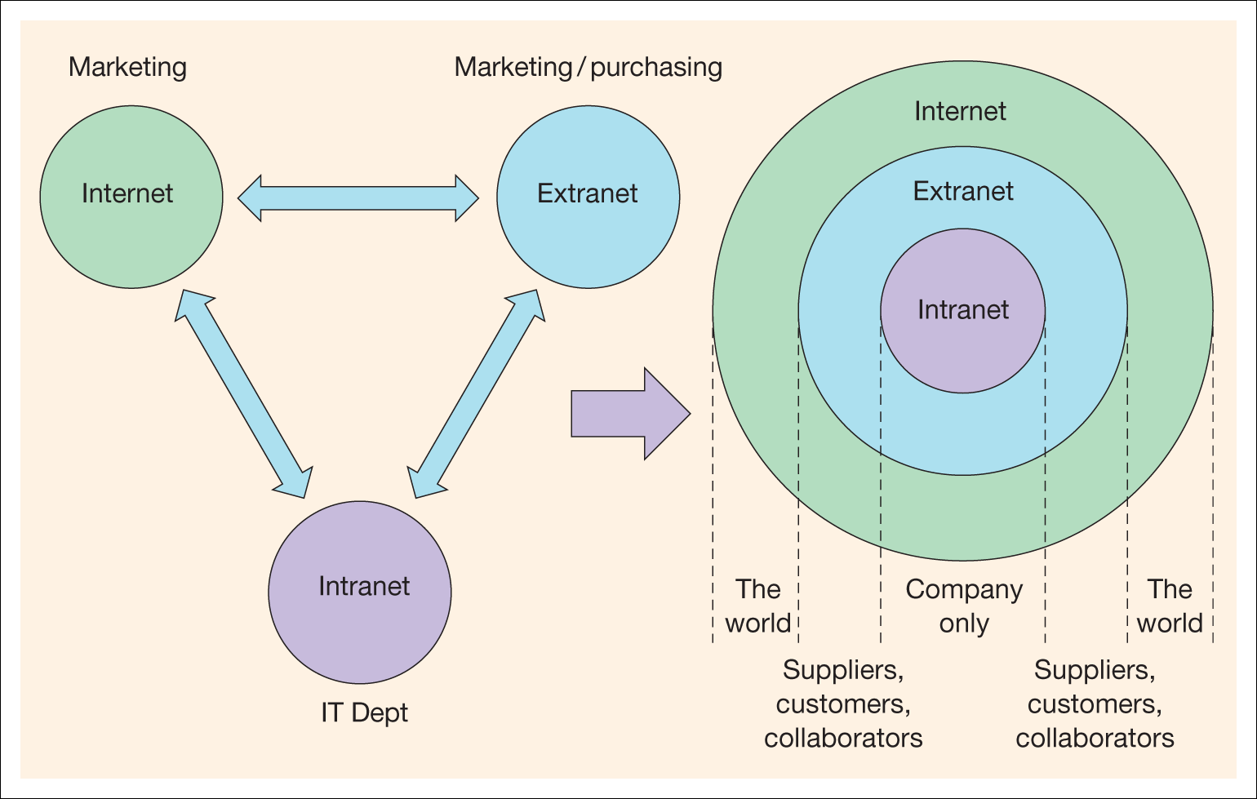
Figure 3.4 The relationship between access to intranets, extranets and the
Internet text editor

Slide 13
Cloud based software
G-mail
Adobe
List other examples and think why companies are keen to use them

Slide 14
The Internet of Things
https://www.youtube.com/watch?v=QSIPNhOiMoE

Slide 15
Guessing peoples emotions through facial recognition software
http://www.theguardian.com/technology/2015/nov/11/microsoft-guess-your-emotions-facial-recognition-software

Slide 16
What is an API?
https://www.youtube.com/watch?v=s7wmiS2mSXY

Slide 17
Location based marketing through mobile apps

Slide 18
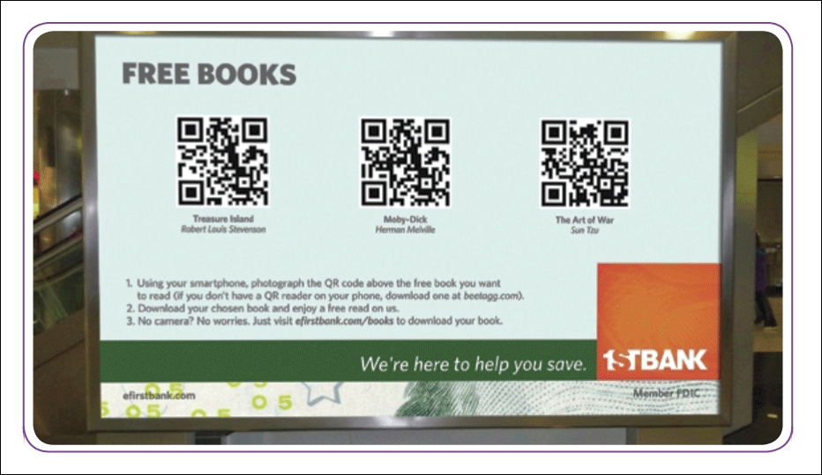
Figure 3.6 QR Codes

Slide 19
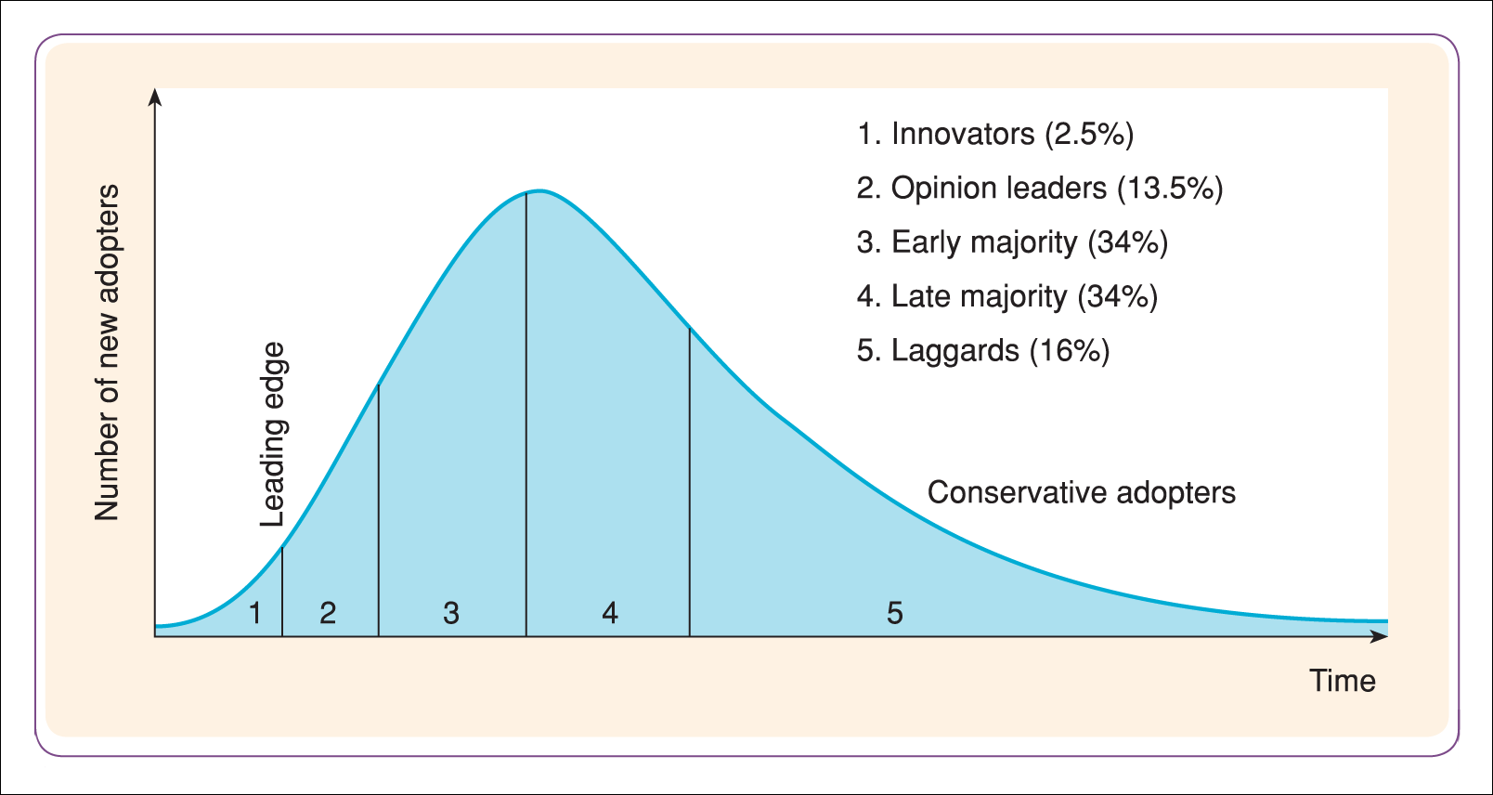
Figure 3.7 Diffusion–adoption curve

Slide 20
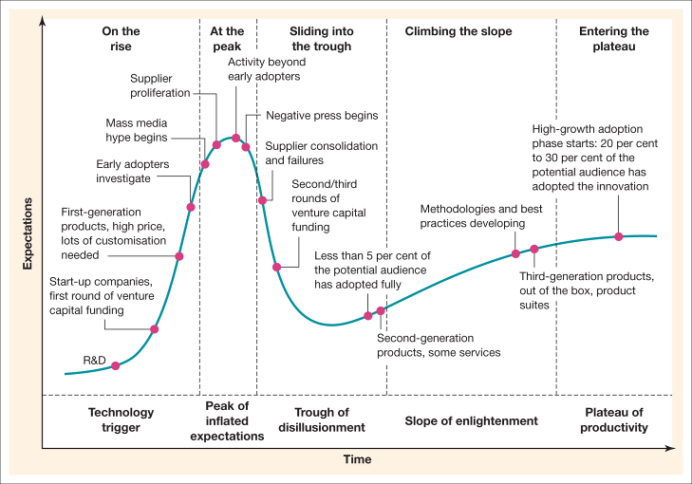
Figure 3.8 Different stages of a Gartner hype cycle
Source: Gartner Group

Slide 21
Ethical issues
Ethical issues concerned with personal information ownership have been usefully summarised by Mason (1986) into four areas:
Privacy – what information is held about the individual?
Accuracy – is it correct?
Property – who owns it and how can ownership be transferred?
Accessibility – who is allowed to access this information, and under which conditions?

Slide 22
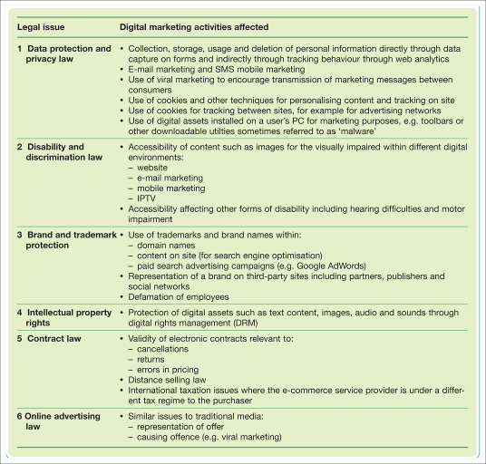
Digital laws
Table 3.1 Significant laws which control digital marketing

Slide 23
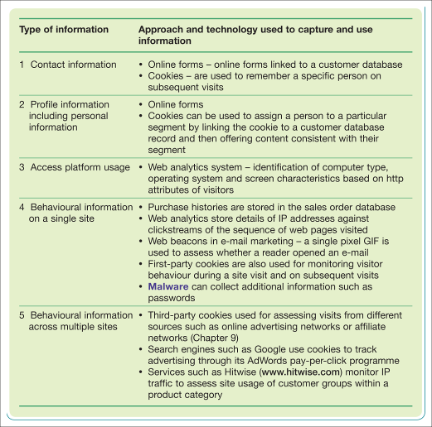
Information collected online
Table 3.2 Types of information collected online and the related technologies

Slide 24
PECR legislation summary
Applies to consumer marketing using e-mail or SMS messages
Is an opt-in regime (consent required)
Requires an opt-out option for all communications
Does not apply to existing customers when marketing similar products
Requires that contact details must be provided
Requires clear From
Applies to direct marketing communications
Restricts the use of cookies
https://ico.org.uk/for-organisations/guide-to-pecr/introduction/what-are-pecr/

Slide 25
Data Protect Act 1998
If you collect data about people for one reason, you must not use it for a different reason;
You must not give people's data to other people or organisations unless they agree;
People have the right to look at data that any organisations store about them;
You must not keep the data for longer than you need to and it must be kept up to date;
You must not send the data to places outside of the European Economic Area unless adequate levels of protection exist;
Organisations that store data about people must register with the Information Commissioner’s Office;
If you store data about people you must make sure that it is secure and well protected;
If an organisation has data about you that is wrong, then you have a right to ask them to change it.

Slide 26
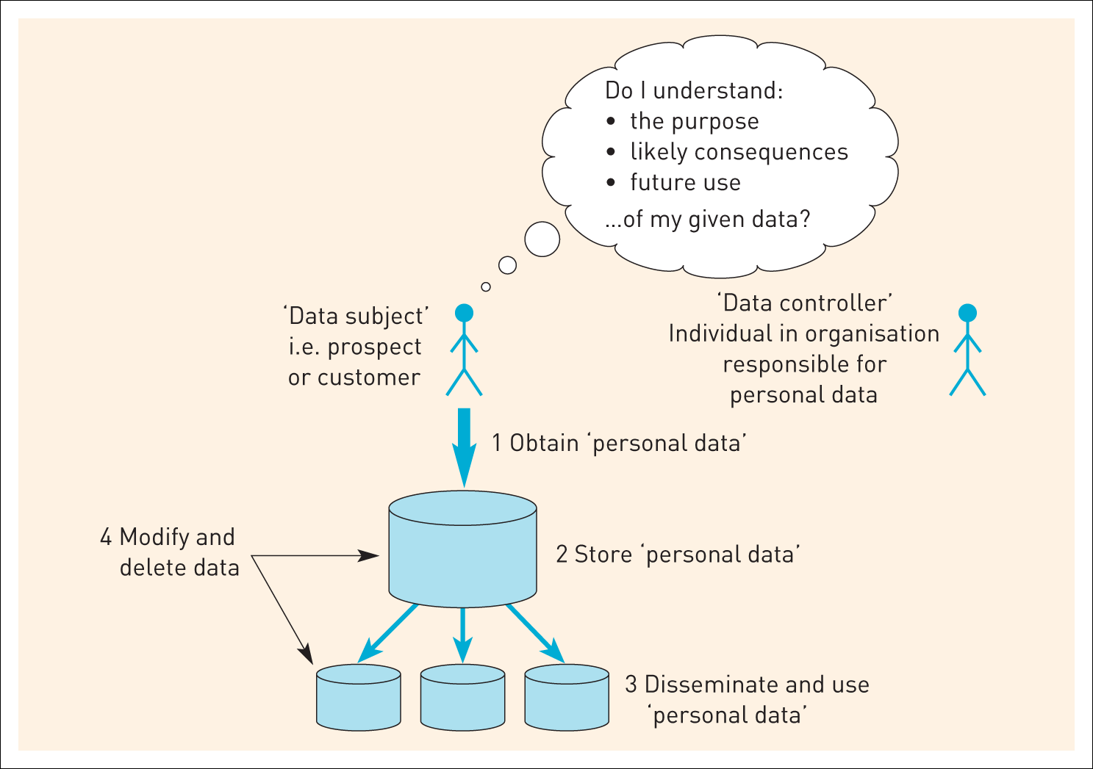
Figure 3.10 Information flows that need to be understood for compliance with data protection legislation

